Slide 1
A Cultural Theory of Copyright
Professor William W. Fisher III WilmerHale Professor of Intellectual Property Law
Harvard Law School
April 4, 2013

Slide 2
The following images appear in the background of the 10th lecture in the CopyrightX lecture series. A recording of the lecture itself is available at http://ipxcourses.org/lectures/. Removed from their original context, the images will not make much sense. The function of this collection of images is to enable persons who have already watched the lecture to review the material it contains.
The terms on which these materials may be used or modified are available at http://ipxcourses.org.

Slide 3
Videopipeline (2008)
Friedman (2011);
Cariou (2011)
Fairey (2011)
Socially
beneficial
Dr. Seuss (1997)
Connectix (2000)
Kelly (2003);
Perfect 10 (2007);
AV (2009); White (2013)
Gaylord (2010)
Salinger (2010)
Graham (2006)
Nunez (2006)
Castle Rock
(1998)
Critical of π
Different
Purpose
Creative
Parody
Rogers (1992)
Campbell (1994);
Leibovitz (1998);
Suntrust (2001);
Mattel (2003)
Free Republic (2000)
Physical
modifications
Blanch (2006)
Lennon (2008)

Slide 4
Justice Blackmun, dissenting
“The situations in which fair use is most commonly recognized are listed in section 107 itself; fair use may be found when a work is used ‘for purposes such as criticism, comment, news reporting, teaching, . . . scholarship, or research.’ … Each of these uses … reflects a common theme: each is a productive use, resulting in some added benefit to the public beyond that produced by the first author’s work. The fair use doctrine, in other words, permits works to be used for ‘socially laudable purposes.’ I am aware of no case in which the reproduction of a copyrighted work for the sole benefit of the user has been held to be fair use.”

Slide 5
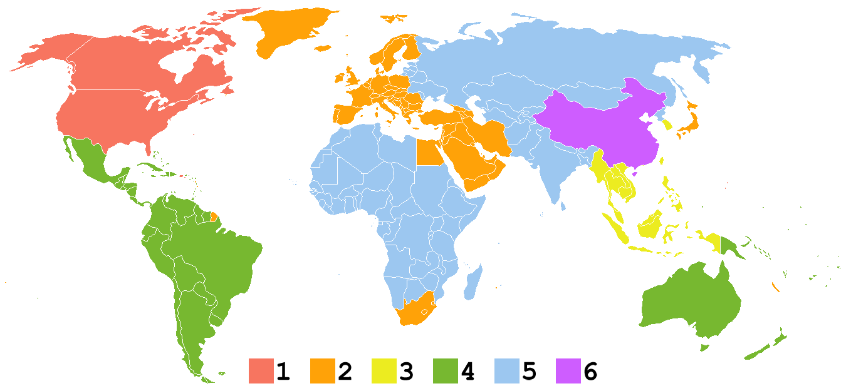
DVD Regional Coding -- source: Wikipedia

Slide 6
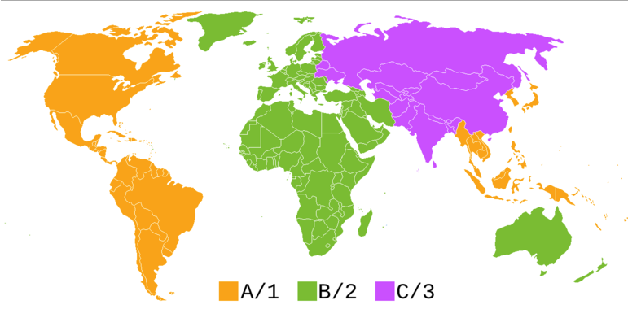
Blu-ray Regional Playback Control

