Slide 1
The Foundations of Copyright Law
William Fisher WilmerHale Professor of Intellectual Property Law
Harvard Law School
January 7, 2016

Slide 2
The following images appear in the background of the first lecture in the CopyrightX lecture series. A recording of the lecture itself is available at http://ipxcourses.org/lectures/. Removed from their original context, the images will not make much sense. The function of this collection of images is to enable persons who have already watched the lecture to review the material it contains.
The terms on which these materials may be used or modified are available at http://ipxcourses.org.

Slide 3
Lecture Topics
The Foundations of Copyright Law
Fairness and Personality Theories
The Subject Matter of Copyright
Welfare Theory
Authorship
The Mechanics of Copyright
Rights to Reproduce and Modify
Rights to Distribute, Perform, and Display
Fair Use and Misuse
Cultural Theory
Supplements to Copyright
Remedies

Slide 6
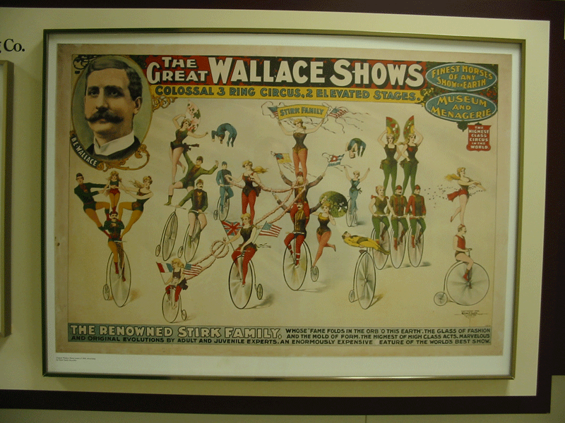

Slide 7
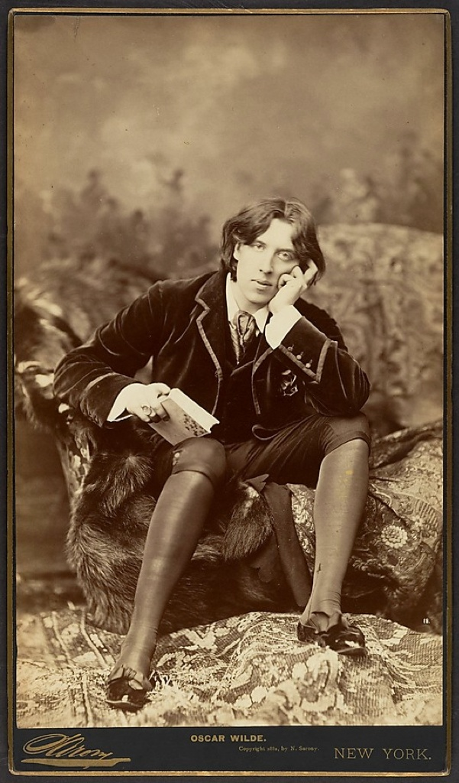
Source: http://www.oscarwildeinamerica.org/sarony/
sarony-photographs.html#item119

Slide 8
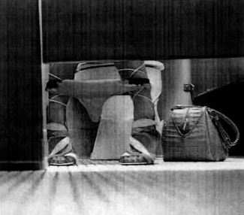
Bill Diodato Photography v. Kate Spade
Original Photograph Accused Photograph

Slide 9
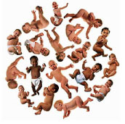

Slide 10
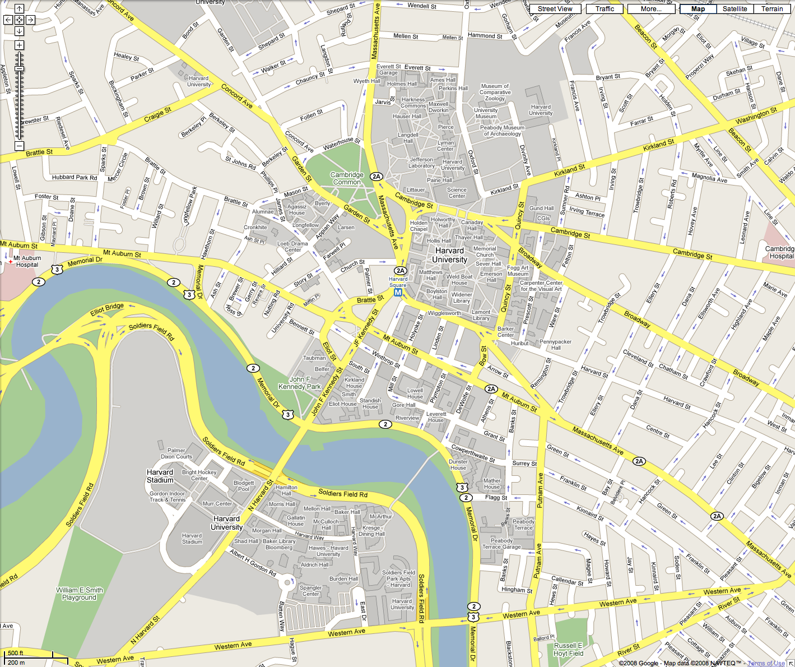
Harvard Law School: Student Orientation Packet

Slide 11
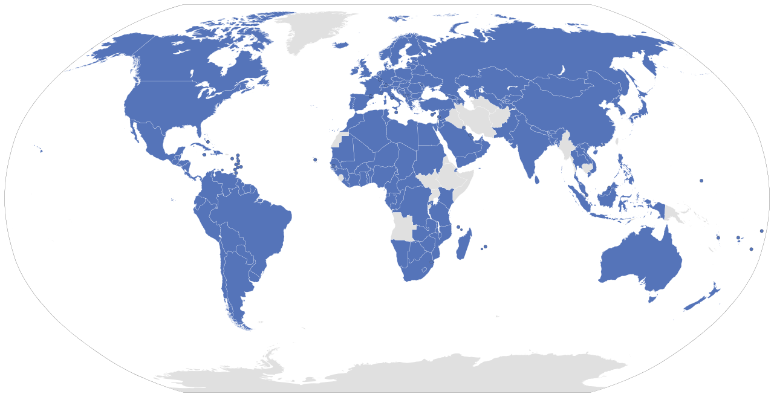
Berne Convention Members (January 2016)
Source: http://en.wikipedia.org/wiki/File:Berne_Convention_signatories.svg

Slide 12
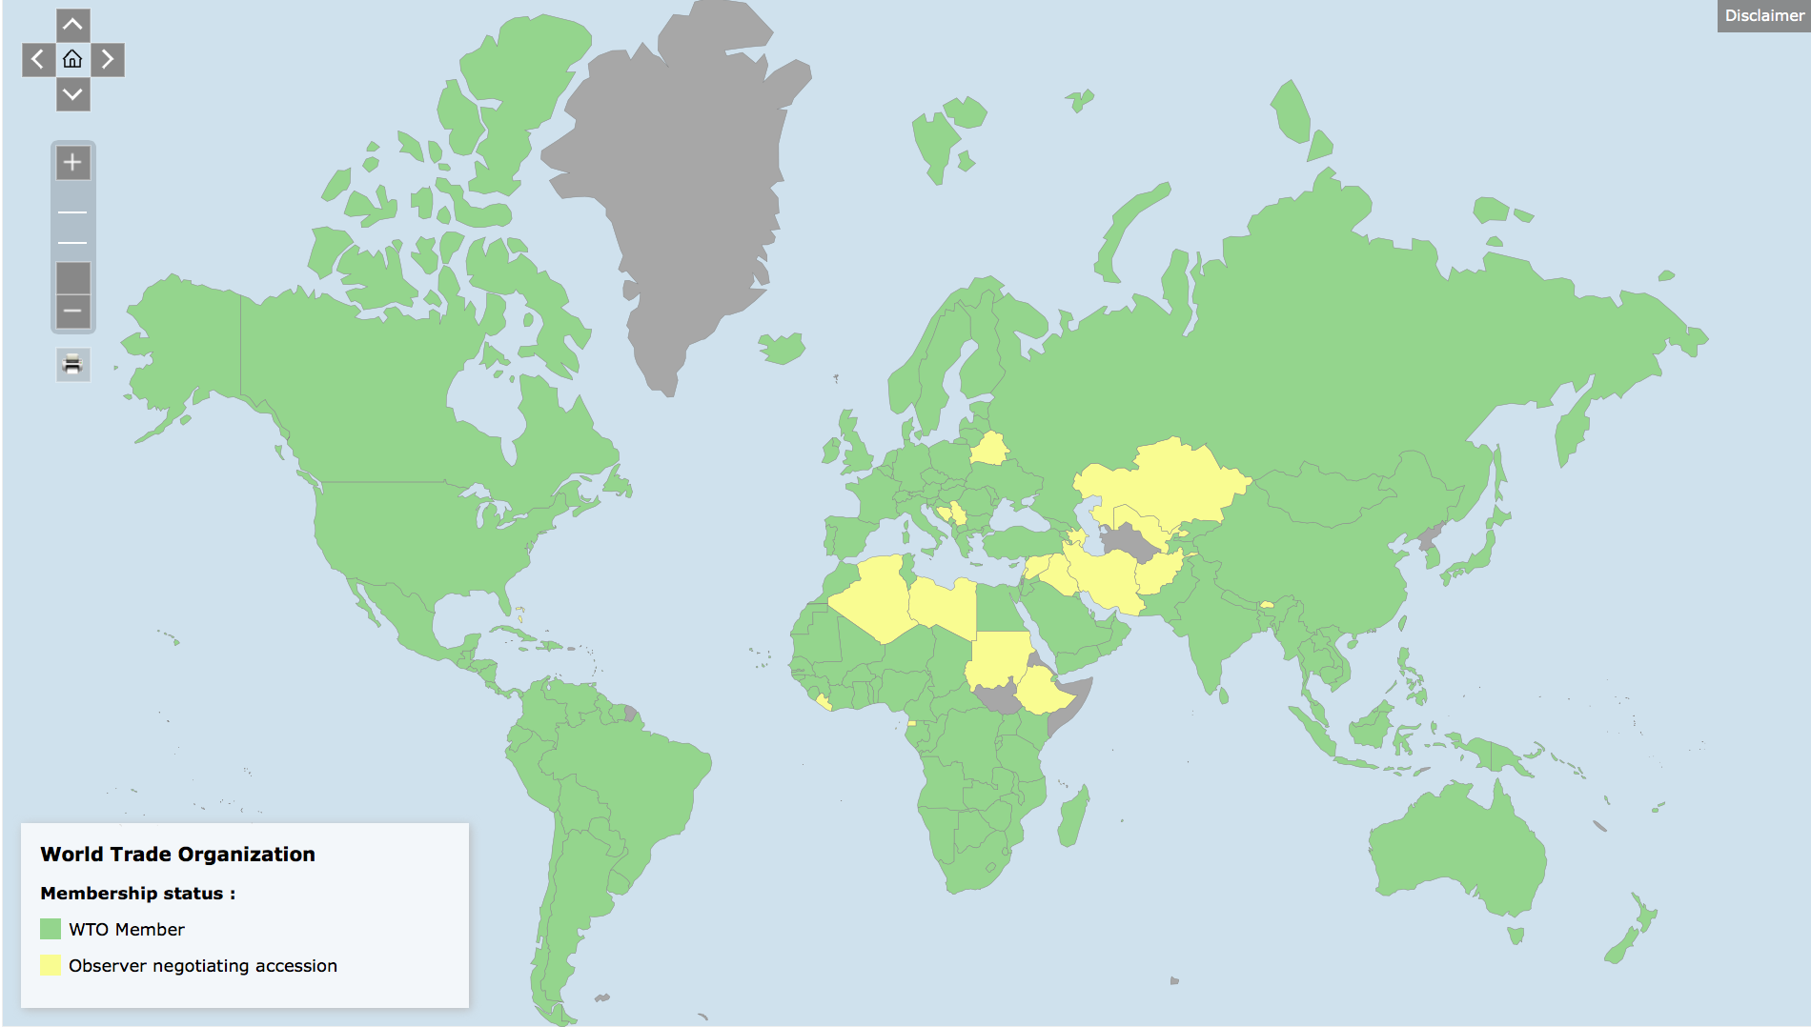
World Trade Organization Members (January 2016)
Source: https://www.wto.org/english/thewto_e/countries_e/org6_map_e.htm

Slide 13
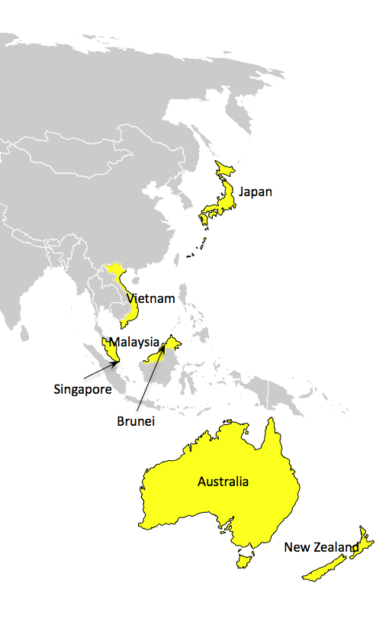
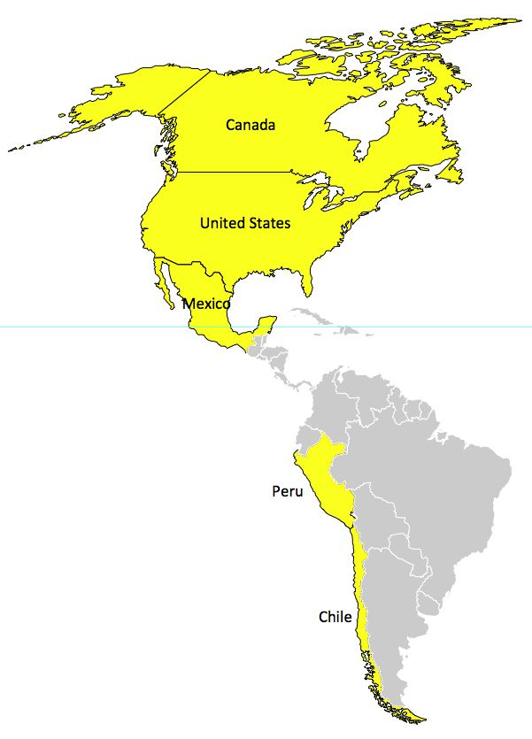
TPP Participating Countries (January 2016)
Fairbanks
Oslo
Saint Petersburg
Anadyr
Unalaska
London
Moscow
Samara
Novosibirsk
Berlin
Astana
Seattle
Toronto
Paris
Vienna
Ulaanbaatar
San Francisco
Chicago
New York
Madrid
Istanbul
Beijing
Seoul
Los Angeles
Washington
Gibraltar
Teheran
Osaka
Tokio
New Orleans
El Golea
Cairo
Delhi
Shanghai
Dakar
Karachi
Dhaka
Mexico -City
Asmara
Mumbai
Kalkutta
San José
Niamey
N‘Djamena
Manila
Accra
Mogadishu
Quito
Mbuji- Mayi
Porto Velho
Dar es Salaam
Jakarta
Port Moresby
Lima
Brasilia
Benguela
Darwin
La Paz
Harare
São Paulo
Rio de Janeiro
Windhuk
Maputo
Santiago
Buenos Aires
Cape Town
Durban
Perth
Sydney
Melbourne
Canberra
Wellington

