Slide 1
Theories of Copyright: Fairness and Personality William Fisher

Slide 2
The following images appear in the background of the second lecture in the CopyrightX lecture series. A recording of the lecture itself is available at http://ipxcourses.org/lectures/. Removed from their original context, the images will not make much sense. The function of this collection of images is to enable persons who have already watched the lecture to review the material it contains.
The terms on which these materials may be used or modified are available at http://ipxcourses.org.

Slide 3
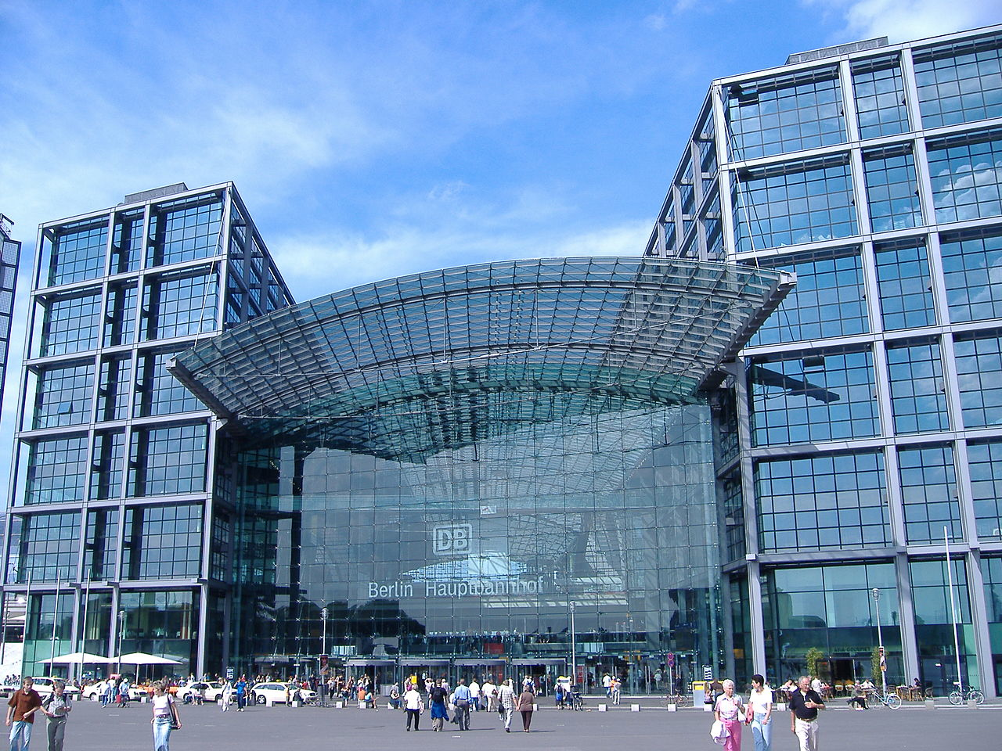
Source: http://commons.wikimedia.org/wiki/File:Berlinhbf.jpg

Slide 4
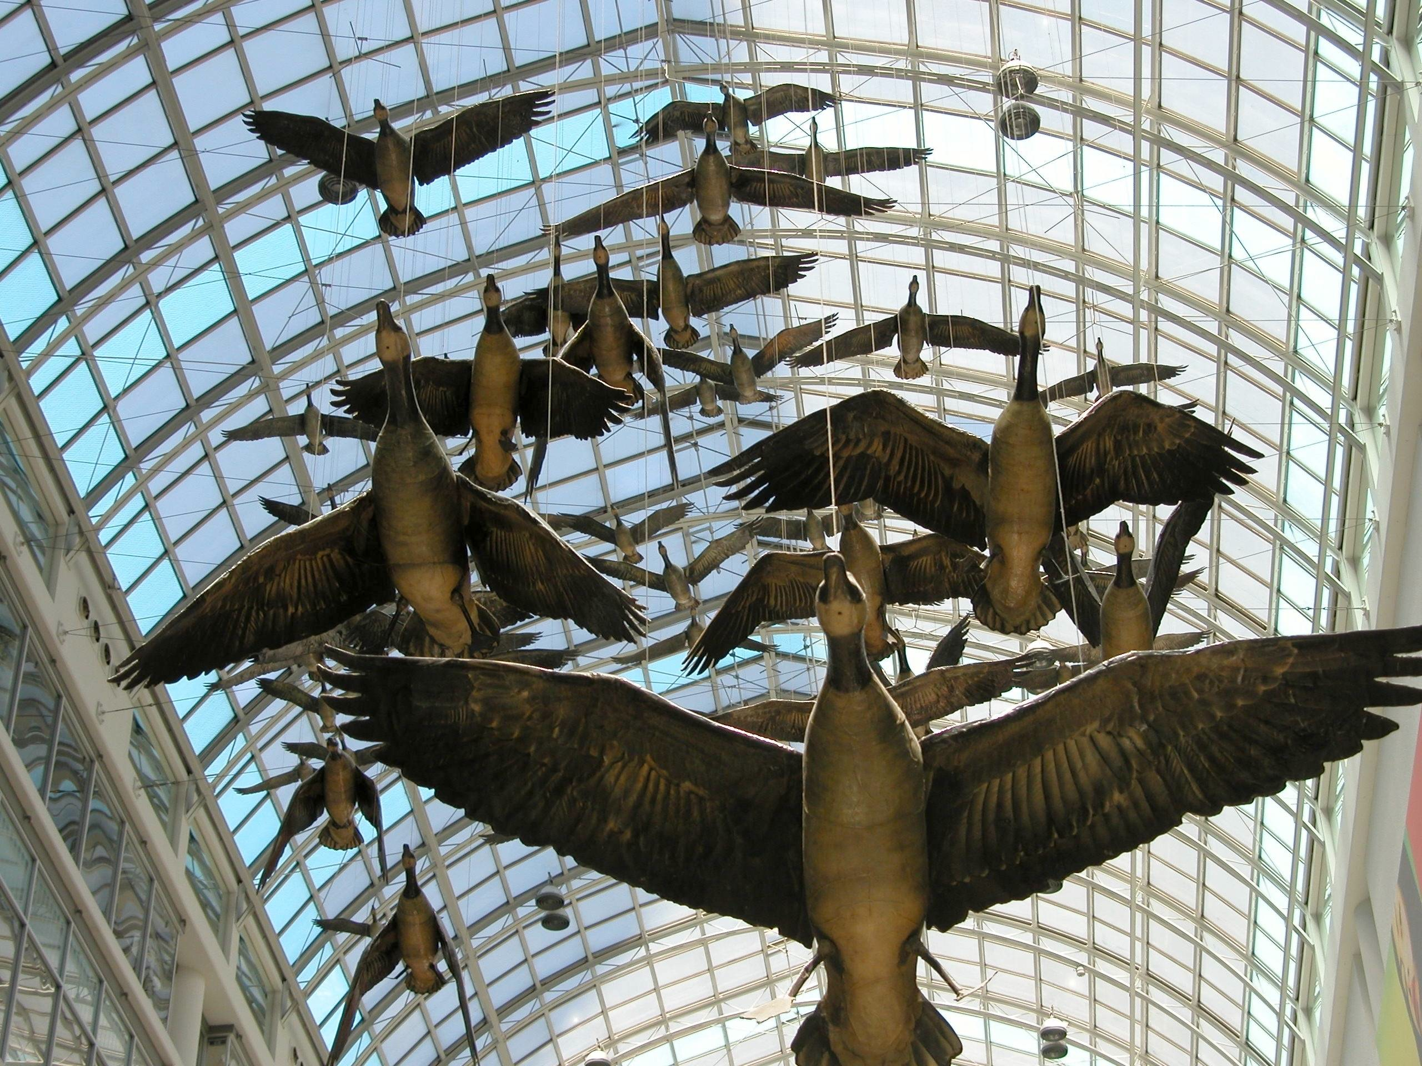
Source: http://gocanada.about.com/od/canadiancities1/ig/Toronto-Picture-Gallery/Canada-Geese--by-Michael-Snow.htm

Slide 5
