Slide 1
CopyrightX Lecture 6:
The Mechanics of Copyright
Selected Illustrations
William Fisher
March 3, 2015

Slide 2
The following images appear in the background of the 6th lecture in the CopyrightX lecture series. A recording of the lecture itself is available at http://ipxcourses.org/lectures/. Removed from their original context, the images will not make much sense. The function of this collection of images is to enable persons who have already watched the lecture to review the material it contains.
The terms on which these materials may be used or modified are available at http://ipxcourses.org.

Slide 3
Copyright Formalities (for U.S. works)
Published 1909-1977 | Published 1978-1989 | Published 1989-
Notice mandatory upon publication | Notice mandatory within 5 years of publication | Notice optional, but may affect statutory damages
Registration prerequisite for infringement suit; mandatory for renewal | Registration application prereq. for infringement suit; necessary for statutory damages & atty fees | Registration application prereq. for infringement suit involving US works; necessary for statutory damages & atty fees
Deposit with LOC; failure punished with forfeiture & fines | Deposit with LOC; failure punished with fines | Deposit with LOC; failure punished with fines

Slide 4
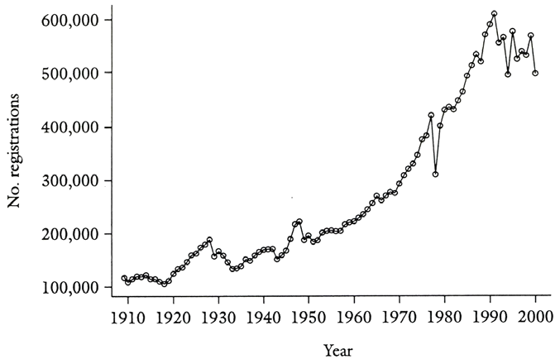
Copyright Registrations (excluding renewals), 1910-2000
From Christopher Sprigman, “Reformalizing Copyright,” 57 Stan. L. Rev. 485, 496 (2004)

Slide 5
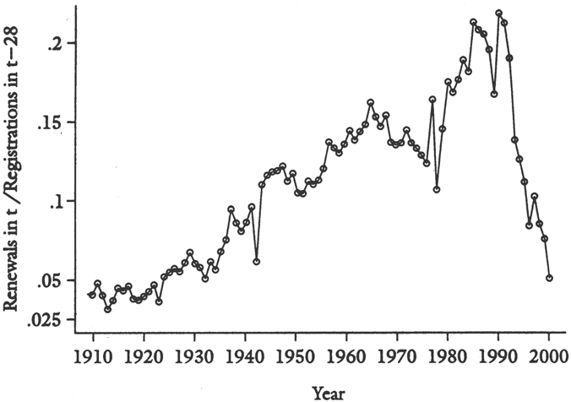
Rate of Copyright Renewals, 1910-2000
From Christopher Sprigman, “Reformalizing Copyright,” 57 Stan. L. Rev. 485, 499 (2004)

Slide 6
Creative Commons
Creation
Federal Copyright Protection
Life + 70 yrs
Public Domain
Publication

Slide 7
1909 Regime
Can be exercised by:
Author
Surviving spouse or children
Author’s executor
Author’s next of kin
1-year renewal
application window
Renewal
Creation
Break in continuity of title
Federal Copyright Protection
©
28 yrs
28 yrs
“new estate”
Common-law
Copyright
Protection
Public Domain
Publication

Slide 8
Since 1909: Several Extensions of Renewal Right
Renewal
Creation
Federal Copyright Protection
©
28 yrs
67 yrs
Common-law
Copyright
Protection
Public Domain
Publication

Slide 9
Duration of Works Published before 1923
Renewal
Creation
Federal Copyright Protection
©
28 yrs
47 yrs
“fell” out of copyright
before CTEA
could rescue them
Common-law
Copyright
Protection
Public Domain
Publication

Slide 10
Duration of Works Published 1923-1963
Can be exercised by:
Author
Surviving spouse or children
Author’s executor
Author’s next of kin
1-year renewal
application window
Renewal
Creation
Federal Copyright Protection
©
28 yrs
67 yrs
Common-law
Copyright
Protection
Public Domain
Publication

Slide 11
Duration of Works Published 1964-1977
Beneficiaries of automatic
renewal remain:
Author
Surviving spouse or children
Author’s executor
Author’s next of kin
Renewal
Creation
Federal Copyright Protection
©
28 yrs
67 yrs
Will begin to fall
out of copyright
in 2059
Common-law
Copyright
Protection
Public Domain
Voluntary renewal still encouraged by:
--presumption of validity of renewal copyright;
--assignee of author’s expectancy interest who
voluntarily renews prevails if author dies in 28th year
Publication

Slide 12
Duration of Works created but not published before 1978
Creation
Federal Copyright Protection
Life + 70 yrs
Or 12/31/2002
(whichever is later)
1978
Public Domain

Slide 13
Duration of Works created but not published before 1978
Strong incentive for heirs
of long dead authors to
publish their works
Creation
Federal Copyright Protection
Life + 70 yrs
Or 12/31/2047
(whichever is later)
1978
Public Domain
Publication by 12/31/2002

Slide 14
Duration of Works Created in 1978 or later
Creation
2048 at the earliest
Federal Copyright Protection
Life + 70 yrs
Public Domain
Publication

Slide 15
Duration of Works Created in 1978 or later
For anonymous works, pseudonymous works, and works for hire
120 yrs
Creation
95 yrs
2073 at
the earliest
Federal Copyright Protection
Public Domain
Publication

Slide 16
1909 Regime
Copyright may
be assigned
by author
Renewal
Creation
Federal Copyright Protection
©
28 yrs
28 yrs
Common-law
Copyright
Protection
Public Domain
Publication

Slide 17
Fred Fisher Music v. M. Witmark & Sons
Witmark
1917
Fred Fisher
Creation
1912
1939
Graff
Graff
©
28 yrs
28 yrs
Common-law
Copyright
Protection
Public Domain
Publication

Slide 18
Works Created in 1978 or later
Who can terminate:
Author
Spouse/children/descendants (per stirpes)
Author’s executor
§203 Termination Rules
nonwaivable
2-10 yrs
Terminated rights pass to persons entitled to terminate on date of original notice
inter vivos transfer
by author
35 yrs
5 yrs
Creation
Federal Copyright Protection
Life + 70 yrs
Publication
Public Domain

Slide 19
Works Published 1964-1977
§203 Termination Rules – apply if transfer made
after 1978
2-10 yrs
35 yrs
5 yrs
Renewal
inter vivos transfer
by author*
Creation
Federal Copyright Protection
©
28 yrs
67 yrs
Common-law
Copyright
Protection
Public Domain
Publication

Slide 20
Works Published 1964-1977
By and for statutory
beneficiaries
§304 Termination Rules – apply if transfer made
before 1978
2-10 yrs
2-10 yrs
nonwaivable
56 yrs
5 yrs
5 yrs
Renewal
inter vivos transfer
by author*
Creation
75 yrs
10/27/1998
Federal Copyright Protection
©
28 yrs
67 yrs
Common-law
Copyright
Protection
Public Domain
Publication

Slide 21
Works Published 1923-1963
§203 Termination Rules – apply if transfer made
in 1978 or later
2-10 yrs
35 yrs
5 yrs
Renewal
Creation
Federal Copyright Protection
©
28 yrs
67 yrs
Common-law
Copyright
Protection
Public Domain
Publication

Slide 22
Works Published 1923-1963
By and for statutory
beneficiaries
§304 Termination Rules – apply if transfer made
before 1978
2-10 yrs
2-10 yrs
nonwaivable
56 yrs
5 yrs
5 yrs
Renewal
inter vivos transfer
by author*
Creation
75 yrs
Federal Copyright Protection
©
28 yrs
67 yrs
Common-law
Copyright
Protection
Public Domain
Publication

