Slide 1
CopyrightX Lecture 8:
Rights of Distribution and Performance
Selected Illustrations
William Fisher
February 27, 2014

Slide 2
The following images appear in the background of the 8th lecture in the CopyrightX lecture series. A recording of the lecture itself is available at http://ipxcourses.org/lectures/. Removed from their original context, the images will not make much sense. The function of this collection of images is to enable persons who have already watched the lecture to review the material it contains.
The terms on which these materials may be used or modified are available at http://ipxcourses.org.

Slide 3

Opposed Forces
Interests of Copyright Owners
Leverage over Intermediaries
Maximize demand for copies
Restrict Arbitrage and thus facilitate differential pricing
Attitudes resistant to restrictions on distribution
Resentment of greed
Skepticism concerning continuing control over objects
Hostility to differential pricing
602(a)(1-3)
602(a)
Kirtsaeng
Omega
Quality
King
106(3)
109(a)
Autodesk
109(b)(1)(A)
109(b)(1)(B)

Slide 4
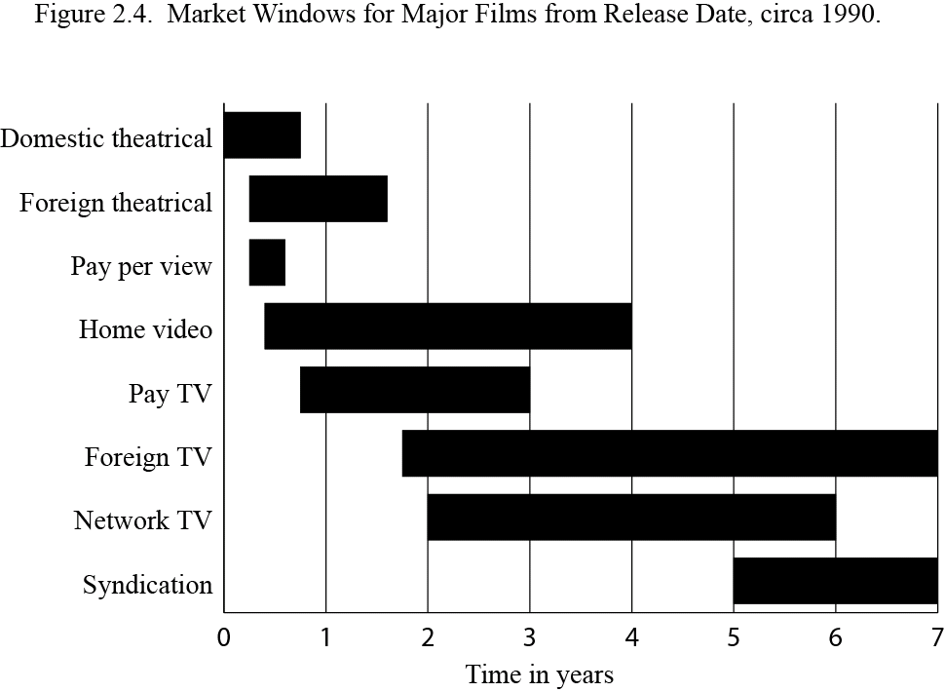

Slide 5
Copyright Autodesk
copy
Authorized Copy
Autodesk
Vernon v Autodesk:
Vernon’s narrative
sale
Authorized Copy
CTA
resale
109(a)
Authorized Copy
Vernon
Ebay
Authorized Copy
Buyer
resale
109(a)

Slide 6
Copyright Autodesk
copy
Authorized Copy
Autodesk
Vernon v Autodesk:
Autodesk’s narrative
lease
Authorized Copy
CTA
Purported
resale
109(a) n.a.
Authorized Copy
Vernon
Ebay
Authorized Copy
Buyer
resale
109(a) n.a.

Slide 7
Vernon v. Autodesk: Holding
We hold today that a software user is a licensee rather than an owner of a copy where the copyright owner
(1) specifies that the user is granted a license;
(2) significantly restricts the user's ability to transfer the software; and
(3) imposes notable use restrictions

Slide 8

A
Violations of §106
MW
E
B
D
SR
MW
MW
SR
MW
SR
F
MW
MW
SR
C
SR
MW
Internet
Digital broadcast
SR
Restaurant
MW
I
G
SR
H
Cable TV
& Radio System
MW
SR
MW
MW
SR
SR

Slide 9
Warner Bros.
NBC
HBO
Cartoon Network
Unauthorized reproduction?
(2) Unauthorized reproduction?
Cablevision
1.2 second buffer
BMR
0.1 second buffer
Primary buffer
Secondary buffer
hard drives
Home
DVR
Set-top box
Arroyo Server
(3) Public performance?
TV
Subscriber

Slide 10
Aereo (2014)
“[I]n light of the purpose and text of the [Transmit] Clause, we conclude that when an entity communicates the same contemporaneously perceptible images and sounds to multiple people, it transmits a performance to them regardless of the number of discrete communications it makes.”

Slide 11
Aereo (2014)
“[A]n entity that transmits a performance to individuals in their capacities as owners or possessors does not perform to ‘the public,’ whereas an entity like Aereo that transmits to large numbers of paying subscribers who lack any prior relationship to the works does so perform.”

Slide 12
Aereo (2014)
“[T]he doctrine of ‘fair use’ can help to prevent inappropriate or inequitable applications of the [Transmit] Clause.”

Slide 13
