Slide 1
The Cat Not in the Hat! Case Study CX025.2 Original author: Ruchi Desai Revised by: Kia Jovanie McLeod Last revised: March 24, 2014

Slide 2
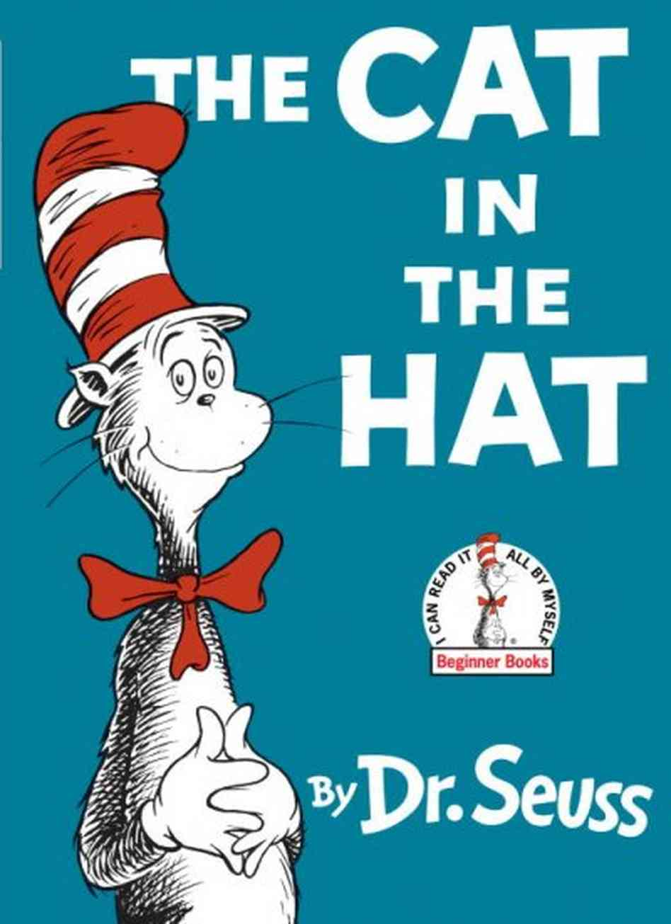
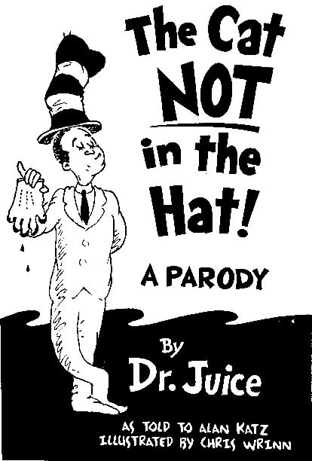
Book Covers

Slide 3
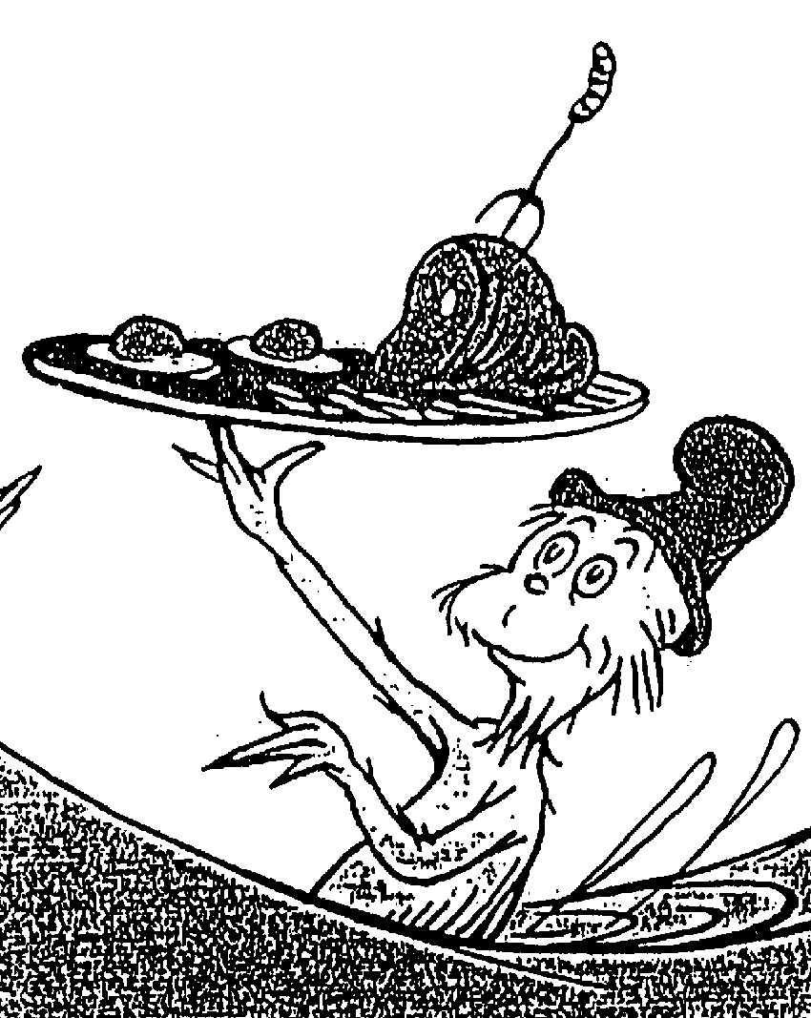
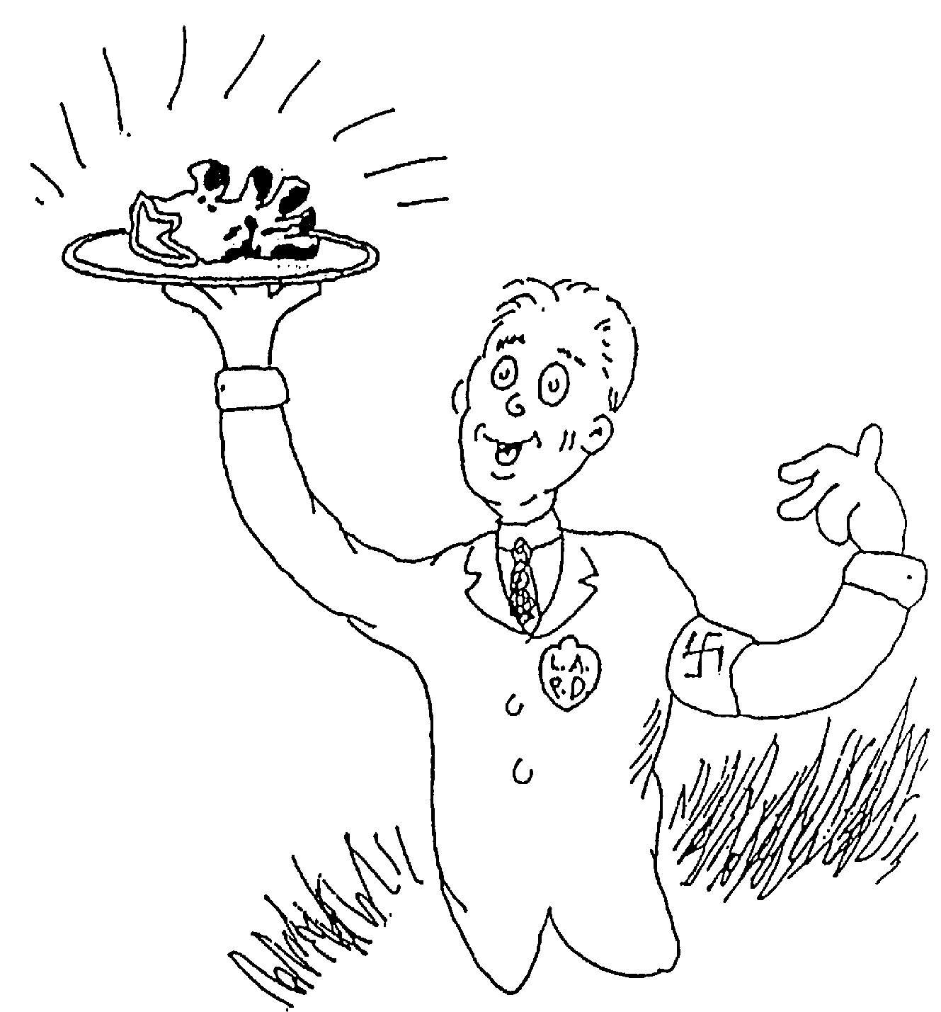
Illustrations
Dr. Seuss’ Green Eggs and Ham
Penguin’s Cat Not in the Hat!

Slide 4
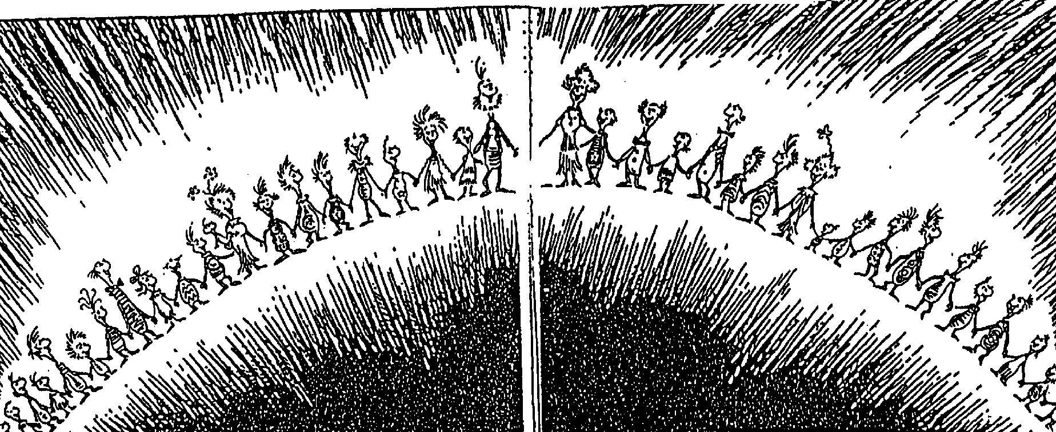
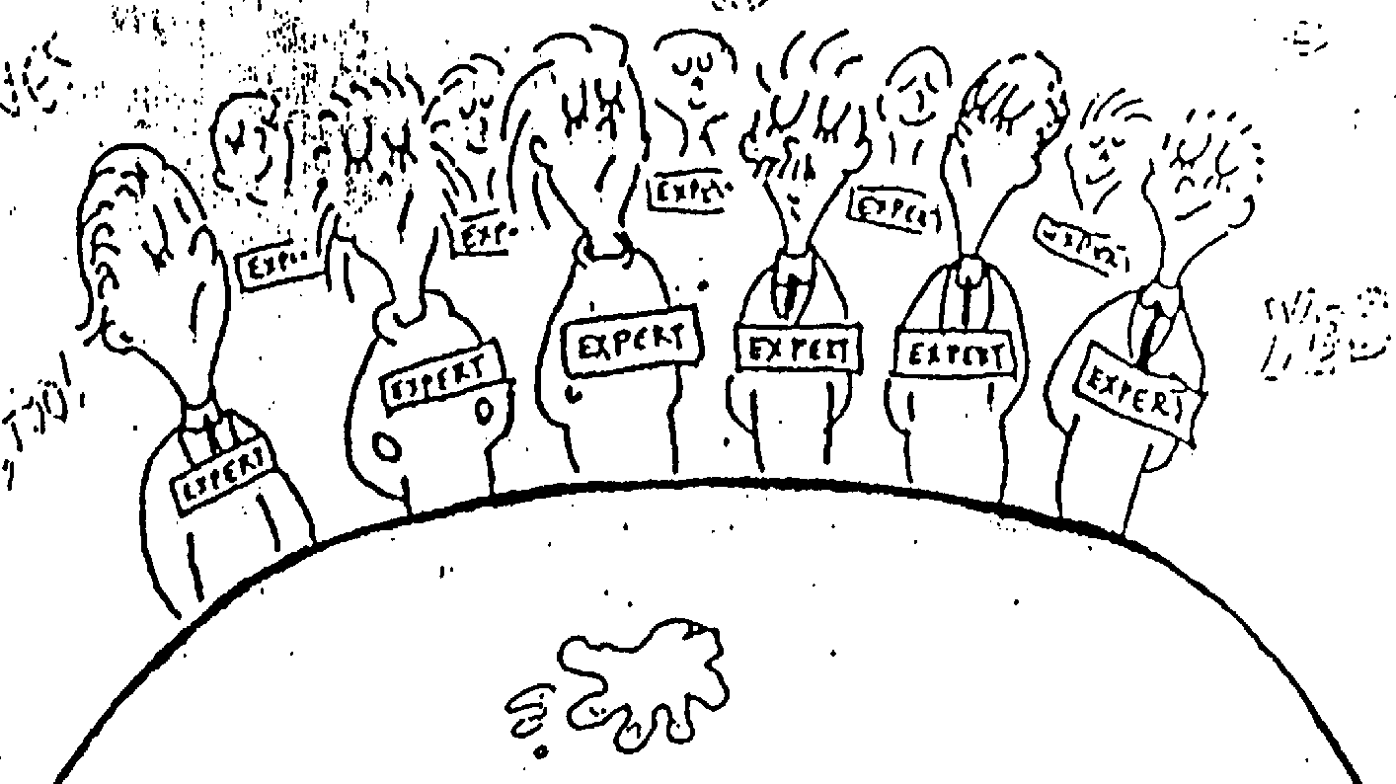
Illustrations
Penguin’s Cat Not in the Hat!
Dr. Seuss’ How the Grinch Stole Christmas

Slide 5
Language
One Fish
two fish
red fish
blue fish.
Black fish
blue fish
old fish
new fish.
One Knife?
Two Knife?
Red Knife
Dead Wife.
Penguin’s Cat Not in the Hat!
Dr. Seuss’ One Fish Two Fish Red Fish Blue Fish

Slide 6
Language?
I do not like them,
Sam-I-am.
I do not like
green eggs and ham.
I do not like pretrial exams
Green-fisted witnesses, surely shams
Take an oath, then sell your story
To Geraldo, Phil, or Maury.
Dr. Seuss’ Green Eggs and Ham
Penguin’s Cat Not in the Hat!

Slide 7
Cat Not in the Hat
1. Purpose and character of defendant’s use | π | No “critical bearing” on the substance or style of π’s works
2. Nature of copyrighted work | π | π’s work is highly creative
3. Amount of copying | π | Δ took “the central character” of Cat in the Hat
4. Impact on potential market | π | We infer adverse market impact from commercial and nontransformative character, in absence of proof to contrary
π
Remedy: enjoin publication, distribution, or marketing of the book
Result:

