Slide 1
Calder
William Fisher
April 2022

Slide 2
Problems
When analyzing the following hypothetical problems, assume that Calder is still alive, all of the works were created after 1990, and Calder has not waived his VARA rights

Slide 3
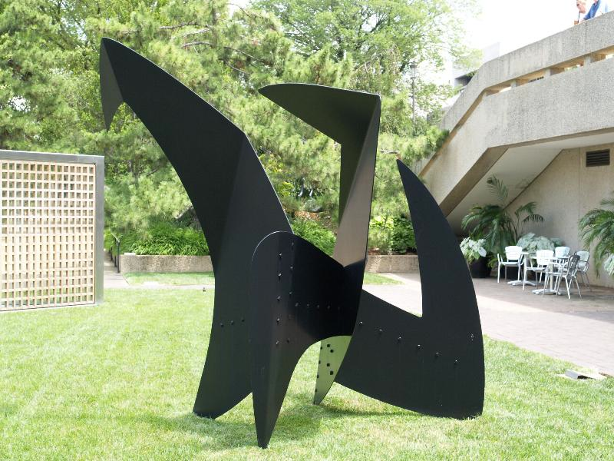
Question 1: Rust

Slide 4
Source: http://www.cambridge2000.com/gallery2/html/2010/P72142612e.html
Question 2: Repaint black

Slide 5
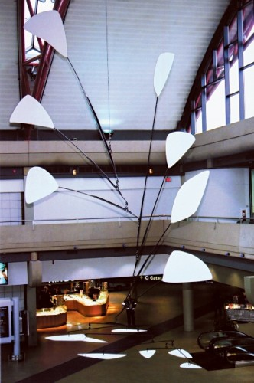
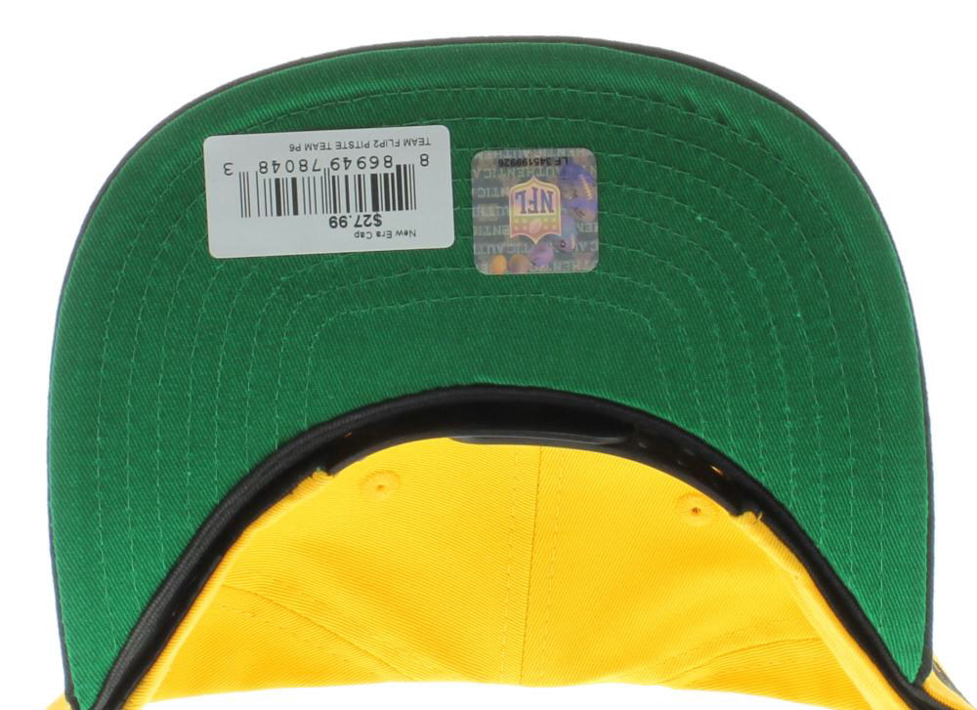
Question 3: Repaint green and gold

Slide 6
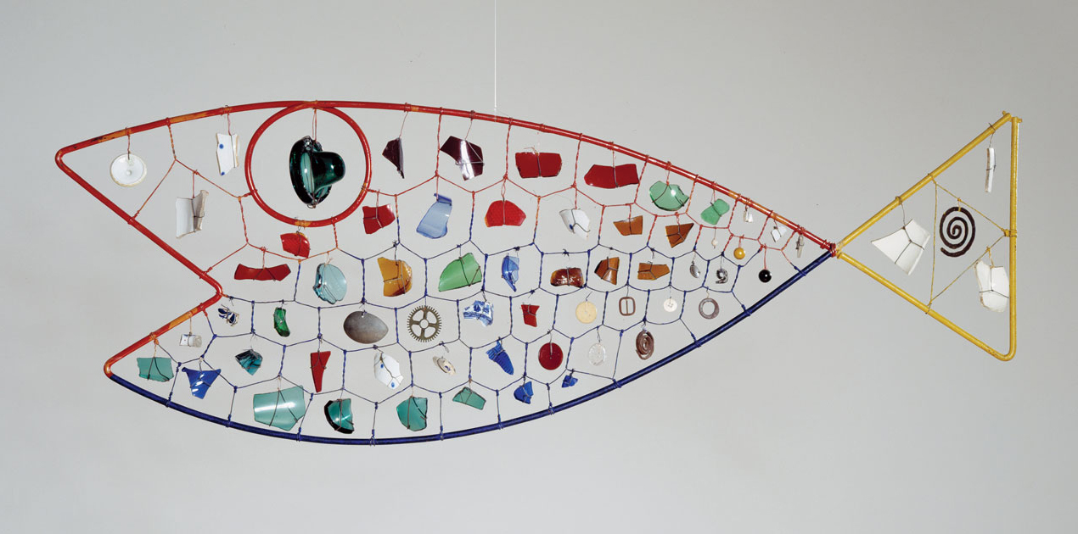
Fish Mobile
Question 4: Remove scale
Source: http://idaaf.com/wp-content/uploads/2016/01/Fish-Mobile-hirshhorn.si_.edu_.jpg

Slide 7
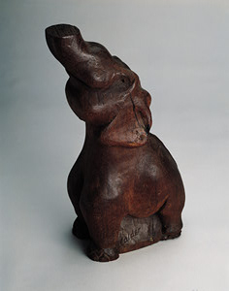
Alexander Calder,
“Elephant” (wood)
Question 5: Claim credit

Slide 8
Question 6: Burning Man Festival
Source: https://www.demilked.com/burning-man-festival-photos-victor-habchy/

