Slide 1
Tattoos
CX235
William Fisher
February 2021

Slide 2
Tattoo problems
 | Subject Matter coverage? | Fixation? | Originality? | Expression? | Ownership? | Copying? | Substantial similarity? | Defense?
Flowers v. Gnomo
Alexander v. 2K
Solid Oak v. 2K
James v. 2K

Slide 3
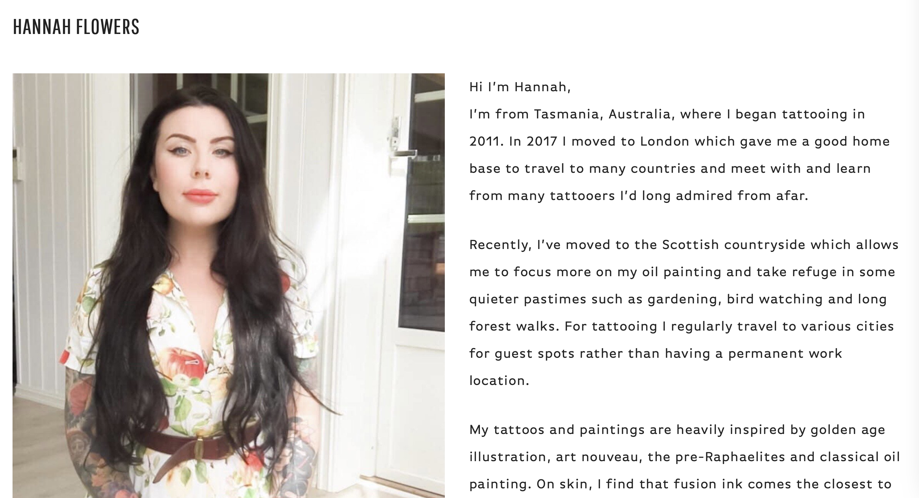

Slide 4
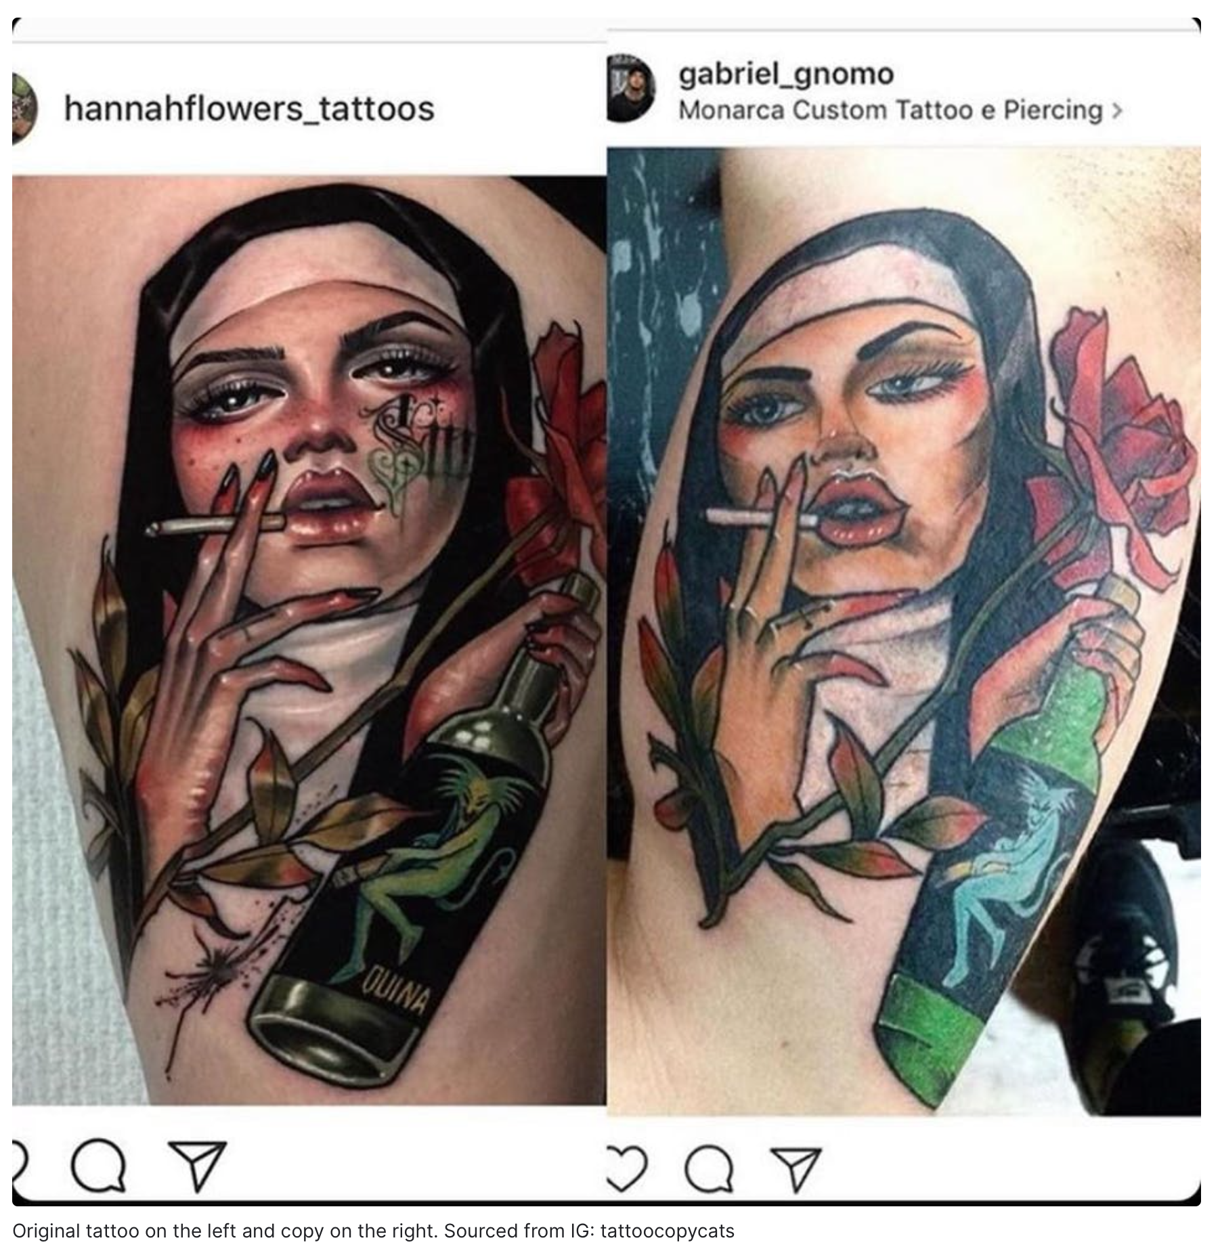

Slide 5
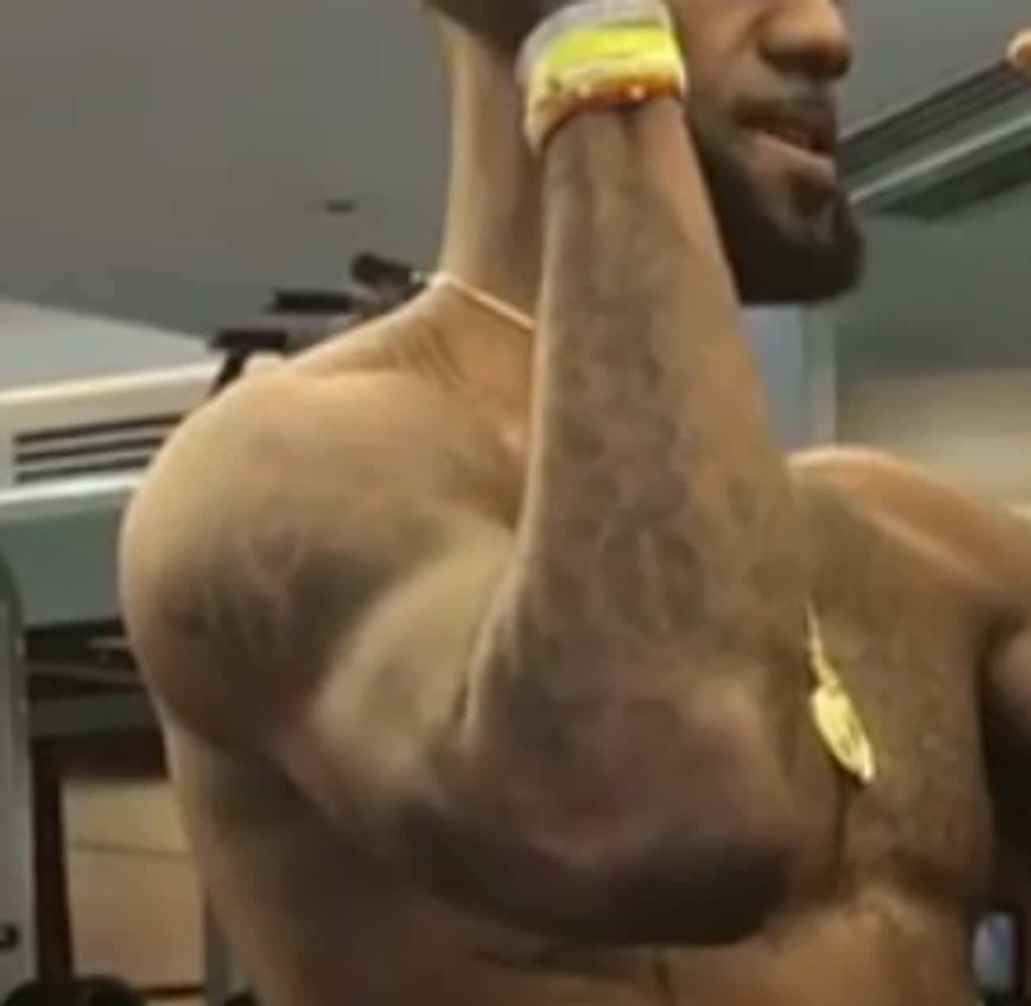
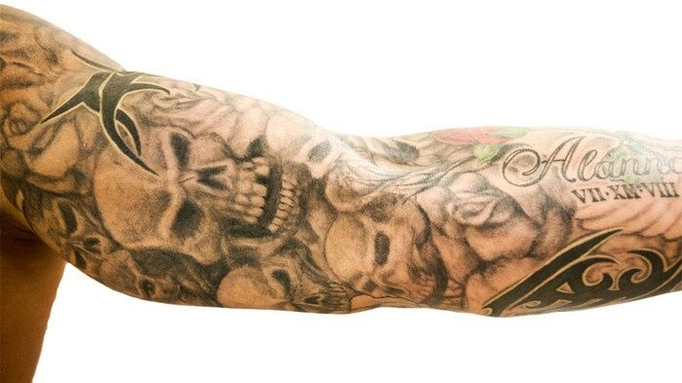
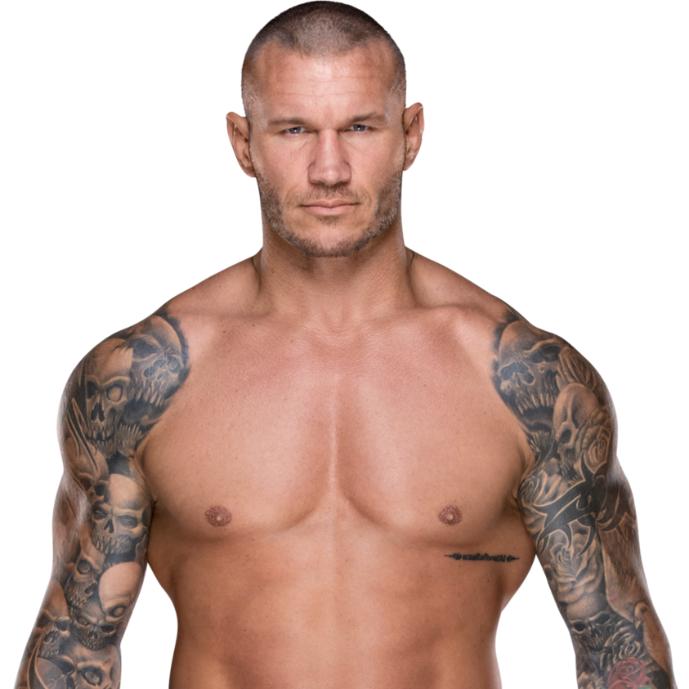
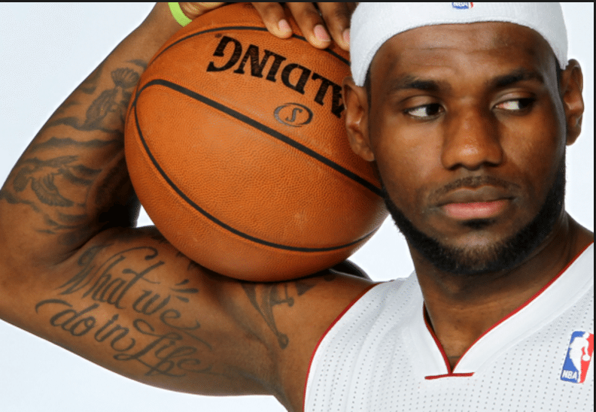
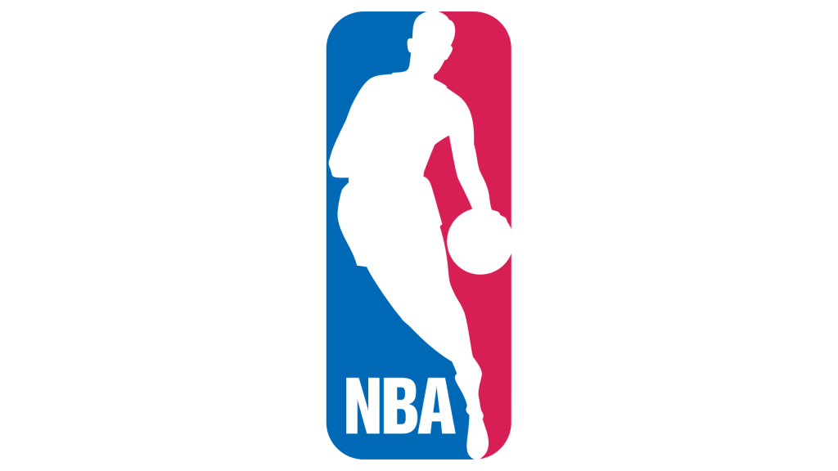
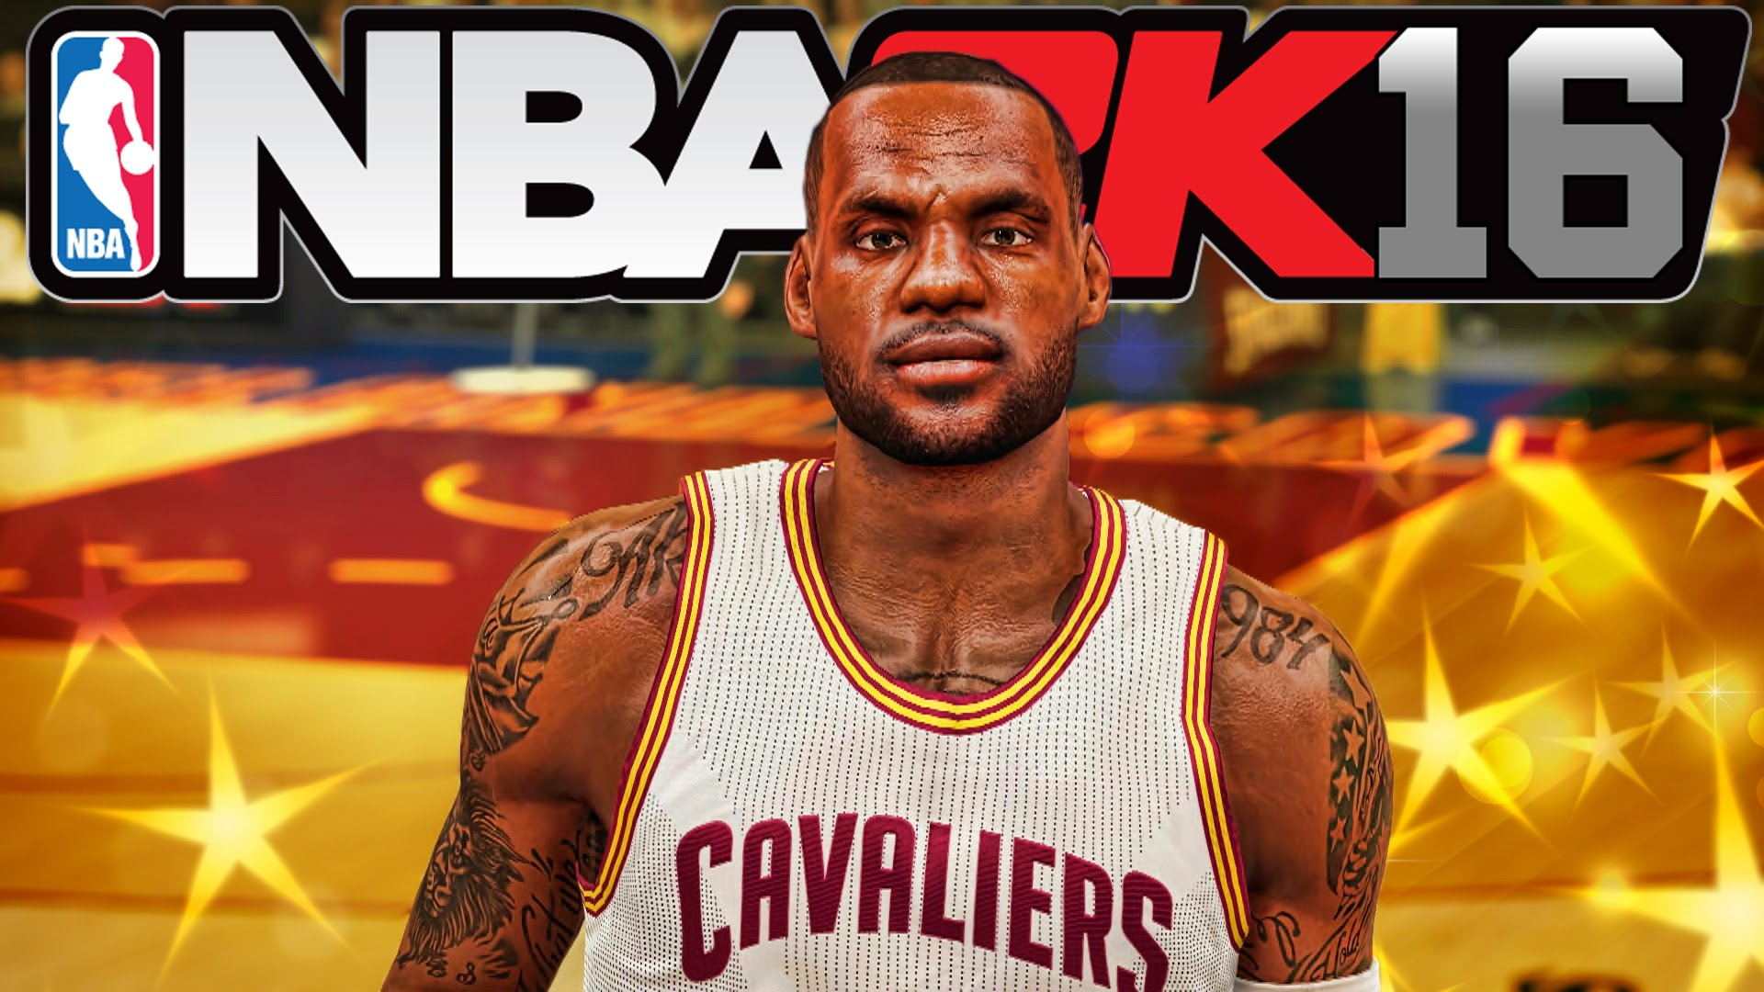
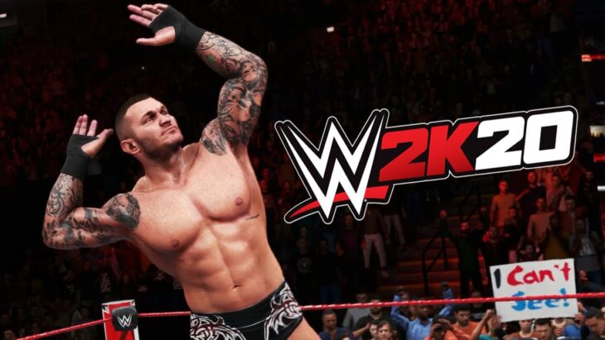
Justin Wright et al.
Catherine Alexander
Tattoo
Tattoo
Randy Orton
License to use likeness
License to use likeness
Exclusive License
World Wrestling Entertainment
Solid Oak Sketches
License to use likeness
License to use likeness
lawsuit
lawsuit
NBA 2K
WWE 2K

