Slide 1
Selected Slides Presented in Class on January 22, 2024
Copyright^{x}
William Fisher
Licensed under terms available at https://ipxcourses.org

Slide 2
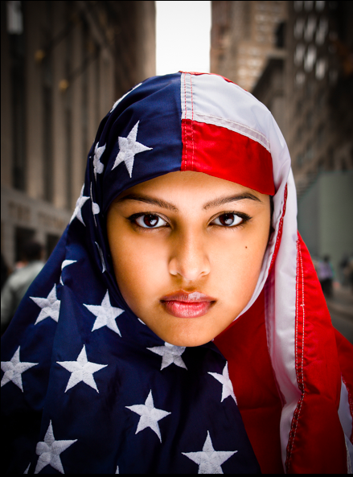
“We the People”
by Shepard Fairey
(January 2017)
“I Am America”
by Ridwan Adhami
(2007)
Munira Ahmed
“The Practice of Islam in America”
by Edward Curtis (NYU Press December 2017)

Slide 3
Using Photographs of People – US Law
Model Release
Freedom of Speech
Right of Publicity & Right of Privacy
For Art or News
For Trade or Advertising
Boundary is not crisp

Slide 4
DiCorcia v. Nussenzweig (2006)
“New York has been fairly liberal in its protection of what constitutes art. … In Hoepker v. Kruger, the court recognized that art can be sold, at least in limited editions, and still retain its artistic character. This analysis recognizes that first amendment protection of art is not limited to only starving artists. The analysis in Hoepker is consistent with the primary purpose/ incidental purpose doctrines, that have developed in connection with the newsworthy exemptions to privacy protections. A profit motive in itself does not necessarily compel a conclusion that art has been used for trade purposes.”
“In their moving papers defendants have prima facie shown that the photograph is "art". This is not a subjective determination, and cannot be based upon the personal preferences of either party or the court. Defendant DiCorcia has demonstrated his general reputation as a photographic artist in the international artistic community. With respect to the HEADS project, DiCorcia has described the creative process he used to shoot, edit and finally select the photographs, ultimately used. The photographs were not simply held for sale in the Pace gallery, but they were exhibited and reviewed by the relevant artistic community.”
“None of the HEADS photographs were used to advertise anything other than the HEADS collection. The catalogue portfolio was used to advertise the exhibition, which is a permitted use under Civil Rights Laws §§ 50, 51.”

Slide 5
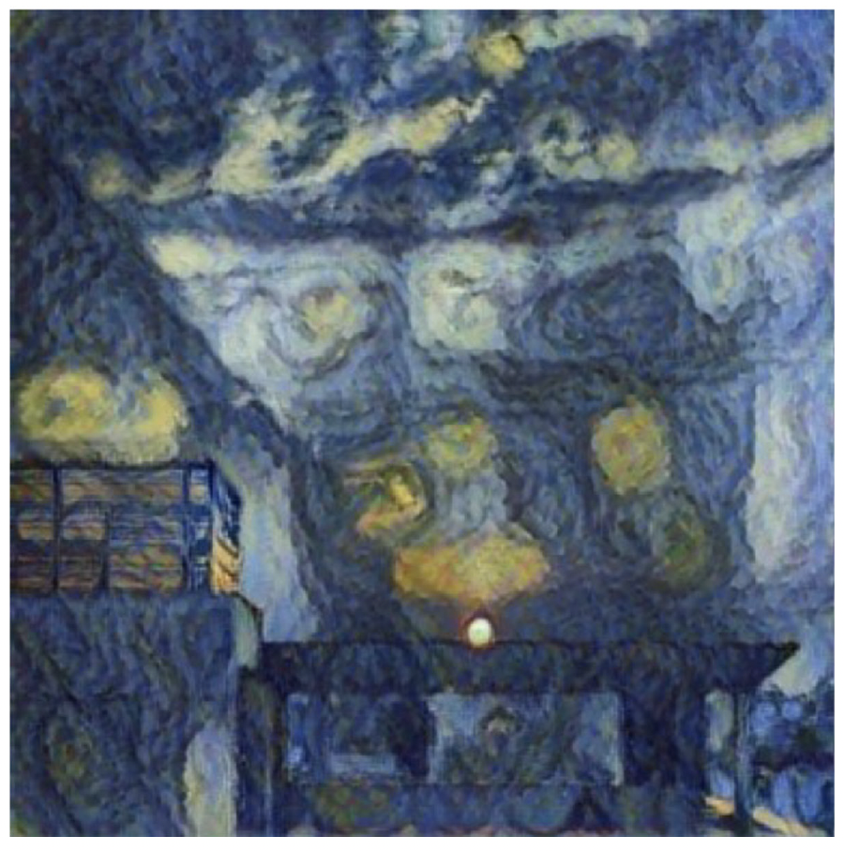
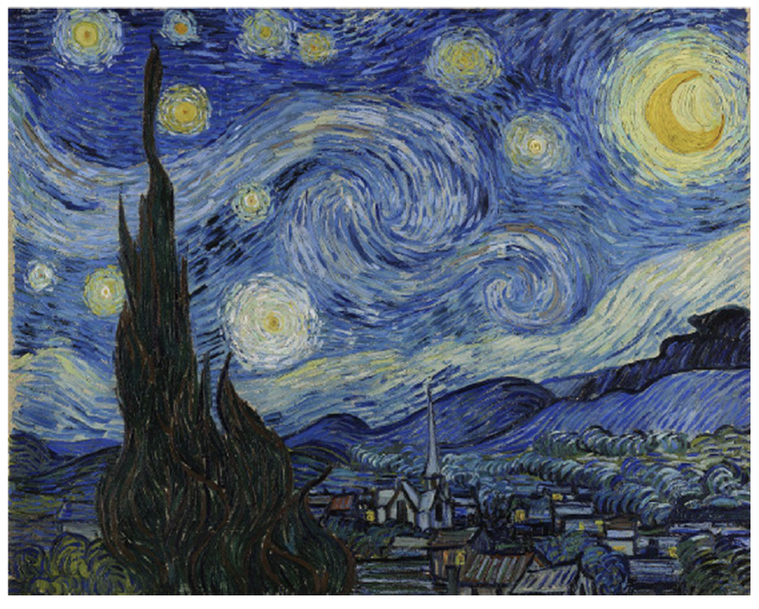
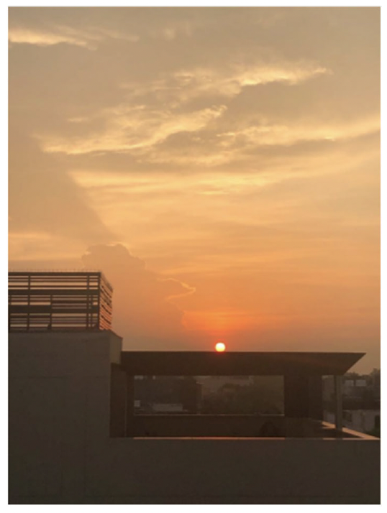
Generative Artificial Intelligence
Programmer(s)
Copyrighted Material
AI Firm
Creators
Assignees
ImageNet
RAGHAV
Suryast
Material in
the Public Domain
Sahni
Source
Material

