Slide 1
The Recorded Music Business Case Study 168
Copyright^{x}
William Fisher
February 2024
Licensed under terms available at https://ipxcourses.org

Slide 2
Economic Conditions Created by the Grant of a Copyright
$
Profit-Maximizing Behavior by a Copyright Owner
who cannot engage in price discrimination
Consumer Surplus
Monopoly Profits
Demand
P
Profit-maximizing price
Deadweight Loss (foregone
consumer surplus)
Marginal Cost
Q
Quantity
Profit-maximizing output

Slide 3
Composer
Assignment of musical-works copyright
Publisher
Reproduction
license
Performance
license
Sheet Music
Printer
Subpublishing
license
BMI;
ASCAP;
SESAC
Mechanical
license
Foreign
Subpublisher
Performer
Synchronization
license
Blanket licenses
Assignment
of sound-recording
copyright
Movie
Studio
Harry Fox
Agency
Radio
or TV
Station
Restaurant
Webcaster
Sound
Exchange
Record
Company

Slide 4
Phase 1 (1970-2000): Expansion

Slide 5
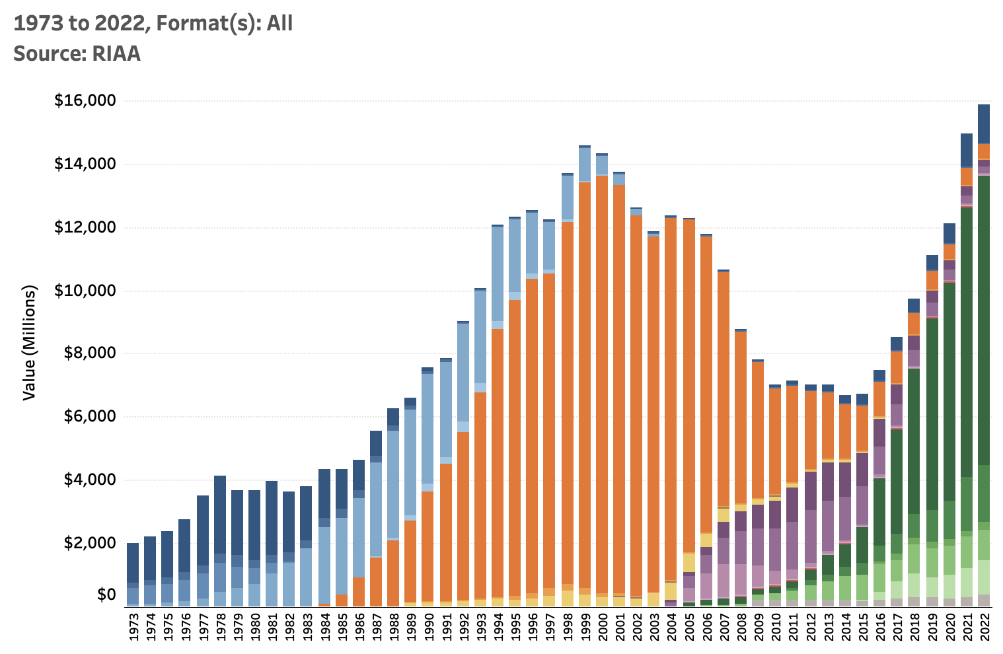
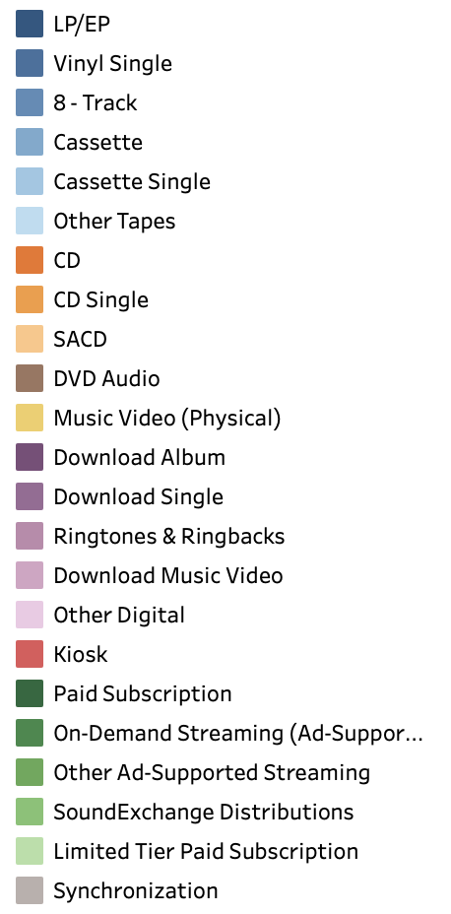
Source: https://www.riaa.com/u-s-sales-database/

Slide 6
Phase 2 (2000-2015): Contraction

Slide 7
Technological Shifts Initiate a Crisis
Digital Recording and Storage Systems
Compression/Decompression Systems (e.g., MP3)
Internet

Slide 8
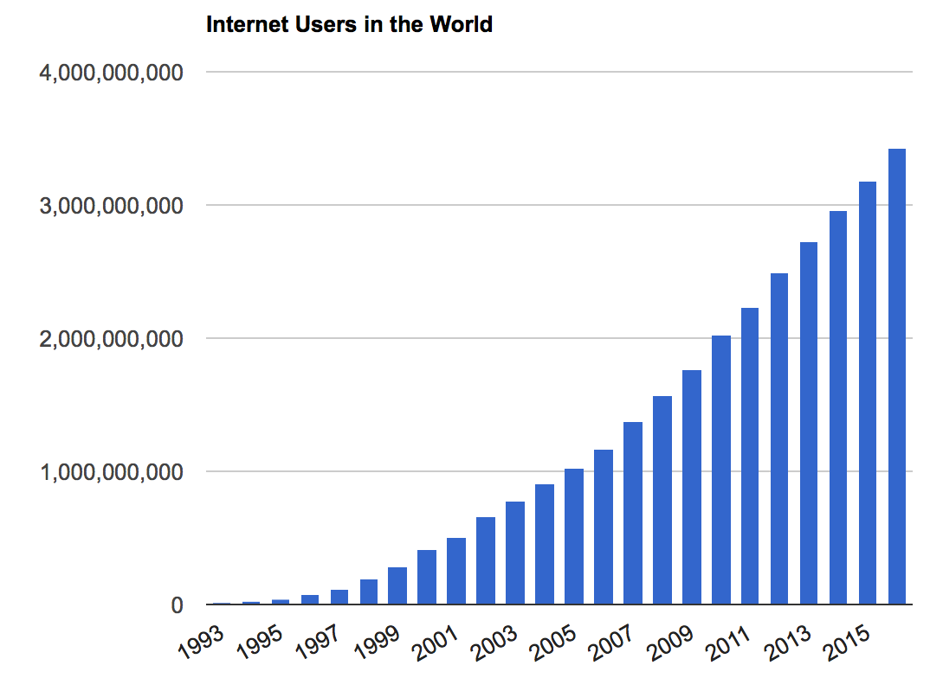
November 20, 2015
Source: http://www.internetlivestats.com/internet-users/#trend
© 2017, William Fisher. This work is licensed under the Creative Commons Attribution-NonCommercial-ShareAlike 2.5 License.

Slide 9
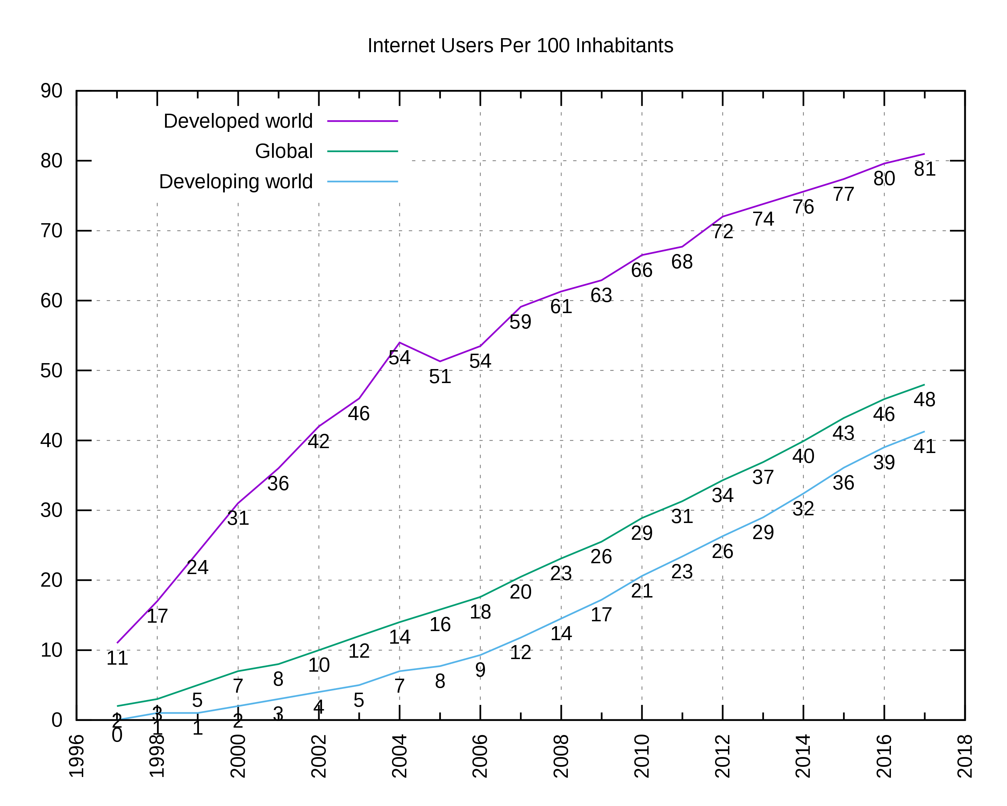
Source: https://en.wikipedia.org/wiki/Global_Internet_usage#/media/File:Internet_users_per_100_inhabitants_ITU.svg

Slide 10
Impact on Recorded Music
© 2015, William Fisher. This work is licensed under the Creative Commons Attribution-NonCommercial-ShareAlike 2.5 License.

Slide 11
Source: https://www.riaa.com/u-s-sales-database/

Slide 12
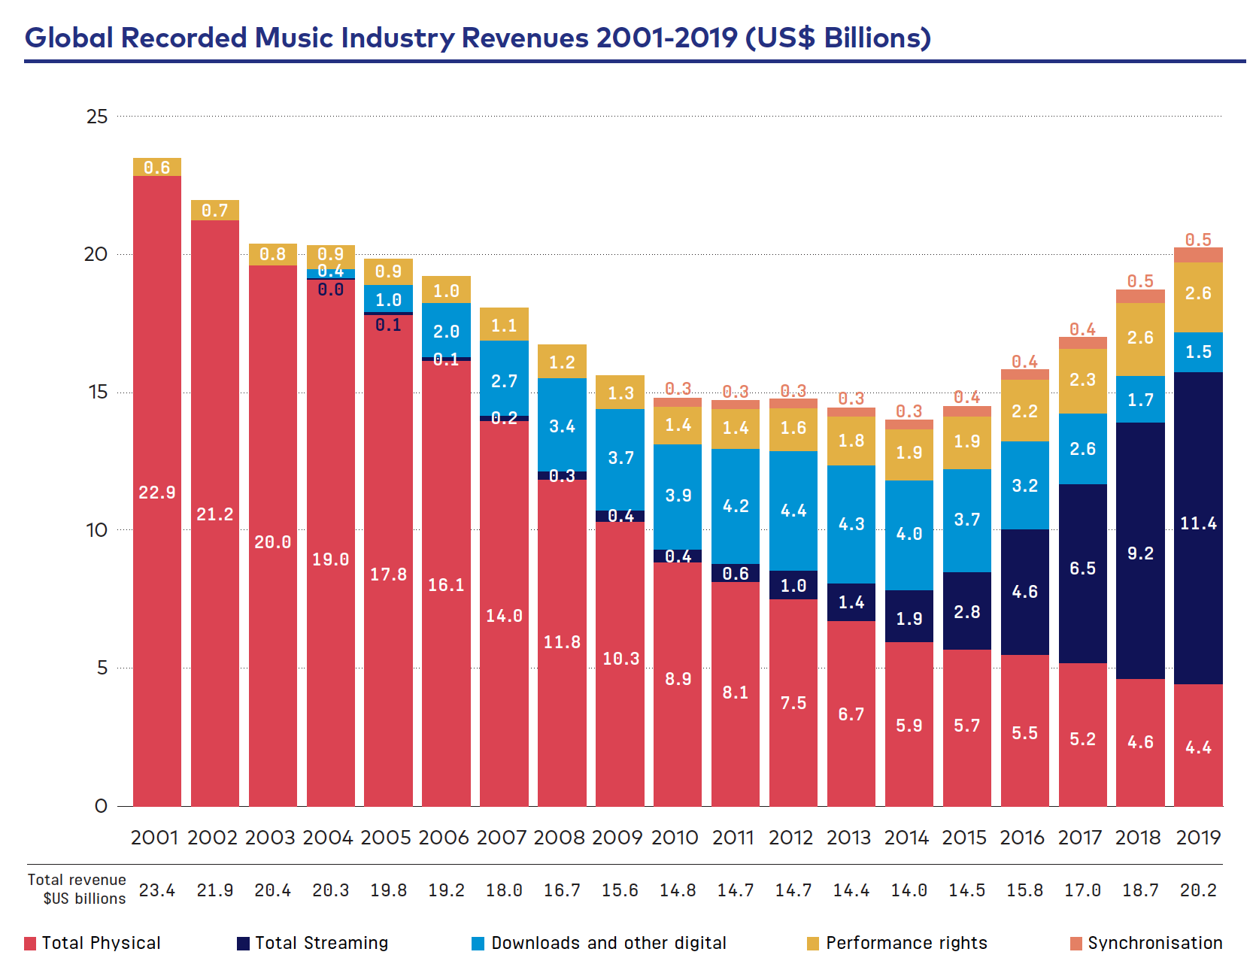
Source: https://www.ifpi.org/wp-content/uploads/2020/07/Global_Music_Report-the_Industry_in_2019-en.pdf

Slide 13
Legal Responses
Enforce Copyright
Suits Against Intermediaries
Napster
Aimster
Grokster
Limewire
Civil Suits Against Individuals
© 2015, William Fisher. This work is licensed under the Creative Commons Attribution-NonCommercial-ShareAlike 2.5 License.

Slide 14
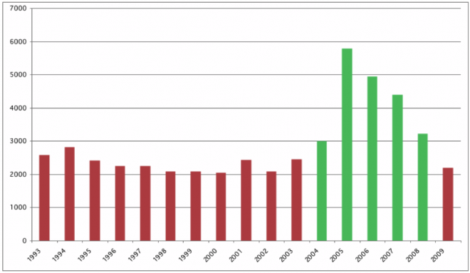
RIAA Lawsuits Against Filesharers
Source: Infostruction, http://www.infostruction.com/2010/12/02/
the-p2p-war-someone-is-monitoring-your-activities/

Slide 15
Legal Responses
Enforce Copyright
Suits Against Intermediaries
Napster
Aimster
Grokster
Limewire
Civil Suits Against Individuals
Criminal Prosecution of Intermediaries
© 2015, William Fisher. This work is licensed under the Creative Commons Attribution-NonCommercial-ShareAlike 2.5 License.

Slide 16
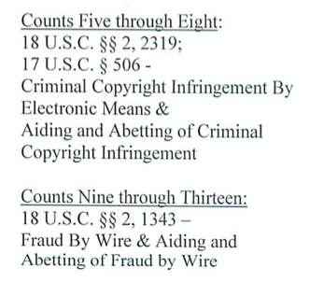
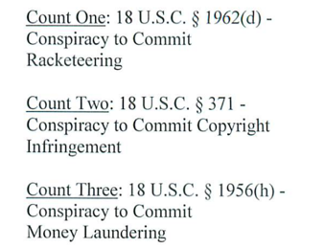
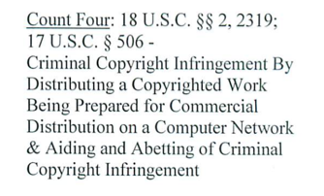
The Indictment
Copyright © 2014 Alex Shank. This case study was originally written by Allison Trzop and was subsequently revised by Alex Shank. It is licensed under the Creative Commons Attribution-NonCommercial-ShareAlike 2.5 License, the terms of which are available at http://creativecommons.org/licenses/by-nc-sa/2.5/.

Slide 17
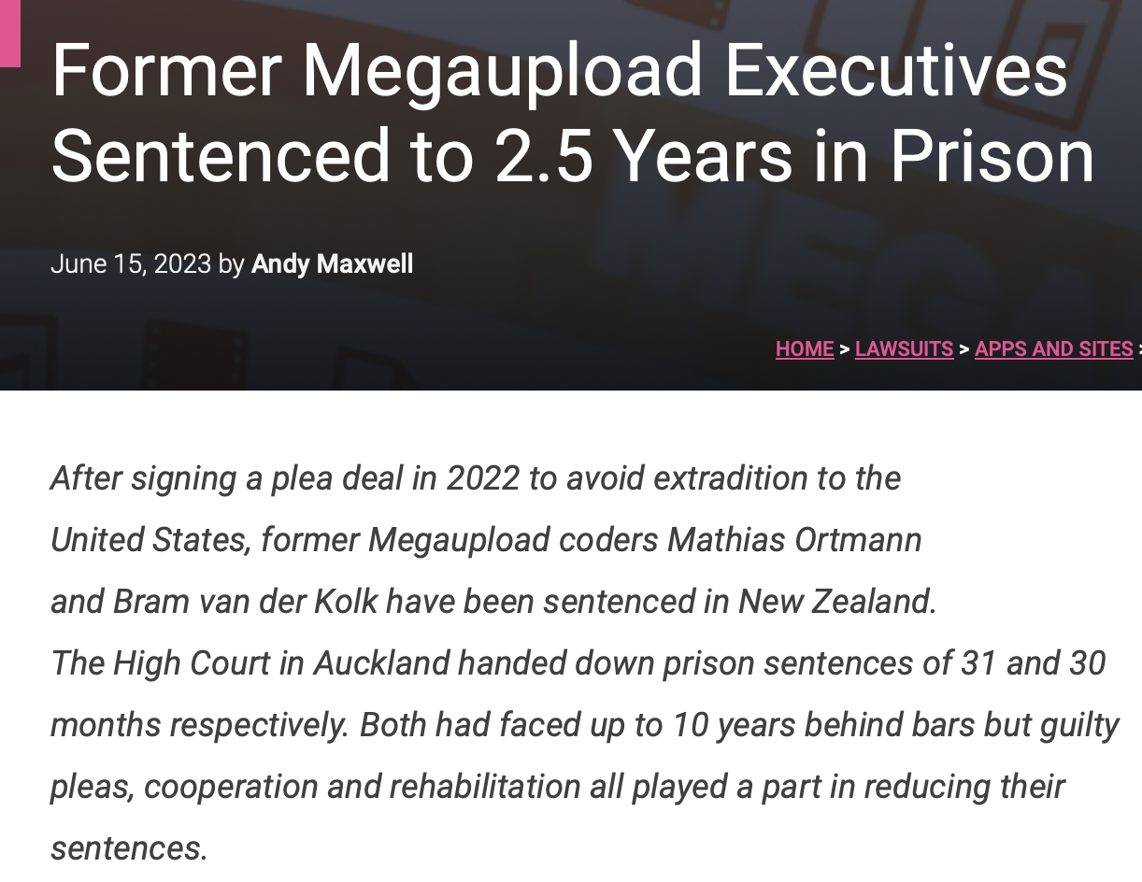

Slide 18
Legal Responses
Enforce Copyright
“Graduated Response”
Hadopi
Trident Media Guard (TMG) monitors Internet traffic for copyright owners, seeks to detect illegal downloading; alerts Hadopi
First offense: email warning letter
Second offense: another email warning + registered letter
Third offense: Hadopi may refer to prosecutors
Potential penalty: fine of 1500€ + suspension of Internet access for one month
© 2015, William Fisher. This work is licensed under the Creative Commons Attribution-NonCommercial-ShareAlike 2.5 License.

Slide 19
Legal Responses
Enforce Copyright
“Graduated Response”
Hadopi
Adopted in October 2009
Initiated January 1, 2010
by 2012:
822,014 first warning letters
68,343 second warning letters
165 under investigation for final phase
Eventually fully applied to only one person
July 2013, Government abandons sanction of suspended Internet access
replaces with automated system of fines for unlawful downloading
© 2015, William Fisher. This work is licensed under the Creative Commons Attribution-NonCommercial-ShareAlike 2.5 License.

Slide 20
Legal Responses
Enforce Copyright
“Graduated Response”
Hadopi
Danaher et al. (2012): iTunes sales in France are 22.5% higher in France since institution of Hodapi than in control-group European countries
Arnold et al. (2014): no significant deterrent effect on illegal filesharing
Giblin (2014): "little to no" evidence that system has any effect in:
1. reduction of infringement
2. increased use of lawful distribution channels
3. increase in the creation and dissemination of a variety of creative materials
© 2015, William Fisher. This work is licensed under the Creative Commons Attribution-NonCommercial-ShareAlike 2.5 License.

Slide 21
Legal Responses
Enforce Copyright
“Graduated Response”
Prohibitions on Encryption Circumvention
WIPO Copyright Treaty (1996)
Art. 11: "Contracting Parties shall provide adequate legal protection and effective legal remedies against the circumvention of effective technological measures that are used by authors in connection with the exercise of their rights under this Treaty or the Berne Convention and that restrict acts, in respect of their works, which are not authorized by the authors concerned or permitted by law."
© 2015, William Fisher. This work is licensed under the Creative Commons Attribution-NonCommercial-ShareAlike 2.5 License.

Slide 22
Legal Responses
Enforce Copyright
“Graduated Response”
Prohibitions on Encryption Circumvention
Block Access to “Pirate Sites”
SOPA/PIPA
© 2015, William Fisher. This work is licensed under the Creative Commons Attribution-NonCommercial-ShareAlike 2.5 License.

Slide 23
Legal Responses
Enforce Copyright
“Graduated Response”
Prohibitions on Encryption Circumvention
Block Access to “Pirate Sites”
SOPA/PIPA
Ley Sinde (Spain)
Copyright owner files complaint with Ministry of Culture, identifying pirate site
MOC notifies website, offers opportunity to remove the material
If website does not, MOC requires ISP to block access
© 2015, William Fisher. This work is licensed under the Creative Commons Attribution-NonCommercial-ShareAlike 2.5 License.

Slide 24
Legal Responses
Enforce Copyright
“Graduated Response”
Prohibitions on Encryption Circumvention
Block Access to “Pirate Sites”
Alternative Compensation System
Proposals in Brazil, Japan, Germany (“Cultural Flatrate”)
Tax
Count (relative frequency with which works are consumed)
Distribute
In proportion to popularity
Or adjusted to promote culture (Agrain)
Legalize file-sharing
© 2015, William Fisher. This work is licensed under the Creative Commons Attribution-NonCommercial-ShareAlike 2.5 License.

Slide 25
Phase 3 (2015-2023): Rebound

Slide 26
Source: https://www.riaa.com/u-s-sales-database/

Slide 27
Visualization of Changing Formats
https://www.aei.org/carpe-diem/animated-chart-of-the-day-recorded-music-sales-by-format-share-1973-to-2022/

Slide 28
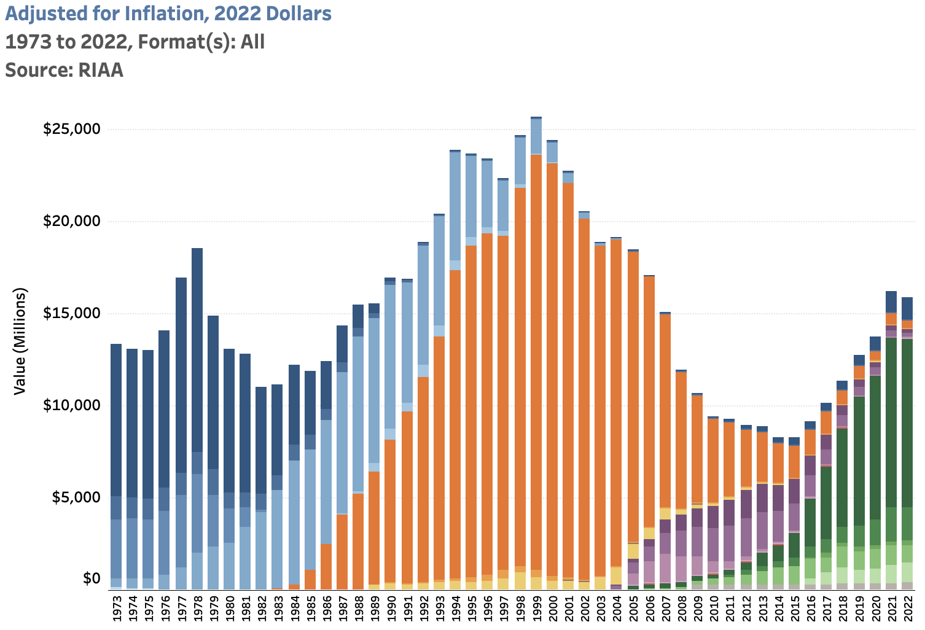
Source: https://www.riaa.com/u-s-sales-database/

Slide 29
Source: https://www.riaa.com/u-s-sales-database/
25.6B/
279M=
$92 p.c.
18.5B/
222M=
$83 per capita
15.9B/
332M=
$48 p.c.

Slide 30
Source: https://www.ifpi.org/wp-content/uploads/2020/07/Global_Music_Report-the_Industry_in_2019-en.pdf

Slide 31
Number of active users of major music streaming services in the United States from 2016 to 2025 (in millions)
2
Note(s): United States; 2016 to 2021; among internet users of any age who listen to each service on any device at least once per month
Further information regarding this statistic can be found on page 8.
Source(s): eMarketer; ID 293749

Slide 32
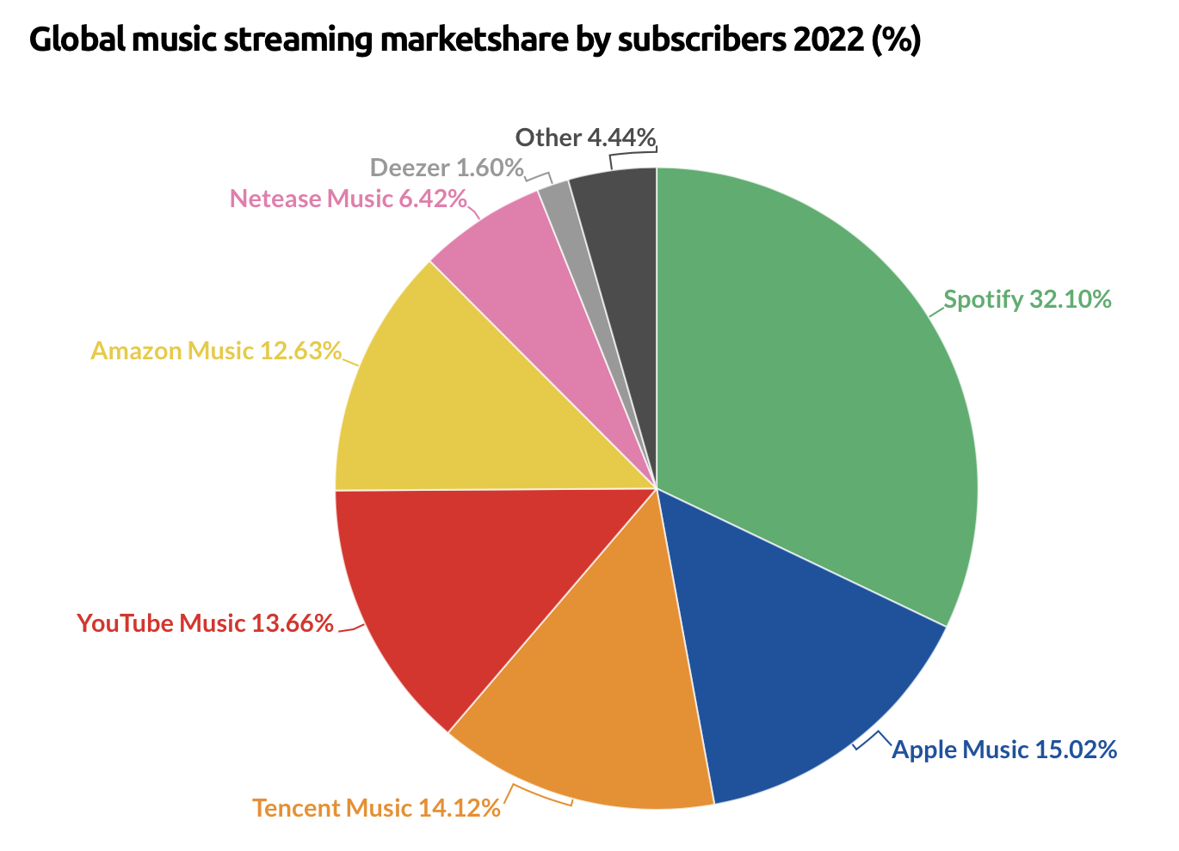

Slide 33
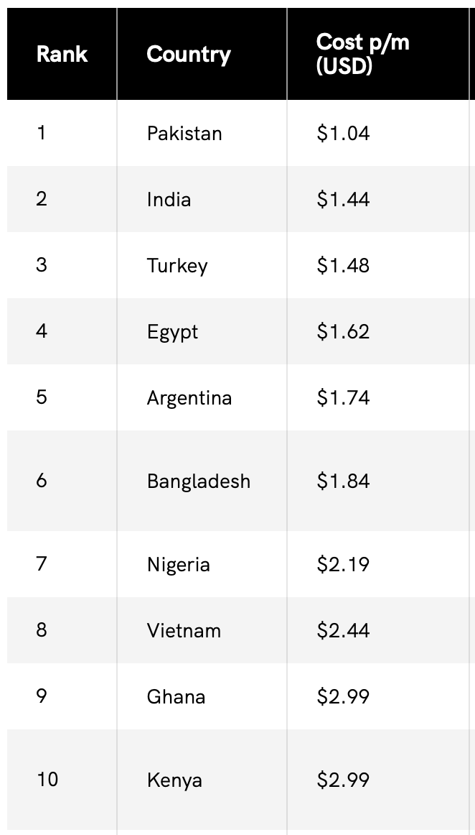
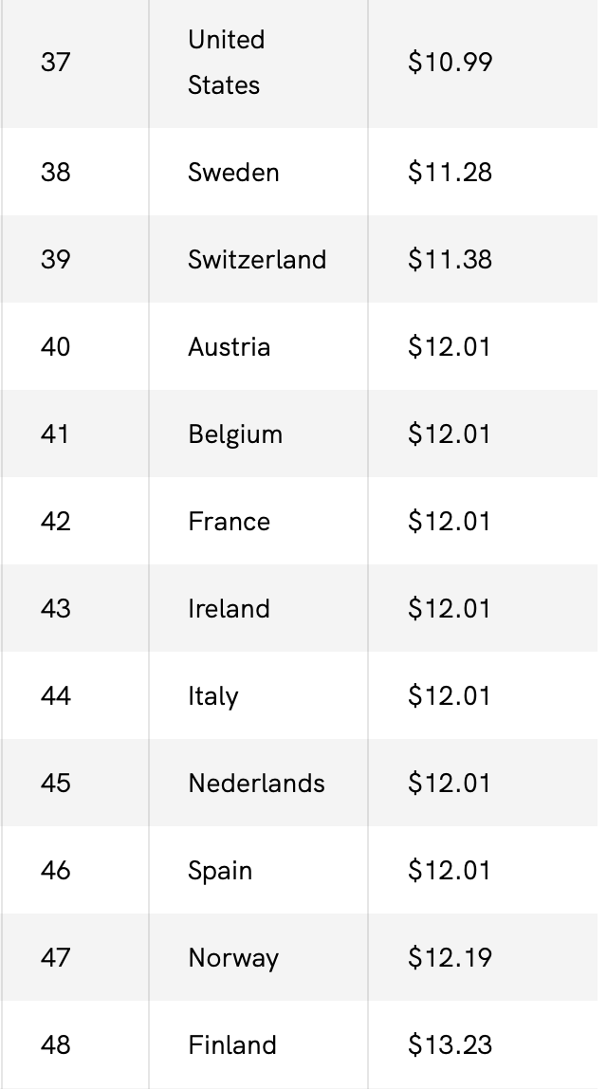
Spotify: Geographic Differential Pricing
Source: https://www.androidauthority.com/how-much-does-spotify-cost-around-the-world-3360533/

Slide 34
2
Spotify's revenue worldwide from 2013 to 2022 (in million euros)
Note(s):2013 to 2022
Further information regarding this statistic can be found on page 8.
Source(s): Spotify; ID 813713

Slide 35
2
Spotify's revenues from 2012 to 2022, by segment (in million euros)
Note(s): Worldwide; 2009 to 2021
Further information regarding this statistic can be found on page 8.
Source(s): Spotify; ID 245125

Slide 36
Spotify's cost of goods sold from 2012 to 2022 (in million euros)
2
Note(s): Worldwide; 2012 to 2021
Further information regarding this statistic can be found on page 8.
Source(s): Spotify; ID 245137

Slide 37
2
Operating income of Spotify worldwide from 2013 to 2022 (in million euros)
Note(s): Worldwide; 2013 to 2022
Further information regarding this statistic can be found on page 8.
Source(s): Spotify; ID 813758

Slide 38
2
Number of Spotify employees worldwide from 2018 to 2022, by region
Note(s): Worldwide; 2018 to 2022
Further information regarding this statistic can be found on page 8.
Source(s): Spotify; ID 813906

Slide 39
Problems
Royalties are too low
Composers fare worse than recording artists
Within each group the distribution of royalties is highly unequal
Collections are not comprehensive

Slide 40
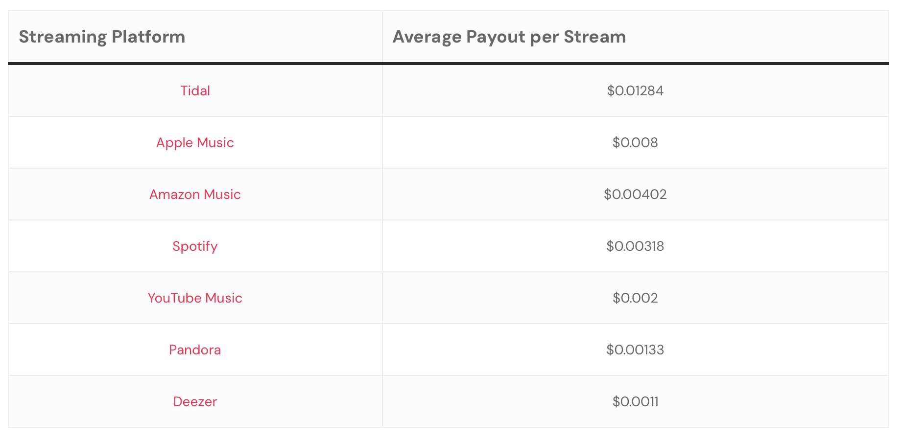
Source: https://virpp.com/hello/music-streaming-payouts-comparison-a-guide-for-musicians/

Slide 41
Composer
Assignment of musical-works copyright
Publisher
Reproduction
license
Performance
license
Sheet Music
Printer
$1B
MLC
Subpublishing
license
BMI;
ASCAP;
SESAC
Mechanical
license
Foreign
Subpublisher
Performer
Synchronization
license
Blanket licenses
Assignment
of sound-recording
copyright
Movie
Studio
Harry Fox
Agency
Radio
or TV
Station
Restaurant
Webcaster
Sound
Exchange
Record
Company

Slide 42
Loyalty
“[F]ormer President Donald J. Trump declared on Sunday that it would be “disloyal” for Ms. Swift to endorse President Biden for re-election, given that Mr. Trump signed legislation that made it easier for artists to collect royalties when their songs are streamed.
“I signed and was responsible for the Music Modernization Act for Taylor Swift and all other Musical Artists,” Mr. Trump wrote on his social media platform, referring to a 2018 bill that passed Congress with near unanimous support from members of both parties. “Joe Biden didn’t do anything for Taylor, and never will. There’s no way she could endorse Crooked Joe Biden, the worst and most corrupt President in the History of our Country, and be disloyal to the man who made her so much money.”
“Besides that, I like her boyfriend, Travis, even though he may be a Liberal, and probably can’t stand me!” Mr. Trump added.
Source: New York Times, February 12, 2024

Slide 43
Spotify Payment Systems
https://loudandclear.byspotify.com/?_ga=2.33459518.1604893273.1707508899-393559438.1707508899#money-flow

Slide 44
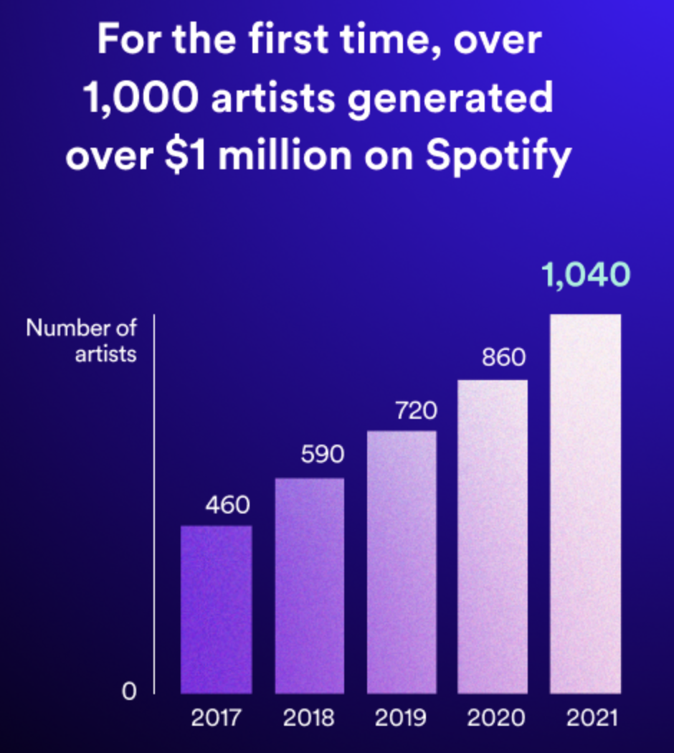
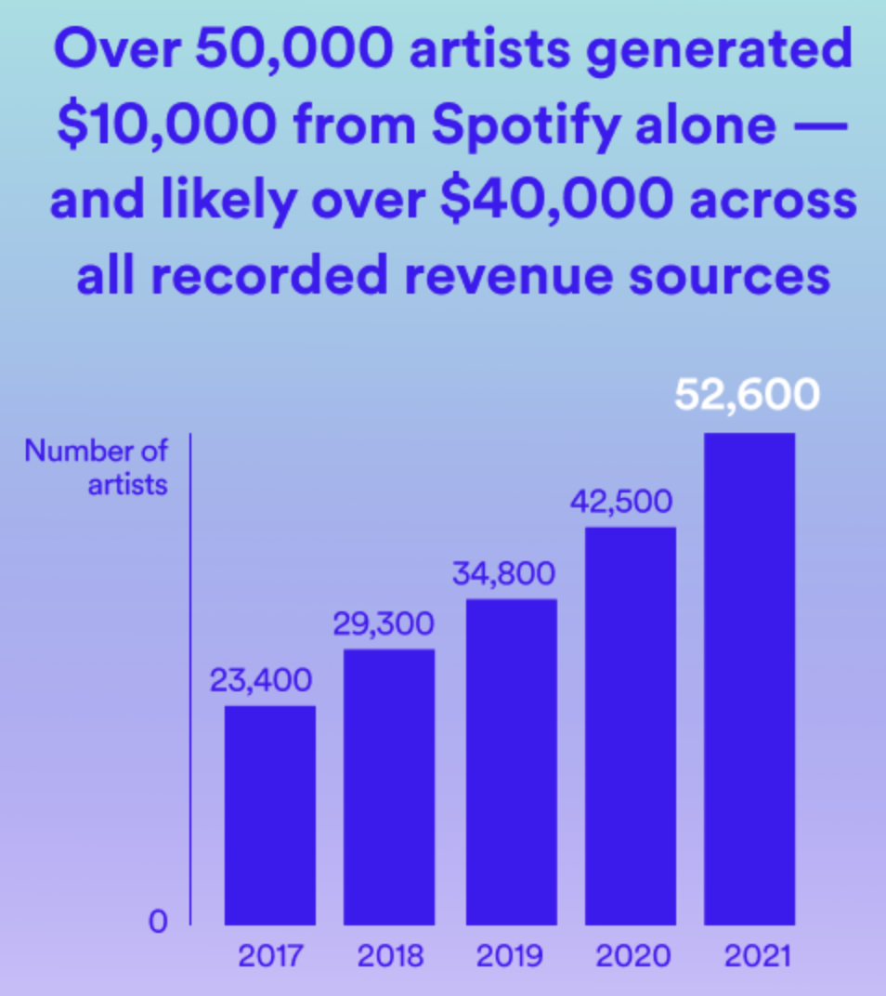
Spotify Payment Systems – March 2023

Slide 45
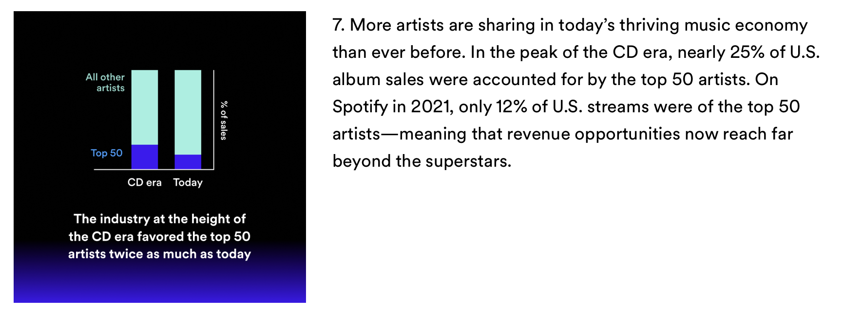
Spotify Payment Systems – March 2023

Slide 46
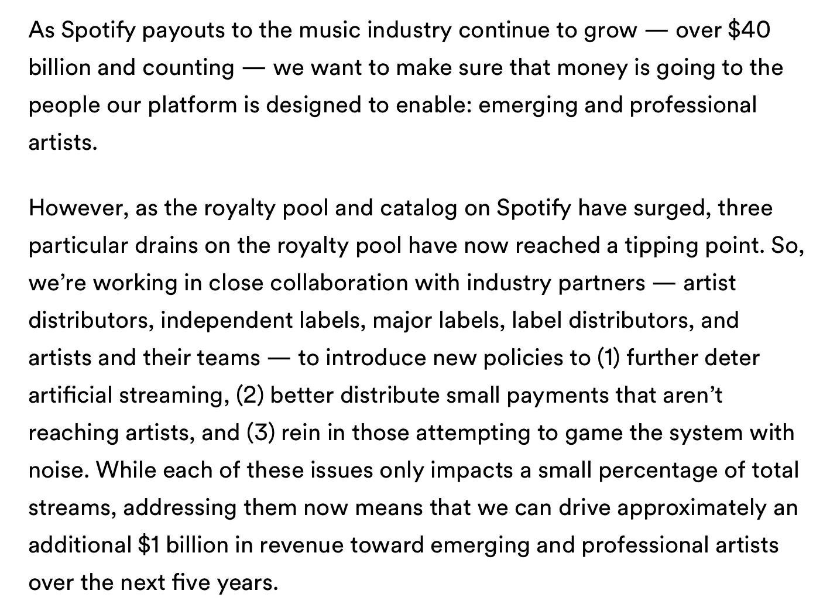
Spotify Payment Systems – changes, Nov. 21, 2023

Slide 47
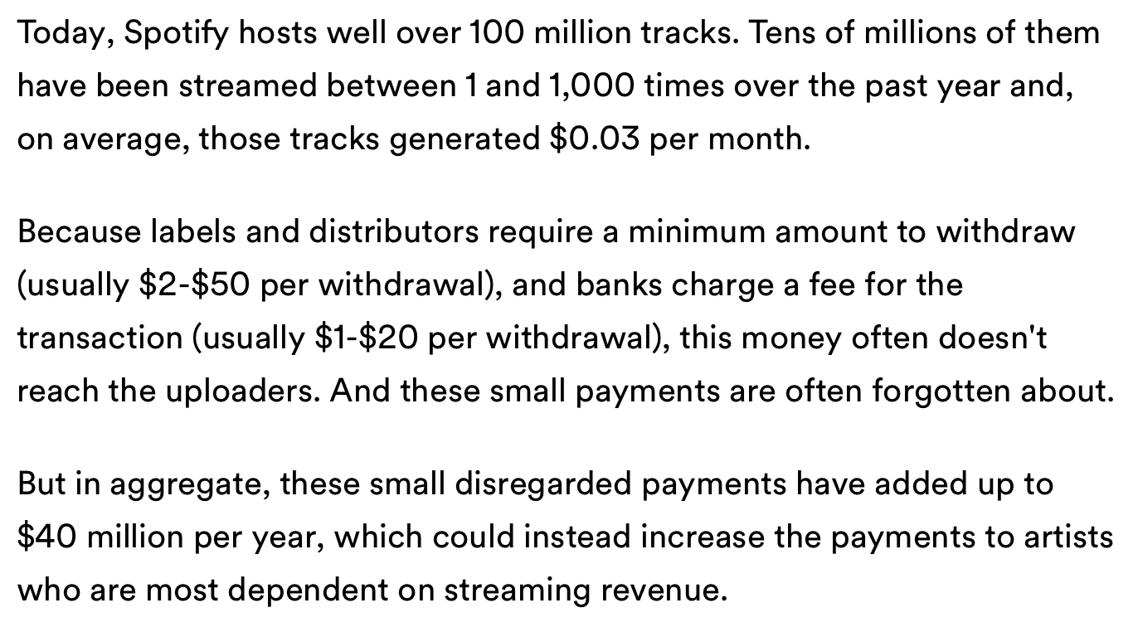
Spotify Payment Systems – changes, Nov. 21, 2023

Slide 48
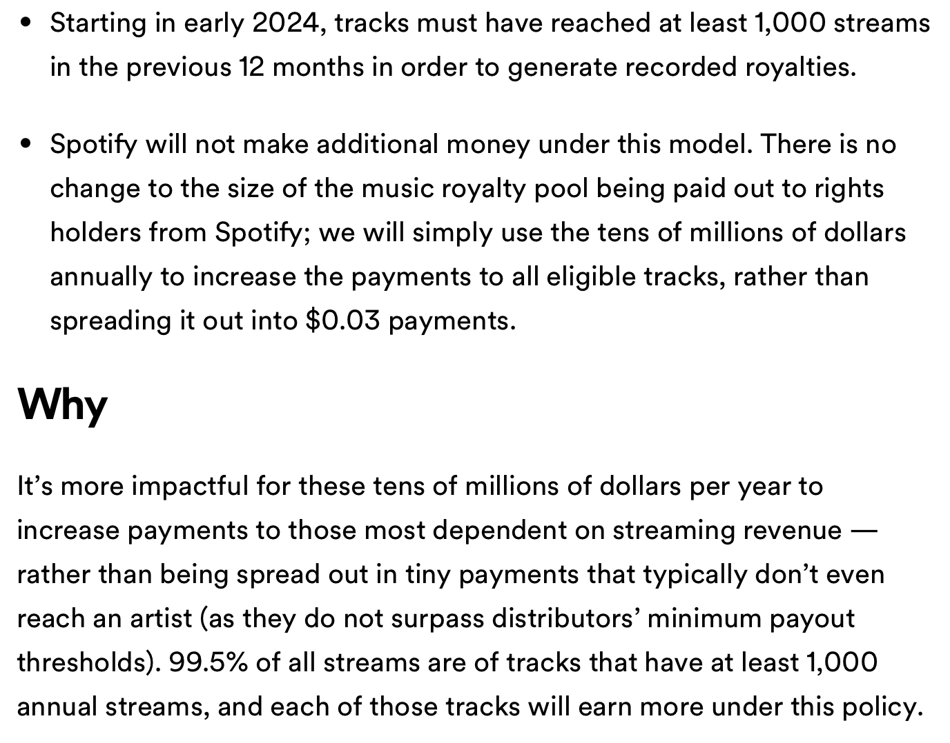
Spotify Payment Systems – changes, Nov. 21, 2023

Slide 49
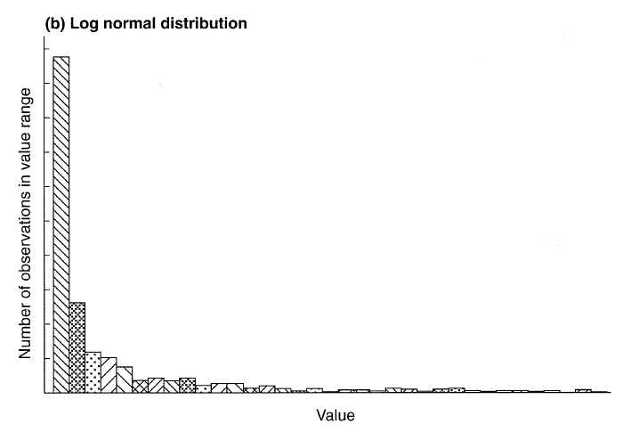
Scherer, “Innovation Lottery”
Recorded Music Industry
Musicians waiting tables in NY & LA
Eric Clapton
$

Slide 51
Proposal
A music streaming service may invoke a compulsory license vis-à-vis all publicly released compositions and sound recordings iff it abides by a royalty-payment regime, with the following characteristics:
(a) 80% of revenues are reserved for copyright owners;
(b) Mandatory payoff scheme – either:
diminishing marginal payouts, or
user-centric payment system
(c) Mandatory distribution between publishers, labels, artists
e.g., 40%; 30%; 30%
(d) must accept all comers – provided they pay a registration fee sufficient to cover costs of processing recordings and storing them on servers
all aspects reset periodically by an administrative tribunal

Slide 52
Variants of Diminishing Marginal Payout
(1) In determining the shares of the pot that should be allocated each month to each track:
Give each of the first 10,000 streams of a given track a weight of 1.
Give each of the streams between 10,001 and 20,000 a weight of .9.
Give each of the streams between 20,001 and 30,000 a weight of .9 x .9 = .81
Give each of the streams between 30,001 and 40,000 a weight of .9 x .9 x .9 = .729
Give each of the streams between 40,001 and 50,000 a weight of .9 x .9 x .9 x .9 = .656
And so forth
(2) Share of the pot is proportional to cube of log of number of streams in a given period

Slide 53
Source: http://www.digitalmedia.fi/wp-content/uploads/2018/02/UC_report_final_171213.pdf

Slide 54
Source: http://www.digitalmedia.fi/wp-content/uploads/2018/02/UC_report_final_171213.pdf

Slide 55
Digital Music Finland Report
“In Spotify’s existing pro rata system, songs recorded by the top 0.4 percent of artists (in terms of overall popularity) got 9.9 percent of the money.”
“However, when the ‘user-centric’ system was hypothetically applied, the researchers got very different results. With this model, said the study, those 0.4 percent of artists would have received just 5.6 percent of the total cash.”
Sources:
https://www.rollingstone.com/music/music-features/should-spotify-change-the-way-it-pays-artists-763986/
Source: https://www.digitalmedia.fi/pro-rata-user-centric-distribution-models-comparative-study/

Slide 56
Scherer, “Innovation Lottery”
Recorded Music Industry
Musicians waiting tables in NY & LA
Clapton
$
Net effect

Slide 57
Benefits
More innovation and diversity
Mitigate bias in favor of music suitable for live performances before large audiences
Fairness to artists
Democratize artists’ access to audiences

