Slide 1
Actavis
PX040
William Fisher
February 2024

Slide 2
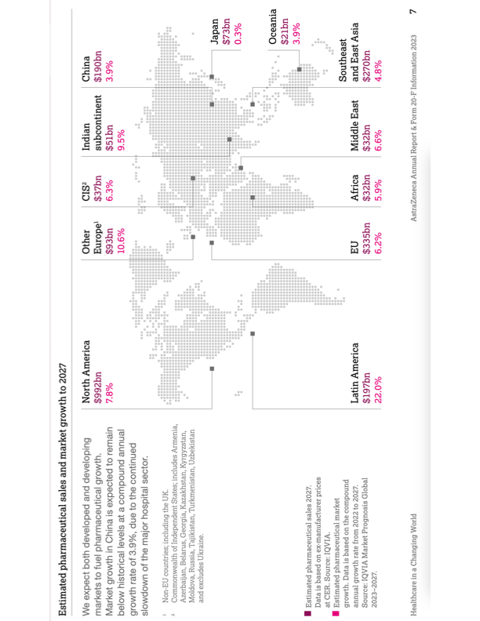

Slide 3
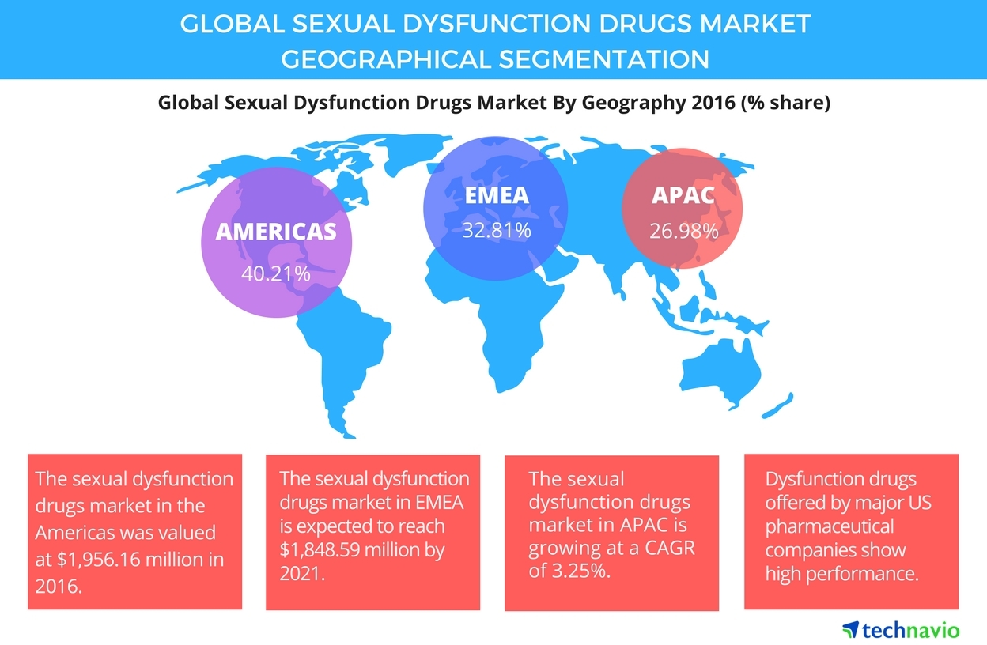
Source: https://www.businesswire.com/news/home/20170912006994/en/Sexual-Dysfunction-Drugs-Market---APAC-to-Offer-Huge-Growth-Potential-Technavio

Slide 5
Leading PDE5 Inhibitors
Sildenafil
(Viagra)
Pfizer
Approved by FDA in 1998
Tadalafil
(Cialis)
Eli Lilly
Approved by FDA in 2003
Vardenafil
(Levitra)
Bayer

Slide 6
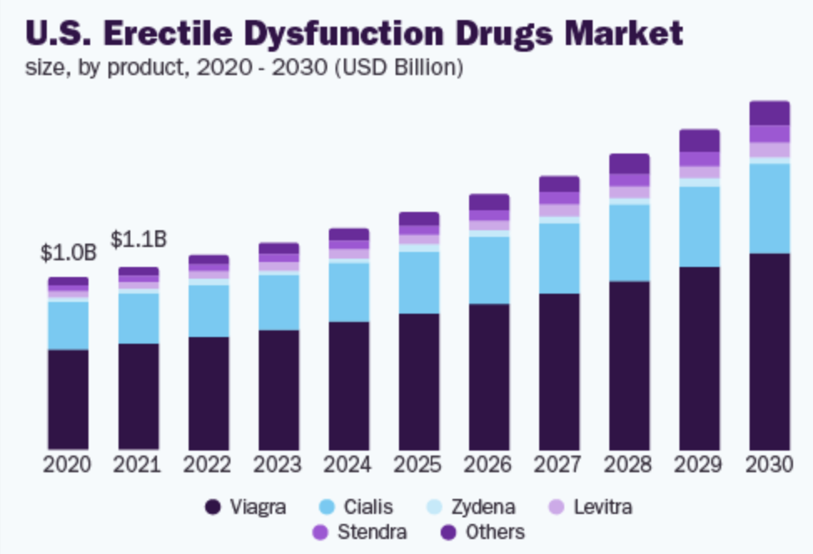
Source: https://www.grandviewresearch.com/industry-analysis/erectile-dysfunction-drugs-market

Slide 7
6
Top 20 branded drugs in the U.S. based on total number of prescriptions in 2014-2015
Cialis
(#12)
Viagra
(#14)

Slide 8
Worldwide revenue of Pfizer's Viagra from 2003 to 2019 (in million U.S. dollars)
2
Patent expired

Slide 9
years
0
4
8
12
16
20
24
28
32
Discovery &
preclinical
Clinical
development
FDA
review
Patent protection
§156
Generic Drug Distribution
Generic Drug Development
FDA review
4
8
12
16
20
Adapted from Choi et al,
“Medicines for the Mind,”
84 Neuron 554 (2014)
Commercial life
FDA
approval

Slide 11
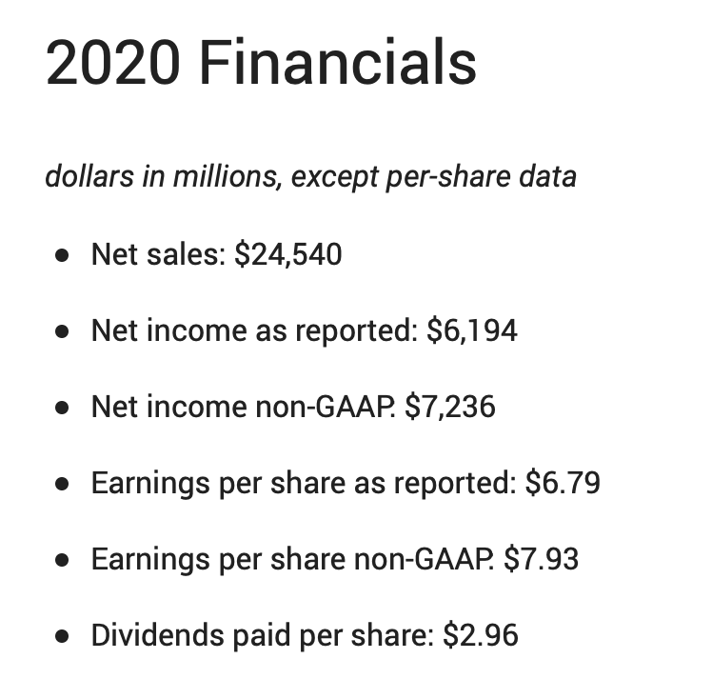

Slide 12
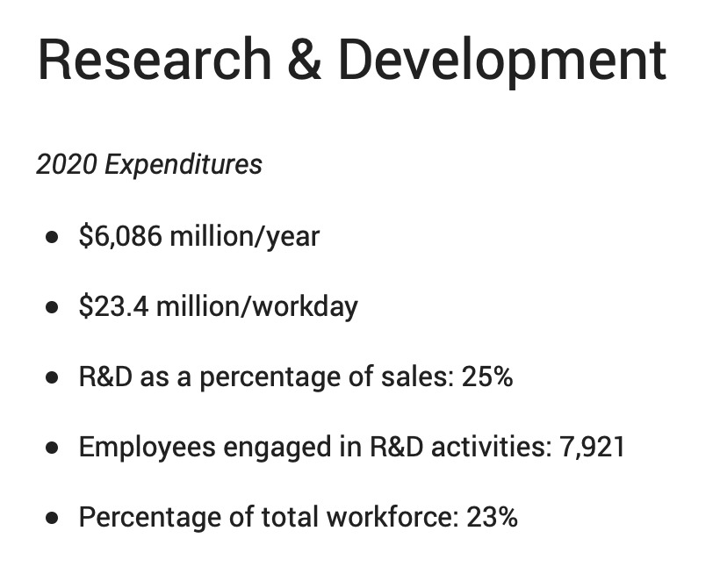

Slide 13
“Evergreening”

Slide 14
Facts
Foundation patent: “[A] patent, whose validity is not challenged, identified [tadalafil] as an efficacious treatment but did not identify an optimal dosage regime.”
expiration date: 2017
Eli Lilly, “which had acquired the patent, conducted extensive research into ascertaining the optimal dosage of the compound. It discovered a dose which not only was safe and effective but also, unexpectedly, could be administered in a new and beneficial manner, because of both the half-life of the compound and its minimal side effects at that dose.”
Lilly sought and was granted a patent in many jurisdictions on the optimal dosage
US application: April 30, 1999
EPO application: April 26, 2000
EPO patent grant: October 15, 2003
“A number of generic drug manufacturers challenge the validity of the dosage patent on the basis that it involves no inventive step.”

Slide 15
The Dosage Patent
Claim 1: “A pharmaceutical unit dosage composition comprising 1 to 5mg of a compound having [the illustrated structural formula of tadalafil] said unit dosage form suitable for oral administration up to a maximum total dose of 5mg per day”.
Claim 6: “the dosage form of any one of claims 1 through 3 for use in treating a condition where inhibition of PDE5 is desirable.”
Claim 7 refers to the dosage form of claim 6 “wherein the condition is a sexual dysfunction”.
(Swiss claim)

Slide 16
“Swiss” claims
“Swiss style claims are a form of claim common in patents for medical treatments that involve the use of a known substance for a new therapeutic treatment. A standard form of Swiss claim is:
‘The use of (relevant substance) in the manufacture of a medicament for the therapeutic treatment of (medical condition)’.
“Swiss claims originated in Europe as a way of circumventing the fact that method of medical treatment claims were not patentable.”
Source: Richard Hoad & Caitlin McCrum, “Full Federal Court shines light on infringement of Swiss style claims,” July 23, 2020

Slide 17
Jurisdiction | Result
Australia | nonobvious
Belgium | obvious
Czech Republic | nonobvious
Denmark | nonobvious
Germany | obvious
Netherlands | obvious
Poland | nonobvious
Portugal | obvious
UK | obvious
US | Settled [expiration in September 2018]

Slide 18
Actavis: UK/EPO Inventive Step Requirement
“Article 56 of the EPO is concerned with the inventive step and provides:
“An invention shall be considered as involving an inventive step if, having regard to the state of the art, it is not obvious to a person skilled in the art. …”
“Section 3 of the 1977 Act, which I set out below, corresponds to this requirement….
“An invention shall be taken to involve an inventive step if it is not obvious to a person skilled in the art, having regard to any matter which forms part of the state of the art by virtue only of section 2(2) above (and disregarding section 2(3) above).”
“Section 2(2) provides:
“The state of the art in the case of an invention shall be taken to comprise all matter (whether a product, a process, information about either, or anything else) which has at any time before the priority date of that invention been made available to the public (whether in the United Kingdom or elsewhere) by written or oral description, by use or in any other way.”

Slide 19
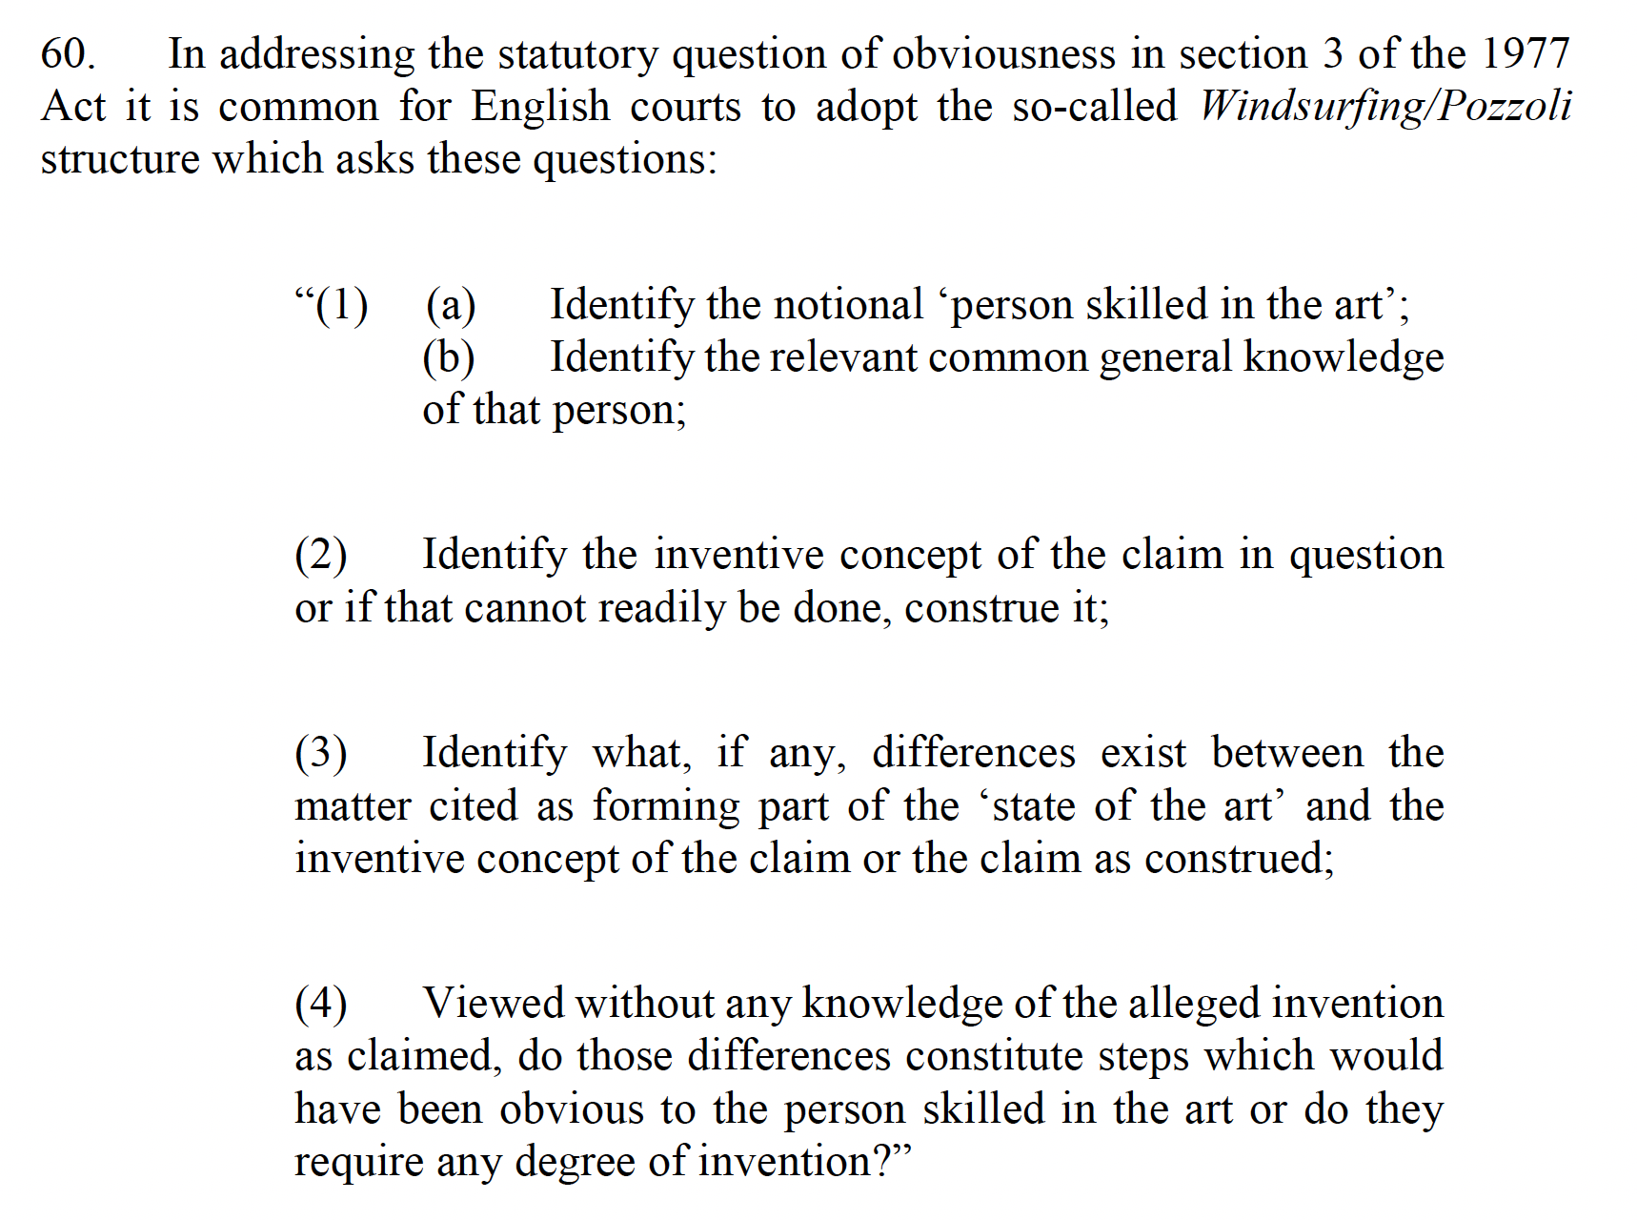
UK Methodology

Slide 20
UK Factors
“whether at the priority date something was “obvious to try”, in other words whether it was obvious to undertake a specific piece of research which had a reasonable or fair prospect of success
“the routine nature of the research and any established practice of following such research through to a particular point
“the burden and cost of the research programme
“the necessity for and the nature of the value judgments which the skilled team would have
“the existence of alternative or multiple paths of research
“the motive of the skilled person
“the fact that the results of research which the inventor actually carried out are unexpected or surprising
“one must not use hindsight, which includes knowledge of the invention
“whether a feature of a claimed invention is an added benefit in a context in which the claimed innovation is obvious for another purpose
“the nature of the invention – e.g., a dosage patent”
“Where inferences from findings of primary fact involve an evaluation of numerous factors, the appropriateness of an intervention by an appellate court will depend on variables including the nature of the evaluation, the standing and experience of the fact-finding judge or tribunal, and the extent to which the judge or tribunal had to assess oral evidence:

Slide 21
Defining the PHOSITA
17. The parties agreed that the notional skilled team, by reference to which the question of the obviousness of the patent in dispute would be assessed, would include a clinical pharmacologist with experience in pharmacokinetics and a clinician specialising in urology. Both were important and would work together. The clinical pharmacologist would take the lead in the quantification of doses and the dose response. The clinician would take the lead when assessing the clinical significance of an effect, whether a desired effect or a side effect. The clinical pharmacologist would be primarily responsible for selecting the doses to be tried in the dose ranging study, with input from the clinician. …
59. The notional skilled person, while having the compendious knowledge of the state of the art which section 2(2) requires, has no inventive capacity. But that does not mean that the skilled person has no skill to take forward in an uninventive way the teaching of the prior art.

Slide 22
Obvious to Try
24. It is not disputed that at the priority date it was entirely obvious for the notional skilled team, given the Daugan patent, to set out taking tadalafil forward into a routine pre-clinical and clinical trial programme as an oral treatment for ED. The statements in Daugan and the huge success of sildenafil as an oral PDE5 inhibitor made it very obvious.

Slide 23
“105. The balance or symmetry in patent law and the pre-established or at least readily foreseeable target of the skilled team’s tests hold the key to the resolution of this dispute. The Daugan patent is ex hypothesi valid and it is not in dispute that it discloses an invention - that is the use of tadalafil in the treatment of ED - in a manner which enables the skilled person to perform it as section 14(3) of the 1977 Act requires. The task which the notional skilled team would undertake was that of implementing Daugan. The target of the skilled team would be to ascertain the appropriate dose, which would usually be the lowest effective dose. The skilled team would know of that target from the outset of its research. The pre-clinical and clinical tests involved familiar and routine procedures and normally progressed to the discovery of the dose-response relationship in Phase IIb. In this case the trial judge’s findings of what would have been the sequence of the tests, which did not depend upon hindsight, included the finding, which the evidence clearly justified, that the team, having found a therapeutic plateau, would be very likely to test lower doses and so come upon the dosage regime which is the subject matter of the patent. For the reasons which I have given above, I am satisfied that the Court of Appeal was entitled to interfere with the trial judge’s assessment of obviousness and to hold that the 181 patent was invalid for lacking an inventive step. ”

Slide 24
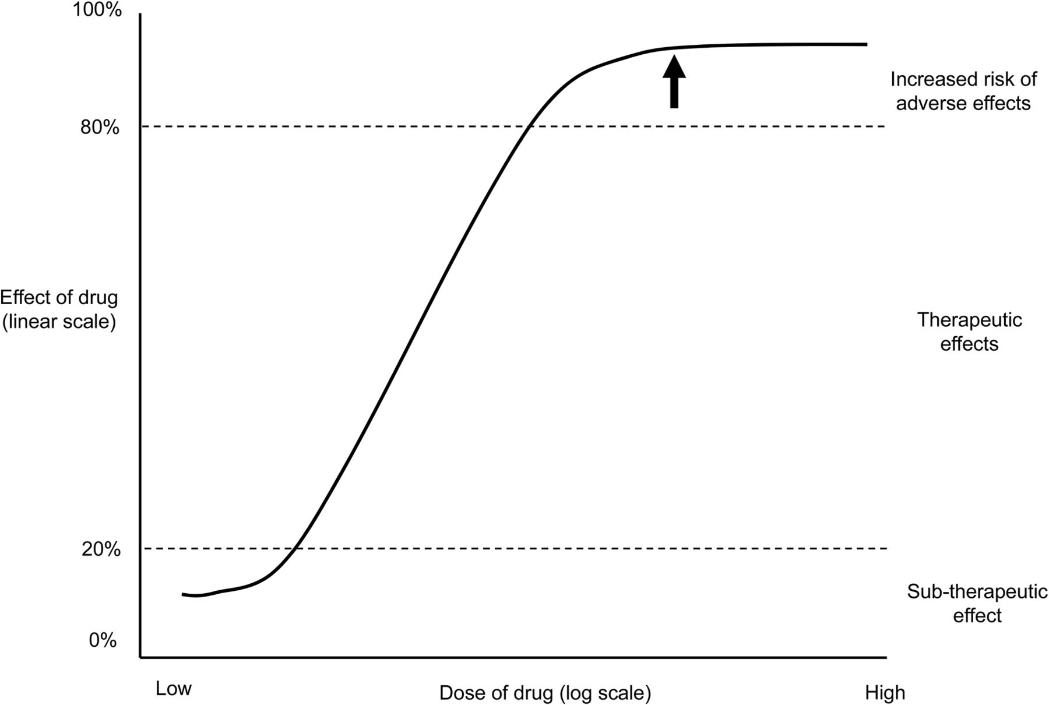
Therapeutic Dose-Response Curve

Slide 25
Conclusion: Obvious

Slide 26
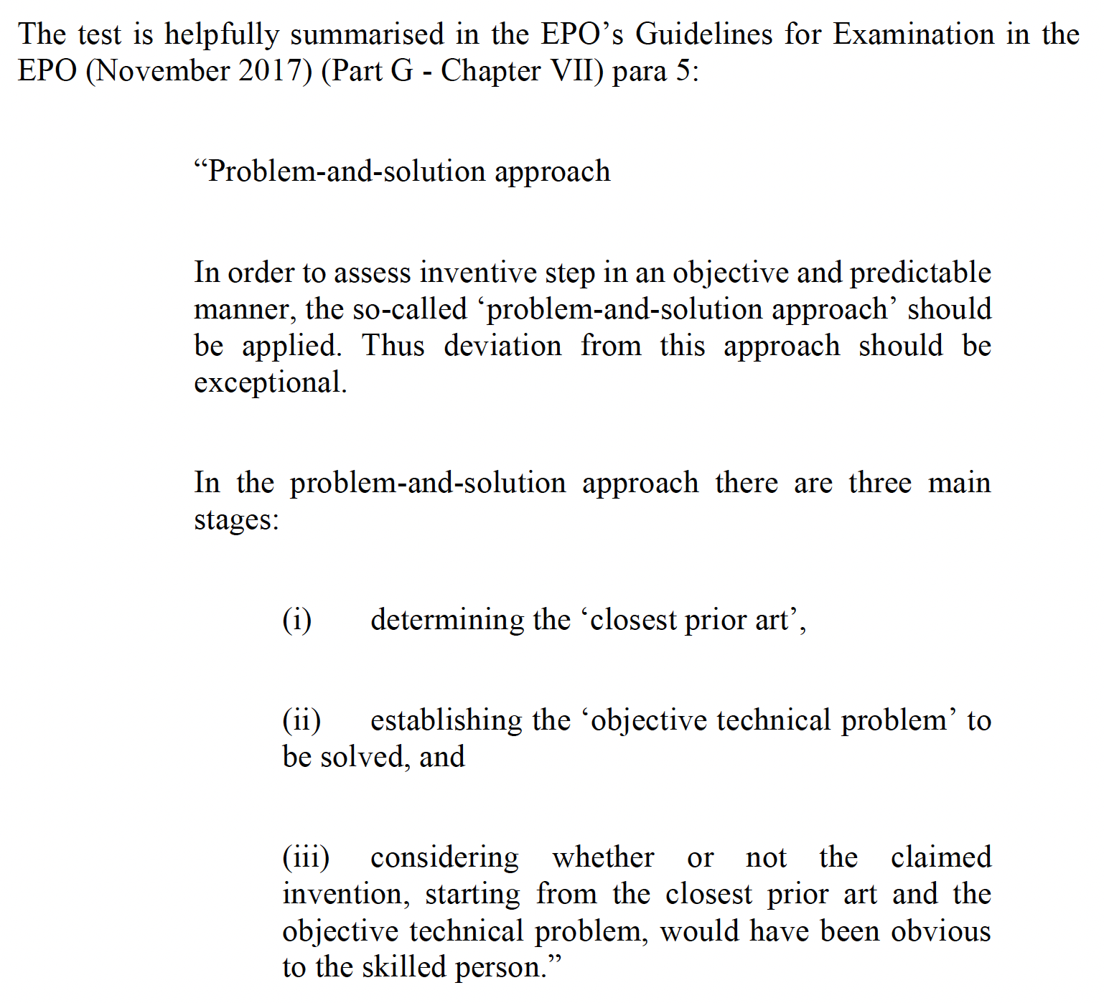
EPO Methodology

Slide 27
EPO Methodology
PHOSITA
The claimed invention
PHOSITA
“Closest Prior Art”
Technical Problem
“Teaching” in the prior art

Slide 28
Applying the EPO Approach
“96. I am not persuaded that the problem-and-solution approach would necessarily give a different answer from that of the Court of Appeal. The closest prior art is the Daugan patent and the well-established procedures of pre-clinical and clinical testing. The problem posed by Daugan was the identification of an appropriate dosage regime. The EPO approach to assessing the obviousness of the claimed invention would then be to apply the “could-would approach”, which means asking not whether the skilled person could have carried out the invention, but whether he would have done so in the hope of solving the underlying technical problem or in the expectation of some improvement or advantage…. The tangible evidence which reveals why the skilled team would have been prompted to come upon the asserted invention is that (a) the team would not have completed the dose-ranging studies which Phase IIb requires if it had stopped after the initial dose-ranging studies which revealed the therapeutic plateau and (b) Dr Saoud’s evidence that it was a “no brainer” to go on with the tests. The judge’s finding that the skilled team would not have had an expectation of effectiveness at a 5mg dose does not militate against the conclusion that the team would have investigated that dose in the course of a sequence of tests which had as its purpose the solution of the underlying technical problem, which the implementation of the Daugan patent entailed.”

Slide 29
US: Reverse-Payment Settlement Agreement

Slide 30
Key provisions of Hatch-Waxman Act (1984)
Extension of patent term to offset FDA approval process – up to 5 years, but no further than 14 years from date of FDA approval (§156)
No liability for making, using, or selling “a patented invention” “solely for uses reasonably related to the development and submission of information” to FDA (§271(e)(1))
Abbreviated New Drug Application procedure (ANDA) for seeking FDA approval for generic equivalent of FDA-approved drug (§271(e)(2)). Applicant must show:
Bioequivalence of the generic and the pioneer drug
No patent impediment to commercial distribution of the generic version
The drug at issue has not been patented
The patent on the drug has expired
Identify the date on which the patent will expire
The patent on the drug is invalid or will not be infringed by the generic

Slide 31
years
0
4
8
12
16
20
24
28
32
Discovery &
preclinical
Clinical
development
FDA
review
Generic Drug Distribution
Patent protection
§156
Generic Drug Development
FDA review
4
8
12
16
20
Adapted from Choi et al,
“Medicines for the Mind,”
84 Neuron 554 (2014)
Commercial life
FDA
approval

Slide 32
US Settlement Press Release
“INDIANAPOLIS, July 12, 2017 /PRNewswire/ -- Eli Lilly and Company (NYSE: LLY) has entered into a settlement agreement with generic companies to resolve pending patent litigation in the U.S. District Court for the Eastern District of Virginia regarding the Cialis® (tadalafil) unit dose patent. This patent was set to expire on April 26, 2020. As part of the agreement, Cialis exclusivity is now expected to end at the earliest on September 27, 2018.
”’The unit dose patent for Cialis is valid and infringed by companies seeking to market a generic version of Cialis. This is a royalty-bearing license agreement that provides us with more certainty regarding our U.S. exclusivity,’" said Michael J. Harrington, senior vice president and general counsel for Lilly. ”’Protection of intellectual property and the assurance of market exclusivity are extremely important to Lilly as we work to support the development of the next generation of innovative medicines.’"
July 12, 2017, to September 27, 2018 = 442 days; September 27, 2018, April 26, 2020 = 577 days.
During the previous year, Lilly had earned from (global) sales of Cialis $2.47 billion.
The “extension” was thus worth roughly $2.99B

