Slide 1
American Axle
PX006
William Fisher
February 2023

Slide 2
The Alice Test for determining whether software is eligible for patent protection in the US
“In Mayo, we set forth a framework for distinguishing patents that claim laws of nature, natu­ral phenomena, and abstract ideas from those that claim patent-eligible applications of those concepts.
“[1] First, we determine whether the claims at issue are directed to one of those patent-ineligible concepts.
“[2] If so, we then ask, ‘[w]hat else is there in the claims before us?’
“To answer that question, we consider the elements of each claim both individually and “as an ordered combination” to determine whether the additional elements “transform the nature of the claim” into a patent-eligible application.
“We have described step two of this analysis as a search for an “‘inventive concept’”—i.e., an element or combination of elements that is “sufficient to ensure that the patent in practice amounts to significantly more than a patent upon the [ineligible concept] itself.”

Slide 3
Discussion Question
In each of the three cases summarized below:
Is the invention in question eligible for patent protection under the Alice test?
Would the extension of patent protection to the invention in question advance or undermine the policies underlying the patent system as a whole?

Slide 4
Geolocation

Slide 5
Summary
“[T]he invention provides a system in which information specific to the location of the user may be shortlisted, thereby filtering out information which relates to other locations. This method provides a basis for various improvements to known information distribution systems.
“Individual sets of information sources may be selected, and dynamically altered, for each user in the system, thereby providing for personalised information distribution which alters the information delivered dynamically in accordance with the location of each of the users.
“The individual set of information sources may be further filtered with user-specific preference information pre-stored for each user.
“Dual filtering, both according to the location of the user and in accordance with pre-stored preference information, can be used to provide particularly useful shortlists whereby the level of expected interest to a user of the information sources selected can be maintained at a high level, whilst nevertheless deriving information from a wide variety of sources.”

Slide 6
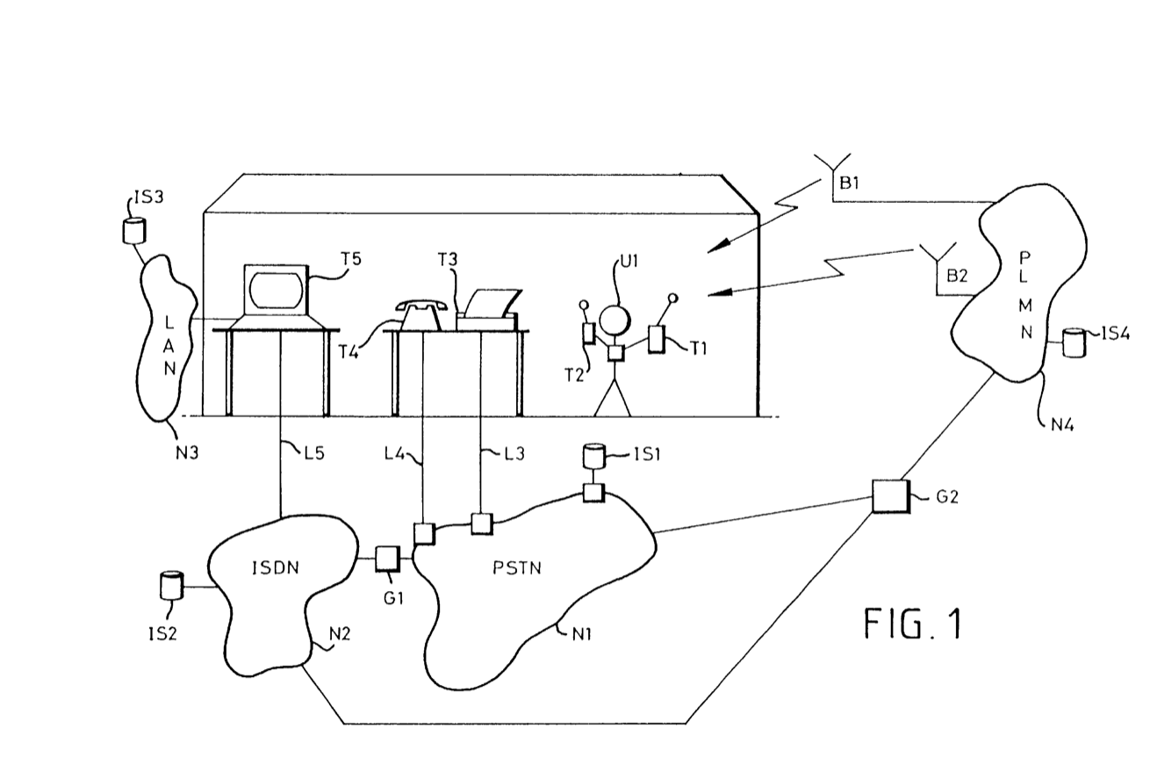
Drawings
“The user U1 carries a tracking device via which his position within the telecommunications environment may be tracked. For example, in this embodiment the tracking device P1 comprises a chip carrying card or “smart card” carrying data identifying the user, and some or all of the terminals T1-T5 carrying a card reader arranged to read the card. Alternatively, it could comprise a ‘smart badge’ transponder, the location of which is tracked within the building.
“Specifically, the workstations T5-T5 and the cellular telephone T1 carry such smart card readers. Additional smart card readers are installed at access doors within the building, and are connected to the LAN N3 to signal thereon.”

Slide 7
Claims (1 of 44)
What is claimed is: 1. A method of selecting information sources from which information is provided to users via a telecommunications system, said method comprising:
tracking the location of a user in the system by receipt of tracking information for said user;
accessing location data indicating localities in which information from the respective sources is deemed to be relevant;
generating a shortlist of information sources for said user on the basis of said tracking information and said location data; and
transmitting said shortlist to a terminal associated with said user so as to allow said user to select an information source of interest and thereby to access information from said source.

Slide 8
Procedure
April 14, 1997: UK patent application by British Telecomm
April 9, 1998: PCT application
May 28, 2002: US6391040 patent issued
March 2018: British Telecomm brings suit in District of Delaware against IAC, Tinder, and Vimeo, asserting violation of several patents, including US6391040:
Complaint: “4. With respect to Tinder, for example, one of the asserted BT patents covers Tinder’s geographical proximity-based identification of potential matches, which is a primary attraction for most Tinder users and a primary selling point for IAC in marketing the Tinder product/service. Indeed, IAC’s tagline for marketing Tinder is allowing users to “Meet new and interesting people nearby.” https://tinder.com/app/login. See Fig. 1 (Tinder Mobile Application).

Slide 9
Procedure
April 14, 1997: UK patent application by British Telecomm
April 9, 1998: PCT application
May 28, 2002: US6391040 patent issued
March 2018: British Telecomm brings suit in District of Delaware against IAC, Tinder, and Vimeo, asserting violation of several patents, including US6391040
Defendants file 12(b)(6) motion, contending that the patent is invalid because it covers unpatentable subject matter

Slide 10
CardioNet

Slide 11
Invention
A device to warn a person of problematic heartbeat rhythm
“The ’207 patent describes cardiac monitoring systems and techniques for detecting and distinguishing atrial fibrillation and atrial flutter from other various forms of cardiac arrythmia.”

Slide 12
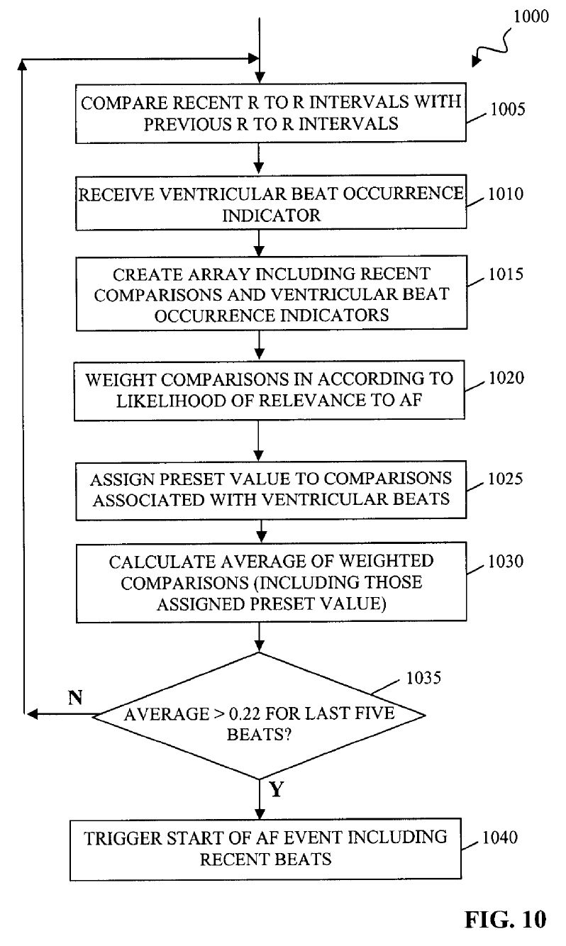
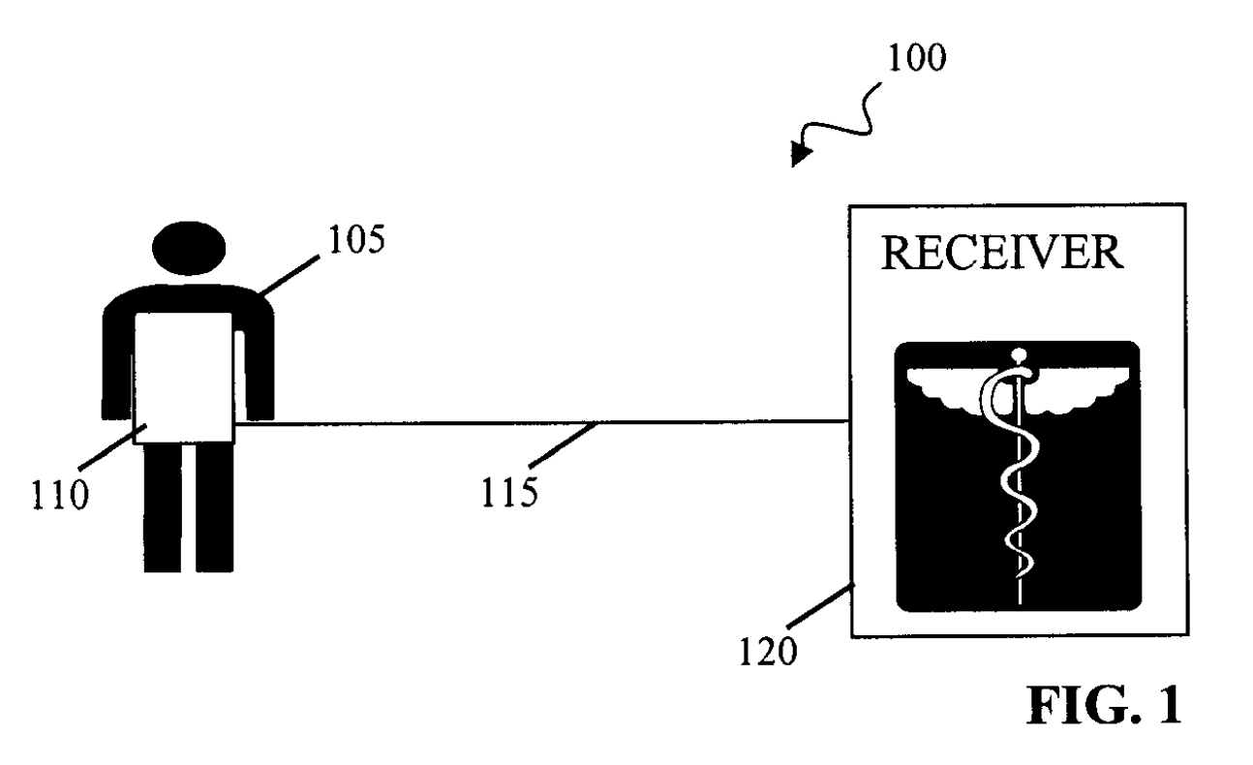
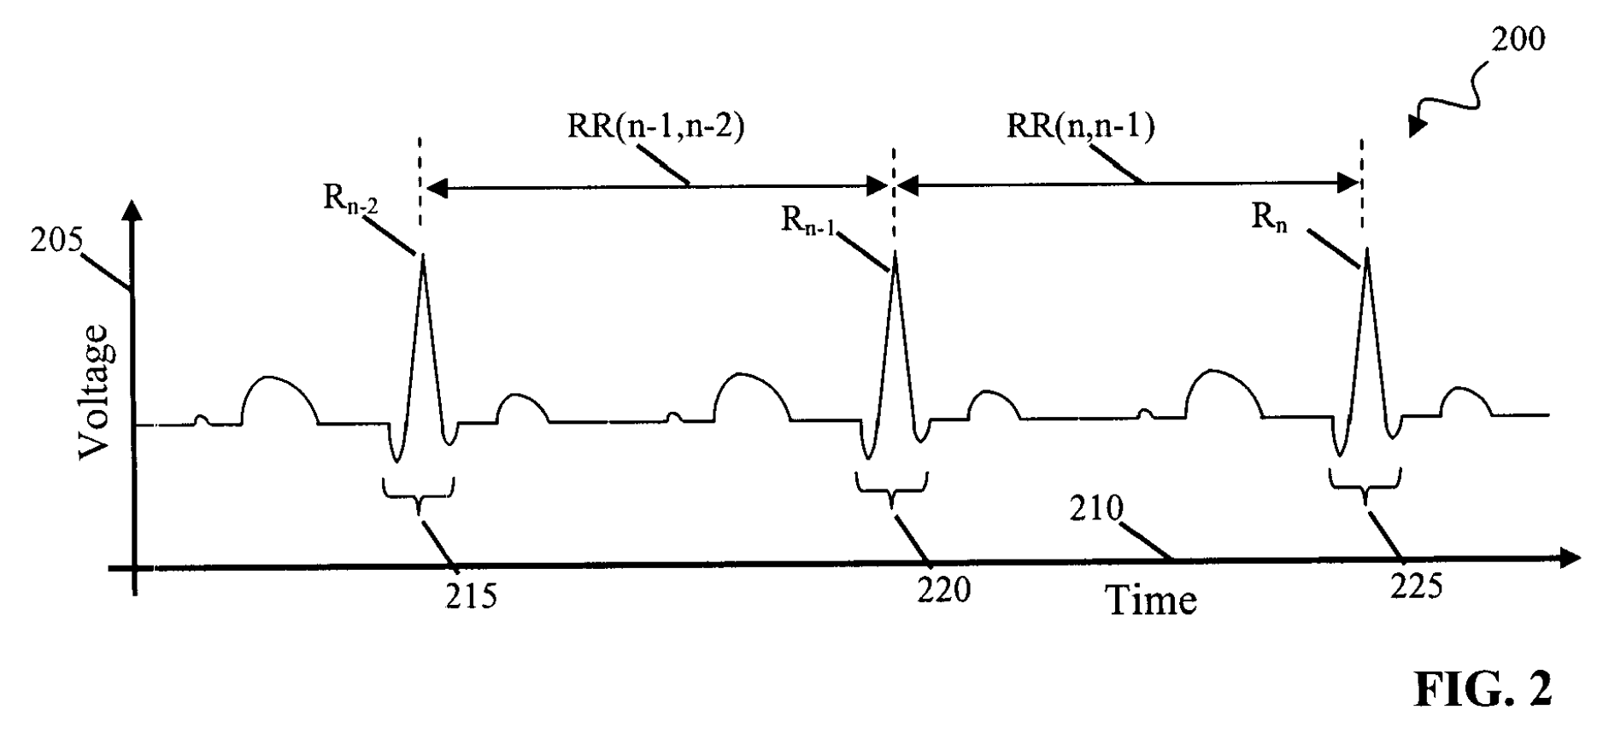
Drawings

Slide 13
Claims (1 of 25)
What is claimed is:
1. A device, comprising:
A beat detector to identify a beat-to-beat timing of cardiac activity;
A ventricular beat detector to identify ventricular beats in the cardiac activity;
Variability determination logic to determine a variability in the beat-to-beat timing of a collection of beats;
Relevance determination logic to identify a relevance of the variability in the beat-to-beat timing to at least one of atrial fibrillation and atrial flutter; and
An event generator to generate an event when the variability in the beat-to-beat timing is identified as relevant to the at least one of atrial fibrillation and atrial flutter in light of the variability in the beat-to-beat timing caused by ventricular beats identified by the ventricular beat detector.

Slide 14
American Axle

Slide 15
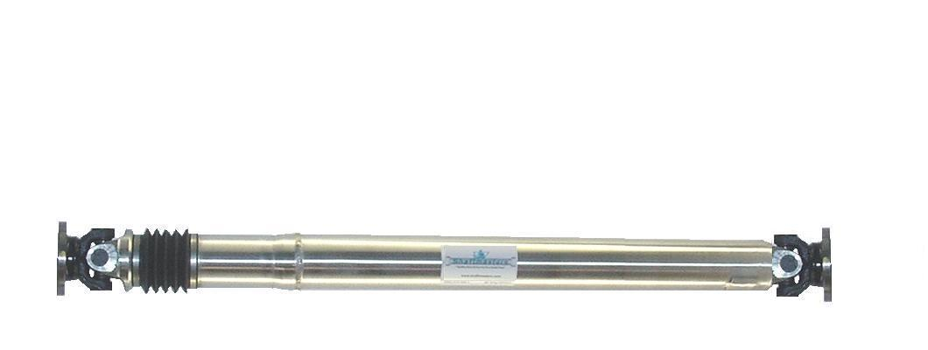
Driveshaft (for Ford Mustang)

Slide 16
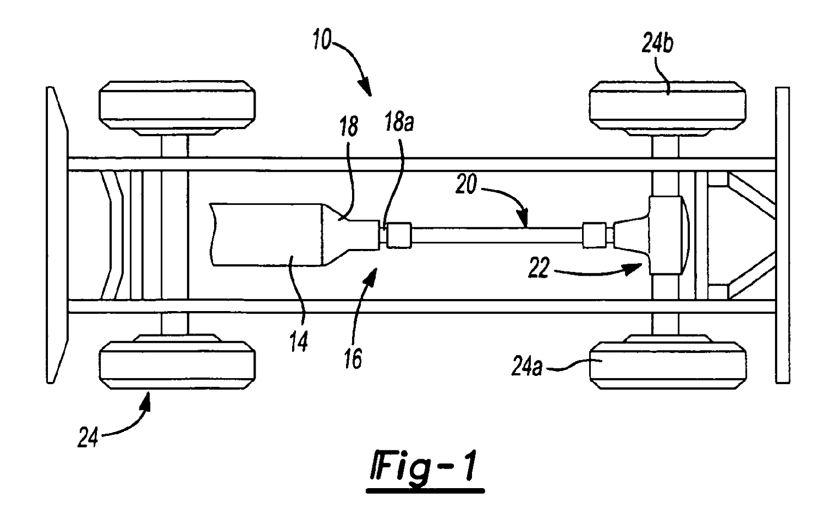

Slide 17
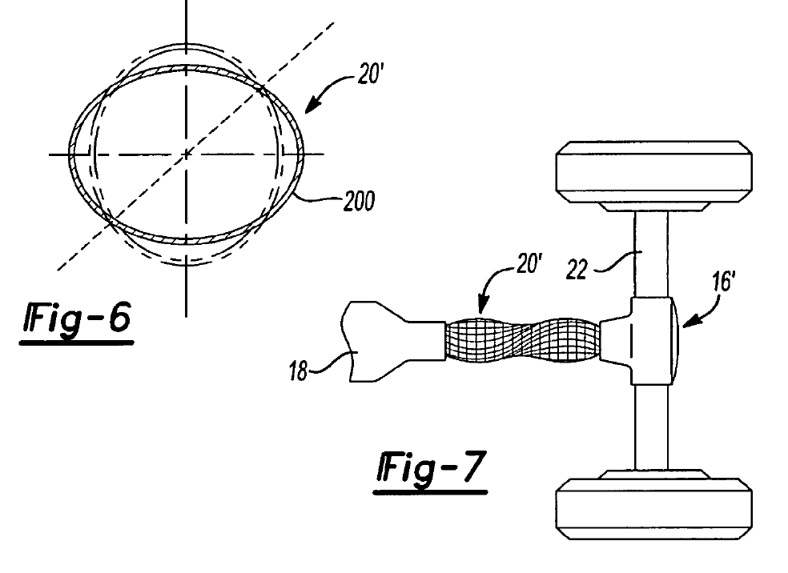
Problem
Driveshafts are susceptible to vibration of three types:
Shell
Torsional
Bending

Slide 18
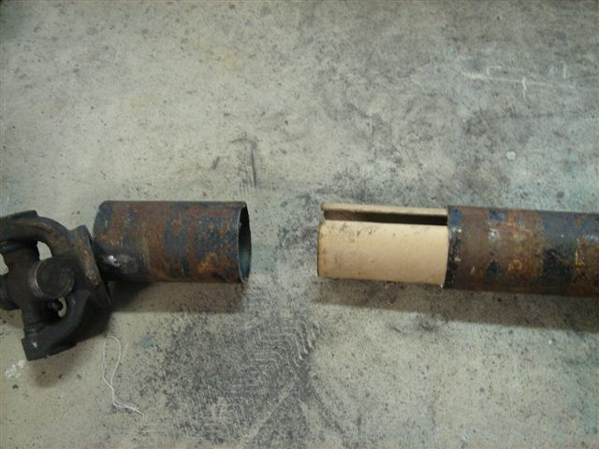
Driveshaft (for Chevrolet Corvette)

Slide 19
Invention
A method for shaping a liner for a drive shaft that will enable it to dampen both bending vibration and shell vibration simultaneously

Slide 20
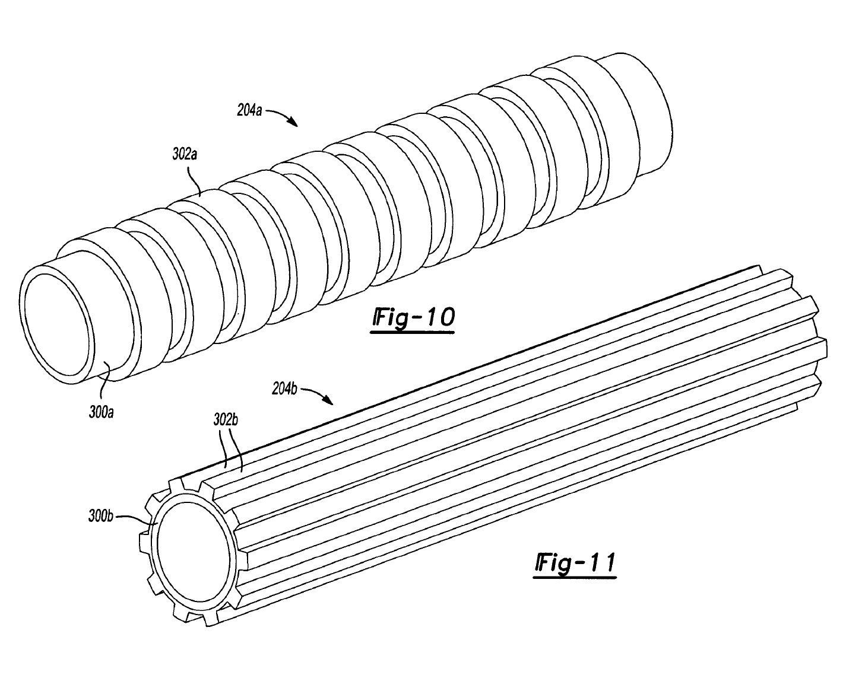

Slide 21
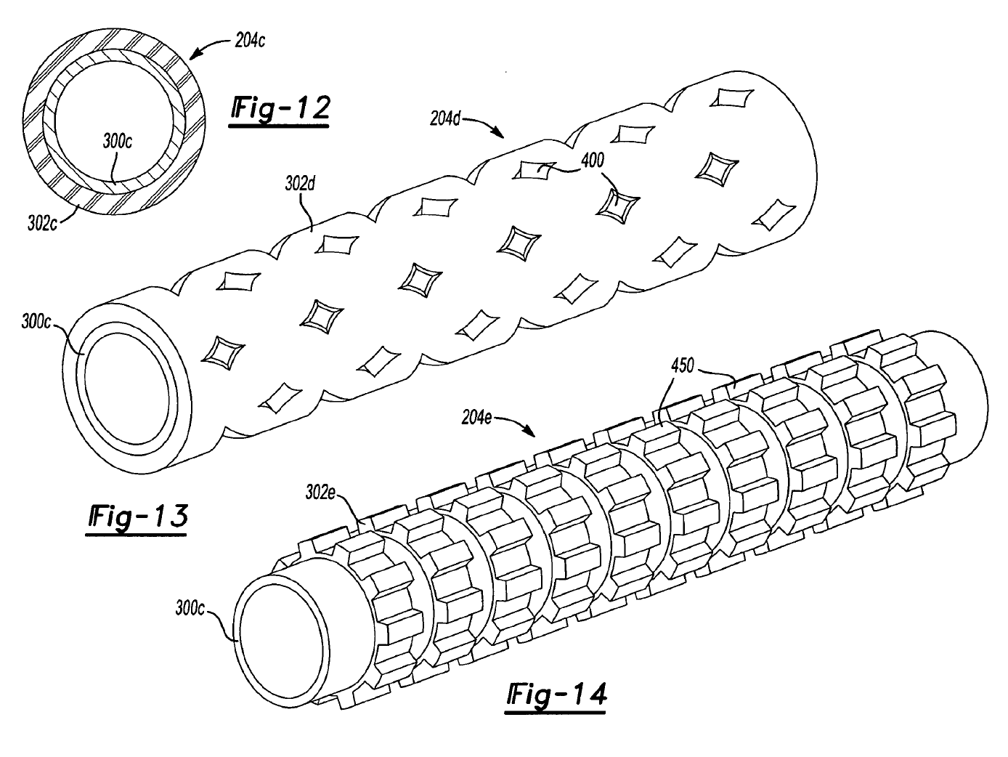

Slide 22
Claim 22
A method for manufacturing a shaft assembly of a driveline system, the driveline system further including a first driveline component and a second driveline component, the shaft assembly being adapted to transmit torque between the first driveline component and the second driveline component, the method comprising:
providing a hollow shaft member;
tuning a mass and a stiffness of at least one liner, and
inserting the at least one liner into the shaft member;
wherein the at least one liner is a tuned resistive absorber for attenuating shell mode vibrations and wherein the at least one liner is a tuned reactive absorber for attenuating bending mode vibrations.

Slide 23
Procedure
February 2006: US patent application filed
August 2010: Patent granted
December 2015: AA brings suit against Neapco
Parties file cross motions for summary judgment with respect to section 101

Slide 24
Scientific Bases of the Invention
“Hooke’s law is an equation that describes the relationship between an object’s mass, its stiffness, and the frequency at which the object vibrates.
“Friction damping is a natural phenomenon whereby damping ‘occur[s] due to the resistive friction and interaction of two surfaces that press against each other as a source of energy dissipation.’”

