Slide 1
Design Patents Case Study 104
Patent^{x}
William Fisher
March 2024
Licensed under terms available at https://ipxcourses.org

Slide 2
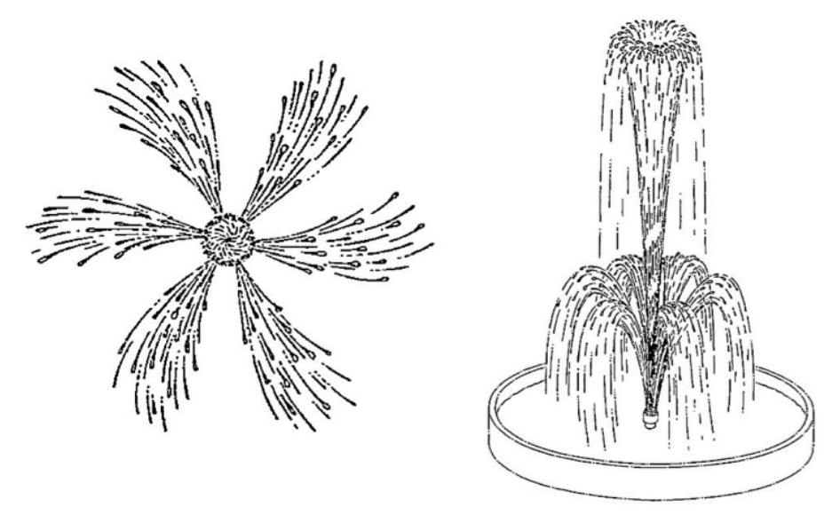
In re Hruby (CCPA 1967)

Slide 3
Avia Group v. LA Gear

Slide 4
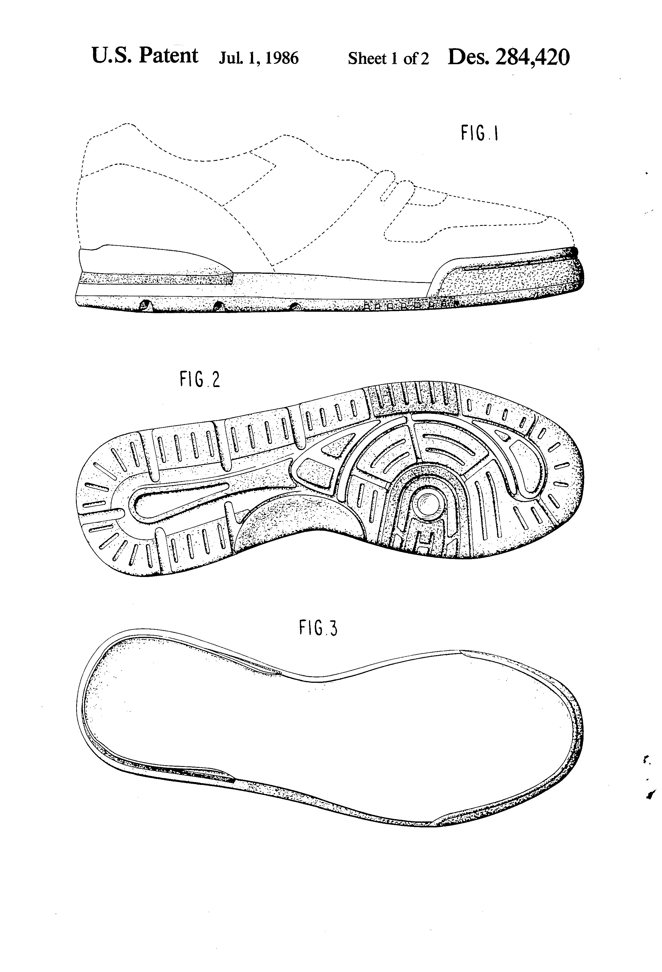
Design Patent 284,420
Claim: “The ornamental design for a shoe sole, as shown and described.”
FIG. 1 is a left side elevational view of a shoe sole showing my new design, the broken line showing of a shoe being environmental only and forms no part of the claimed design;
FIG. 2 is a bottom plan view thereof; FIG. 3 is a top plan view thereof; FIG. 4 is a right side elevational view thereof; FIG. 5 is a rear elevational view thereof; and FIG. 6 is a front elevational view thereof.

Slide 5
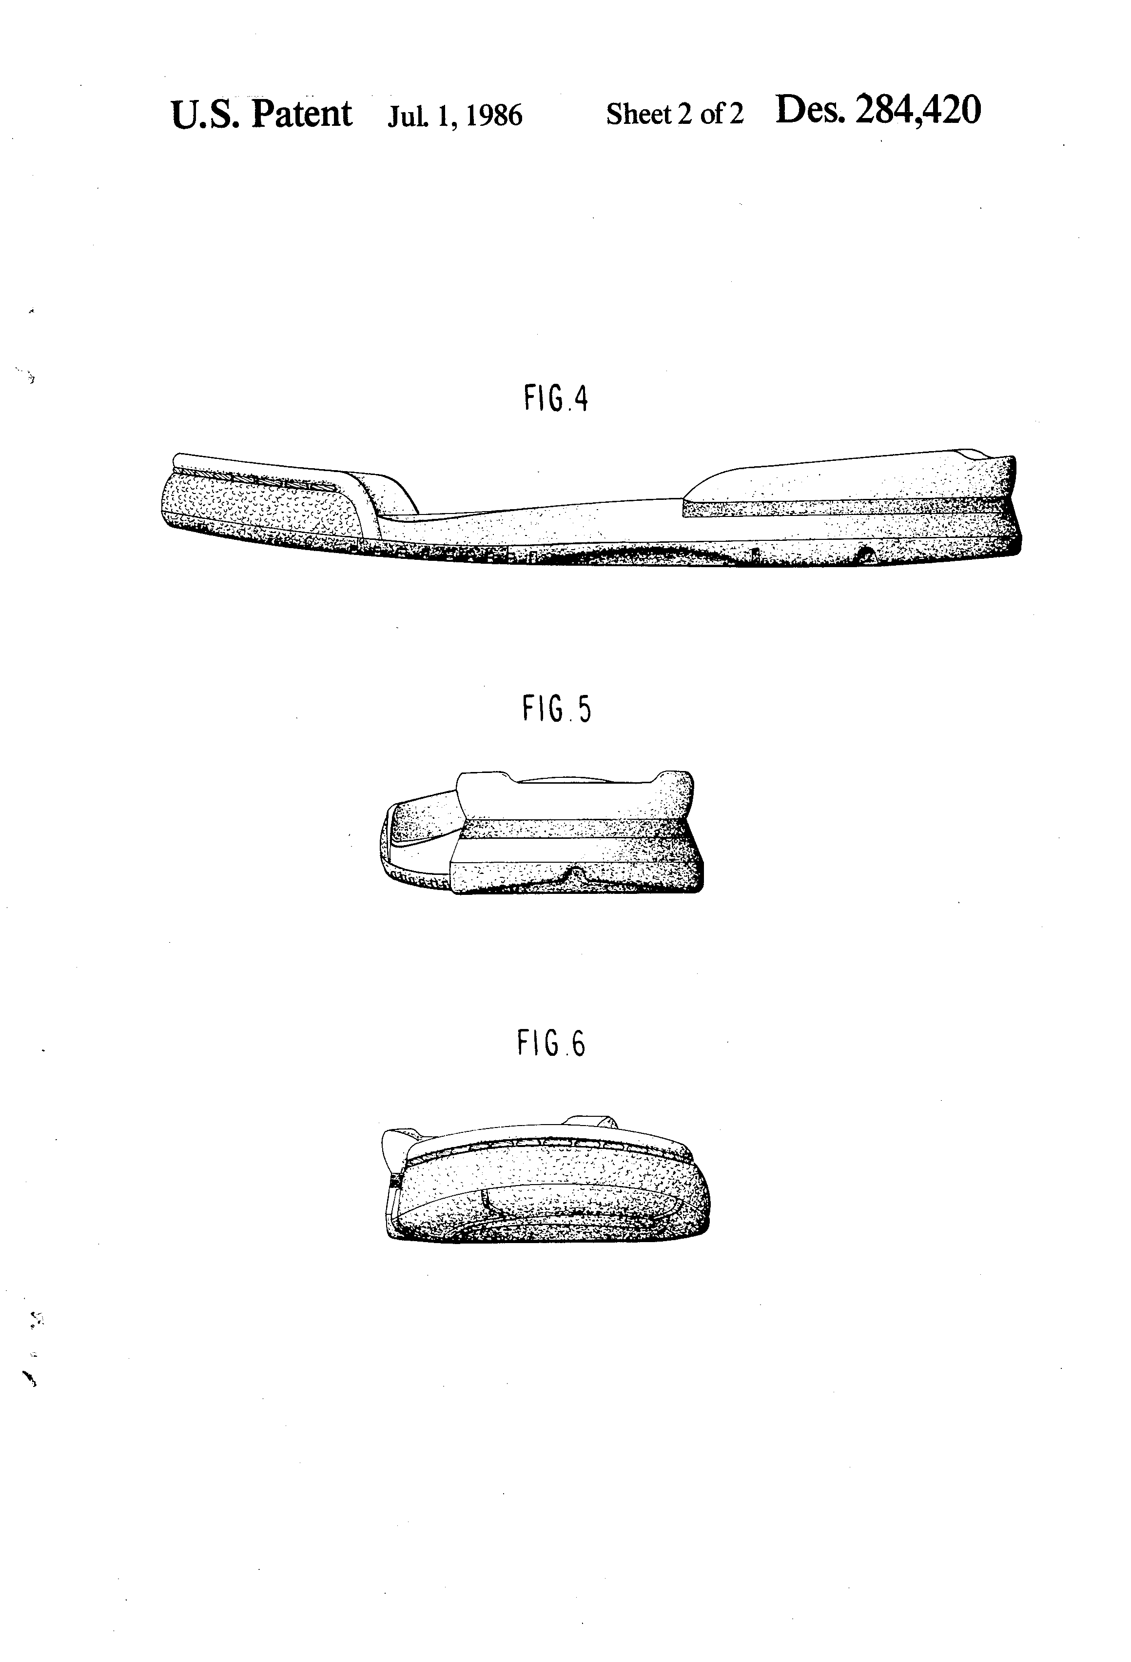
Design Patent 284,420
Claim: “The ornamental design for a shoe sole, as shown and described.”
FIG. 1 is a left side elevational view of a shoe sole showing my new design, the broken line showing of a shoe being environmental only and forms no part of the claimed design;
FIG. 2 is a bottom plan view thereof; FIG. 3 is a top plan view thereof; FIG. 4 is a right side elevational view thereof; FIG. 5 is a rear elevational view thereof; and FIG. 6 is a front elevational view thereof.

Slide 6
Ethicon

Slide 7
Explanation of the technology
https://youtu.be/dR0H9no9yME

Slide 8
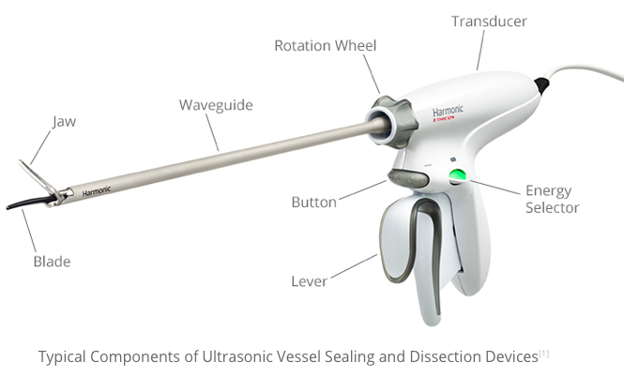
Source: http://www.twomeyconsulting.com/ultrasonic-vessel-sealing-dissection-devices/

Slide 9
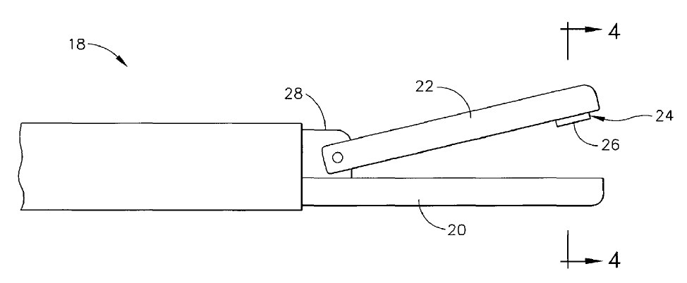
US8182501

Slide 10
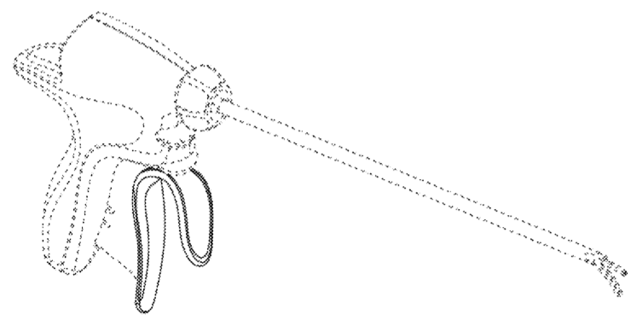
D’501

Slide 11
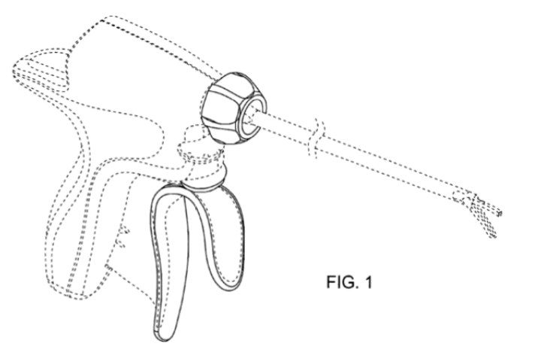
D’504

Slide 12
Apple (CAFC 2012)

Slide 13
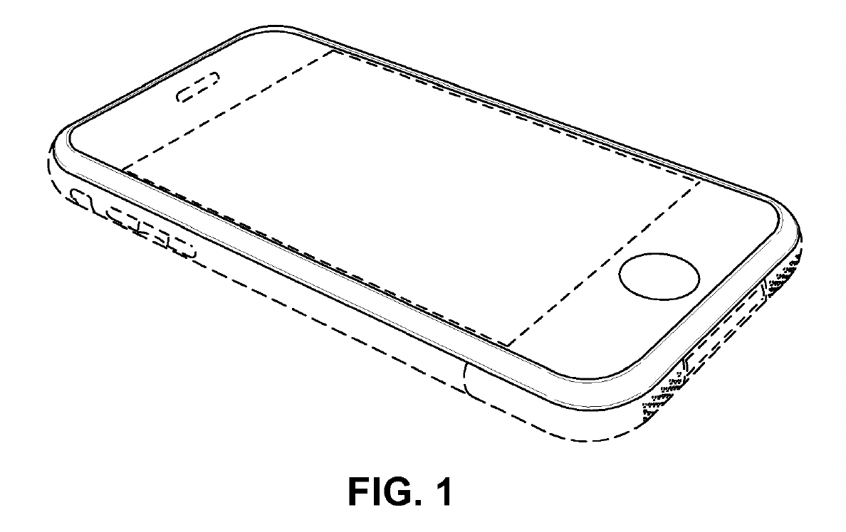

Slide 14
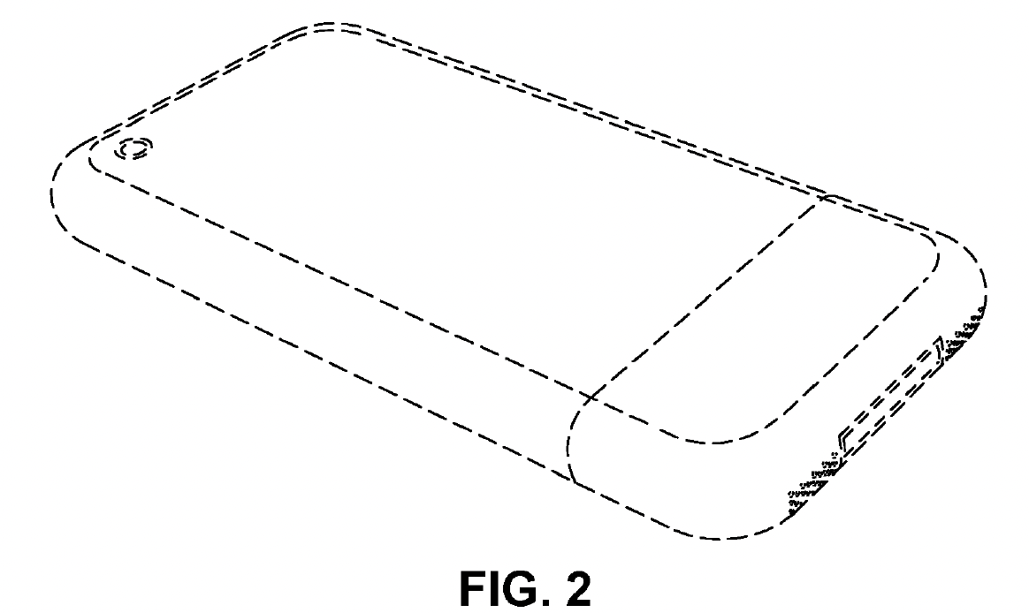

Slide 15
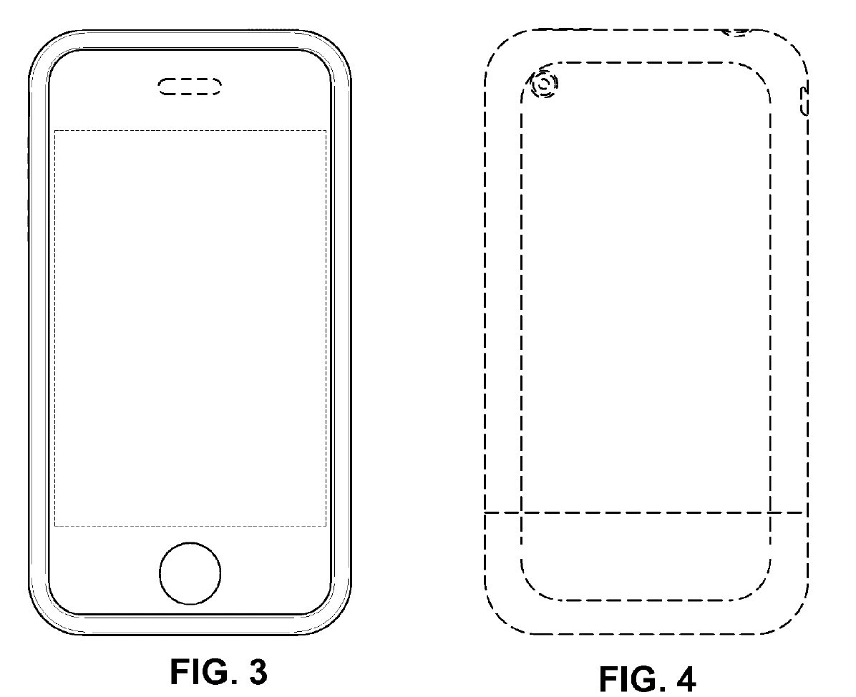

Slide 16
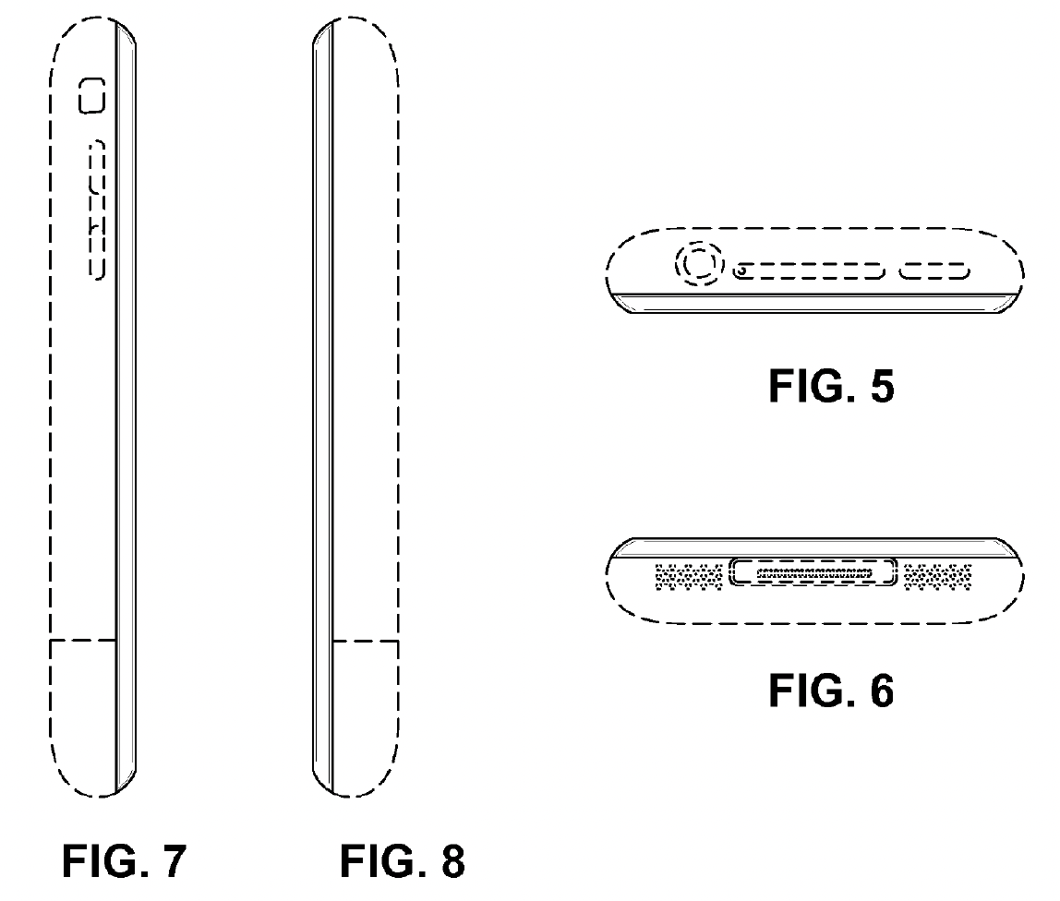

Slide 17
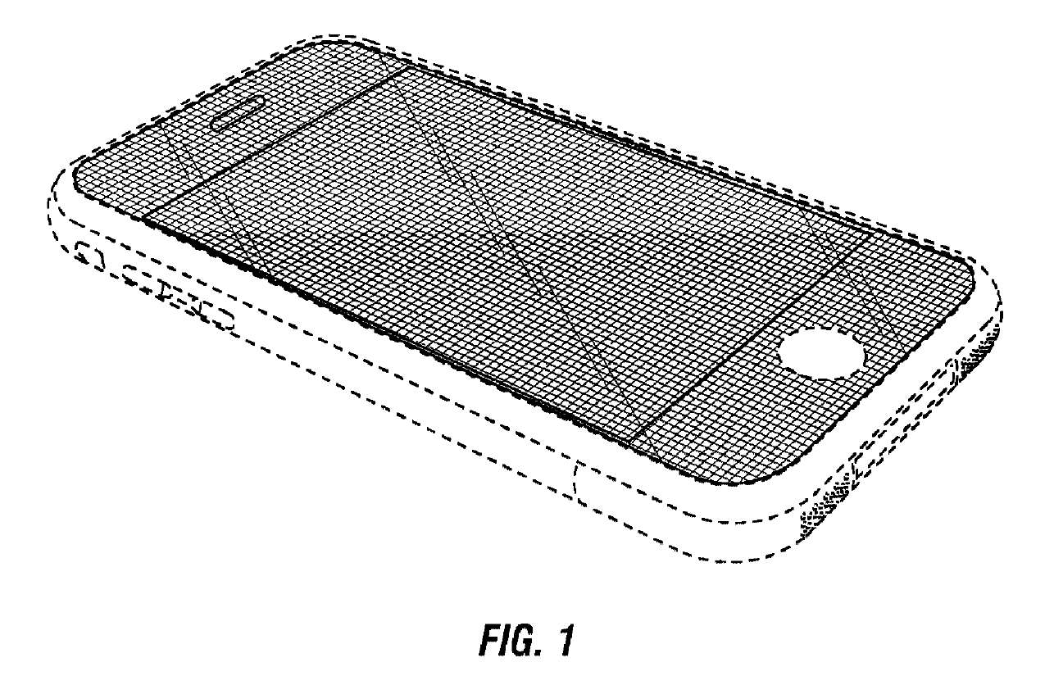

Slide 18
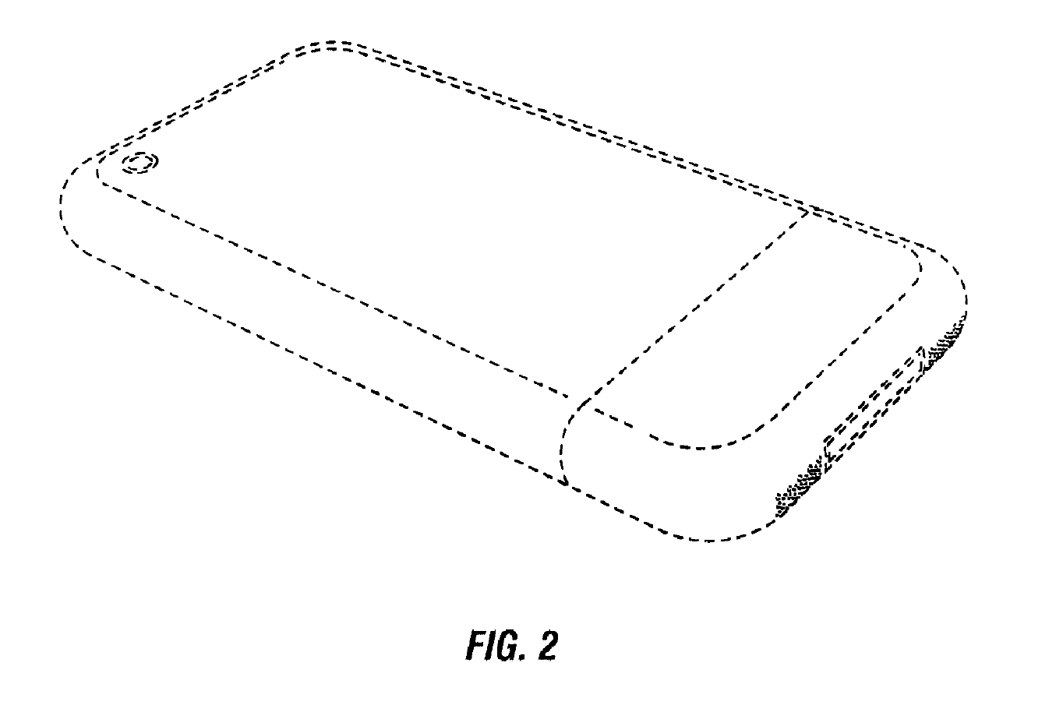

Slide 19
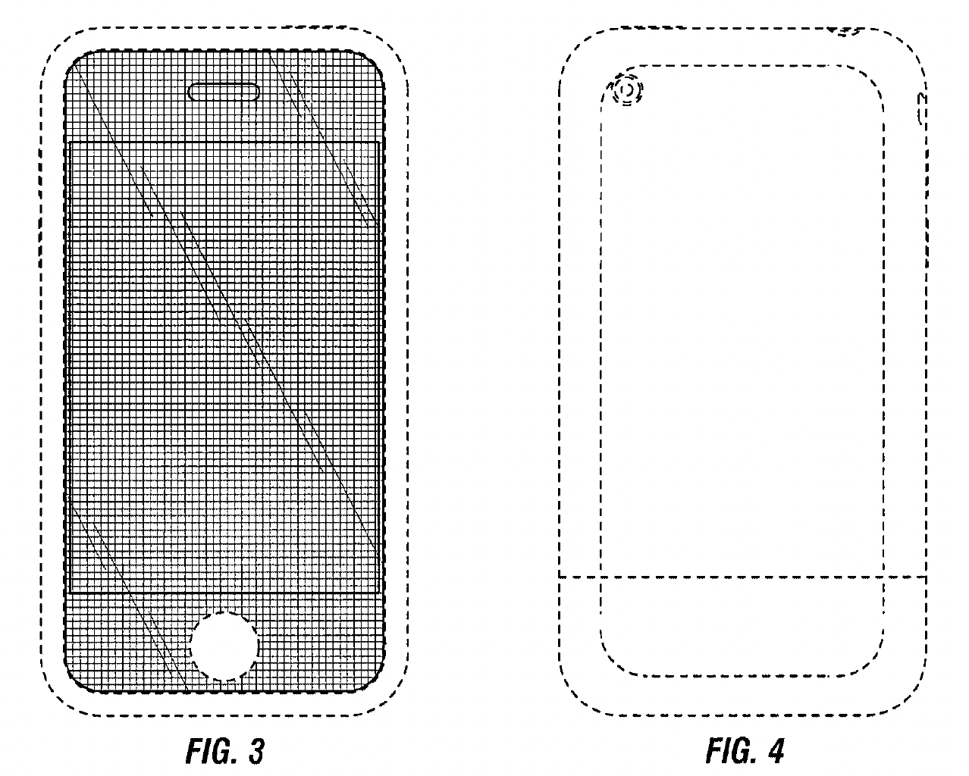

Slide 20
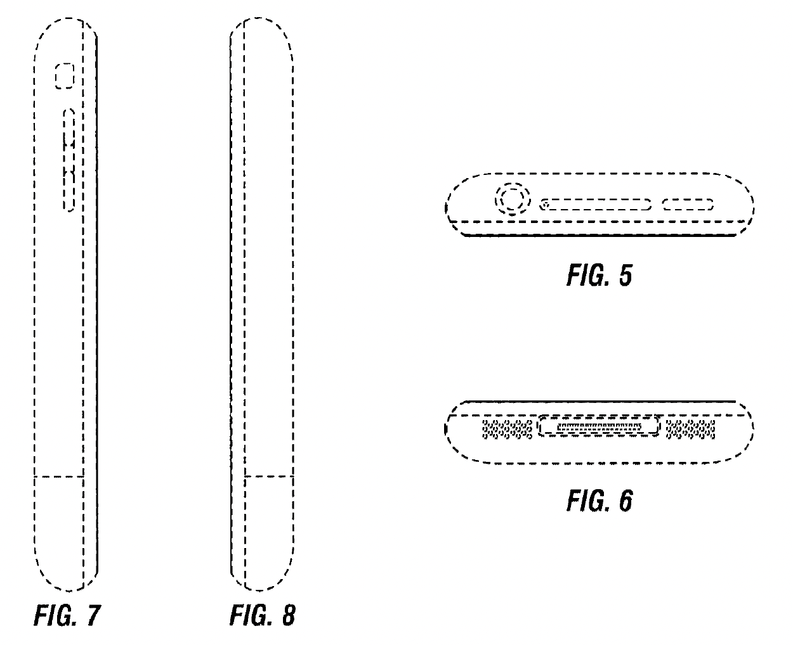

Slide 21
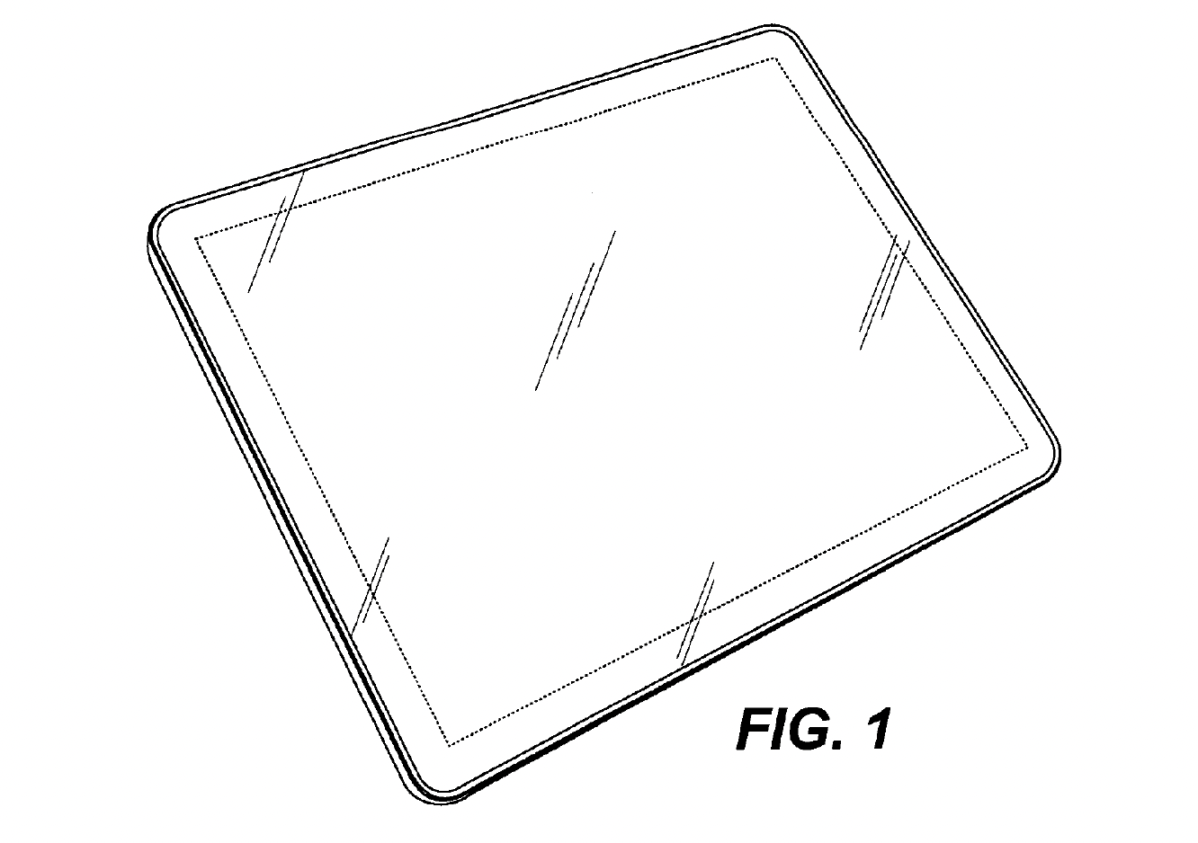
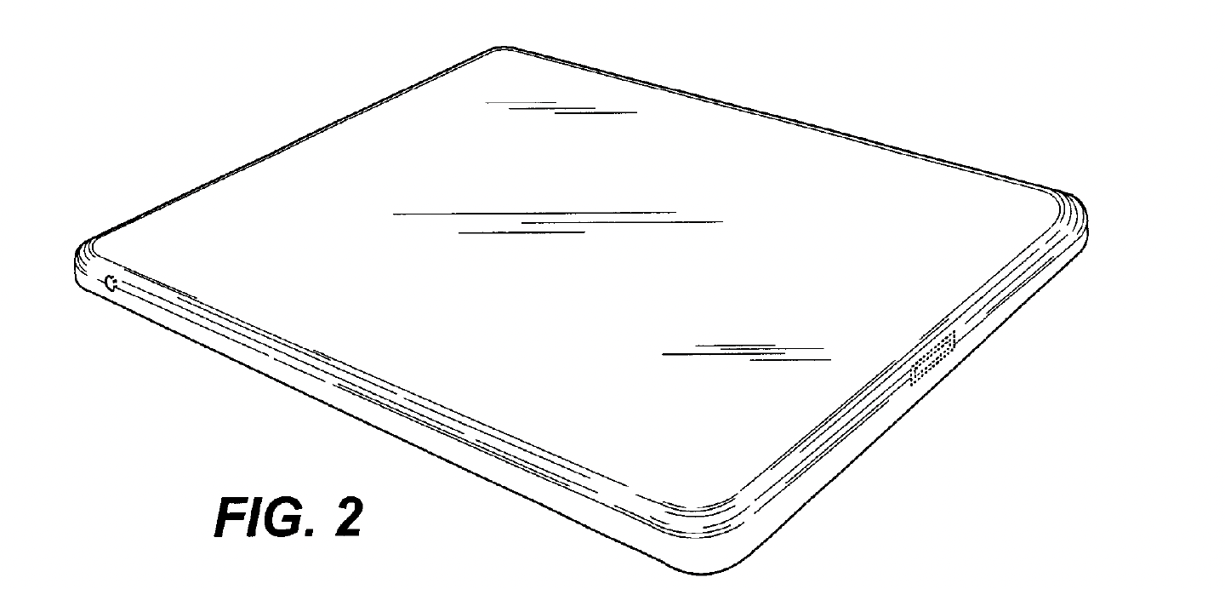

Slide 22
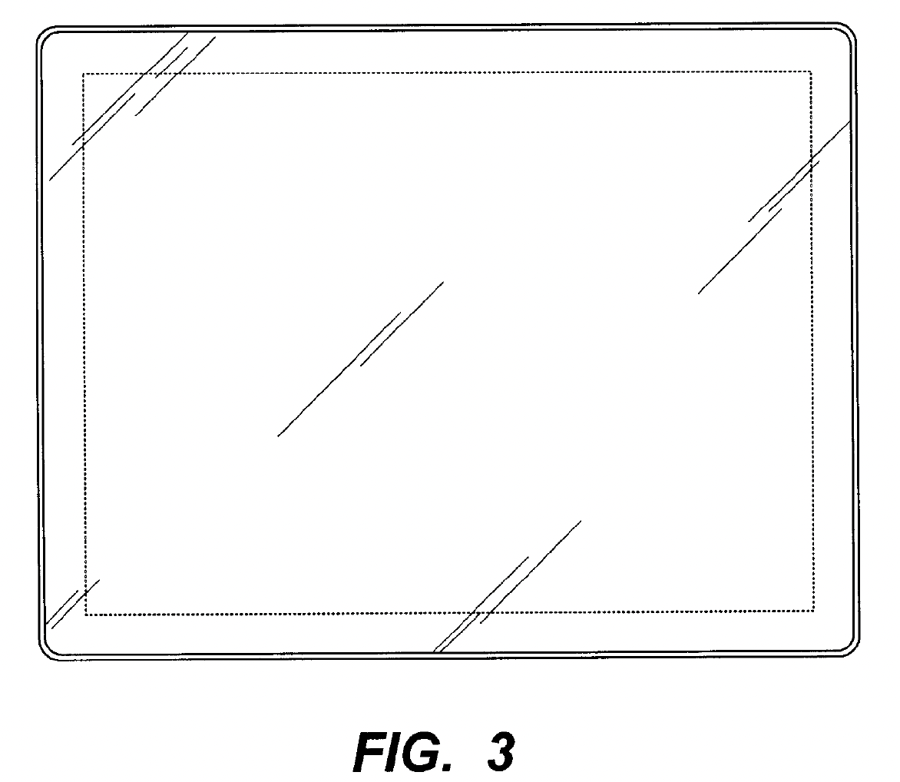
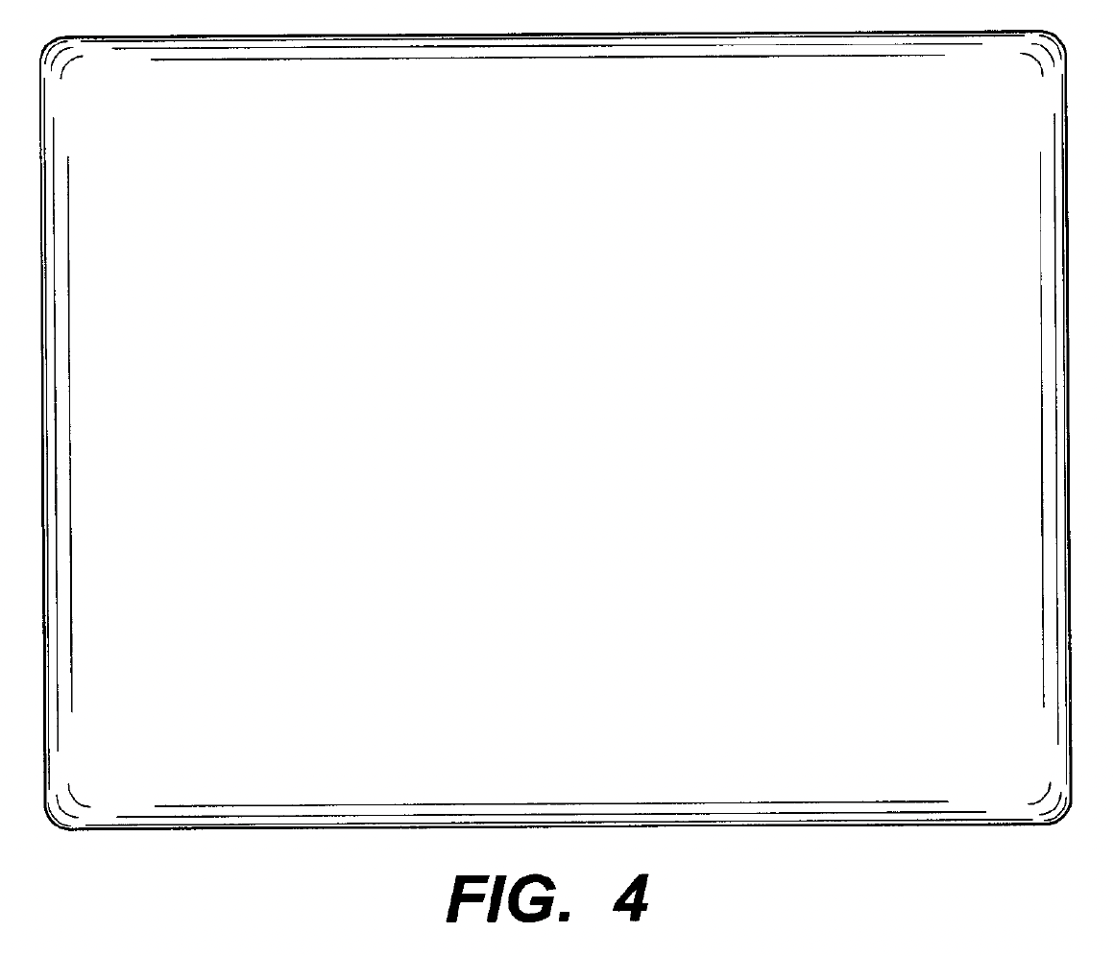

Slide 23
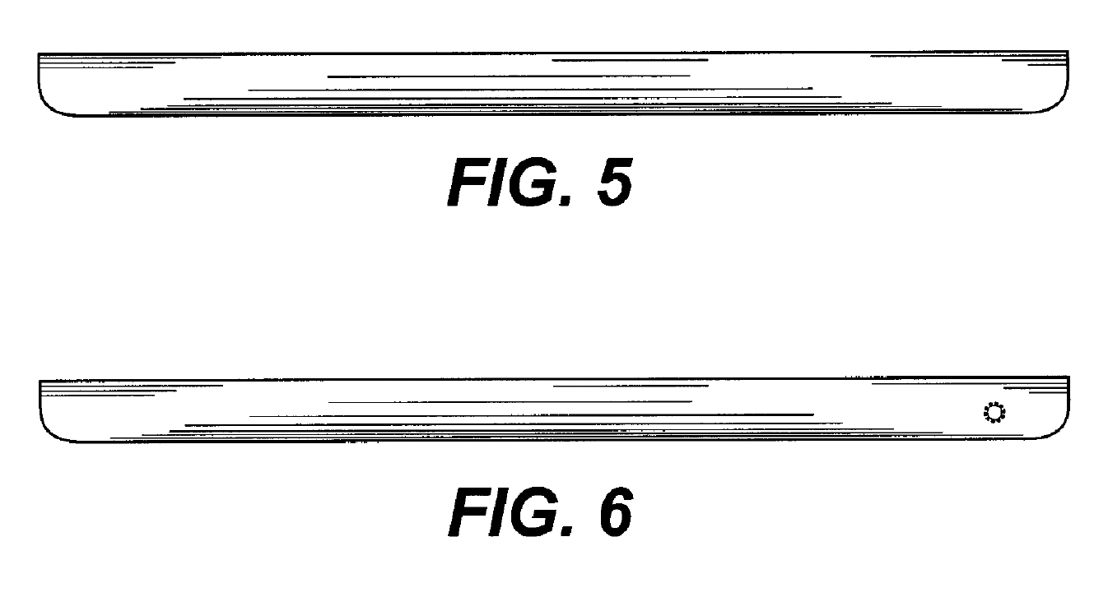
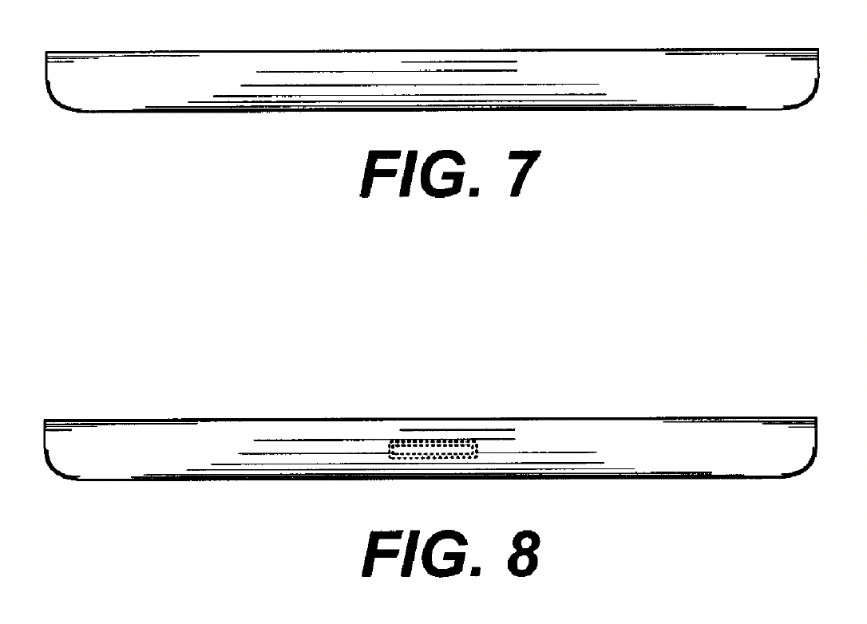

Slide 24
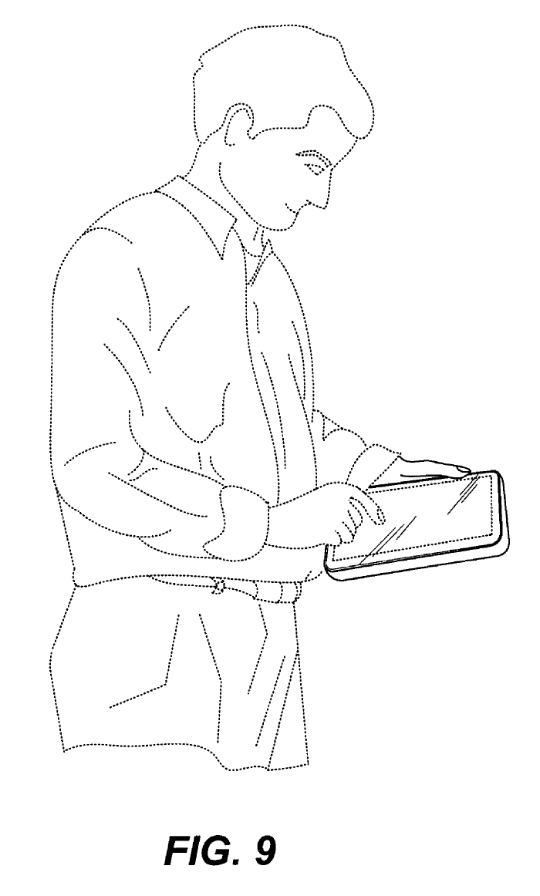

Slide 25
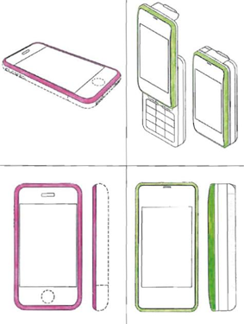
Novelty
D’087 Patent
Japanese
‘638 Patent

Slide 26
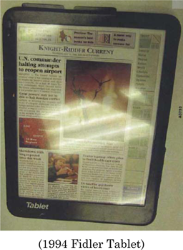
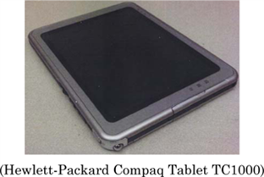
Nonobviousness
D’889 Patent

Slide 27
(Outmoded) “Point of Novelty” Test

Slide 28
Prior Art

Slide 29
Prior Art
Patented
Design
Novel features
Novelty & Nonobviousness concern
relationship between red and blue zones

Slide 30
Prior Art
Patented
Design
Defendant’s
Product
Infringement concerns
relationship between yellow and blue zones

Slide 31
Prior Art
Patented
Design
Novel features
Under point-of-novelty test, this is infringement

Slide 32
Prior Art
Patented
Design
Defendant’s
Product
Novel features
Under point-of-novelty test, this is not infringement

Slide 33
Litton v. Whirlpool (CAFC 1984)

Slide 34
Prior Art

Slide 35
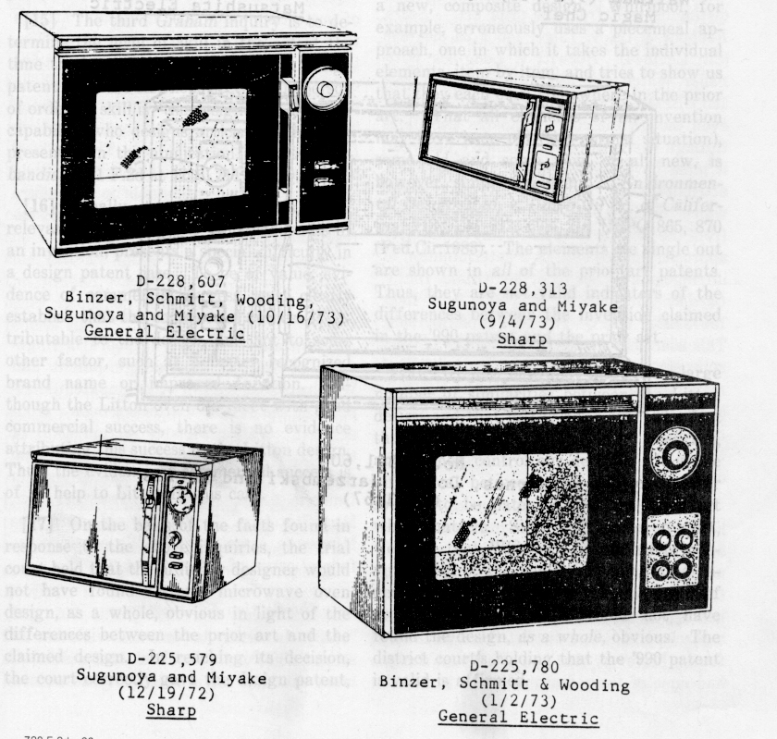
Prior Art

Slide 36
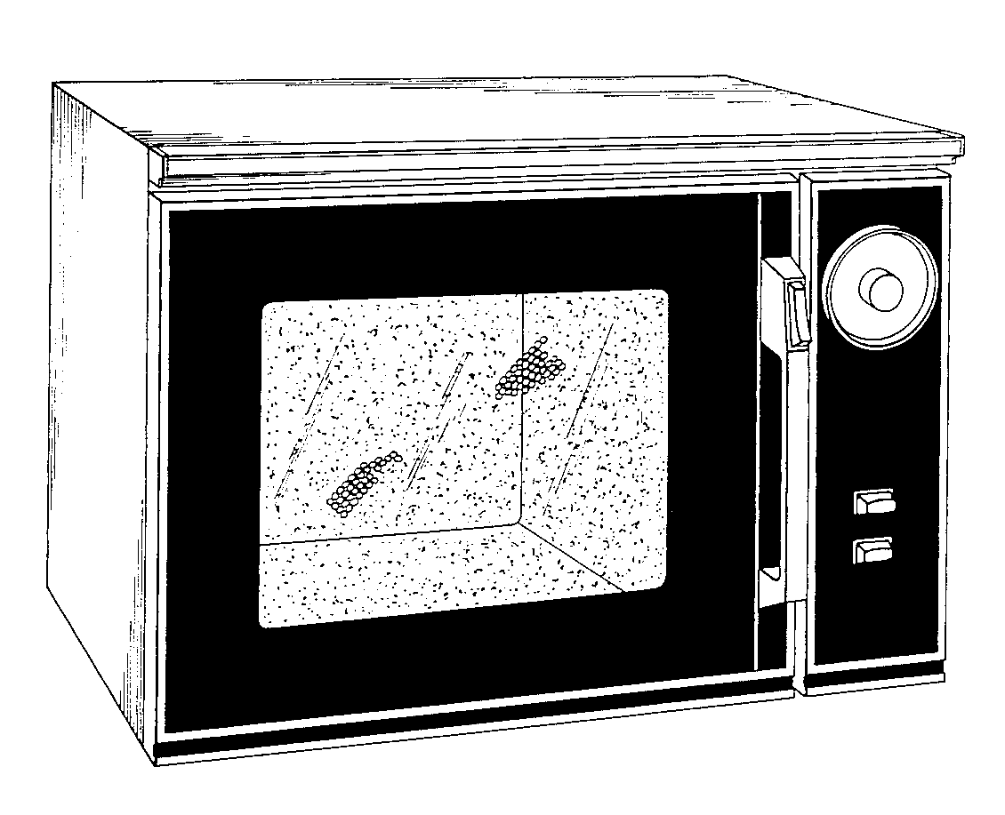
GE 607

Slide 37
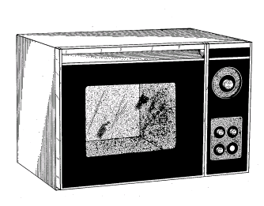
GE 780

Slide 38
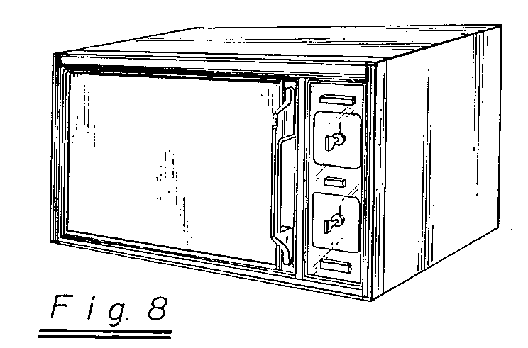
Sharp 313

Slide 39
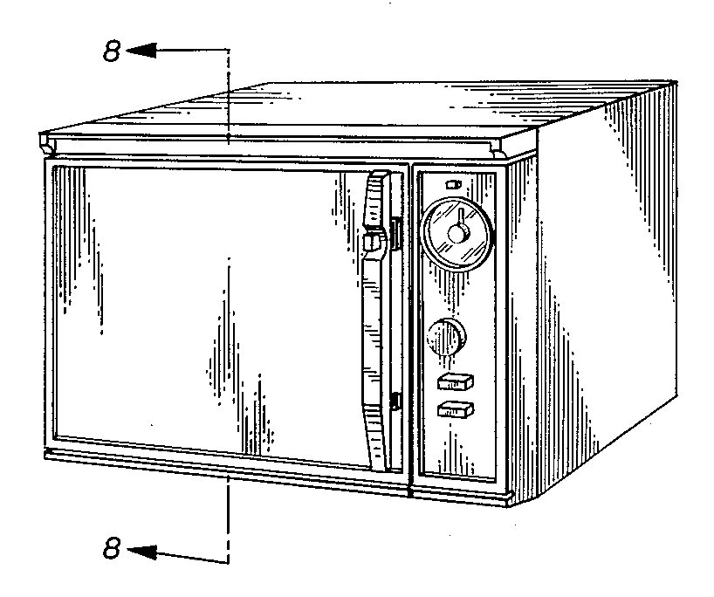
Sharp 579

Slide 40
Prior Art

Slide 41
Plaintiff’s Product

Slide 42
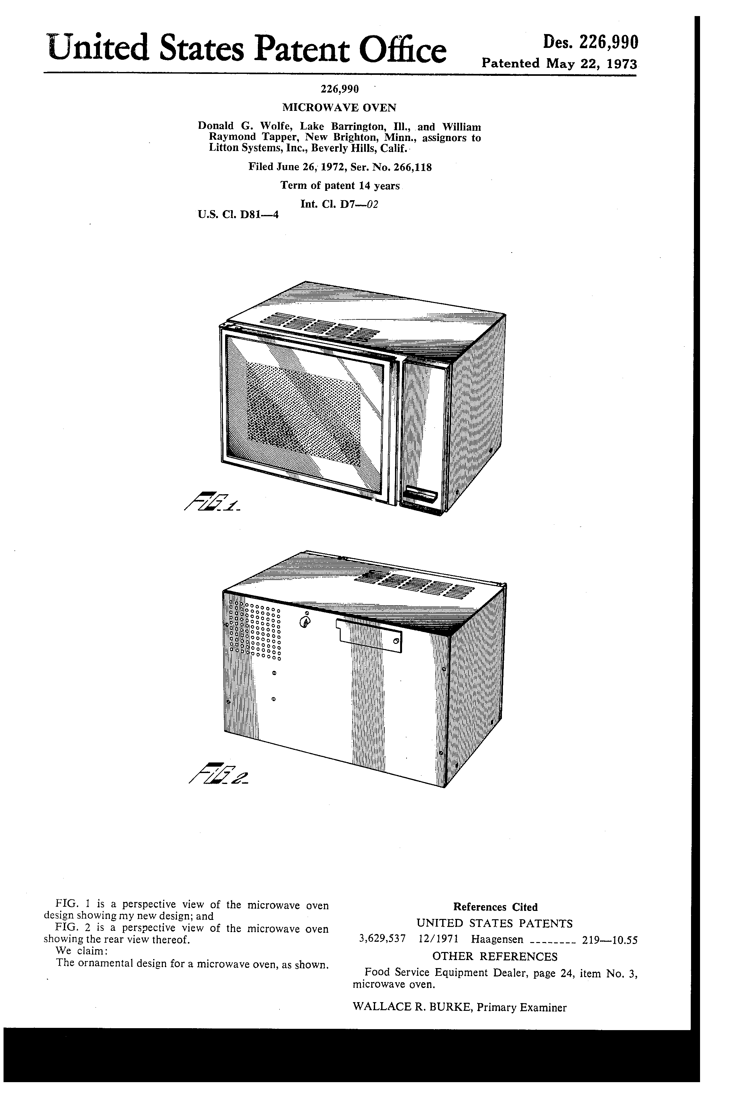

Slide 43
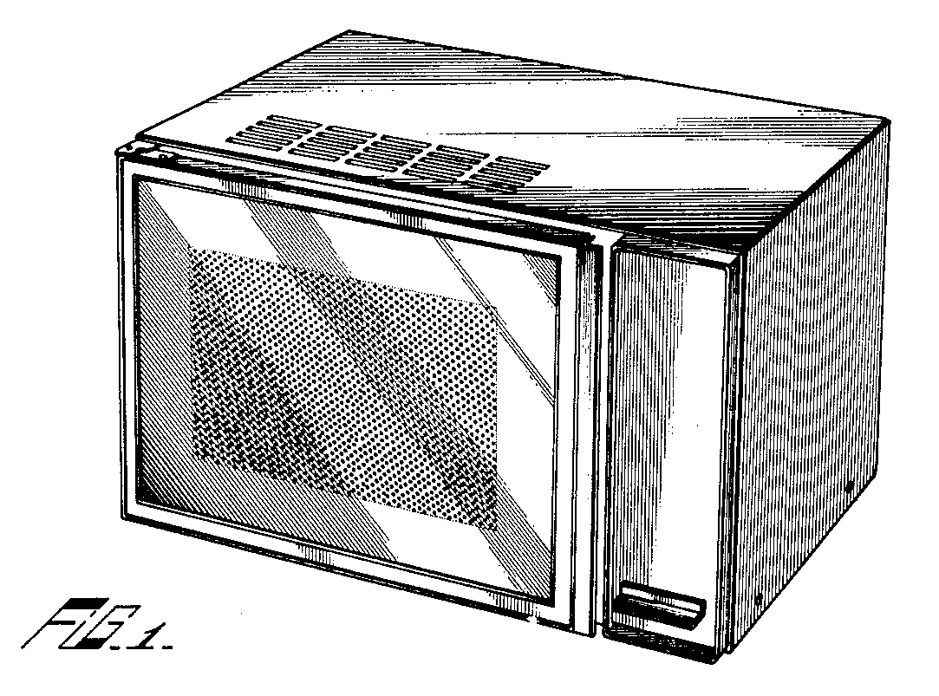

Slide 44
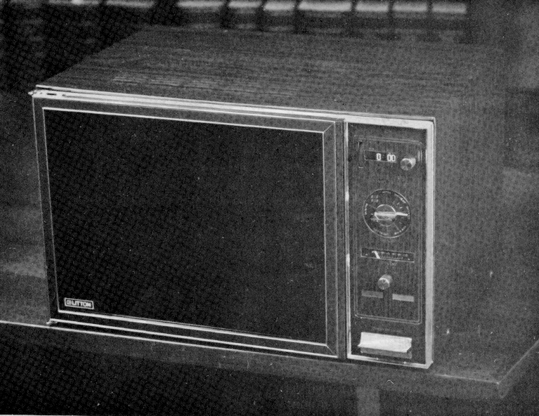
Litton Model 419

Slide 45
Defendant’s Product

Slide 46
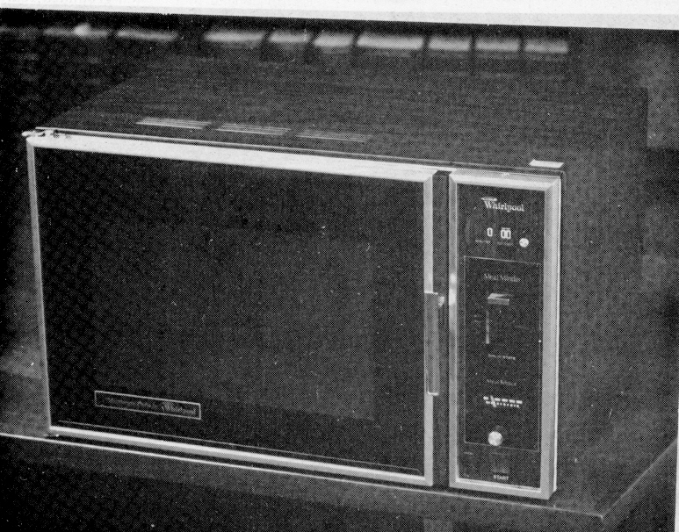
Whirlpool Model 7600

Slide 48
Prior Art
Plaintiff
Defendant

Slide 50
Egyptian Goddess (2008)

Slide 51
Plaintiff’s Product

Slide 52
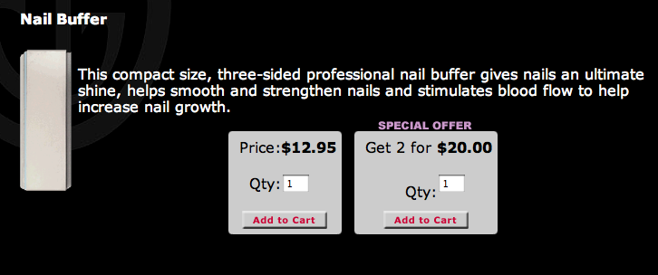

Slide 53
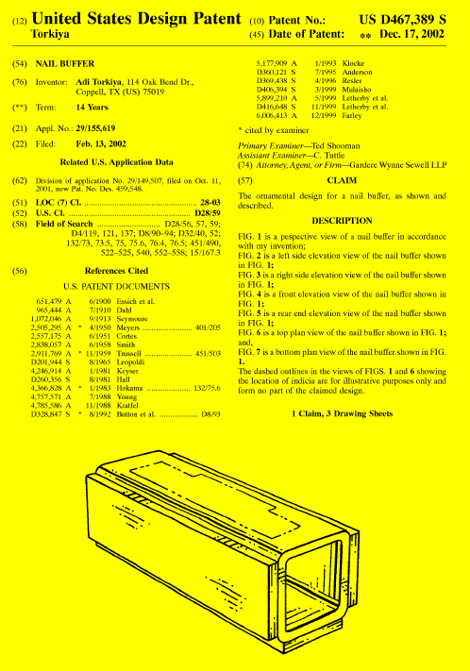

Slide 54
Defendant’s Product

Slide 56
Comparison of both with Prior Art

Slide 57
Prior Art
Defendant
Plaintiff
(The diagram is reprinted from the CAFC en banc opinion)

Slide 58
In Egyptian Goddess, the CAFC explicated the “ordinary observer” test for design-patent infringement as follows:
“[1] In some instances, the claimed design and the accused design will be sufficiently distinct that it will be clear without more that the patentee has not met its burden of proving the two designs would appear “substantially the same” to the ordinary observer, as required by Gorham. [2] In other instances, when the claimed and accused designs are not plainly dissimilar, resolution of the question whether the ordinary observer would consider the two designs to be substantially the same will benefit from a comparison of the claimed and accused designs with the prior art, as in many of the cases discussed above and in the case at bar. Where there are many examples of similar prior art designs, as in a case such as Whitman Saddle, differences between the claimed and accused designs that might not be noticeable in the abstract can become significant to the hypothetical ordinary observer who is conversant with the prior art. “
Step [1] makes clear that infringement of a design patent, unlike infringement of a utility patent, is not an “element-by-element” analysis. Instead, the decisionmaker should compare the overall impressions created by the protected design and the accused product
Step [2] is loosely analogous to the principle, applicable to utility patents, that one cannot recover, through the doctrine of equivalents, territory that would have been deemed obvious in light of the prior art.

Slide 59
In Egyptian Goddess, the CAFC explicated the “ordinary observer” test for design-patent infringement as follows:
“[1] In some instances, the claimed design and the accused design will be sufficiently distinct that it will be clear without more that the patentee has not met its burden of proving the two designs would appear “substantially the same” to the ordinary observer, as required by Gorham. [2] In other instances, when the claimed and accused designs are not plainly dissimilar, resolution of the question whether the ordinary observer would consider the two designs to be substantially the same will benefit from a comparison of the claimed and accused designs with the prior art, as in many of the cases discussed above and in the case at bar. Where there are many examples of similar prior art designs, as in a case such as Whitman Saddle, differences between the claimed and accused designs that might not be noticeable in the abstract can become significant to the hypothetical ordinary observer who is conversant with the prior art. “
Step [1] makes clear that infringement of a design patent, unlike infringement of a utility patent, is not an “element-by-element” analysis. Instead, the decisionmaker should compare the overall impressions created by the protected design and the accused product
Step [2] is loosely analogous to the principle, applicable to utility patents, that one cannot recover, through the doctrine of equivalents, territory that would have been deemed obvious in light of the prior art.

Slide 60
In Egyptian Goddess, the CAFC explicated the “ordinary observer” test for design-patent infringement as follows:
“[1] In some instances, the claimed design and the accused design will be sufficiently distinct that it will be clear without more that the patentee has not met its burden of proving the two designs would appear “substantially the same” to the ordinary observer, as required by Gorham. [2] In other instances, when the claimed and accused designs are not plainly dissimilar, resolution of the question whether the ordinary observer would consider the two designs to be substantially the same will benefit from a comparison of the claimed and accused designs with the prior art, as in many of the cases discussed above and in the case at bar. Where there are many examples of similar prior art designs, as in a case such as Whitman Saddle, differences between the claimed and accused designs that might not be noticeable in the abstract can become significant to the hypothetical ordinary observer who is conversant with the prior art. “
Step [1] makes clear that infringement of a design patent, unlike infringement of a utility patent, is not an “element-by-element” analysis. Instead, the decisionmaker should compare the overall impressions created by the protected design and the accused product
Step [2] is loosely analogous to the principle, applicable to utility patents, that one cannot recover, through the doctrine of equivalents, territory that would have been deemed obvious in light of the prior art.

Slide 61
In Egyptian Goddess, the CAFC explicated the “ordinary observer” test for design-patent infringement as follows:
“[1] In some instances, the claimed design and the accused design will be sufficiently distinct that it will be clear without more that the patentee has not met its burden of proving the two designs would appear “substantially the same” to the ordinary observer, as required by Gorham. [2] In other instances, when the claimed and accused designs are not plainly dissimilar, resolution of the question whether the ordinary observer would consider the two designs to be substantially the same will benefit from a comparison of the claimed and accused designs with the prior art, as in many of the cases discussed above and in the case at bar. Where there are many examples of similar prior art designs, as in a case such as Whitman Saddle, differences between the claimed and accused designs that might not be noticeable in the abstract can become significant to the hypothetical ordinary observer who is conversant with the prior art. “
Step [1] makes clear that infringement of a design patent, unlike infringement of a utility patent, is not an “element-by-element” analysis. Instead, the decisionmaker should compare the overall impressions created by the protected design and the accused product
Step [2] is loosely analogous to the principle, applicable to utility patents, that one cannot recover, through the doctrine of equivalents, territory that would have been deemed obvious in light of the prior art.

Slide 62
All-Elements Rule
Claim

Slide 63
All-Elements Rule
Claim
Elements

Slide 64
All-Elements Rule
Accused
device
Claim
Elements

Slide 65
All-Elements Rule
Accused
device
Claim
Elements
infringement

Slide 66
All-Elements Rule
Accused
device
Claim
Elements
No (literal) infringement

Slide 67
All-Elements Rule
Accused
device
Claim
Elements
No (literal) infringement

Slide 68
In Egyptian Goddess, the CAFC explicated the “ordinary observer” test for design-patent infringement as follows:
“[1] In some instances, the claimed design and the accused design will be sufficiently distinct that it will be clear without more that the patentee has not met its burden of proving the two designs would appear “substantially the same” to the ordinary observer, as required by Gorham. [2] In other instances, when the claimed and accused designs are not plainly dissimilar, resolution of the question whether the ordinary observer would consider the two designs to be substantially the same will benefit from a comparison of the claimed and accused designs with the prior art, as in many of the cases discussed above and in the case at bar. Where there are many examples of similar prior art designs, as in a case such as Whitman Saddle, differences between the claimed and accused designs that might not be noticeable in the abstract can become significant to the hypothetical ordinary observer who is conversant with the prior art. “
Step [1] makes clear that infringement of a design patent, unlike infringement of a utility patent, is not an “element-by-element” analysis. Instead, the decisionmaker should compare the overall impressions created by the protected design and the accused product
Step [2] is loosely analogous to the principle, applicable to utility patents, that one cannot recover, through the doctrine of equivalents, territory that would have been deemed obvious in light of the prior art.

Slide 69
In Egyptian Goddess, the CAFC explicated the “ordinary observer” test for design-patent infringement as follows:
“[1] In some instances, the claimed design and the accused design will be sufficiently distinct that it will be clear without more that the patentee has not met its burden of proving the two designs would appear “substantially the same” to the ordinary observer, as required by Gorham. [2] In other instances, when the claimed and accused designs are not plainly dissimilar, resolution of the question whether the ordinary observer would consider the two designs to be substantially the same will benefit from a comparison of the claimed and accused designs with the prior art, as in many of the cases discussed above and in the case at bar. Where there are many examples of similar prior art designs, as in a case such as Whitman Saddle, differences between the claimed and accused designs that might not be noticeable in the abstract can become significant to the hypothetical ordinary observer who is conversant with the prior art. “
Step [1] makes clear that infringement of a design patent, unlike infringement of a utility patent, is not an “element-by-element” analysis. Instead, the decisionmaker should compare the overall impressions created by the protected design and the accused product
Step [2] is loosely analogous to the principle, applicable to utility patents, that one cannot recover, through the doctrine of equivalents, territory that would have been deemed obvious in light of the prior art.

Slide 70
Prior Art
Prior
Art

Slide 71
Obvious
Prior Art
Prior
Art

Slide 72
Obvious
Prior Art
Prior
Art
Original Claim

Slide 73
Obvious
Prior Art
Prior
Art
Original Claim
§103 Problem

Slide 74
In Egyptian Goddess, the CAFC explicated the “ordinary observer” test for design-patent infringement as follows:
“[1] In some instances, the claimed design and the accused design will be sufficiently distinct that it will be clear without more that the patentee has not met its burden of proving the two designs would appear “substantially the same” to the ordinary observer, as required by Gorham. [2] In other instances, when the claimed and accused designs are not plainly dissimilar, resolution of the question whether the ordinary observer would consider the two designs to be substantially the same will benefit from a comparison of the claimed and accused designs with the prior art, as in many of the cases discussed above and in the case at bar. Where there are many examples of similar prior art designs, as in a case such as Whitman Saddle, differences between the claimed and accused designs that might not be noticeable in the abstract can become significant to the hypothetical ordinary observer who is conversant with the prior art. “
Step [1] makes clear that infringement of a design patent, unlike infringement of a utility patent, is not an “element-by-element” analysis. Instead, the decisionmaker should compare the overall impressions created by the protected design and the accused product
Step [2] is loosely analogous to the principle, applicable to utility patents, that one cannot recover, through the doctrine of equivalents, territory that would have been deemed obvious in light of the prior art.

Slide 75
The following decisions illustrate how this approach has been interpreted in practice:
Wing Shing Products v. Sunbeam (SDNY 2009), aff’d per curiam, CAFC 2010
Minka v. Maxim (ND Tex 2009)
Smith v. CHF (SDNY 2011)
Victor Stanley v. Creative Pipe, 2011 LEXIS 112846 (D.Md. 2011)
Sofpool v. Kmart, No. 10-cv-3333 (ED CA 2013)
Wallace v. IdeaVillage (CAFC 2016) (nonprecedential)
Lanard Toys (CAFC 2020)

Slide 76
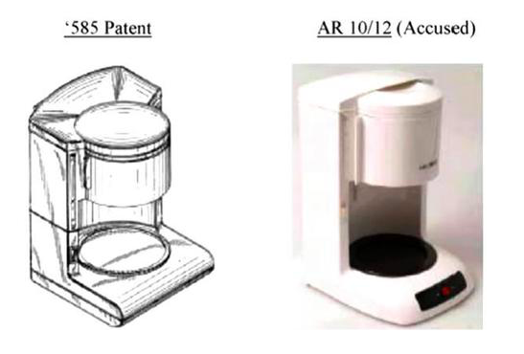
Prior Art
Source: https://www.law360.com/articles/576417/tests-for-design-patent-infringement-post-egyptian-goddess

Slide 77
Prior Art
Held: No infringement – against the background of “crowded” prior art.
Wing Shing Products v. Sunbeam (SDNY 2009), aff’d per curiam, CAFC 2010
Source: https://www.law360.com/articles/576417/tests-for-design-patent-infringement-post-egyptian-goddess

Slide 79
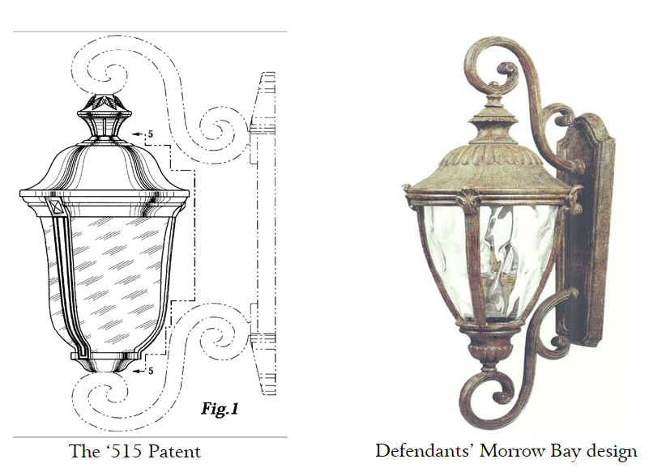

Slide 80
Held: “The Court finds that an ordinary observer of Defendants’ accused designs would be left with the impression that it is substantially different from the ‘515 patent.
Comparing the figures of the ‘515 patent with the accused designs, the Court determines that the overall visual impressions are distinct, and it is readily apparent that an ordinary observer would not be confused. There are several differences that would be readily apparent to an ordinary observer….”
silhouette;
Shape of top finials
Amount of ornamentation
Shape of lower medallions
Minka v. Maxim (ND Tex 2009)

Slide 81
Held: “The Court finds that an ordinary observer of Defendants’ accused designs would be left with the impression that it is substantially different from the ‘515 patent.
Comparing the figures of the ‘515 patent with the accused designs, the Court determines that the overall visual impressions are distinct, and it is readily apparent that an ordinary observer would not be confused. There are several differences that would be readily apparent to an ordinary observer….”
silhouette;
Shape of top finials
Amount of ornamentation
Shape of lower medallions
Minka v. Maxim (ND Tex 2009)

Slide 82
Held: “The Court finds that an ordinary observer of Defendants’ accused designs would be left with the impression that it is substantially different from the ‘515 patent.
Comparing the figures of the ‘515 patent with the accused designs, the Court determines that the overall visual impressions are distinct, and it is readily apparent that an ordinary observer would not be confused. There are several differences that would be readily apparent to an ordinary observer….”
silhouette;
Shape of top finials
Amount of ornamentation
Shape of lower medallions
Minka v. Maxim (ND Tex 2009)

Slide 83
Held: “The Court finds that an ordinary observer of Defendants’ accused designs would be left with the impression that it is substantially different from the ‘515 patent.
Comparing the figures of the ‘515 patent with the accused designs, the Court determines that the overall visual impressions are distinct, and it is readily apparent that an ordinary observer would not be confused. There are several differences that would be readily apparent to an ordinary observer….”
silhouette;
Shape of top finials
Amount of ornamentation
Shape of lower medallions
Minka v. Maxim (ND Tex 2009)

Slide 84
Held: “The Court finds that an ordinary observer of Defendants’ accused designs would be left with the impression that it is substantially different from the ‘515 patent.
Comparing the figures of the ‘515 patent with the accused designs, the Court determines that the overall visual impressions are distinct, and it is readily apparent that an ordinary observer would not be confused. There are several differences that would be readily apparent to an ordinary observer….”
silhouette;
Shape of top finials
Amount of ornamentation
Shape of lower medallions
Minka v. Maxim (ND Tex 2009)

Slide 86
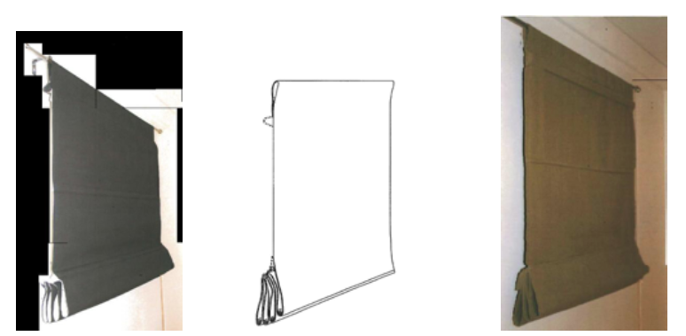
Design Patent
Prior Art
Defendant
Source for the images: https://www.finnegan.com/en/insights/five-years-later-did-egyptian-goddess-live-up-to-the-hype.html

Slide 87
Design Patent
Prior Art
Defendant
The court denies defendant’s motion for summary judgment on the ground that: “Assuming that these examples are prior art, a review of these images reveals that an ordinary observer, familiar with these designs, could still be deceived into believing that the accused product is the same as the patented design. In fact, a hypothetical ordinary observer would likely attach more importance to at least one aspect of the claimed design when viewed in the context of CHF's prior art examples — the folds that stack and cascade slightly upwards at the bottom of the '651 and '039 designs' shade when the shade is raised. This feature is also in [defendant’s] Pole-Top Roman Shade and is largely why an ordinary observer could be deceived into believing that the accused product is the same as the patented design.” Smith v. CHF (SDNY 2011)
Source for the images: https://www.finnegan.com/en/insights/five-years-later-did-egyptian-goddess-live-up-to-the-hype.html

Slide 88
Design Patent
Prior Art
Defendant
The court denies defendant’s motion for summary judgment on the ground that: “Assuming that these examples are prior art, a review of these images reveals that an ordinary observer, familiar with these designs, could still be deceived into believing that the accused product is the same as the patented design. In fact, a hypothetical ordinary observer would likely attach more importance to at least one aspect of the claimed design when viewed in the context of CHF's prior art examples — the folds that stack and cascade slightly upwards at the bottom of the '651 and '039 designs' shade when the shade is raised. This feature is also in [defendant’s] Pole-Top Roman Shade and is largely why an ordinary observer could be deceived into believing that the accused product is the same as the patented design.” Smith v. CHF (SDNY 2011)
Source for the images: https://www.finnegan.com/en/insights/five-years-later-did-egyptian-goddess-live-up-to-the-hype.html

Slide 89
Design Patent
Prior Art
Defendant
The court denies defendant’s motion for summary judgment on the ground that: “Assuming that these examples are prior art, a review of these images reveals that an ordinary observer, familiar with these designs, could still be deceived into believing that the accused product is the same as the patented design. In fact, a hypothetical ordinary observer would likely attach more importance to at least one aspect of the claimed design when viewed in the context of CHF's prior art examples — the folds that stack and cascade slightly upwards at the bottom of the '651 and '039 designs' shade when the shade is raised. This feature is also in [defendant’s] Pole-Top Roman Shade and is largely why an ordinary observer could be deceived into believing that the accused product is the same as the patented design.” Smith v. CHF (SDNY 2011)
Source for the images: https://www.finnegan.com/en/insights/five-years-later-did-egyptian-goddess-live-up-to-the-hype.html

Slide 90
Design Patent
Prior Art
Defendant
The court denies defendant’s motion for summary judgment on the ground that: “Assuming that these examples are prior art, a review of these images reveals that an ordinary observer, familiar with these designs, could still be deceived into believing that the accused product is the same as the patented design. In fact, a hypothetical ordinary observer would likely attach more importance to at least one aspect of the claimed design when viewed in the context of CHF's prior art examples — the folds that stack and cascade slightly upwards at the bottom of the '651 and '039 designs' shade when the shade is raised. This feature is also in [defendant’s] Pole-Top Roman Shade and is largely why an ordinary observer could be deceived into believing that the accused product is the same as the patented design.” Smith v. CHF (SDNY 2011)
Source for the images: https://www.finnegan.com/en/insights/five-years-later-did-egyptian-goddess-live-up-to-the-hype.html

Slide 91
Design Patent
Prior Art
Defendant
The court denies defendant’s motion for summary judgment on the ground that: “Assuming that these examples are prior art, a review of these images reveals that an ordinary observer, familiar with these designs, could still be deceived into believing that the accused product is the same as the patented design. In fact, a hypothetical ordinary observer would likely attach more importance to at least one aspect of the claimed design when viewed in the context of CHF's prior art examples — the folds that stack and cascade slightly upwards at the bottom of the '651 and '039 designs' shade when the shade is raised. This feature is also in [defendant’s] Pole-Top Roman Shade and is largely why an ordinary observer could be deceived into believing that the accused product is the same as the patented design.” Smith v. CHF (SDNY 2011)
Source for the images: https://www.finnegan.com/en/insights/five-years-later-did-egyptian-goddess-live-up-to-the-hype.html

Slide 93
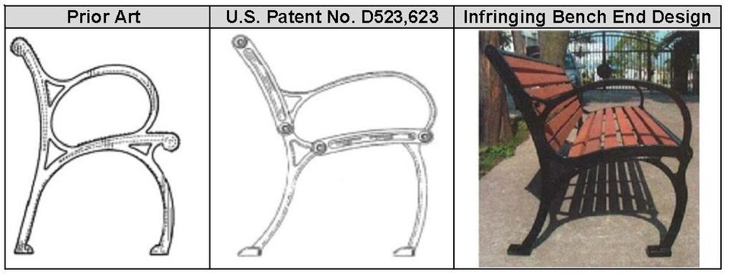
Victor Stanley v. Creative Pipe, 2011 LEXIS 112846 (D.Md. 2011)
Images from https://www.wilsonlegalgroup.com/how-to-determine-infringement-of-a-design-patent

Slide 94
Victor Stanley v. Creative Pipe, 2011 LEXIS 112846 (D.Md. 2011)
Defendant held liable because ““an ordinary observer, familiar with prior art designs, would be unable to easily distinguish them in a side-by-side comparison without unusually careful effort.”
Images from https://www.wilsonlegalgroup.com/how-to-determine-infringement-of-a-design-patent

Slide 96
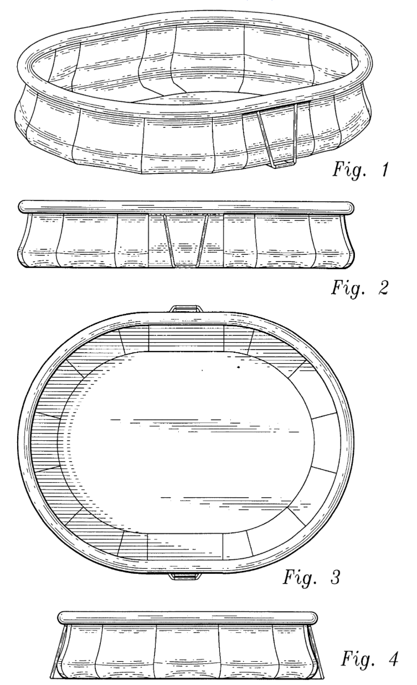
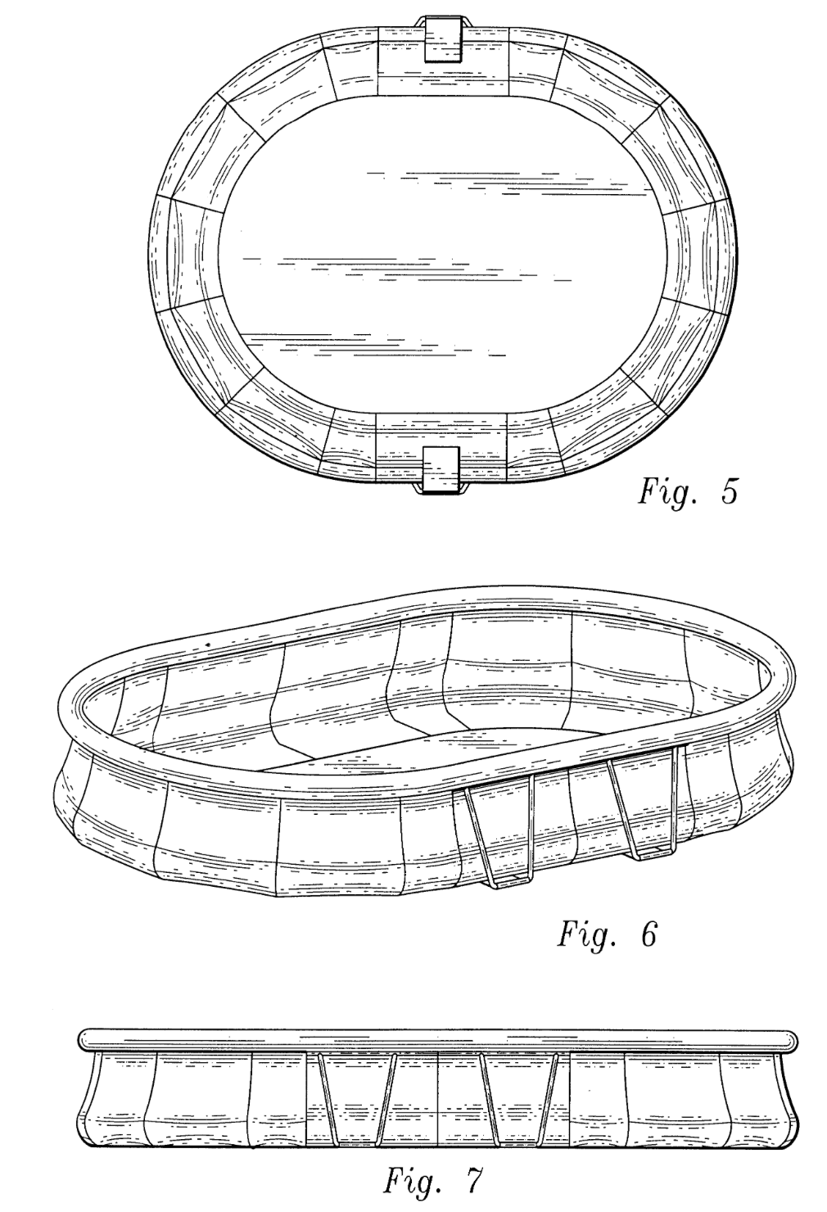
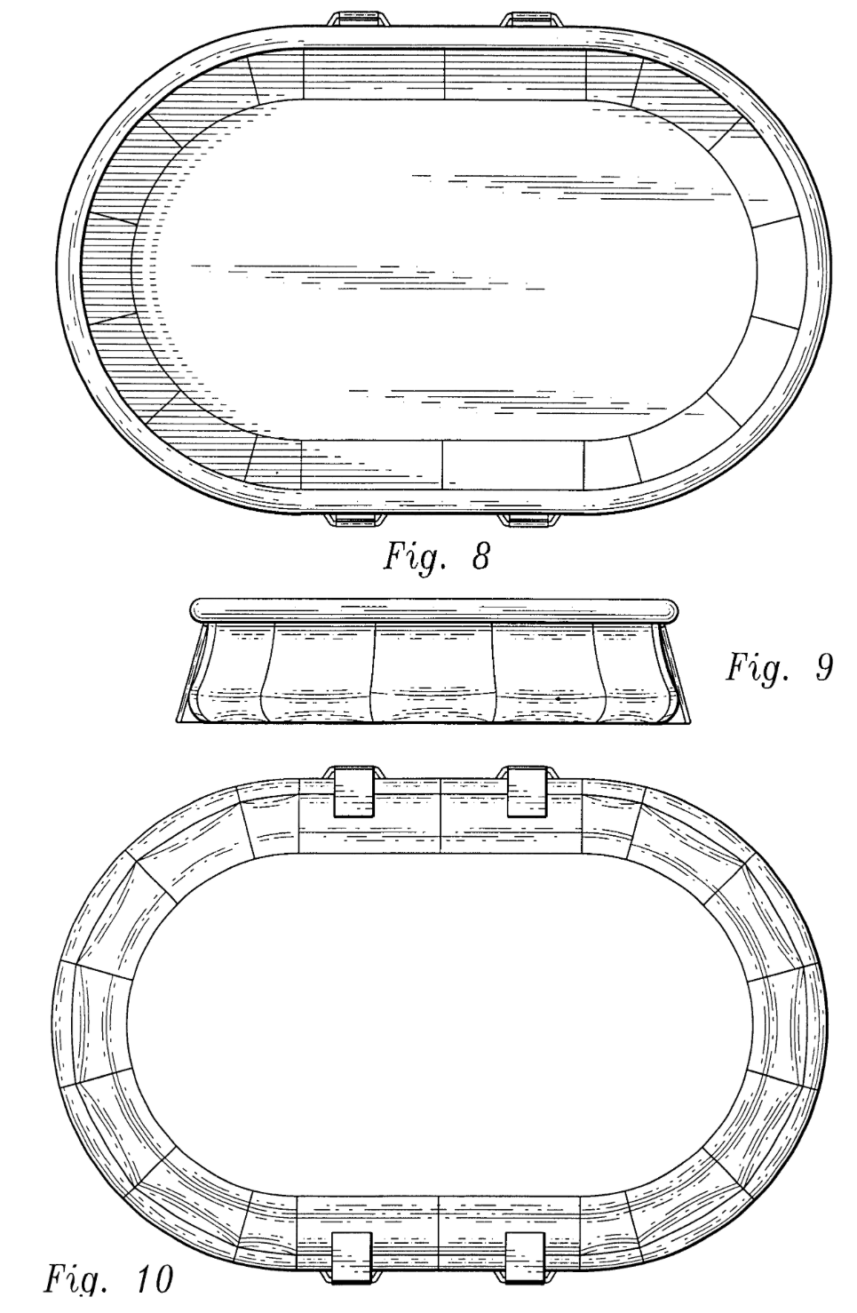
Design Patent D480,817: “Above Ground Swimming Pool”

Slide 97
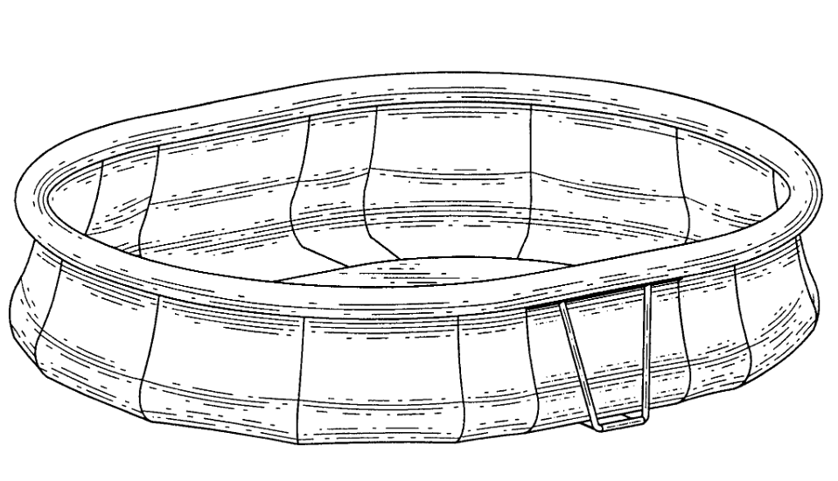
Design Patent
Source: https://www.finnegan.com/en/insights/five-years-later-did-egyptian-goddess-live-up-to-the-hype.html

Slide 98
Defendant’s Product
Design Patent
Source: https://www.finnegan.com/en/insights/five-years-later-did-egyptian-goddess-live-up-to-the-hype.html

Slide 99
Defendant’s Product
Design Patent
Held: “[N]no reasonable juror could find that an ordinary observer would conclude that the taller, more elegant accused pool embodies the squat pool plaintiff patented, or any colorable imitation thereof.” Sofpool v. Kmart, No. 10-cv-3333 (ED CA 2013)
Source: https://www.finnegan.com/en/insights/five-years-later-did-egyptian-goddess-live-up-to-the-hype.html

Slide 101
Wallace v. IdeaVillage (CAFC 2016) (nonprecedential) Step 1: Compare the design patent and the defendant’s product

Slide 103
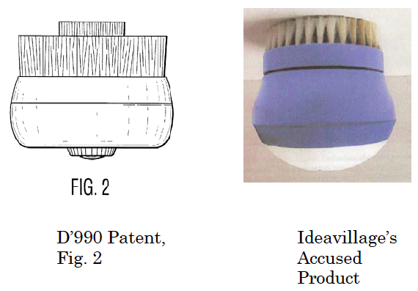

Slide 104
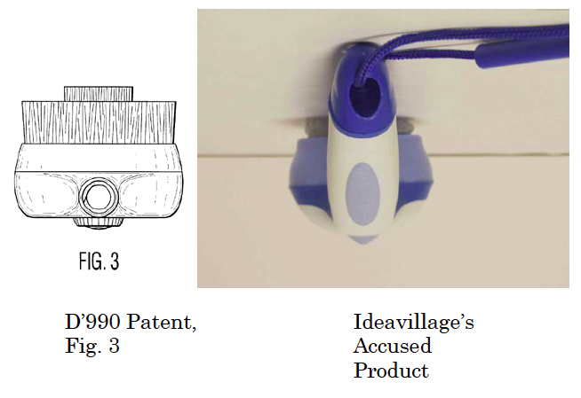

Slide 105
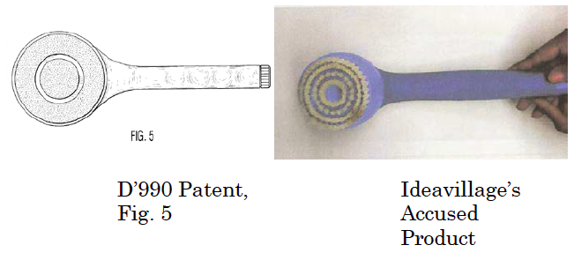

Slide 106
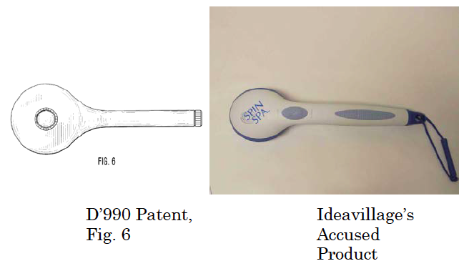

Slide 107
Step 1
“The district court properly found that the D’990 patent’s design and the accused product are plainly dissimilar. Bath brushes with a generally rounded head and roughly cylindrical handle were shown in the prior art, and the curved shape of the handle, the angled connection between the handle and brush, the ovoid design of the head, and the surface details are such that an ordinary observer viewing both designs would not confuse one product for the other.”

Slide 108
Wallace v. IdeaVillage (CAFC 2016) (nonprecedential) Step 2: Compare (a) the design patent, (b) the defendant’s product, and (c) the prior art

Slide 109
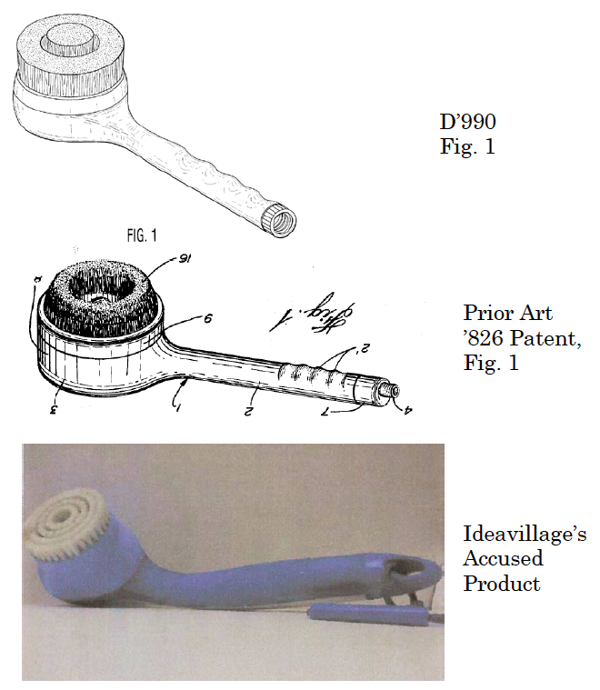

Slide 110
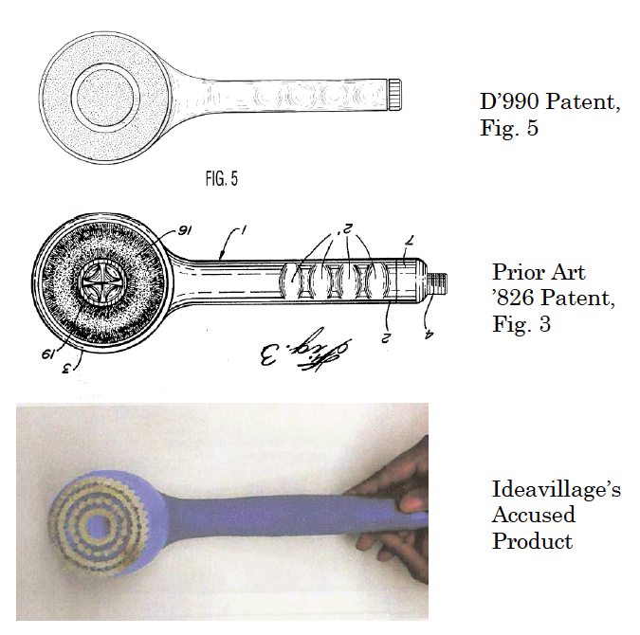

Slide 112
Step 2
“The district court properly concluded that, ‘in light of the similarities between the ‘826 patent [the prior art] and the ’990 patent [the plaintiff’s patent], . . . no reasonable ordinary observer, familiar with the prior art, would be deceived into believing the [Ideavillage] [p]roduct is the same as the design depicted in the ’990 patent.’ The district court correctly applied the law, that ‘differences between the claimed and accused designs that might not be noticeable in the abstract can become significant to the hypothetical ordinary observer who is conversant with the prior art.’ Egyptian Goddess, 543 F.3d at 678.”

Slide 114
Lanard Toys (CAFC 2020)

Slide 115
Lanard Toys (CAFC 2020)

Slide 116
Lanard Toys (CAFC 2020)
Design Patent

Slide 117
Lanard Toys (CAFC 2020)
Design Patent
Defendant’s product

Slide 118
Lanard Toys (CAFC 2020)
Affirm District Court’s grant of summary judgment to defendant:
“The [District] court concluded, based on the evidence presented, that no reasonable fact finder could find that an ordinary observer, taking into account the prior art, would believe the accused design to be the same as the patented design.”
“To be clear, the ‘ordinary observer’ test for design patent infringement requires the fact finder to ‘compar[e] similarities in overall designs, not similarities of ornamental features in isolation.’ But, while the ‘ordinary observer’ test is not an element-by-element comparison, it also does not ignore the reality that designs can, and often do, have both functional and ornamental aspects. …. Under the ‘ordinary observer’ test, a court must consider the ornamental features and analyze how they impact the overall design. …. We conclude that the district court struck the correct balance of considering the ornamental aspects of the design while remaining focused on how an ordinary observer would view the overall design.”

Slide 119
Lanard Toys (CAFC 2020)
Affirm District Court’s grant of summary judgment to defendant:
“The [District] court concluded, based on the evidence presented, that no reasonable fact finder could find that an ordinary observer, taking into account the prior art, would believe the accused design to be the same as the patented design.”
“To be clear, the ‘ordinary observer’ test for design patent infringement requires the fact finder to ‘compar[e] similarities in overall designs, not similarities of ornamental features in isolation.’ But, while the ‘ordinary observer’ test is not an element-by-element comparison, it also does not ignore the reality that designs can, and often do, have both functional and ornamental aspects. …. Under the ‘ordinary observer’ test, a court must consider the ornamental features and analyze how they impact the overall design. …. We conclude that the district court struck the correct balance of considering the ornamental aspects of the design while remaining focused on how an ordinary observer would view the overall design.”

Slide 120
Lanard Toys (CAFC 2020)
Affirm District Court’s grant of summary judgment to defendant:
“The [District] court concluded, based on the evidence presented, that no reasonable fact finder could find that an ordinary observer, taking into account the prior art, would believe the accused design to be the same as the patented design.”
“To be clear, the ‘ordinary observer’ test for design patent infringement requires the fact finder to ‘compar[e] similarities in overall designs, not similarities of ornamental features in isolation.’ But, while the ‘ordinary observer’ test is not an element-by-element comparison, it also does not ignore the reality that designs can, and often do, have both functional and ornamental aspects. …. Under the ‘ordinary observer’ test, a court must consider the ornamental features and analyze how they impact the overall design. …. We conclude that the district court struck the correct balance of considering the ornamental aspects of the design while remaining focused on how an ordinary observer would view the overall design.”

Slide 121
Lanard Toys (CAFC 2020)
Affirm District Court’s grant of summary judgment to defendant:
“The [District] court concluded, based on the evidence presented, that no reasonable fact finder could find that an ordinary observer, taking into account the prior art, would believe the accused design to be the same as the patented design.”
“To be clear, the ‘ordinary observer’ test for design patent infringement requires the fact finder to ‘compar[e] similarities in overall designs, not similarities of ornamental features in isolation.’ But, while the ‘ordinary observer’ test is not an element-by-element comparison, it also does not ignore the reality that designs can, and often do, have both functional and ornamental aspects. …. Under the ‘ordinary observer’ test, a court must consider the ornamental features and analyze how they impact the overall design. …. We conclude that the district court struck the correct balance of considering the ornamental aspects of the design while remaining focused on how an ordinary observer would view the overall design.”

Slide 122
Lanard Toys (CAFC 2020)
Design Patent
Defendant’s product

Slide 123
In Egyptian Goddess, the CAFC explicated the “ordinary observer” test for design-patent infringement as follows:
“[1] In some instances, the claimed design and the accused design will be sufficiently distinct that it will be clear without more that the patentee has not met its burden of proving the two designs would appear “substantially the same” to the ordinary observer, as required by Gorham. [2] In other instances, when the claimed and accused designs are not plainly dissimilar, resolution of the question whether the ordinary observer would consider the two designs to be substantially the same will benefit from a comparison of the claimed and accused designs with the prior art, as in many of the cases discussed above and in the case at bar. Where there are many examples of similar prior art designs, as in a case such as Whitman Saddle, differences between the claimed and accused designs that might not be noticeable in the abstract can become significant to the hypothetical ordinary observer who is conversant with the prior art. “
Step [1] makes clear that infringement of a design patent, unlike infringement of a utility patent, is not an “element-by-element” analysis. Instead, the decisionmaker should compare the overall impressions created by the protected design and the accused product
Step [2] is loosely analogous to the principle, applicable to utility patents, that one cannot recover, through the doctrine of equivalents, territory that would have been deemed obvious in light of the prior art.

Slide 124
No infringement Infringement

Slide 126
Design Patent Data

Slide 127
Source: http://www.forbes.com/sites/haydnshaughnessy/2013/08/22/the-surprise-leader-in-design-patents/

Slide 128
Source: USPTO Performance Report

Slide 129
Source: http://www.ipwatchdog.com/wp-content/uploads/2016/09/design-patents-1975-2015.jpg

Slide 130
Source: https://patentlyo.com/patent/2010/01/design-patent-application-pendency.html

Slide 131
Source: https://patentlyo.com/patent/2013/01/design-patents-are-still-relatively-quick.html

Slide 132
Source: Patently-O Blog: http://www.patentlyo.com/patent/2007/12/index.html

Slide 133
Copyright

Slide 134
“Marita” (Mara Series)
– Pivot Point
http://pivotpointstore.com/
marita_20.html

Slide 135
Trade Dress Protection

Slide 136
Ferrari Testarossa, circa. 1985

Slide 138
In 1985, aprx. $230,000

Slide 139
Carl Roberts Motor Group

Slide 141
In 1985, aprx. $25,000

Slide 143
Fiberglass body
by Roberts
($8,500)
+

Slide 144
Fiberglass body
by Roberts
($8,500)
+
=

Slide 147
Can Ferrari Stop Roberts?
Patent?
Copyright?
Trademark?
Trade Dress?

Slide 148
Can Ferrari Stop Roberts?
Patent?
Copyright?
Trademark?
Trade Dress?
Secondary meaning
Nonfunctionality

Slide 149
Angelo Bellei
Principal developer of Ferrari Grand Touring Cars, 1964-1975
Testifies that he and his team developed the body shape for “beauty and distinctiveness,” not speed

