Slide 1
Differential Pricing of Patented Products
PX044
William Fisher
March 2024

Slide 2
Part 1: Differential Pricing in General

Slide 3
Differential Pricing
Simple version: charging different consumers different prices for the same good or service
Complex version: charging different consumers different prices for different versions of a good or service when the variation cannot be explained by differences in the costs of the versions

Slide 4
“Personalized” Online Retailing
Source: https://www.channelsight.com/blog/clickstream-data

Slide 5
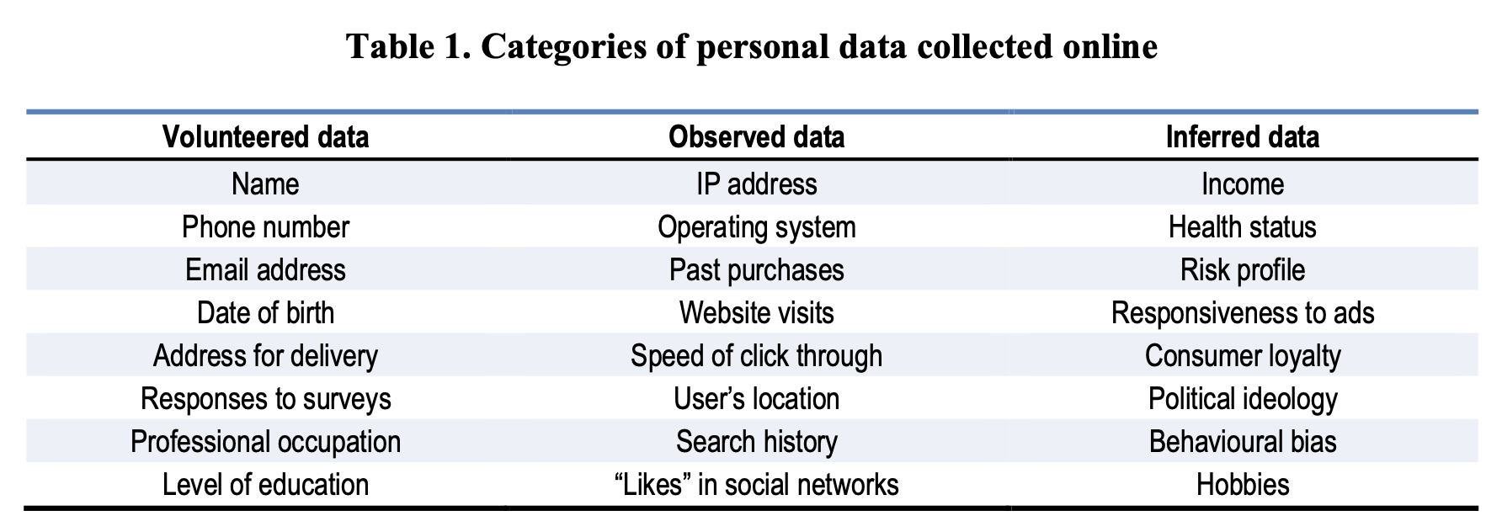
“Personalized” Online Retailing
Source: OECD, “Personalised Pricing in the Digital Era” (2018), https://one.oecd.org/document/DAF/COMP(2018)13/en/pdf

Slide 6
“Personalized” Online Retailing
Source: OECD, “Personalised Pricing in the Digital Era” (2018), https://one.oecd.org/document/DAF/COMP(2018)13/en/pdf

Slide 7
“Personalized” Online Retailing
Source: OECD, “Personalised Pricing in the Digital Era” (2018), https://one.oecd.org/document/DAF/COMP(2018)13/en/pdf

Slide 8
“Personalized” Online Retailing
“Large datasets on individual behavior, popularly referred to as ”big data,” are now readily available, and contain information potentially useful for person-specific pricing. For example, web browsing data may indicate psychographic profiles or direct interest in a related product, or reflect latent demographics or characteristics such as sexual orientation, social phobia, and marital happiness - all information that can be used to form a hedonic estimate of willingness to pay. In this paper, I investigate the extent of incremental information contained in web browsing behavior, the profitability of first-degree PD, and the resulting distribution of prices different consumers would be offered when purchasing the exact same item. The results demonstrate how the burgeoning massive consumer-level data collection and analytics might revolutionize even the basic underpinnings of markets.”
Source: Shiller, “First-Degree Price Discrimination Using Big Data” (2014)

Slide 9
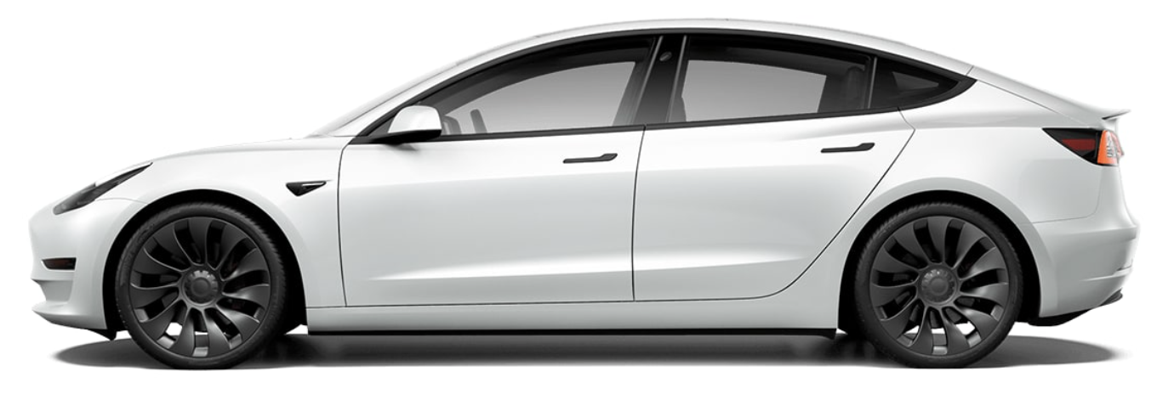
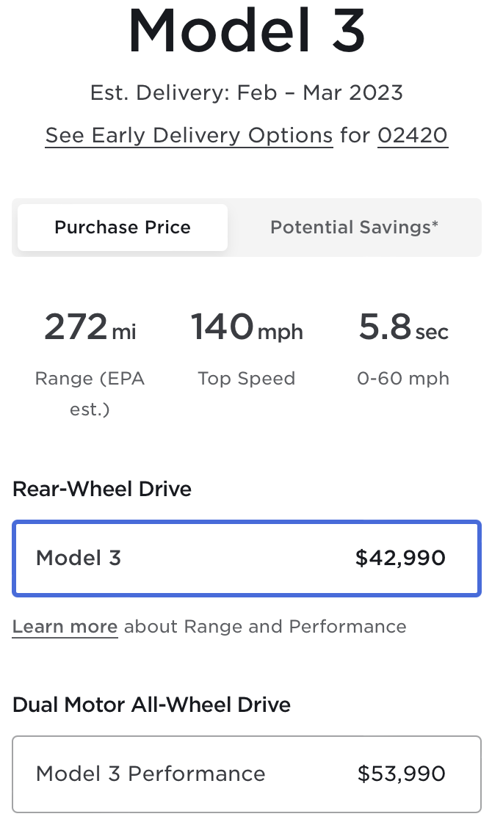
Requirements
market power
restrictions on arbitrage
heterogeneity among buyers
ability to differentiate those buyers
“First degree”: charge each buyer what he or she is able and willing to spend for a good or service
“Second degree”: the seller does not know how much different potential buyers are able and willing to pay, but induces them to reveal their resources or preferences
“Third degree”: seller separates buyers into classes corresponding roughly to their ability and willingness to pay

Slide 10
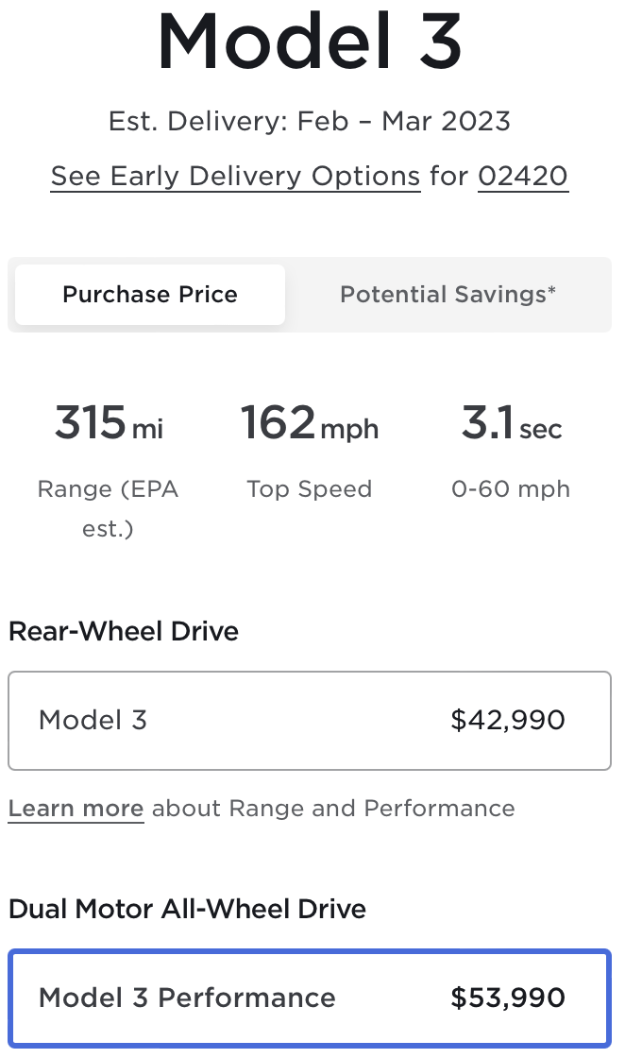
Requirements
market power
restrictions on arbitrage
heterogeneity among buyers
ability to differentiate those buyers
“First degree”: charge each buyer what he or she is able and willing to spend for a good or service
“Second degree”: the seller does not know how much different potential buyers are able and willing to pay, but induces them to reveal their resources or preferences
“Third degree”: seller separates buyers into classes corresponding roughly to their ability and willingness to pay

Slide 11
Requirements
market power
restrictions on arbitrage
heterogeneity among buyers
ability to differentiate those buyers
“First degree”: charge each buyer what he or she is able and willing to spend for a good or service
“Second degree”: the seller does not know how much different potential buyers are able and willing to pay, but induces them to reveal their resources or preferences
“Third degree”: seller separates buyers into classes corresponding roughly to their ability and willingness to pay

Slide 12
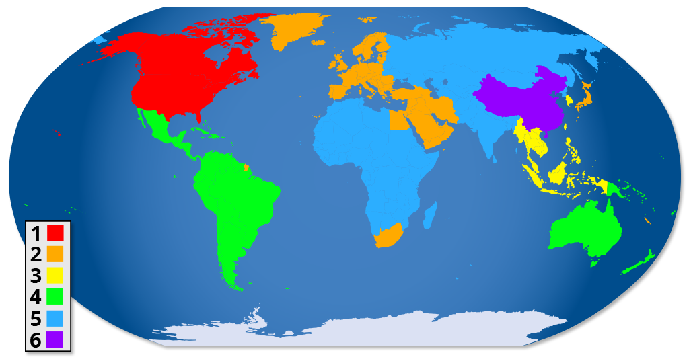
DVD Region Coding

Slide 13
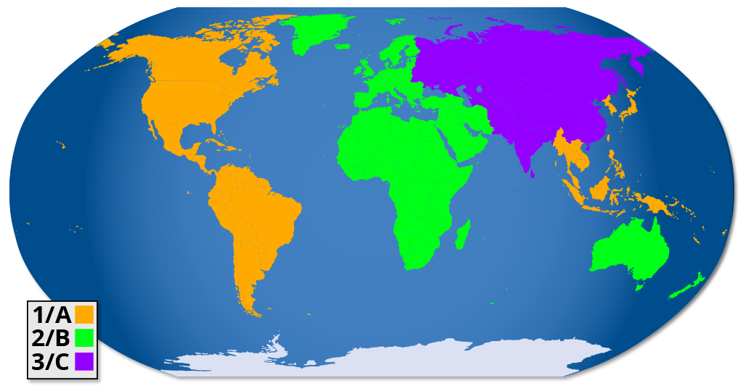
Blu-Ray Region Coding

Slide 14
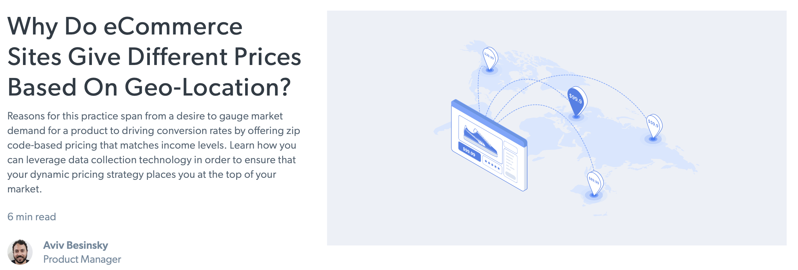
Online Retail Sales: Using Geolocation
Source: https://brightdata.com/blog/leadership/why-do-ecommerce-sites-give-different-prices-based-on-geo-location

Slide 15
Part 2: Differential Pricing of Patented Products

Slide 16
Software

Slide 18
Medical Devices

Slide 19
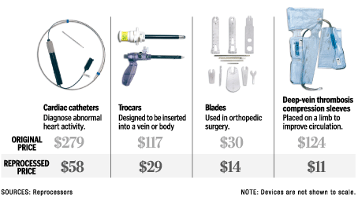
Patented Medical Devices
Prohibitions on Reuse

Slide 20
Impact of Prohibition on Reuse
Large hospital uses cardiac catheter 10 times; small hospital only once
If reuse is permitted, both pay patentee same price: $279
because the fee for reconditioning goes to the reconditioner, not patentee
If reuse is forbidden, large hospital pays patentee $2,790, while small hospital pays $279

Slide 21
Pharmaceutical Products

Slide 22
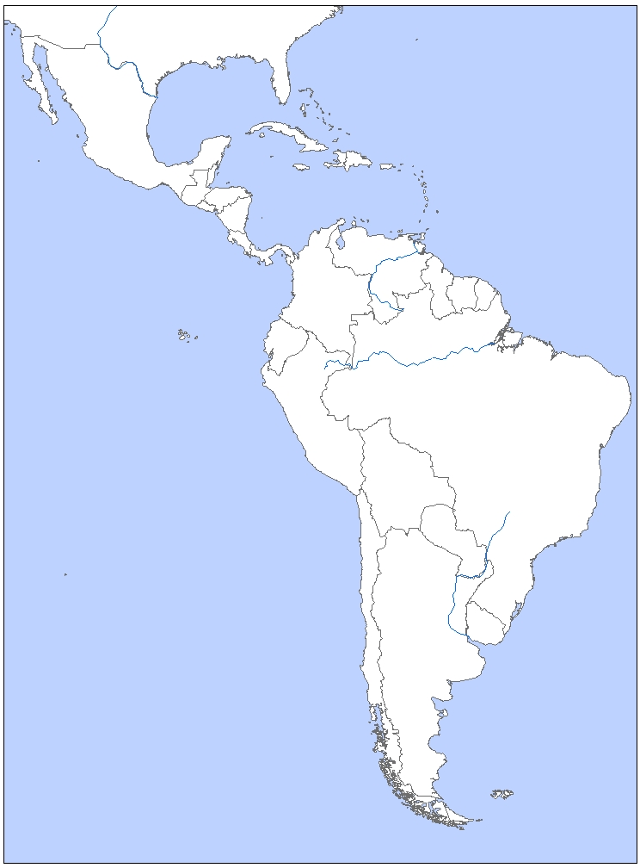
Price for one
year of
3TC/AZT/EFV
May 2002
$1484
$3820
$1226
$1380
$2407
$2650
$1332
$2837
$3619
$1307
$1339
Source: Richard Hornbeck, “Price Discrimination
and the Smuggling of AIDS Drugs” (2005)

Slide 23
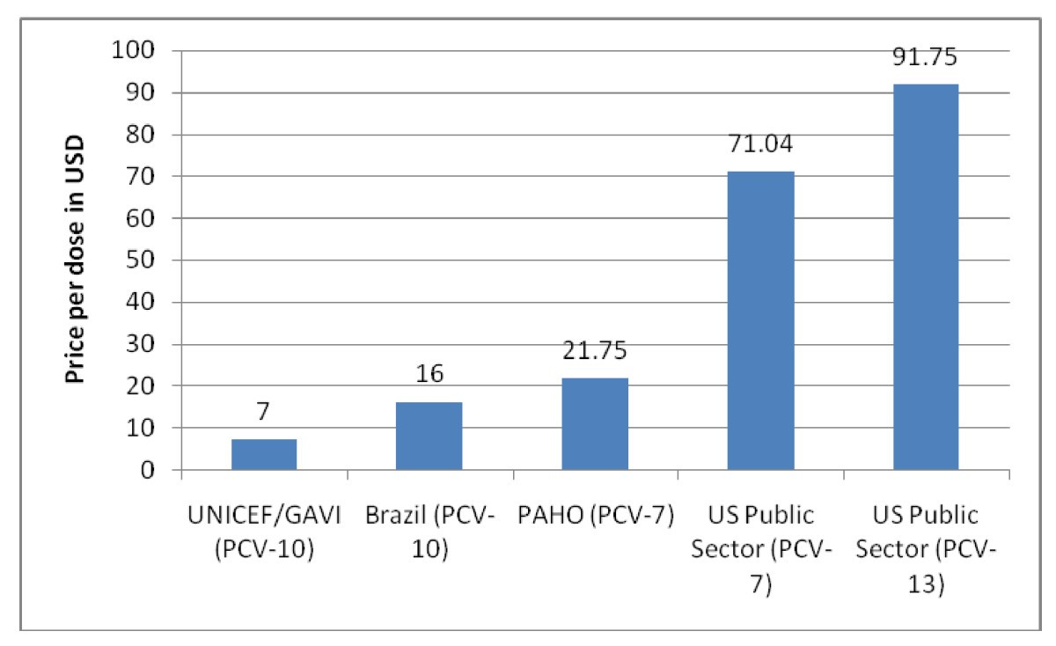
Pneumococcal conjugate vaccine tiered prices.
Source: Moon et al., “A win-win solution?: A critical analysis of tiered pricing to
improve access to medicines in developing countries
https://globalizationandhealth.biomedcentral.com/articles/10.1186/1744-8603-7-39
Pan American
Health Organization

Slide 24
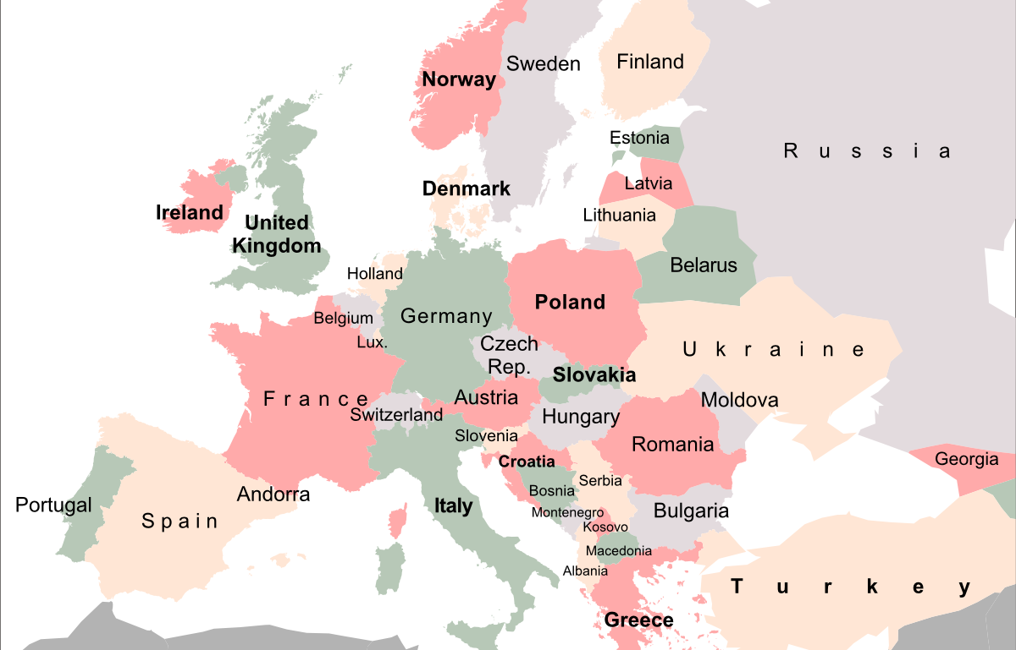
Metformin (insulin)
Prices per 1000 mg
$0.13
Data sources: UK, Holland, Germany from Management Sciences for Health’s International Drug Price Indicator Guide, 2010 numbers, listed in USD; Latvia, Hungary, Austria, Finland, Norway from Common European Drug Database, 2010-2011 numbers, gross retail price, converted from native currency to USD using currency converters, current as of October 31, 2011.
$0.17
400 tablets, 500 mg, $34.34
100 tablets,
850 mg, $11.17
500 tablets,
500 mg, $9.60
500 tablets, 850 mg, $5.58
120 tablets,
1000 mg, $17.19
$0.14
$0.04
$0.01
30 tablets, 1000 mg, $2.65
$0.09
1000 tablets, 500 mg, $19.23
$0.04
60 tablets, 1000 mg, $5.50
$0.09

Slide 25
Distribution and Payment Systems for Drugs in the United States
Pharma
Payments through this channel are the lowest
branded biologic
branded small molecule
≈ 78-82% AWP
grantbacks
Specialty Pharmaceutical
Wholesaler
rebates
23.1% or 13% discount
off private market
≈ 80-85% AWP
Government Provider
(VA, military medical, etc.)
Pharma Benefit Manager
≈ 85-90% AWP
Private Provider
(hospital, HMO, doctor, pharmacy)
Private
Insurer
Government Payer
(Medicare, Medicaid, VA)
≈ 85-90% AWP
many formulae;
goal = less than private reimbursements
insurance
premium
taxes
Employer
insurance premium
taxes
co-pay or retail price
wage reduction
Patients

Slide 26
Distribution and Payment Systems for Drugs in the United States
Pharma
Payments through this channel are the lowest
Payments through this channel are higher
branded biologic
branded small molecule
≈ 78-82% AWP
grantbacks
Specialty Pharmaceutical
Wholesaler
rebates
23.1% or 13% discount
off private market
≈ 80-85% AWP
Government Provider
(VA, military medical, etc.)
Pharma Benefit Manager
≈ 85-90% AWP
Private Provider
(hospital, HMO, doctor, pharmacy)
Private
Insurer
Government Payer
(Medicare, Medicaid, VA)
≈ 85-90% AWP
many formulae;
goal = less than private reimbursements
insurance
premium
taxes
Employer
insurance premium
taxes
co-pay or retail price
wage reduction
Patients

Slide 27
Distribution and Payment Systems for Drugs in the United States
Pharma
Payments through this channel are the lowest
Payments through this channel are higher
Payments through this channel are higher still
branded biologic
branded small molecule
≈ 78-82% AWP
grantbacks
Specialty Pharmaceutical
Wholesaler
rebates
23.1% or 13% discount
off private market
≈ 80-85% AWP
Government Provider
(VA, military medical, etc.)
Pharma Benefit Manager
≈ 85-90% AWP
Private Provider
(hospital, HMO, doctor, pharmacy)
Private
Insurer
Government Payer
(Medicare, Medicaid, VA)
≈ 85-90% AWP
many formulae;
goal = less than private reimbursements
insurance
premium
taxes
Employer
insurance premium
taxes
co-pay or retail price
wage reduction
Patients

Slide 28
Distribution and Payment Systems for Drugs in the United States
Pharma
Payments through this channel are the lowest
Payments through this channel are higher
Payments through this channel are higher still
branded biologic
branded small molecule
≈ 78-82% AWP
grantbacks
Payments through this channel are highest
Specialty Pharmaceutical
Wholesaler
rebates
23.1% or 13% discount
off private market
≈ 80-85% AWP
Government Provider
(VA, military medical, etc.)
Pharma Benefit Manager
≈ 85-90% AWP
Private Provider
(hospital, HMO, doctor, pharmacy)
Private
Insurer
Government Payer
(Medicare, Medicaid, VA)
≈ 85-90% AWP
many formulae;
goal = less than private reimbursements
insurance
premium
taxes
Employer
insurance premium
taxes
co-pay or retail price
wage reduction
Patients

Slide 29
Laser Printers

Slide 30
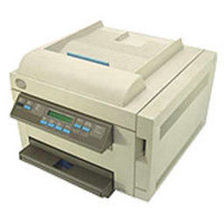
IBM Series E

Slide 31
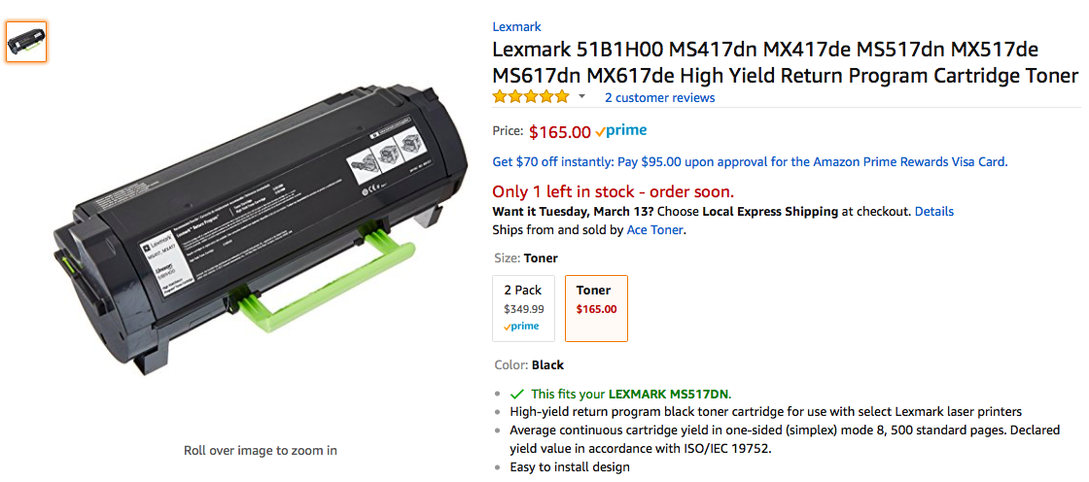

Slide 32
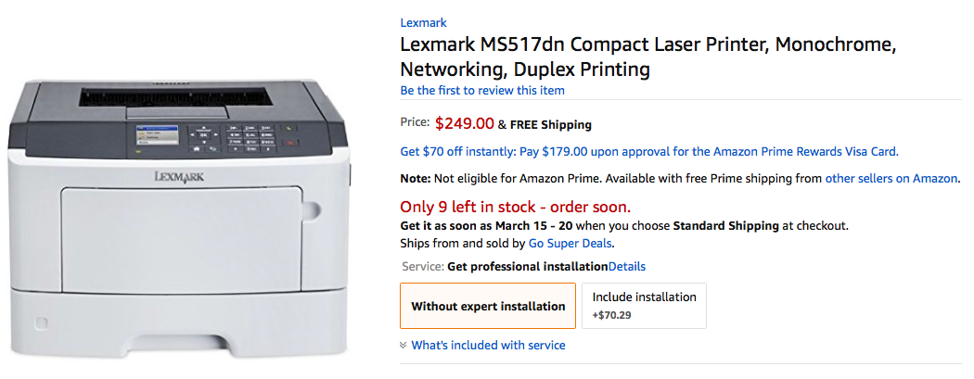
$249-$165 = $84

Slide 33
Possible rationales for this business model
Consumers typically do not know or investigate the cost of the cartridges
Consumers underestimate future costs of all sorts
Differential pricing
High-volume users, who typically are able and willing to pay more, will, over the life of the printer, pay much more than low-volume users

Slide 34
Canning Machines & Cans

Slide 35
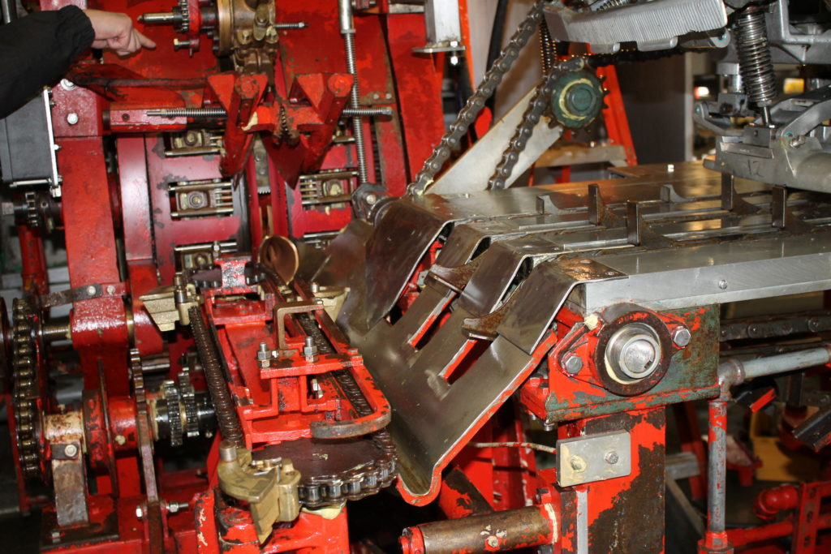

Slide 36
Refurbished Computers

Slide 37
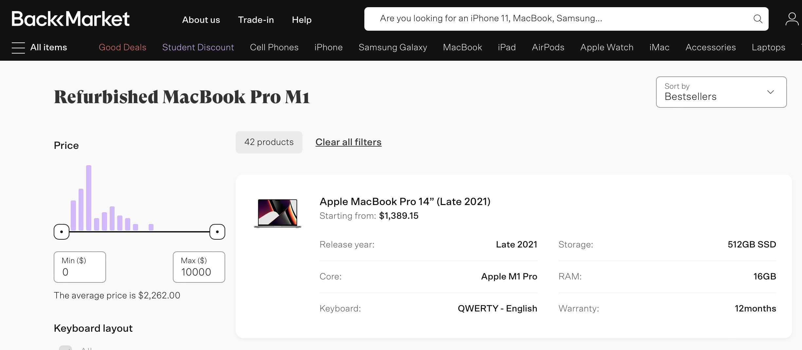

Slide 38
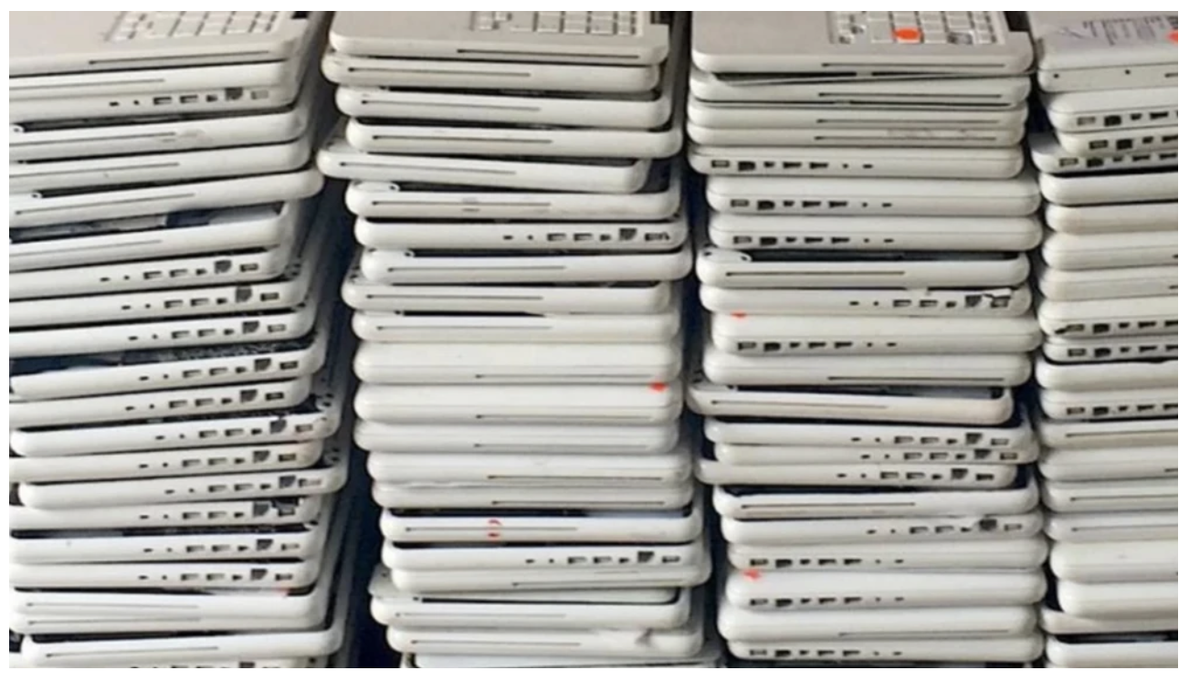
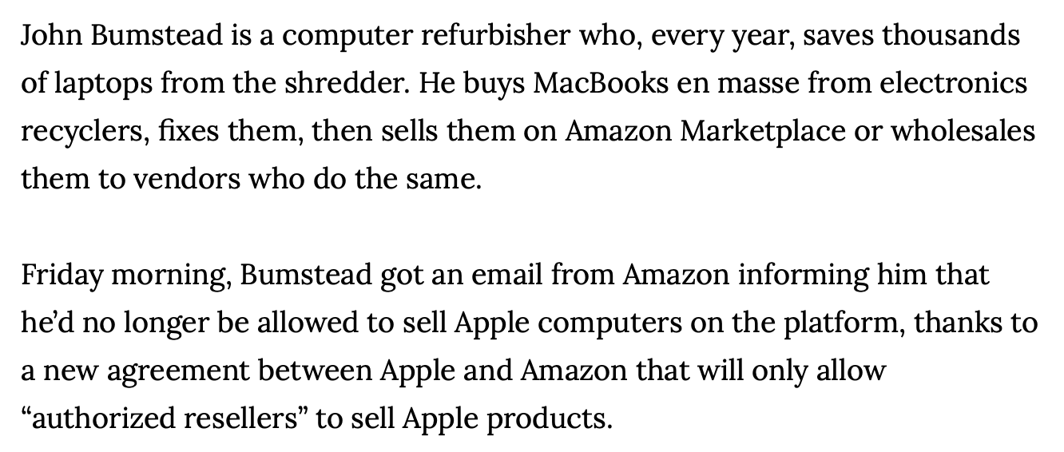
Source: https://www.vice.com/en/article/bjexb5/amazon-is-kicking-all-unauthorized-
apple-refurbishers-off-the-site

Slide 39
Patent Filing Fees

Slide 40
For definition of ”small entity,” see 37 CFR 1.27
For definition of “micro entity,” see 27 CFR 1.29

Slide 42
$1820 $728 $364

Slide 44
Neel Sukhatme, “Regulatory Monopoly and Differential Pricing in the Market for Patents” (2014)
Argues for technology-specific differential pricing of fees (especially maintenance fees)
“In the context of patents, the PTO could use third-degree price discrimination to charge different prices to applicants and patentees in different industries depending on their willingness to pay for patent protection. For example, if pharmaceutical patentees care more about patent protection than mechanical patentees, the PTO could charge the former higher maintenance fees than the latter. Because the pharmaceutical patentees care more about patent protection, they will be willing to pay more, hence enabling the PTO to increase its revenues.”

Slide 45
Part 3: How Can Legal Rules influence the use of Differential Pricing?

Slide 46
Requirements
A patent can provide the seller the market power necessary to engage in differential pricing
--e.g., an expansive interpretation of “make,” which encompasses repairs, expands market power by suppressing the market for “refurbished” products
The scope of the first-sale and exhaustion defenses
--e.g., an expansive exhaustion doctrine facilitates arbitrage and thus discourages differential pricing
Privacy laws can forbid the gathering or use of personal information
Antidiscrimination laws can prevent the use of specified criteria
market power
restrictions on arbitrage
heterogeneity among buyers
ability to differentiate those buyers
“First degree”: charge each buyer what he or she is able and willing to spend for a good or service
“Second degree”: the seller does not know how much different potential buyers are able and willing to pay, but induces them to reveal their resources or preferences
“Third degree”: seller separates buyers into classes corresponding roughly to their ability and willingness to pay

Slide 47
Part 4: Should We Encourage or Discourage Differential Pricing?

Slide 48
Perspectives
Welfare Theory
Fairness Theory
Cultural Theory

Slide 49
Market A
Price Discrimination
$
5
Consumer Surplus: $100,000
Market B
4
Consumer Surplus: $56,250
Profit:
$200,000
3
Deadweight loss: $56,250
Profit:
$112,500
Deadweight loss: $100,000
2
MC
MC
1
5
4
3
2
1
O
1
2
3
Q
(x100,000)
Q
(x100,000)
MR
MR
© 2008, William Fisher. This work is licensed under the Creative Commons Attribution-NonCommercial-ShareAlike 2.5 License.

Slide 50
Market A
Price Discrimination
$
5
Consumer Surplus: $100,000
Market B
4
Consumer Surplus: $56,250
Profit:
$200,000
3
Deadweight loss: $56,250
Profit:
$112,500
Deadweight loss: $100,000
2
MC
MC
1
5
4
3
2
1
O
1
2
3
Q
(x100,000)
Q
(x100,000)
MR
MR
© 2008, William Fisher. This work is licensed under the Creative Commons Attribution-NonCommercial-ShareAlike 2.5 License.

Slide 51
Market A
Price Discrimination
$
5
Market B
4
Consumer Surplus: $156,250
3
Deadweight loss: $156,250
Profit:
$312,500
2
MC
MC
1
5
4
3
2
1
O
1
2
3
Q
(x100,000)
Q
(x100,000)
MR
MR
© 2008, William Fisher. This work is licensed under the Creative Commons Attribution-NonCommercial-ShareAlike 2.5 License.

Slide 52
Market A
No Price Discrimination
$
5
Market B
4
Consumer Surplus: 250,000
3
Deadweight loss: $125,000
Profit:
$250,000
2
MC
MC
1
5
4
3
2
1
O
1
2
3
Q
(x100,000)
Q
(x100,000)
MR
MR
© 2008, William Fisher. This work is licensed under the Creative Commons Attribution-NonCommercial-ShareAlike 2.5 License.

Slide 53
Market A
No Price Discrimination
$
5
Market B
4
Consumer Surplus: 250,000
3
Deadweight loss: $125,000
Profit:
$250,000
2
MC
MC
1
5
4
3
2
1
O
1
2
3
Q
(x100,000)
Q
(x100,000)
MR
MR
© 2008, William Fisher. This work is licensed under the Creative Commons Attribution-NonCommercial-ShareAlike 2.5 License.

Slide 54
 | Market A | Market B | Market A+B Discrim | Market A+B No Discrim
Output | 100,000 | 150,000 | 250,000 | 250,000
Price | $3 | $1.75 |  | $2
Profit | $200,000 | $112,500 | $312,500 | $250,000
Consumer Surplus | $100,000 | $56,250 | $156,250 | $250,000
Total Surplus | $300,000 | $168,750 | $468,750 | $500,000
Deadweight Loss | $100,000 | $56,250 | $156,250 | $125,000
© 2008, William Fisher. This work is licensed under the Creative Commons Attribution-NonCommercial-ShareAlike 2.5 License.

Slide 55
Market A
Price Discrimination
$
5
Consumer Surplus: $100,000
Market C
4
Consumer Surplus: $8,333
Profit:
$200,000
3
Deadweight loss: $8,333
Profit:
$16,667
Deadweight loss: $100,000
2
MC
MC
1
5
4
3
2
1
O
1
2
3
Q
(x100,000)
Q
(x100,000)
MR
MR
© 2008, William Fisher. This work is licensed under the Creative Commons Attribution-NonCommercial-ShareAlike 2.5 License.

Slide 56
Market A
Price Discrimination
$
5
Consumer Surplus: $100,000
Market C
4
Consumer Surplus: $8,333
Profit:
$200,000
3
Deadweight loss: $8,333
Profit:
$16,667
Deadweight loss: $100,000
2
MC
MC
1
5
4
3
2
1
O
1
2
3
Q
(x100,000)
Q
(x100,000)
MR
MR
© 2008, William Fisher. This work is licensed under the Creative Commons Attribution-NonCommercial-ShareAlike 2.5 License.

Slide 57
Market A
Price Discrimination
$
5
Market C
4
Consumer Surplus: $108,333
3
Deadweight loss: $108,333
Profit:
$216,667
2
MC
MC
1
5
4
3
2
1
O
1
2
3
Q
(x100,000)
Q
(x100,000)
MR
MR
© 2008, William Fisher. This work is licensed under the Creative Commons Attribution-NonCommercial-ShareAlike 2.5 License.

Slide 58
Market A
No Price Discrimination
$
5
Market C
4
Consumer Surplus: $100,000
3
Deadweight loss: $133,333
Profit:
$200,000
2
MC
MC
1
5
4
3
2
1
O
1
2
3
Q
(x100,000)
Q
(x100,000)
MR
MR
© 2008, William Fisher. This work is licensed under the Creative Commons Attribution-NonCommercial-ShareAlike 2.5 License.

Slide 59
 | Market A | Market C | Market A+C Discrim | Market A+C No Discrim
Output | 100,000 | 66,700 | 166,700 | 100,000
Price | $3 | $1.25 |  | $3
Profit | $200,000 | $16,667 | $216,667 | $200,000
Consumer Surplus | $100,000 | $8,333 | $108,333 | $100,000
Total Surplus | $300,000 | $25,000 | $325,000 | $300,000
Deadweight Loss | $100,000 | $8,333 | $108,333 | $133,333
© 2008, William Fisher. This work is licensed under the Creative Commons Attribution-NonCommercial-ShareAlike 2.5 License.

Slide 60
Complications
Dynamic effects of increased monopoly profits from PD may offset welfare losses
Redistribution of wealth through DP may increase general welfare
Strong positive network externalities in the "weak" market my cause DP to promote welfare even when total output does not increase
Whether permitting seller to engage in DP (of a particular sort) will promote welfare depends on how she will behave if prevented
Welfare effects of DP must take into account "psychic externalities"
depends upon
(a) general principle of diminishing marginal utility of wealth; and
(b) random distribution of utility curves

Slide 61
Complications
Dynamic effects of increased monopoly profits from PD may offset welfare losses
Redistribution of wealth through DP may increase general welfare
Strong positive network externalities in the "weak" market my cause DP to promote welfare even when total output does not increase
Whether permitting seller to engage in DP (of a particular sort) will promote welfare depends on how she will behave if prevented
Welfare effects of DP must take into account "psychic externalities"
E.g. educational discounts for software
E.g., DP that makes vaccines available cheaply in developing countries will have strong positive externalities

Slide 62
Complications
Dynamic effects of increased monopoly profits from PD may offset welfare losses
Redistribution of wealth through DP may increase general welfare
Strong positive network externalities in the "weak" market my cause DP to promote welfare even when total output does not increase
Whether permitting seller to engage in DP (of a particular sort) will promote welfare depends on how she will behave if prevented
Welfare effects of DP must take into account "psychic externalities"
Second-degree DP is often more socially wasteful than third-degree (e.g., versioning; temporal)

Slide 63
Complications
Dynamic effects of increased monopoly profits from PD may offset welfare losses
Redistribution of wealth through DP may increase general welfare
Strong positive network externalities in the "weak" market my cause DP to promote welfare even when total output does not increase
Whether permitting seller to engage in DP (of a particular sort) will promote welfare depends on how she will behave if prevented
Welfare effects of DP must take into account "psychic externalities"
Wide variety of popular attitudes toward DP:
unpopularity of "charging what the market will bear”; "gouging"
unpopularity of "versioning"
consumers like transparency, dislike hidden pricing strategies
consumers like choices
consumers accept 3rd-degree DP if they think the categories are fair
framing matters
"discount" or "surcharge"

Slide 64
Perspectives
Welfare Theory
Fairness Theory
Cultural Theory

Slide 65
Perspectives
Pro: “It’s my party….”
Con: You get only “one bite at the apple.”
“[T]he patent exhaustion doctrine is premised on the broad principle that the patent owner is entitled to only one bite at the apple…” Skladony, “Commentary on Exhaustion Principles” (2007)
Assessments of the fairness of DP often seem to hinge on the legitimacy of the criteria used to create subgroups of consumers
Welfare Theory
Fairness Theory
Cultural Theory

Slide 66
Illegitimate
Legitimate
Geography
Gender
Wealth
Race
Age
Ayres’ study
of car sales
Need-based
college
scholarships
Region-specific
gasoline or grocery prices
Patricia Williams
And Benetton
Senior
discounts
1995 California Gender-Tax Repeal Act
(NYC; PA, MA)

Slide 67
Perspectives
Pro:
DP can help equalize access to life-saving or informational products
DP can foster progressive redistribution of wealth
Con:
DP can corrode spirit of altruistic sharing
DP can foster invasions of privacy (to ferret out the information necessary to set prices precisely)
Welfare Theory
Fairness Theory
Cultural Theory

Slide 68
Perspectives
Pro:
DP can help equalize access to life-saving or informational products
DP can foster progressive redistribution of wealth
Con:
DP can corrode spirit of altruistic sharing
DP can foster invasions of privacy (to ferret out the information necessary to set prices precisely)
Welfare Theory
Fairness Theory
Cultural Theory
All of the arguments, pro and con, vary sharply by context

