Slide 1
Patents and the Pharmaceutical Industry
William Fisher
February 2024

Slide 2
(1) The Roles of Governments

Slide 3
Potential Tools
Government research
Grants
Prizes
Enhance private protections
IP
Incentives
Access
Regulation
Procurement
Price regulation
Subsidized insurance
Antitrust
Comprehensive licensure for safety & efficacy
Approve, accelerate, or slow based on cost/benefit analysis
Coordinate post-approval studies

Slide 4
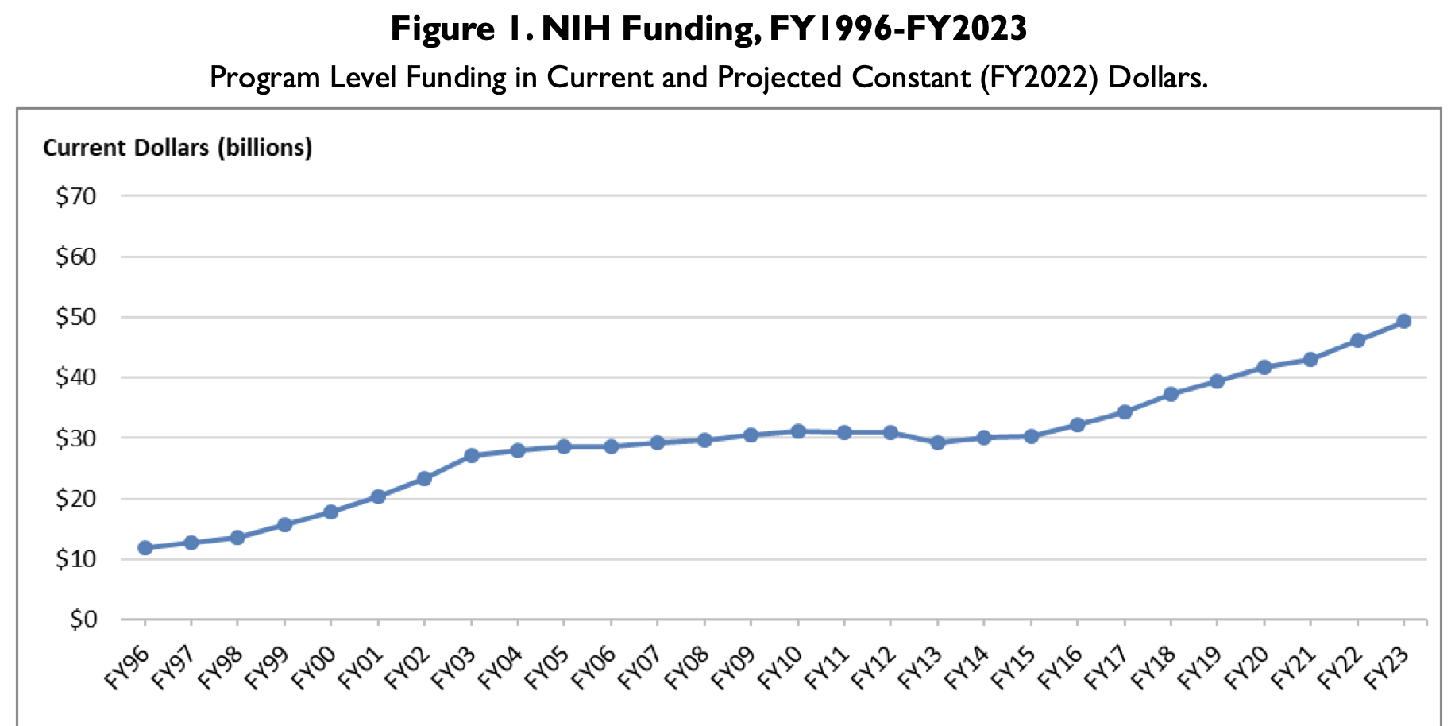
Source: https://crsreports.congress.gov/product/pdf/R/R43341/45

Slide 5
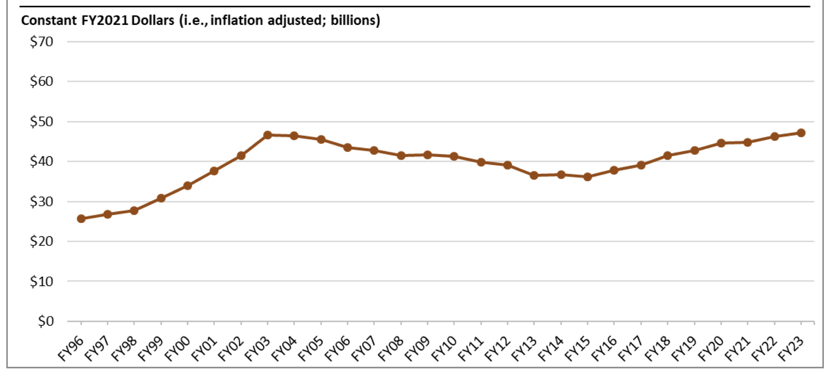
Source: https://crsreports.congress.gov/product/pdf/R/R43341/45

Slide 6
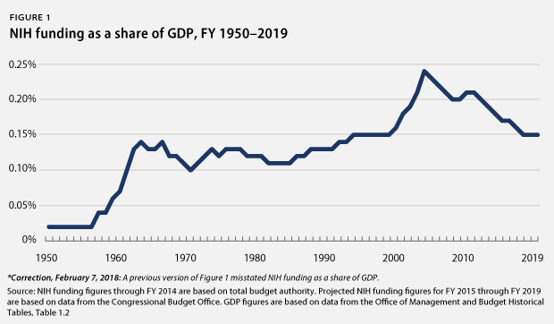
Source: https://www.americanprogress.org/issues/economy/reports/2014/03/25/86369/
erosion-of-funding-for-the-national-institutes-of-health-threatens-u-s-leadership-in-biomedical-research/

Slide 7
years
0
4
8
12
16
20
24
28
32
Discovery &
preclinical
Clinical
development
FDA
review
Patent protection
§156
Generic Drug Distribution
Generic Drug Development
FDA review
4
8
12
16
20
Adapted from Choi et al,
“Medicines for the Mind,”
84 Neuron 554 (2014)
Commercial life
FDA
approval

Slide 8
Exclusivity
data-exclusivity rules forbid the FDA to accept an application that relies upon safety or efficacy studies conducted by the beneficiary of the exclusivity
market-exclusivity rules forbid the FDA to approve a drug that will compete with a drug developed by the beneficiary of the exclusivity.

Slide 9
Exclusivity Periods
7 years of market exclusivity for “orphan drugs” (drugs that address diseases that affect fewer than 200,000 patients in the United States);
5 years of data exclusivity for new chemical entities (NCEs);
3 years of data exclusivity for modifications of existing drugs significant enough to require new clinical trials;
6 months of market exclusivity for on-patent drugs that have been tested (at the FDA’s request) for efficacy on children;
5 years of market exclusivity for new antibiotic agents;
4 years of data exclusivity plus an additional 8 years of market exclusivity for biologics

Slide 10
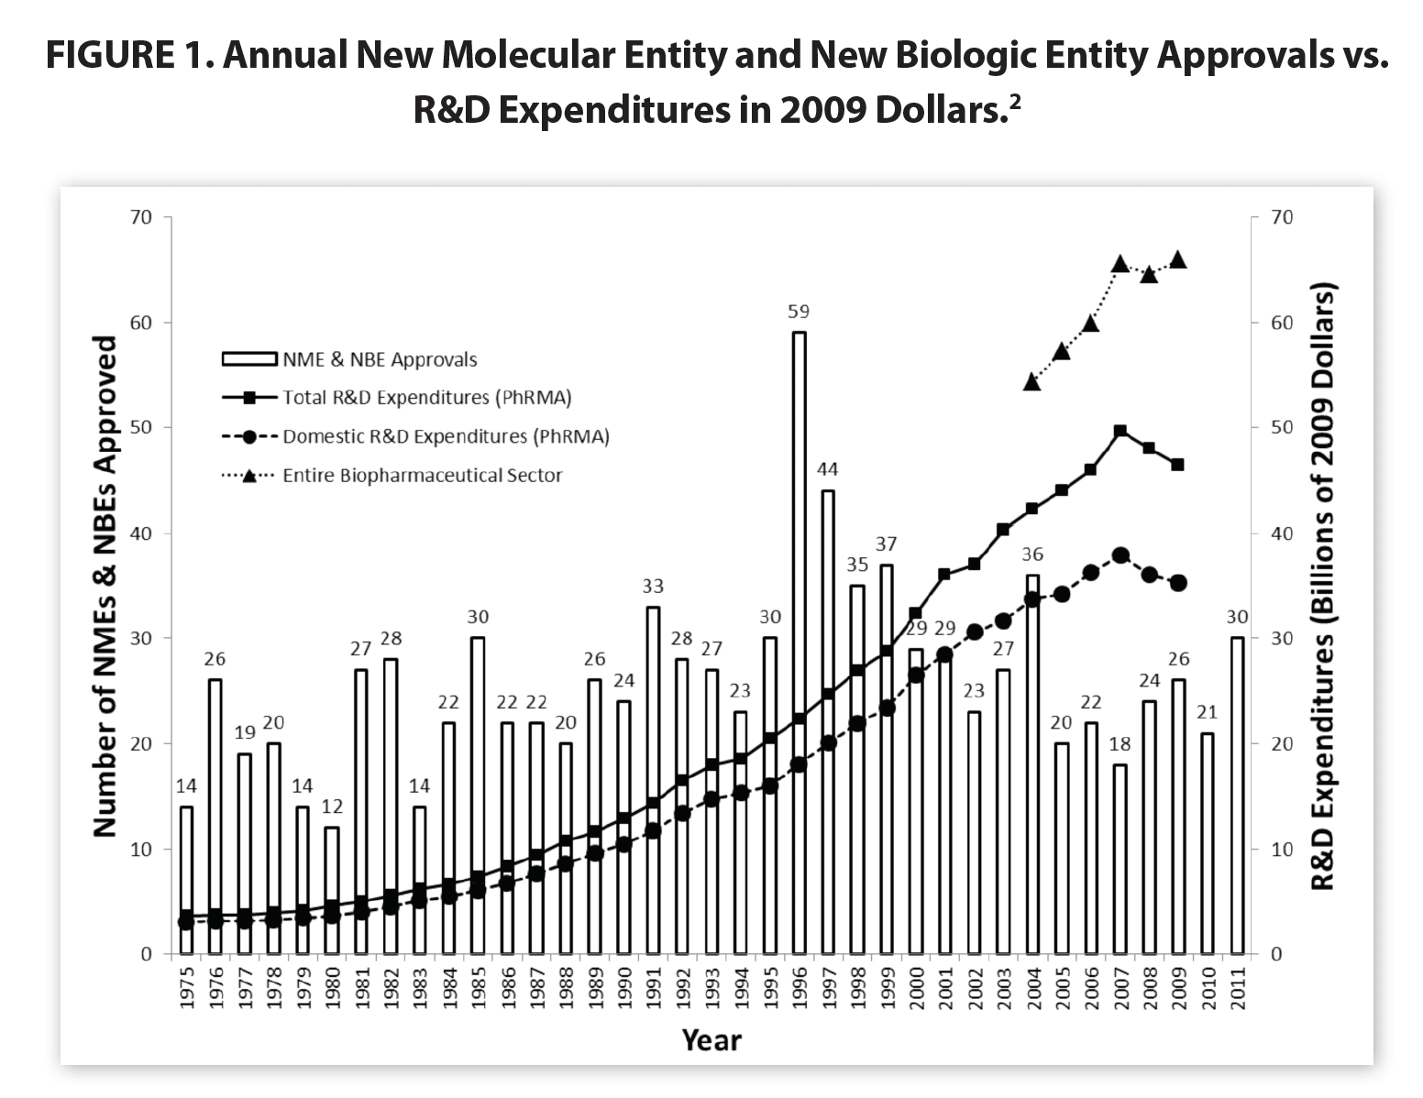
Source: President’s Council of Advisors on Science and Technology,
Propelling Innovation in Drug Discovery, Development and Evaluation (2012)

Slide 11
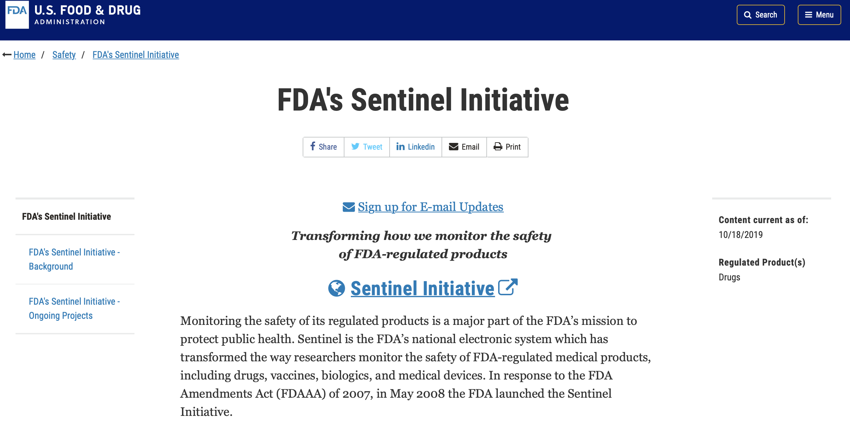

Slide 12
(2) Successes and Failures

Slide 13
Lack of coordination among the three sectors leads to:
Conflicts
High cost of drugs in US
Bias in favor of medicines and against vaccines
  Willingness to pay does not account for externalities
  Prospect theory (bounded rationality)
  Products liability
  Procurement pricing
Gaps
Excessive investment in “me-too” drugs
Insufficient investment in:
  translational research
  drugs aimed at CNS disorders
  drugs focused on infectious diseases common in developing countries

Slide 14
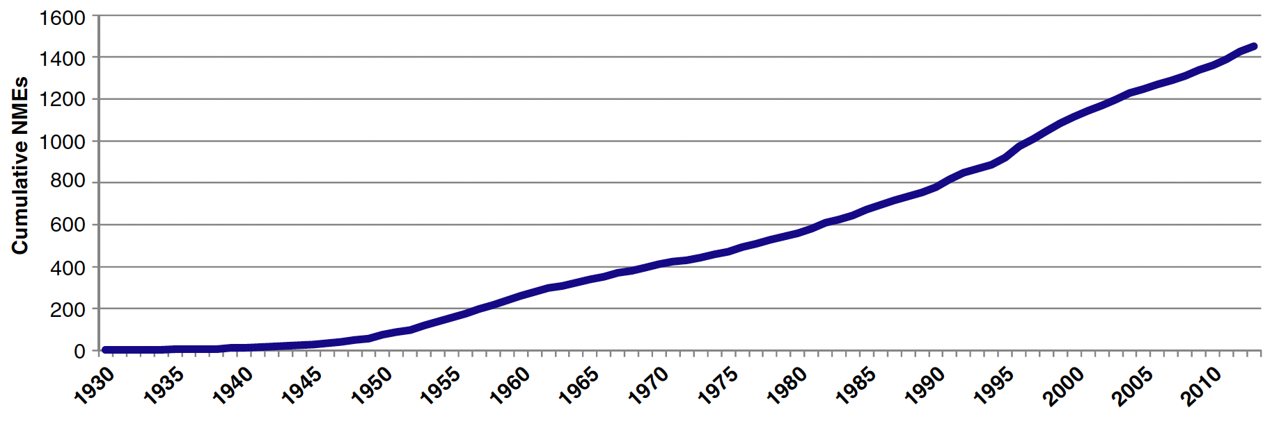
Cumulative New Molecular Entities Approved by FDA
Source: Kinch et al., “An overview of FDA-approved new molecular entities: 1927–2013,” Drug Discovery Today 19 (2014)

Slide 15
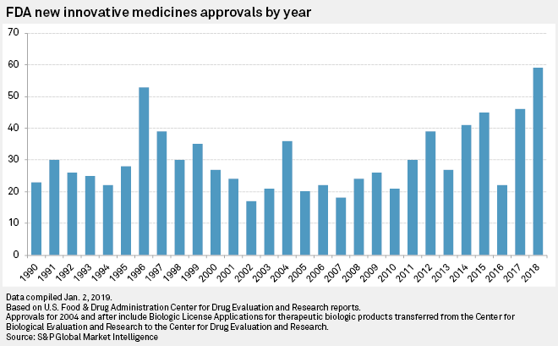
Source: Woleben, “US FDA shatters drug approval records in 2018,” S&P Market Intelligence (2019)

Slide 16
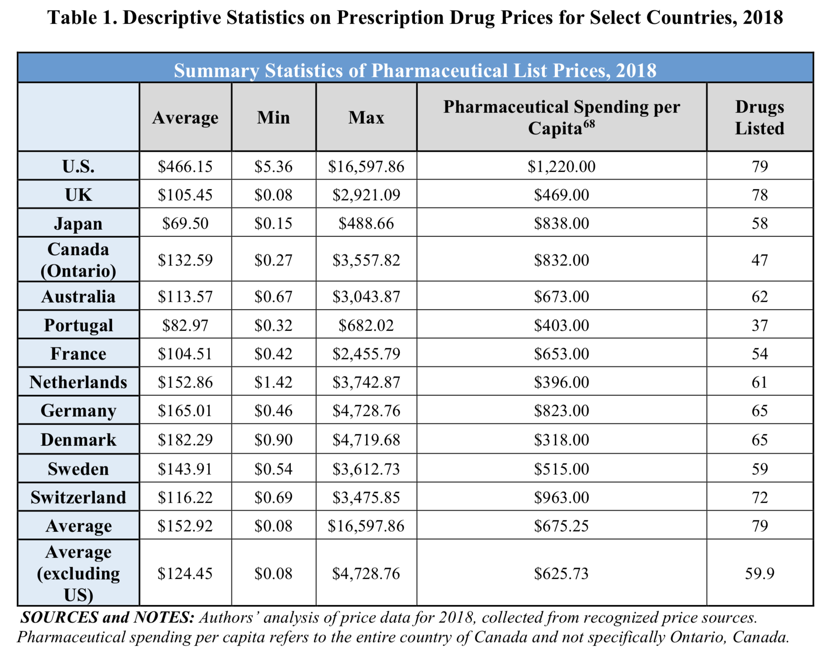
Source: https://waysandmeans.house.gov/sites/democrats.waysandmeans.house.gov/files/
documents/U.S.%20vs.%20International%20Prescription%20Drug%20Prices_0.pdf

Slide 17
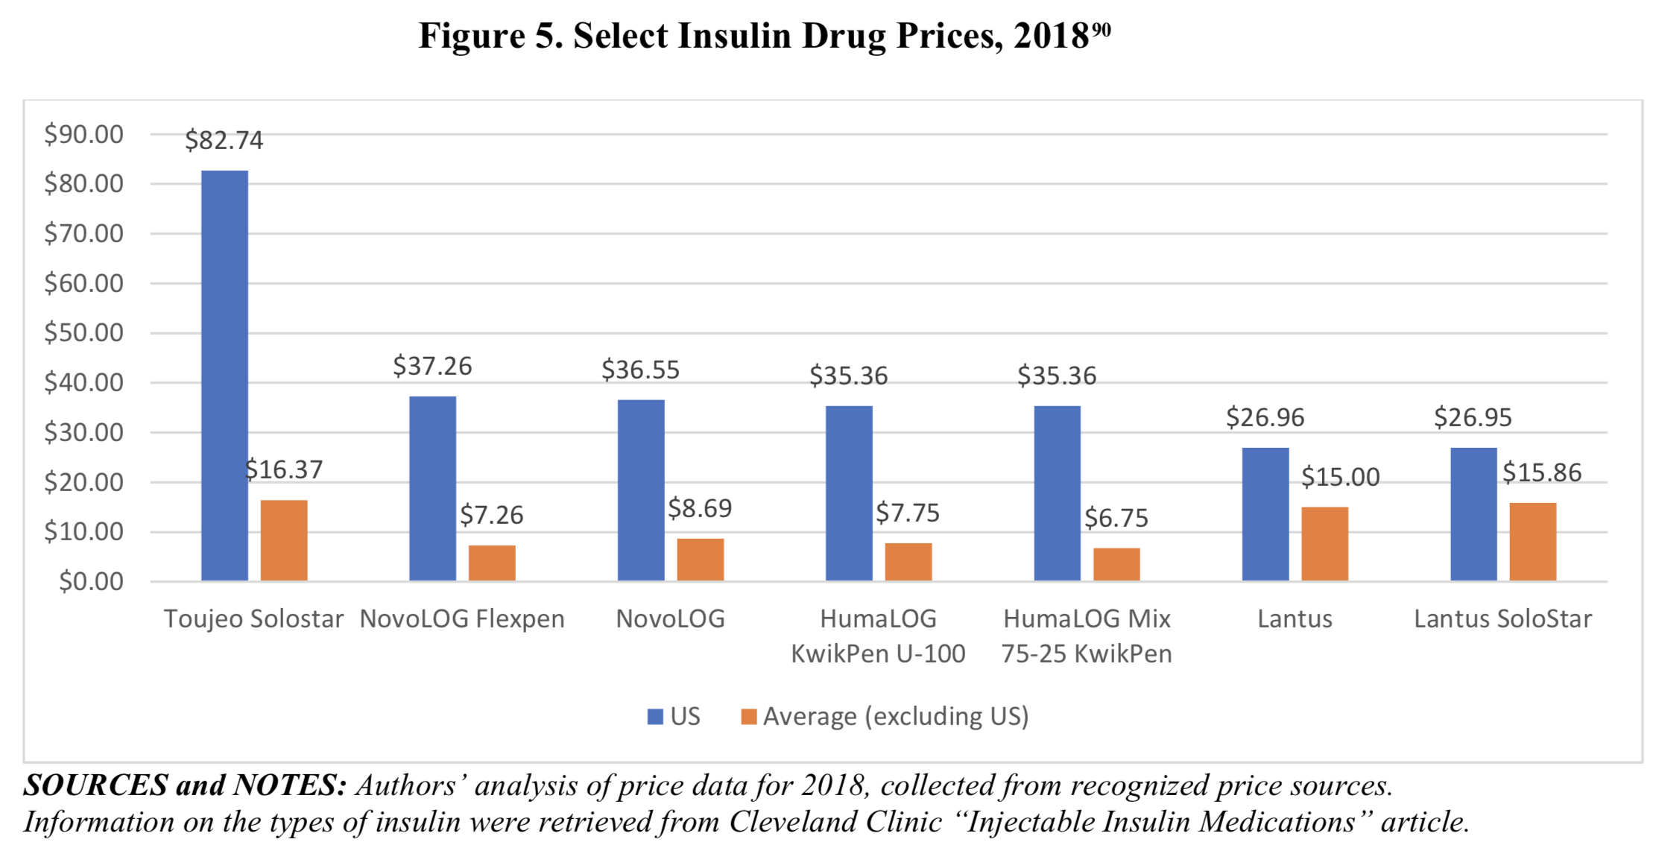
Source: https://waysandmeans.house.gov/sites/democrats.waysandmeans.house.gov/files/
documents/U.S.%20vs.%20International%20Prescription%20Drug%20Prices_0.pdf

Slide 18
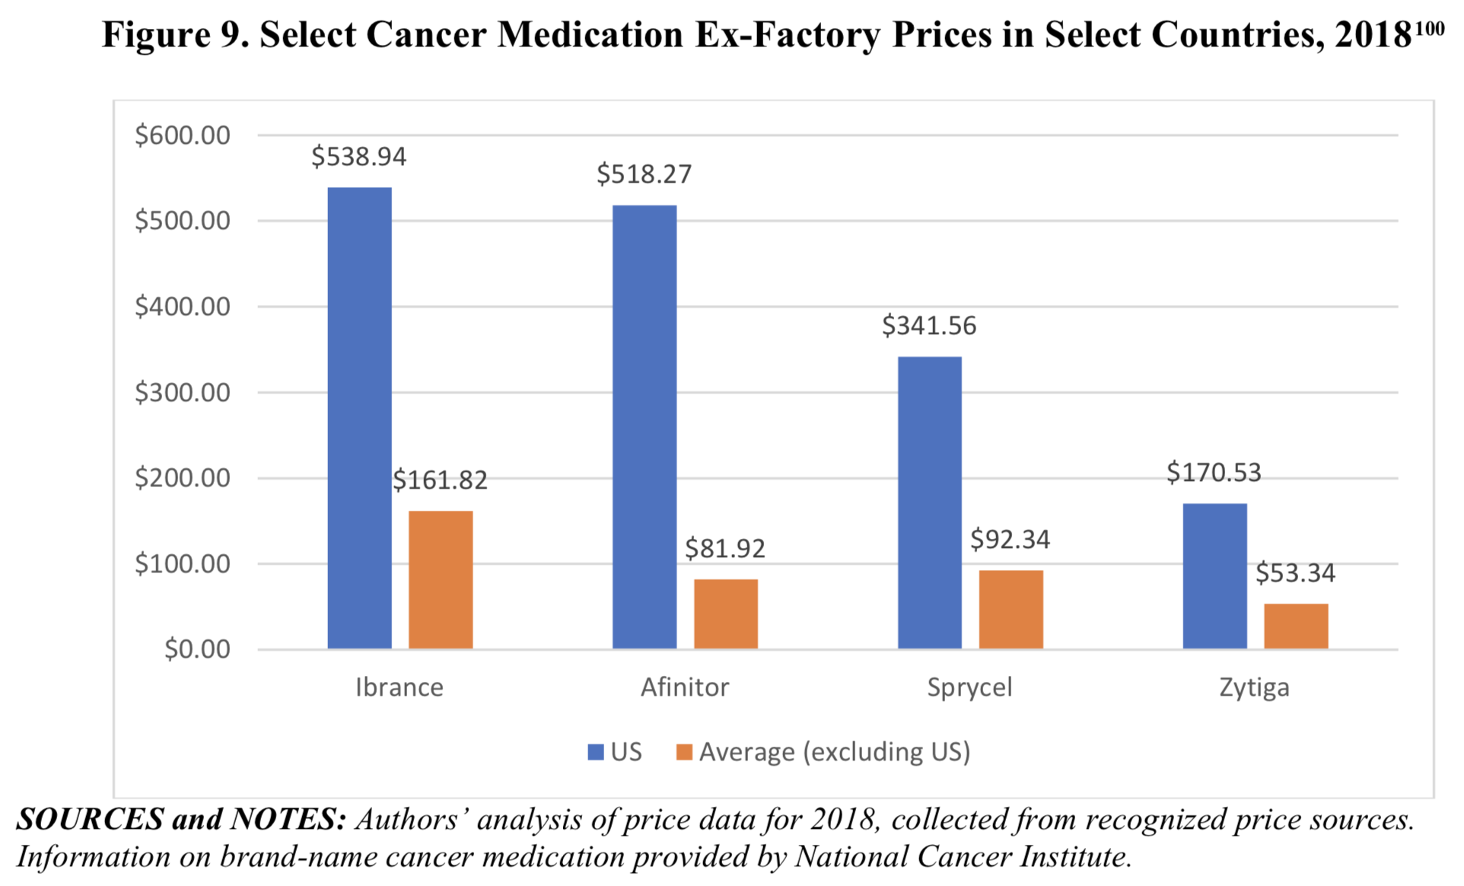
Source: https://waysandmeans.house.gov/sites/democrats.waysandmeans.house.gov/files/
documents/U.S.%20vs.%20International%20Prescription%20Drug%20Prices_0.pdf

Slide 19
2
Prescription drug expenditure in the United States from 1960 to 2022 (in billion U.S. dollars)
Note(s): United States
Further information regarding this statistic can be found on page 8.
Source(s): CMS; ID 184914

Slide 20
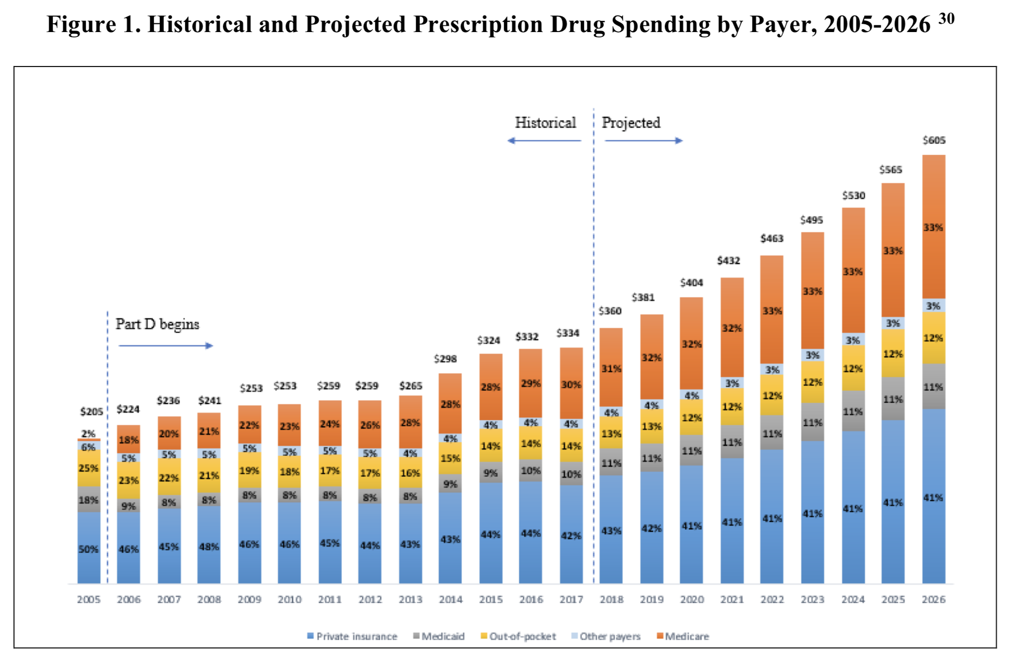
[in USD billions per year in the United States]
Source: https://waysandmeans.house.gov/sites/democrats.waysandmeans.house.gov/files/
documents/U.S.%20vs.%20International%20Prescription%20Drug%20Prices_0.pdf

Slide 21
National per capita health expenditure in the United States from 1960 to 2022 (in U.S. dollars)
2
Note(s): United States; 1960 to 2022
Further information regarding this statistic can be found on page 8.
Source(s): CMS; ID 184955

Slide 22
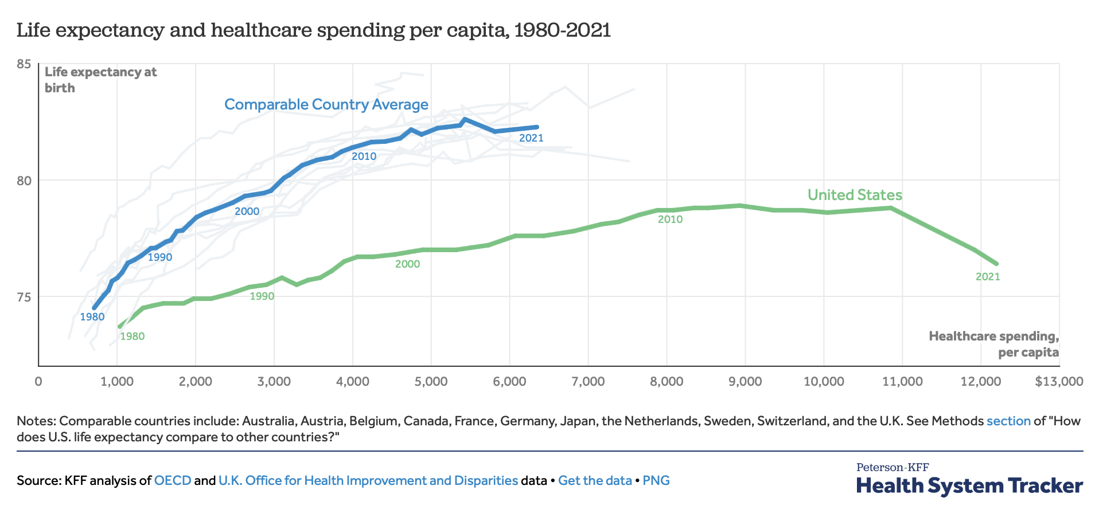
Source: https://www.healthsystemtracker.org/chart-collection/u-s-life-expectancy-compare-countries/#Life%20expectancy%20at%20birth%20by%20sex,%20in%20years,%202021

Slide 23
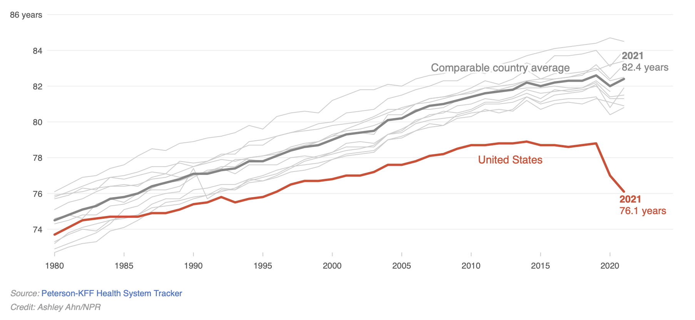
Source: “Life expectancy continues to decline in the U.S. as it rebounds in other countries,” NPR, March 25, 2023,
https://www.npr.org/sections/health-shots/2023/03/25/1164819944/live-free-and-die-the-sad-state-of-u-s-life-expectancy

Slide 24
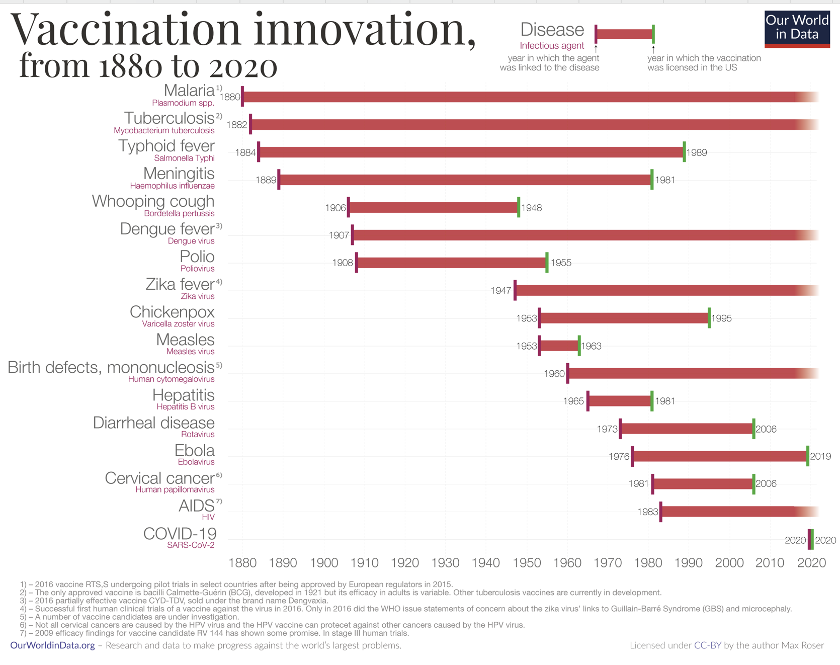
Source: https://ourworldindata.org/vaccination

Slide 25
(3) Life Cycle of a Patented Drugs

Slide 26
Price
Based on data for (almost) all prescription drugs sold in the US, 2000-2004 (1560 molecules)
Source: Frank R. Lichtenberg and Gautier Duflos, "The Effect of Patent Expiration on
U.S. Drug Prices, Marketing, and Utilization by the Public,” Manhattan Institute for Policy
Research (2009), http://www.manhattan-institute.org/html/mpr_11.htm

Slide 27
Price
?
Source: Frank R. Lichtenberg and Gautier Duflos, "The Effect of Patent Expiration on
U.S. Drug Prices, Marketing, and Utilization by the Public,” Manhattan Institute for Policy
Research (2009), http://www.manhattan-institute.org/html/mpr_11.htm

Slide 28
Price
CBO: Average period of patent protection for drugs = 11.5 years, http://www.cbo.gov/doc.cfm?index=655&type=0&sequence=5
Source: Frank R. Lichtenberg and Gautier Duflos, "The Effect of Patent Expiration on
U.S. Drug Prices, Marketing, and Utilization by the Public,” Manhattan Institute for Policy
Research (2009), http://www.manhattan-institute.org/html/mpr_11.htm

Slide 29
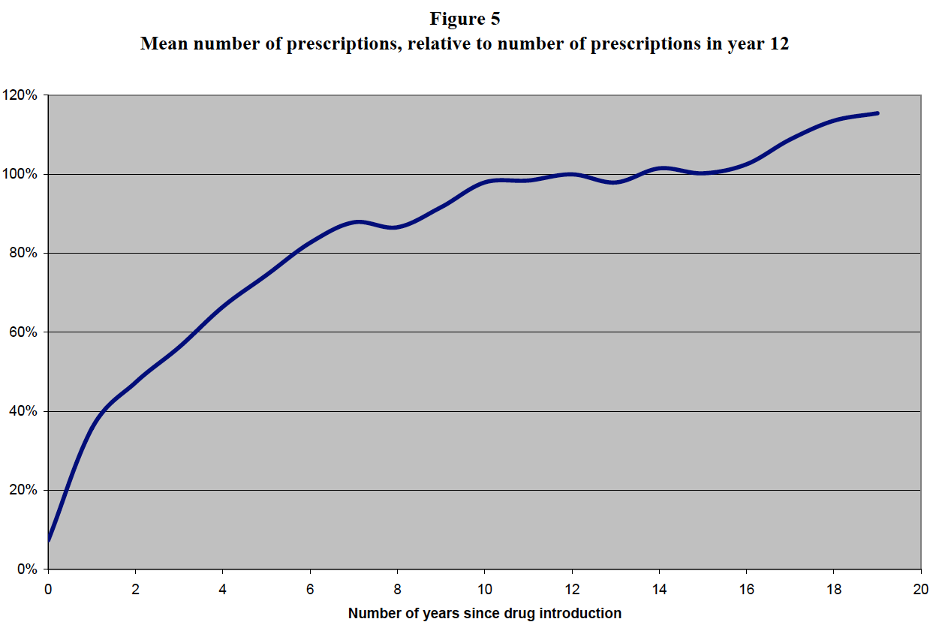
Volume
(total number of prescriptions;
branded + generic)
Based on data for (almost) all prescription drugs sold in the US, 2000-2004 (1560 molecules)
Source: Frank R. Lichtenberg and Gautier Duflos, "The Effect of Patent Expiration on
U.S. Drug Prices, Marketing, and Utilization by the Public,” Manhattan Institute for Policy
Research (2009), http://www.manhattan-institute.org/html/mpr_11.htm

Slide 30
Volume
Based on data for (almost) all prescription drugs sold in the US, 2000-2004 (1560 molecules)
Source: Frank R. Lichtenberg and Gautier Duflos, "The Effect of Patent Expiration on
U.S. Drug Prices, Marketing, and Utilization by the Public,” Manhattan Institute for Policy
Research (2009), http://www.manhattan-institute.org/html/mpr_11.htm

Slide 31
Source: Frank R. Lichtenberg and Gautier Duflos, "The Effect of Patent Expiration on
U.S. Drug Prices, Marketing, and Utilization by the Public,” Manhattan Institute for Policy
Research (2009), http://www.manhattan-institute.org/html/mpr_11.htm

Slide 32
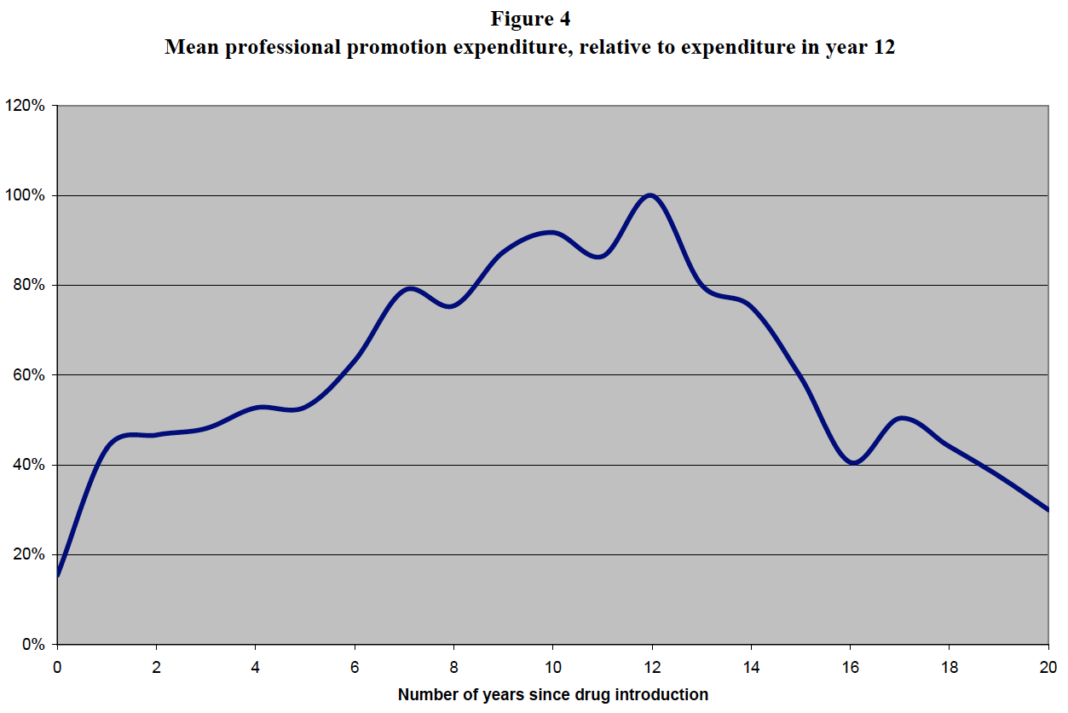
Source: Frank R. Lichtenberg and Gautier Duflos, "The Effect of Patent Expiration on
U.S. Drug Prices, Marketing, and Utilization by the Public,” Manhattan Institute for Policy
Research (2009), http://www.manhattan-institute.org/html/mpr_11.htm

Slide 33
(4) Revenue Model of the US Pharmaceutical Industry

Slide 34
Types
“Small molecules”
  Compounds manufactured through chemical synthesis
  Well-defined chemical structures
  Easy to “reverse engineer”
  Currently ~95% of global pharmaceutical market
  When no longer protected by IP, compete with “generics”
“Biologics”
  Drugs extracted from or manufactured in living organisms
  Complex composition
  Difficult to “reverse engineer”
  Currently ~5% of global pharmaceutical market, but rising
  When no longer protected by IP, compete with “biosimilars”

Slide 35

Distribution and Payment Systems for Drugs in the United States
Pharma
branded biologic
branded small molecule
≈ 78-82% AWP
grantbacks
Specialty Pharmaceutical
Wholesaler
rebates
23.1% or 13% discount
off private market
≈ 80-85% AWP
Government Provider
(VA, military medical, etc.)
Pharma Benefit Manager
≈ 85-90% AWP
Private Provider
(hospital, HMO, doctor, pharmacy)
Private
Insurer
Government Payer
(Medicare, Medicaid, VA)
≈ 85-90% AWP
many formulae;
goal = less than private reimbursements
insurance
premium
taxes
Employer
insurance premium
taxes
co-pay or retail price
wage reduction
Patients

