Slide 1
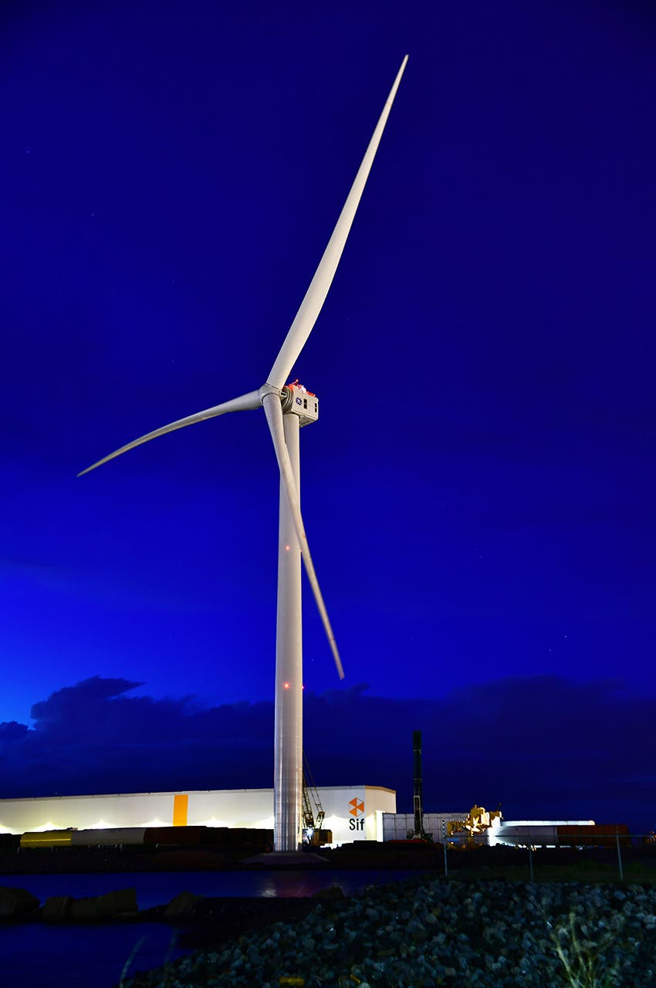
Siemens
PX047
William Fisher
March 27, 2024

Slide 2
Background

Slide 3
Definitions
Watt = a measure of electric power
More specifically, a measure of the rate of energy transfer over a unit of time
one watt = one joule (J) per second
Megawatt = 1000 kilowatts = 1,000,000 watts
Aprx. Enough to supply 750 homes simultaneously
Terawatt = 1 trillion watts = 1,000,000 megawatts
A “watt hour” is a measure of electricity consumption
1 Wh is (of course) the consumption of one watt of electricity for one hour

Slide 4
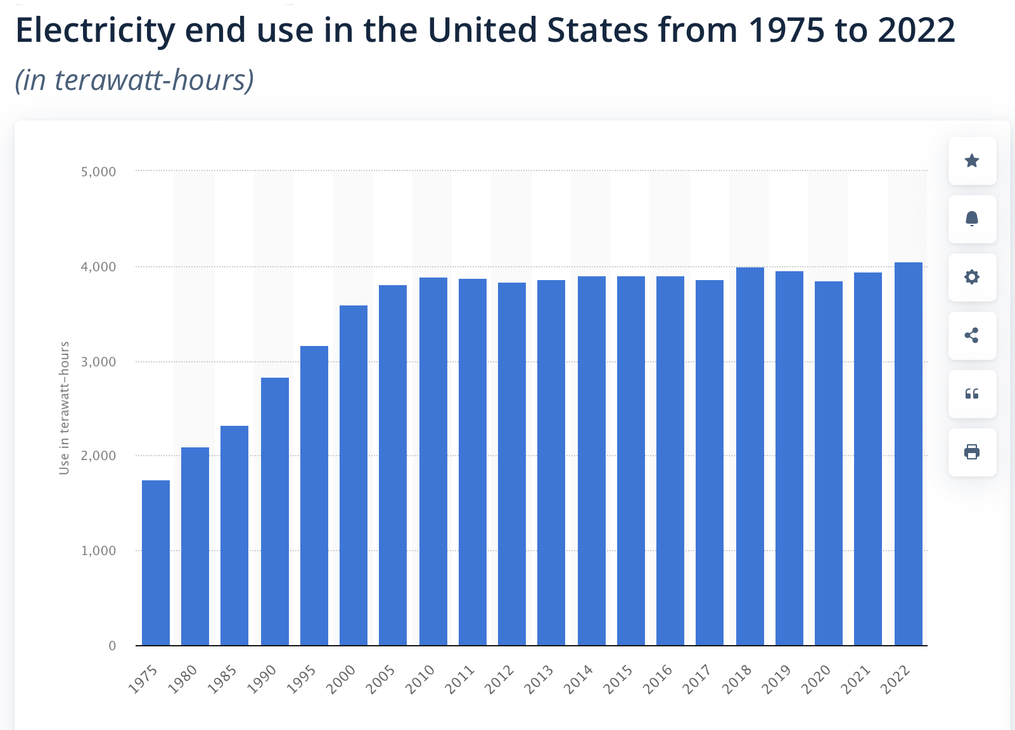

Slide 5
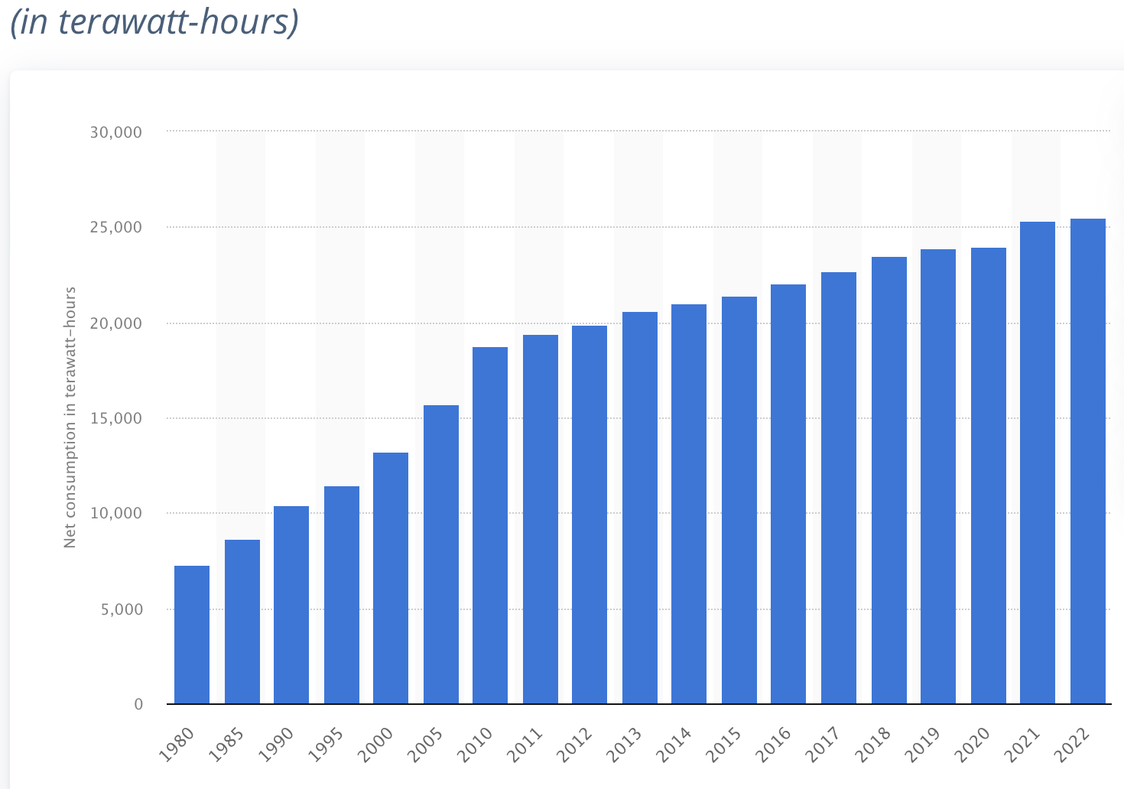
Global Electricity Consumption

Slide 6
6
Generation of electricity worldwide from 1990 to 2022, by energy source (in terawatt-hours)
Note(s): Worldwide; 1990 to 2022; IEA is the source of the figures until 2019.
Further information regarding this statistic can be found on page 8.
Source(s): Ember; IEA; ID 273273

Slide 7
6
Generation of electricity worldwide from 1990 to 2022, by energy source (in terawatt-hours)
Wind
Note(s): Worldwide; 1990 to 2022; IEA is the source of the figures until 2019.
Further information regarding this statistic can be found on page 8.
Source(s): Ember; IEA; ID 273273

Slide 8
4
Distribution of electricity generation worldwide in 2022, by energy source
Note(s): Worldwide; 2022
Further information regarding this statistic can be found on page 8.
Source(s): Ember; ID 269811

Slide 9
4
Distribution of electricity generation worldwide in 2022, by energy source
Note(s): Worldwide; 2022
Further information regarding this statistic can be found on page 8.
Source(s): Ember; ID 269811

Slide 10
Wind Farms

Slide 11
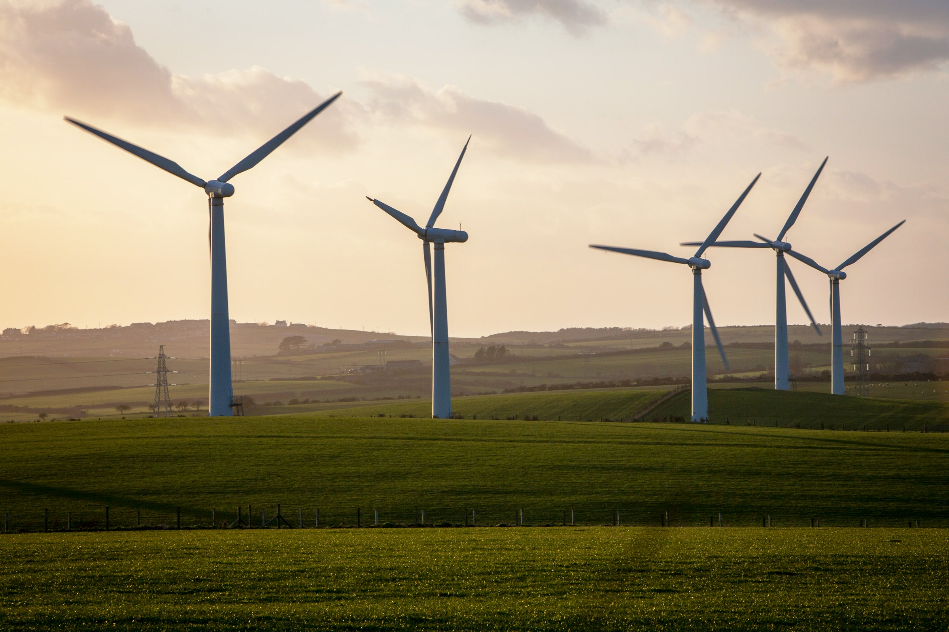
Wind Farms
On Shore
Source: https://www.wired.com/story/wind-turbine-efficiency-algorithm/

Slide 12
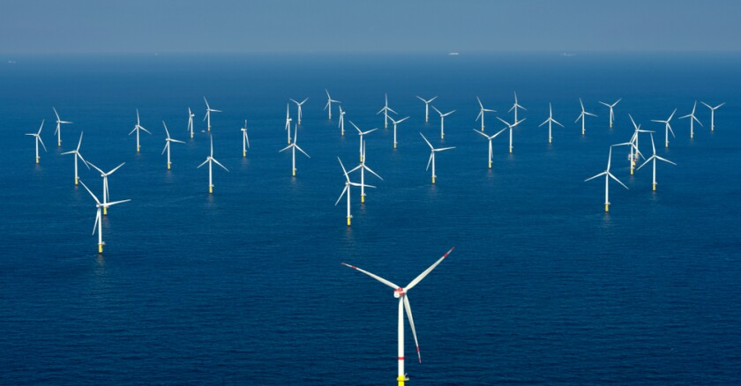
Wind Farms
On Shore
Off Shore
Source: https://www.wired.com/story/wind-turbine-efficiency-algorithm/
Source: https://www.governing.com/now/wind-turbines-and-lawsuits-are-coming-to-the-jersey-shore

Slide 13
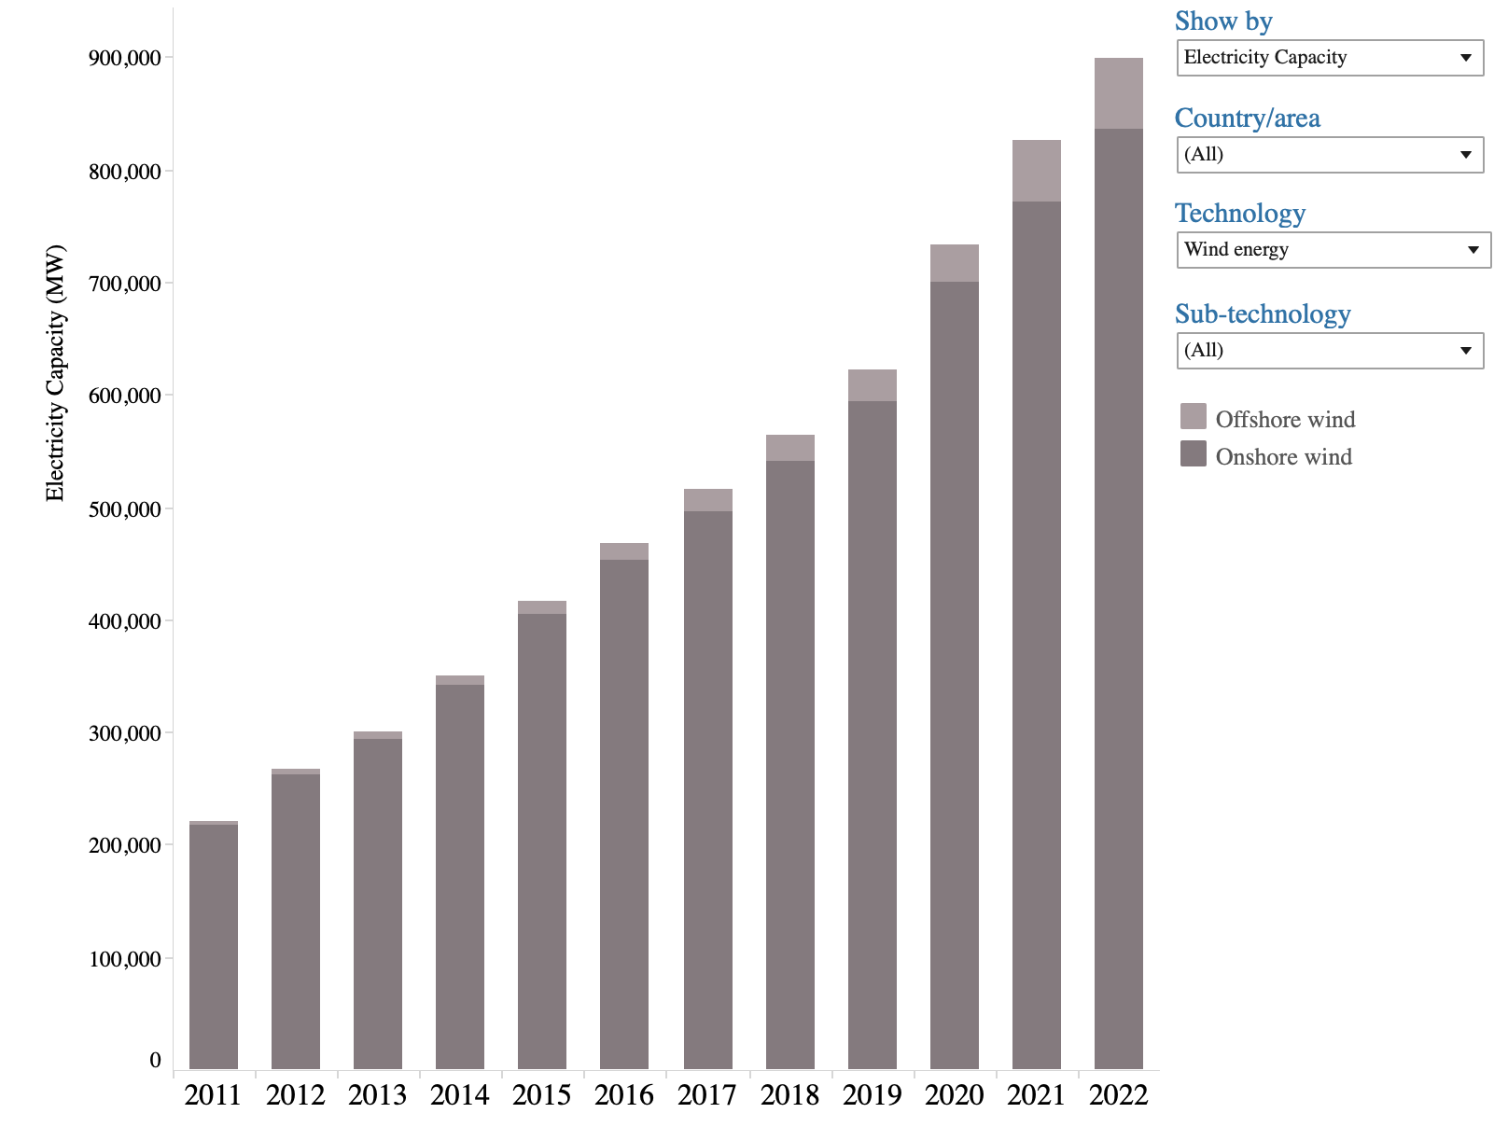
Production of Electricity from Wind (Global)
Source: https://www.irena.org/
Energy-Transition/Technology/Wind-energy

Slide 14
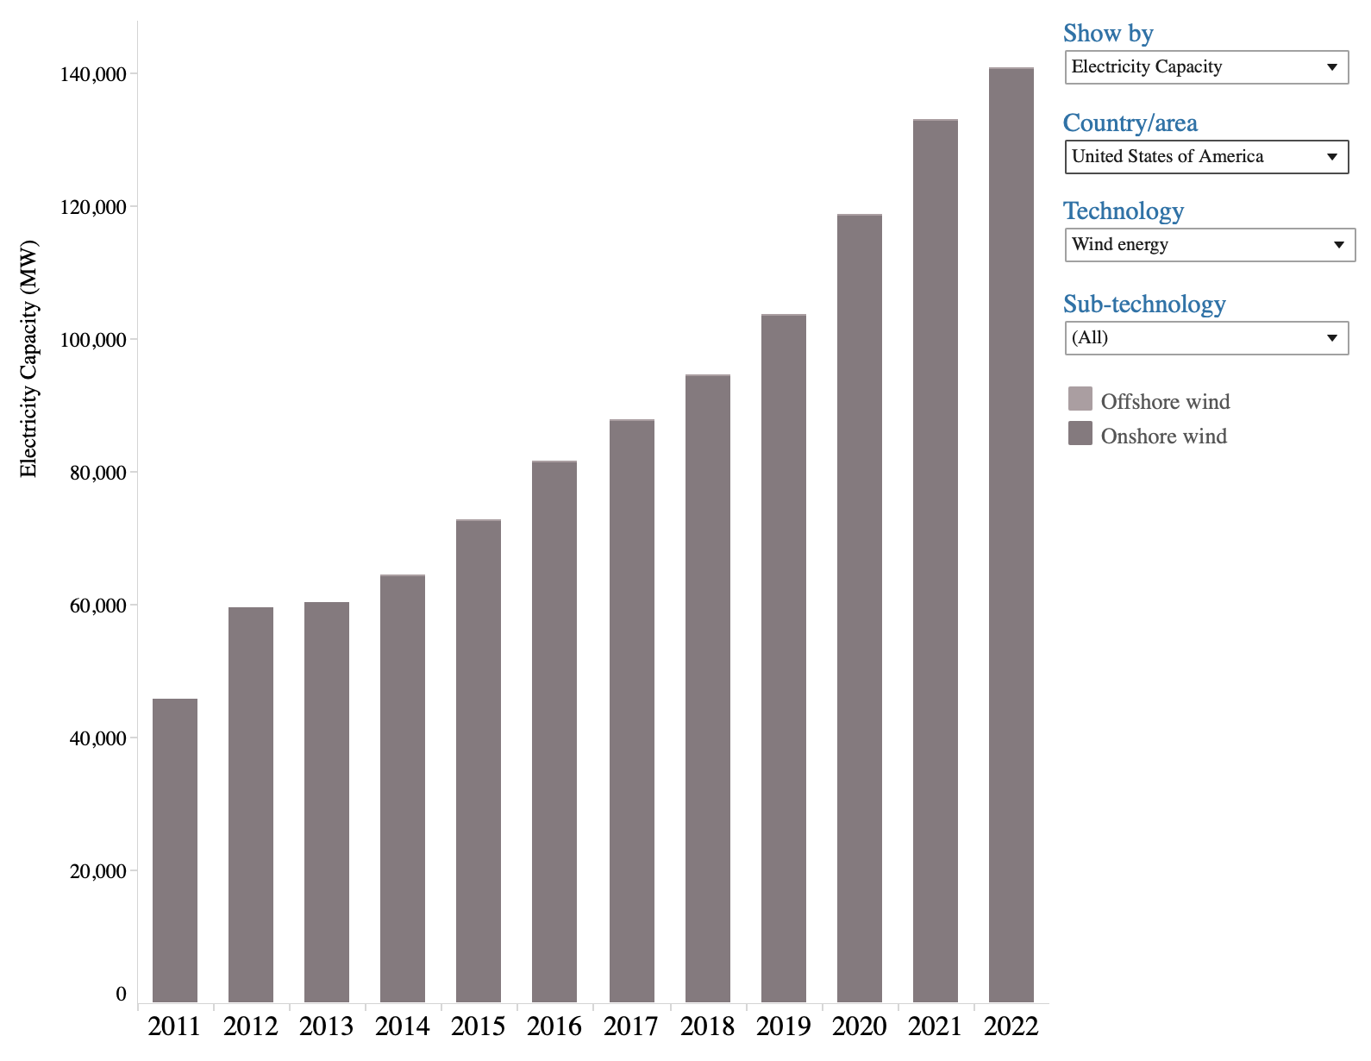
Production of Electricity from Wind (US)
Source: https://www.irena.org/
Energy-Transition/Technology/Wind-energy

Slide 15
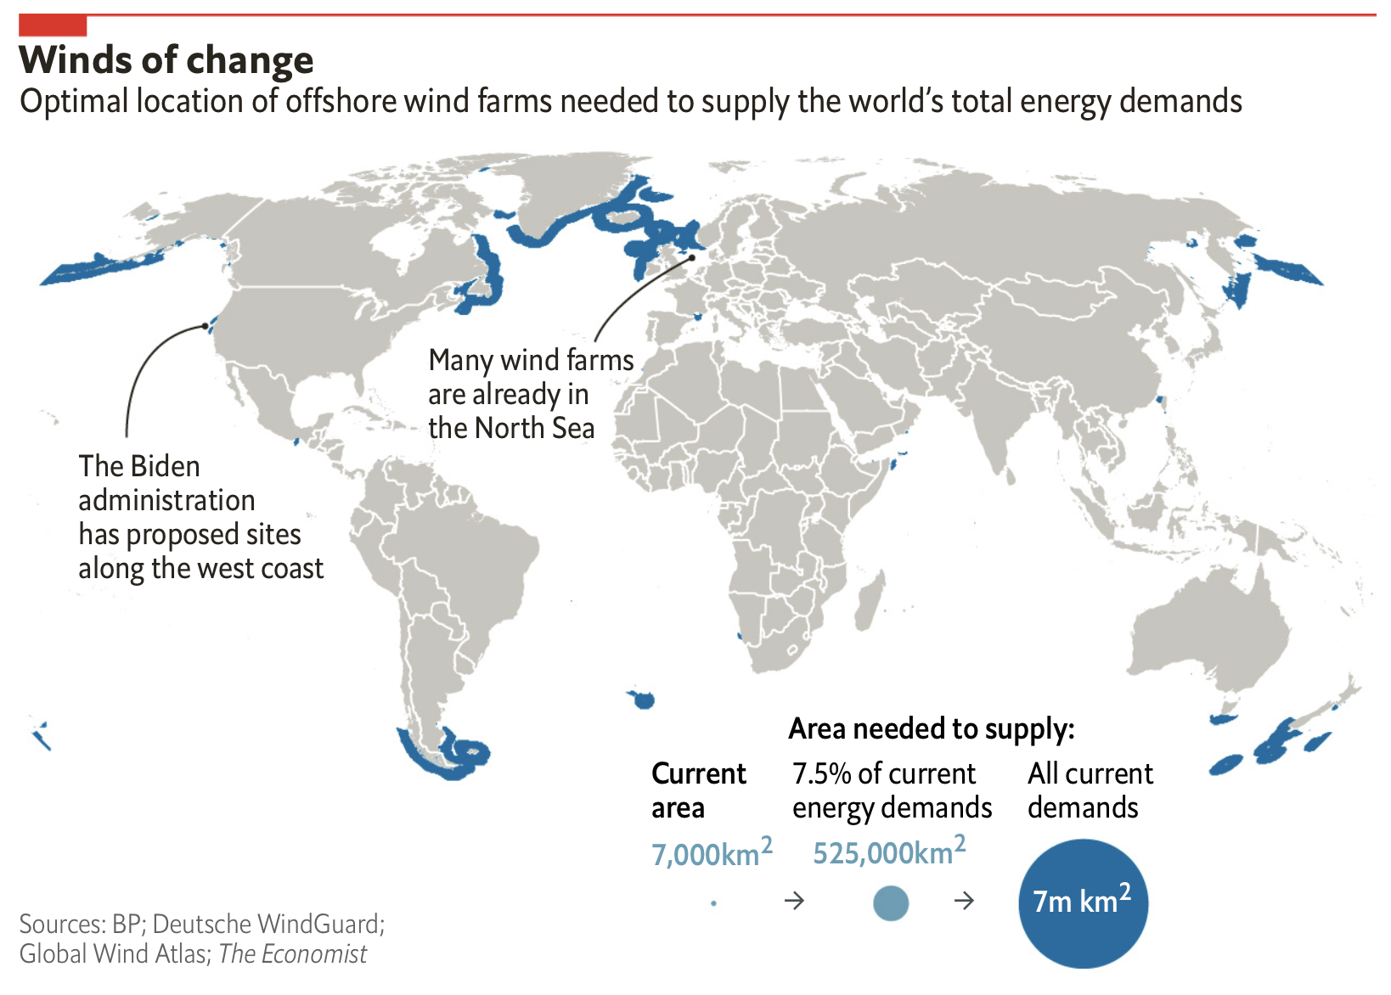
Source: https://www.economist.com/graphic-detail/2021/11/04/
what-would-a-world-powered-entirely-by-offshore-wind-look-like

Slide 16
The Current Status of Offshore Wind Farms

Slide 17
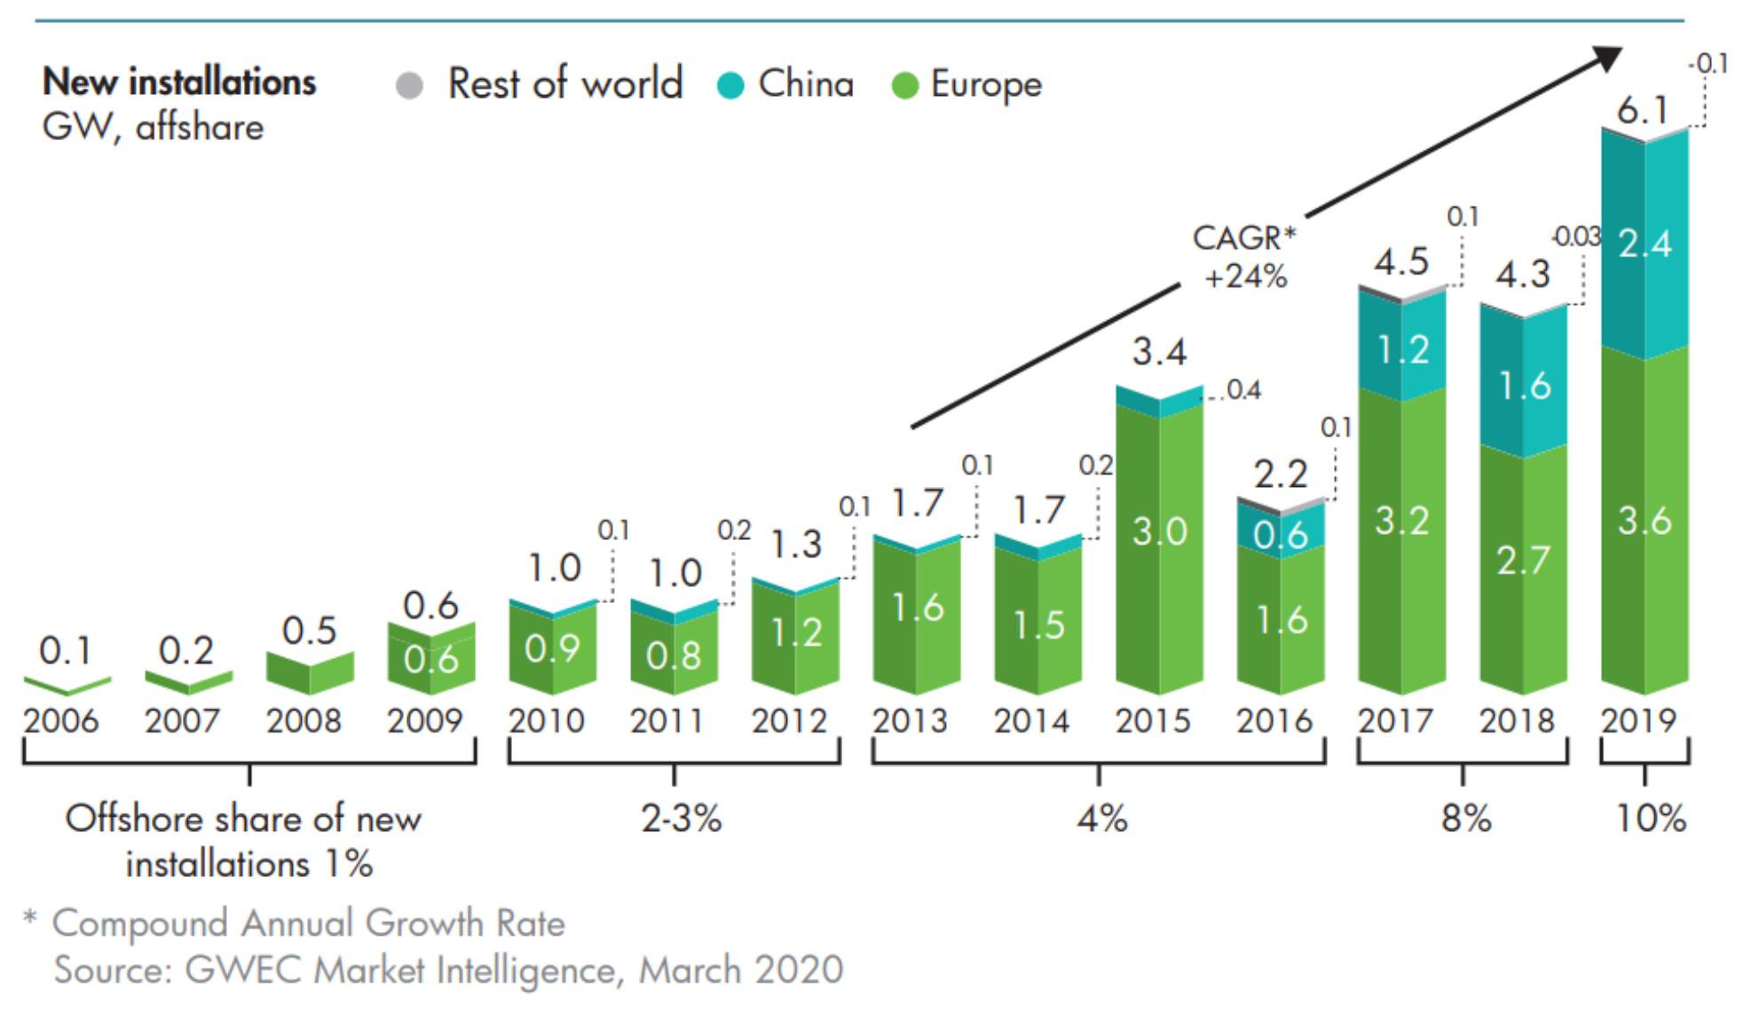
Offshore Wind Farms
Source: https://www.weforum.org/agenda/2020/08/offshore-wind-energy-growth-energy-transition/

Slide 18
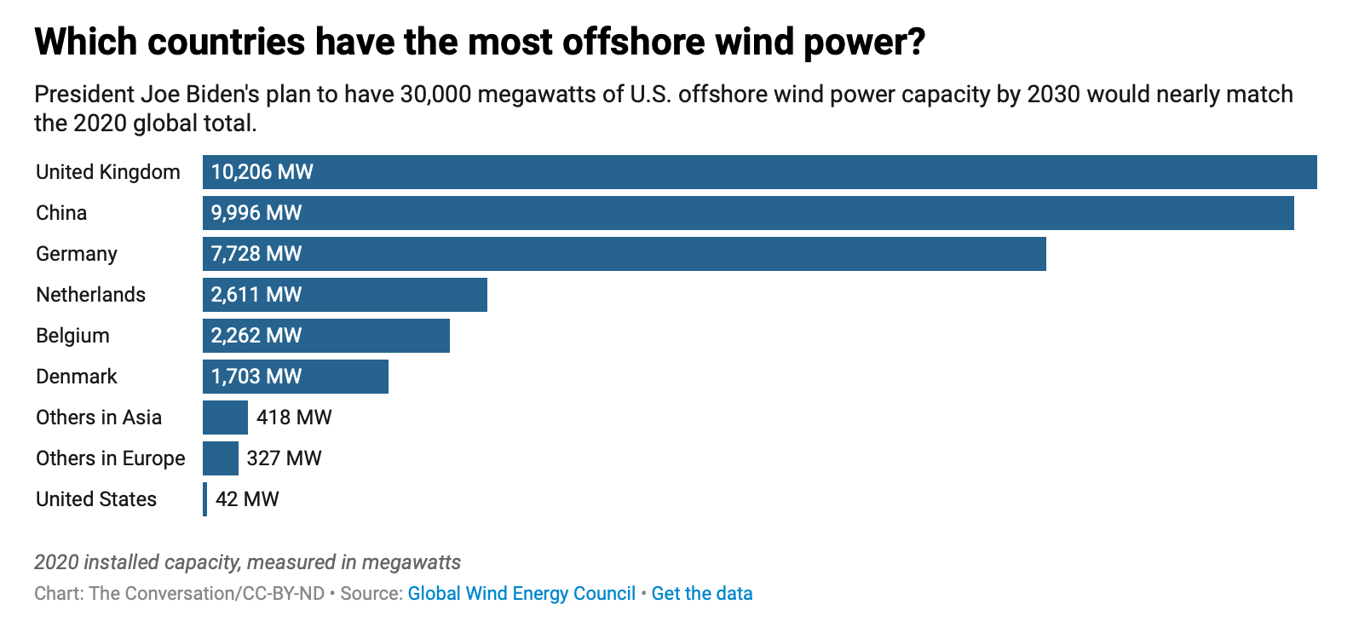

Slide 19
Industry Forecasts

Slide 20
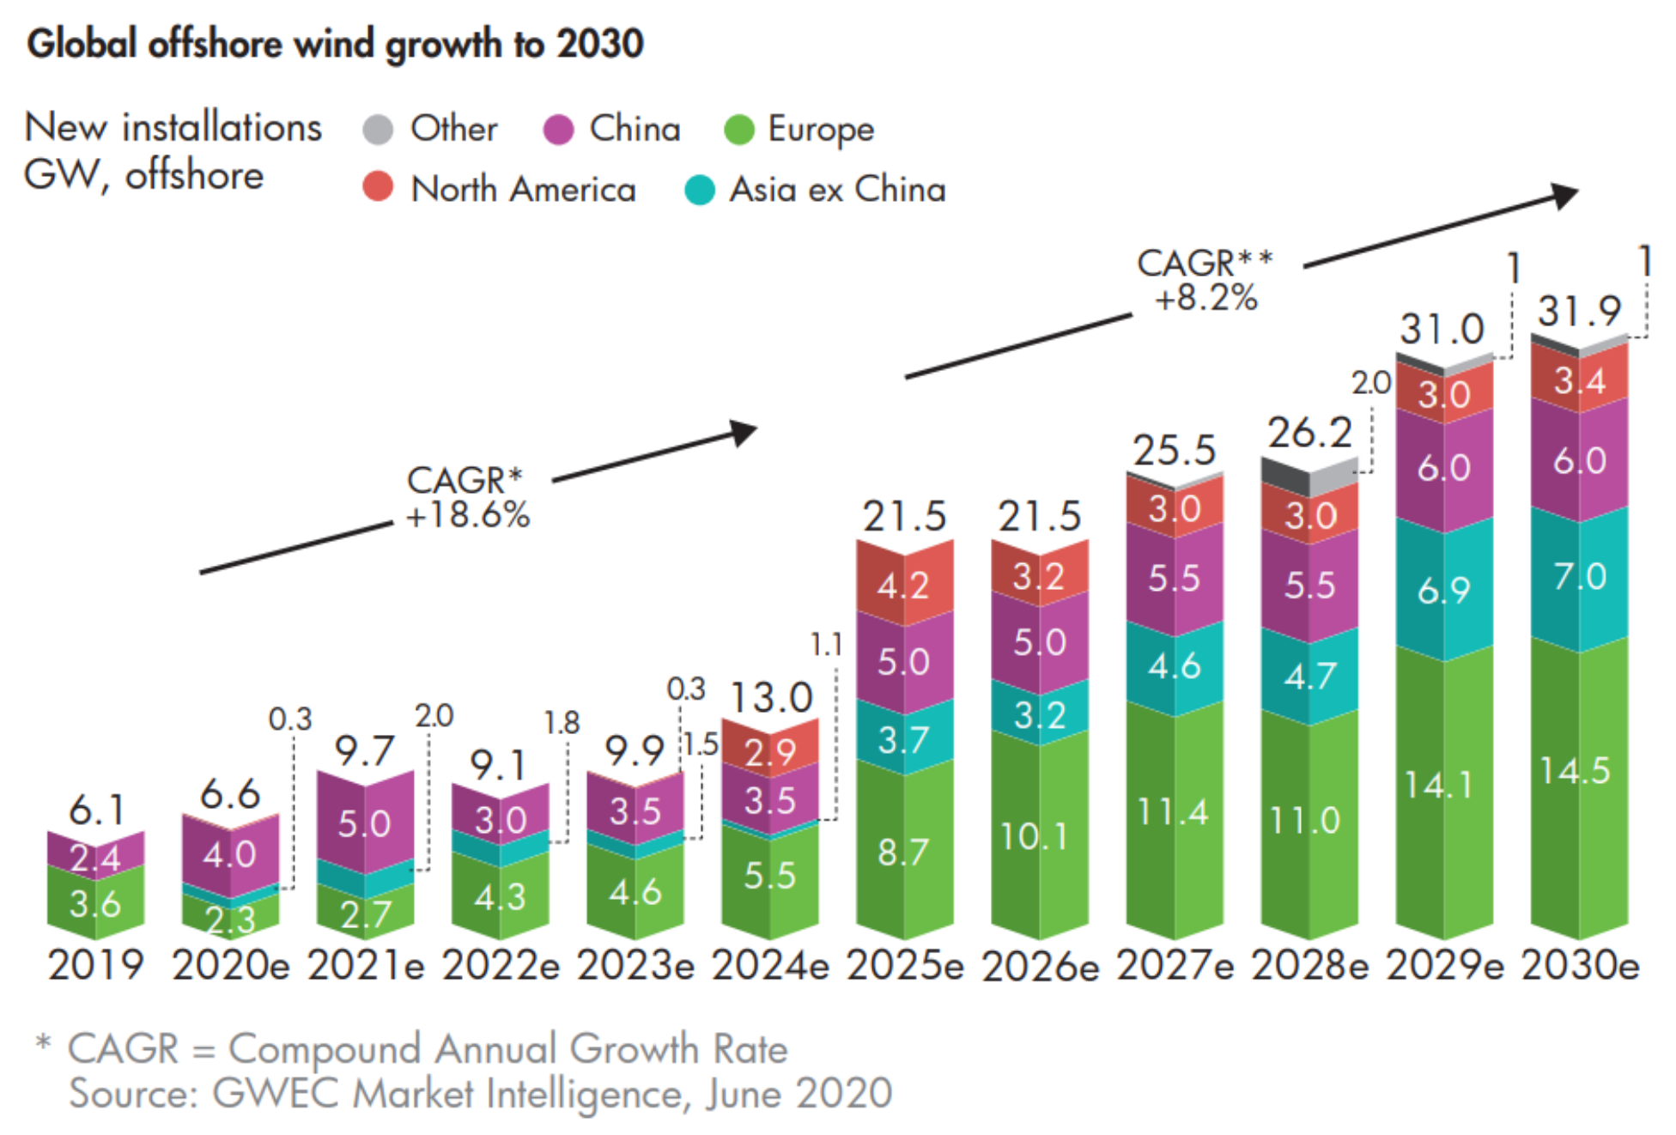
Offshore Wind Farms
Source: https://www.weforum.org/agenda/2020/08/offshore-wind-energy-growth-energy-transition/

Slide 21
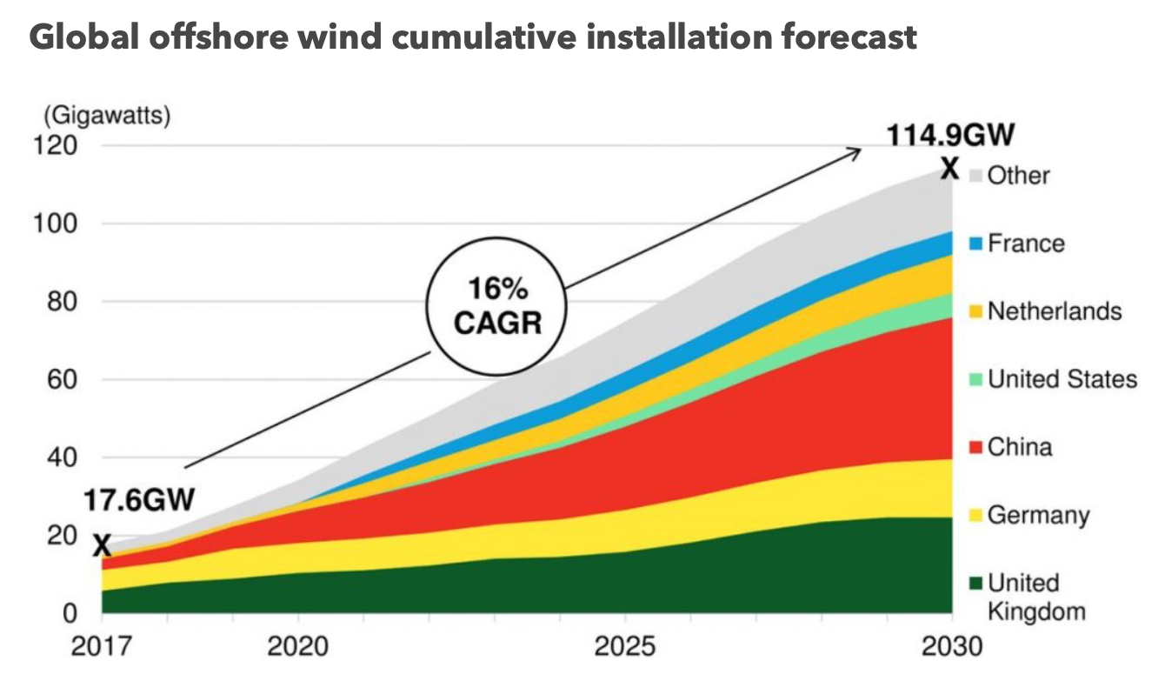
Source: https://about.bnef.com/blog/global-offshore-wind-market-set-to-grow-sixfold-by-2030/
Offshore Wind Farms

Slide 22
Source: https://about.bnef.com/blog/global-offshore-wind-market-set-to-grow-sixfold-by-2030/
Offshore Wind Farms

Slide 23
Why Tall Turbines Are Desirable

Slide 24
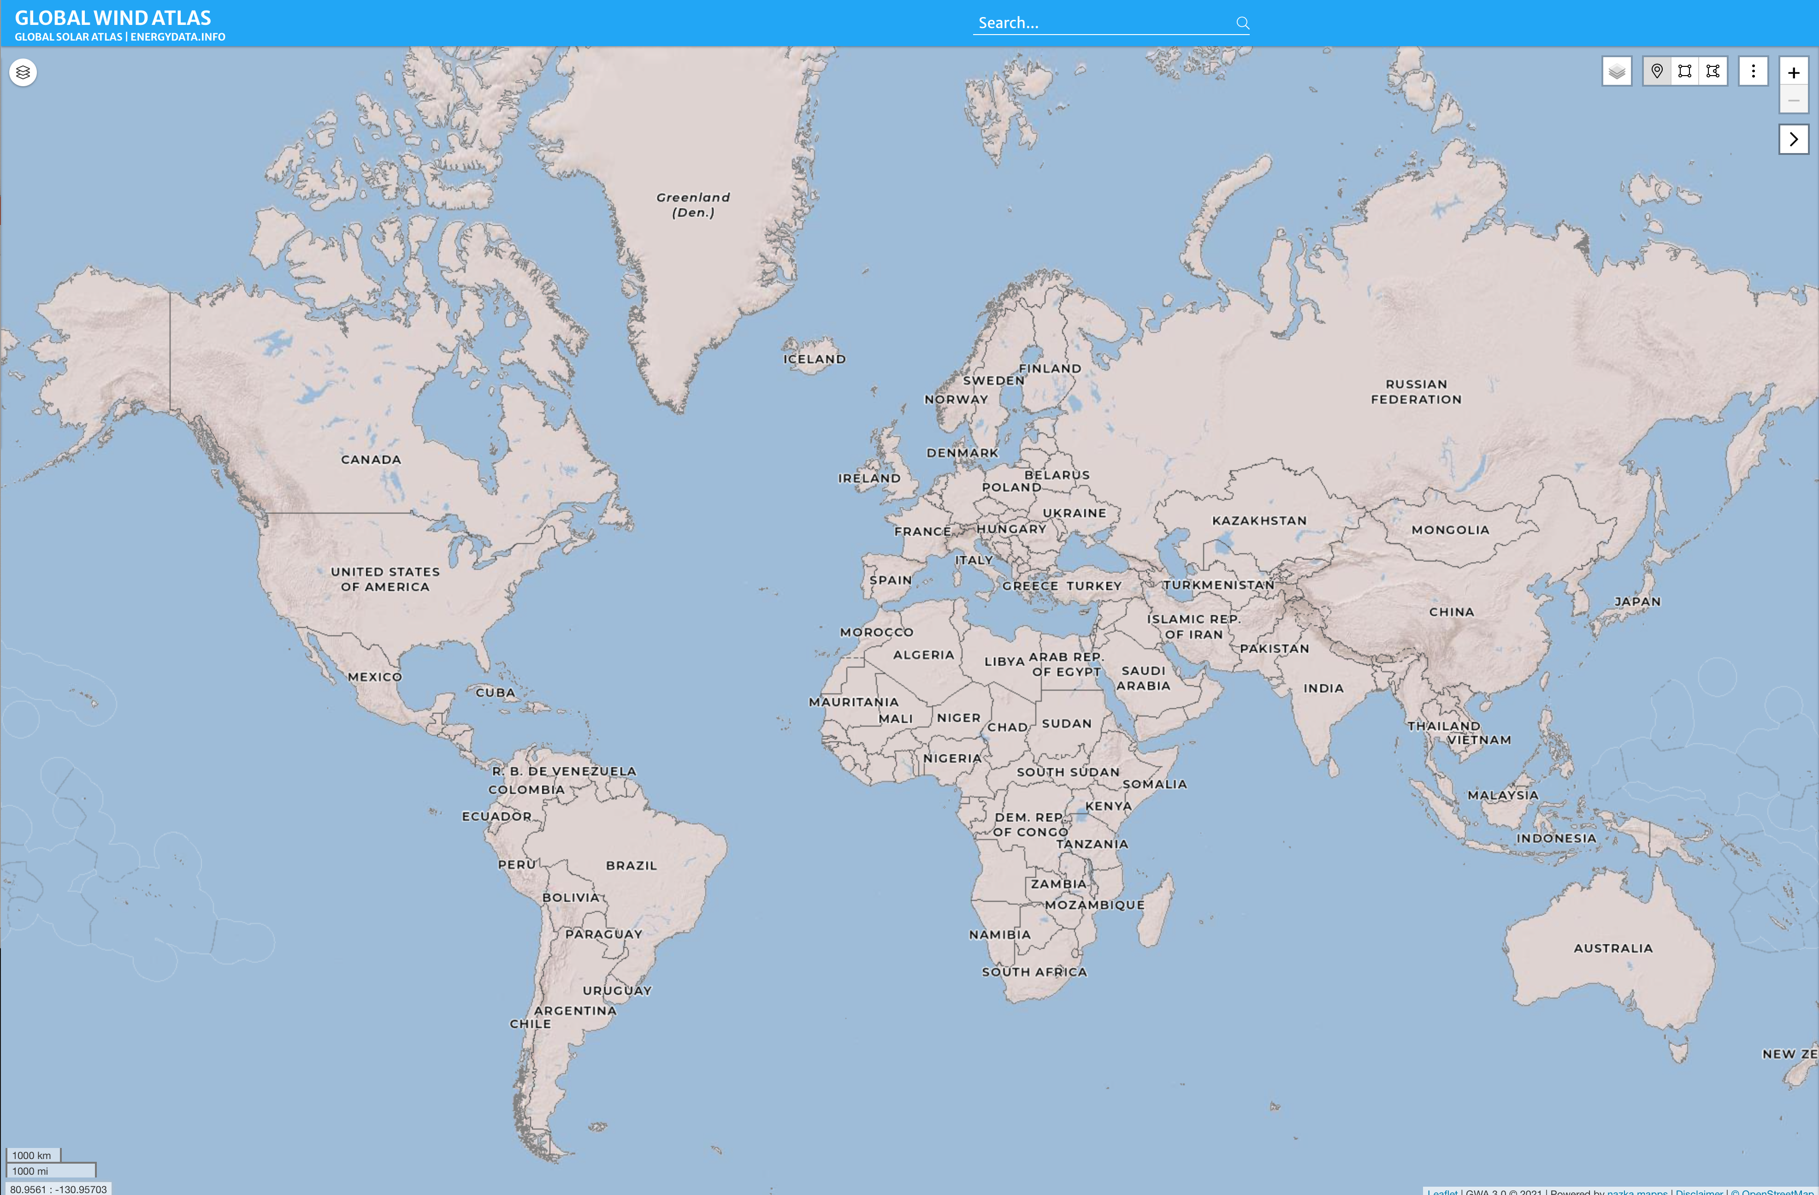

Slide 26
Mean wind speed at 10 meters above the ground

Slide 27
Mean wind speed at 50 meters above the ground
Source: https://www.weforum.org/agenda/2020/08/offshore-wind-energy-growth-energy-transition/

Slide 28
Mean wind speed at 100 meters above the ground
Source: https://www.weforum.org/agenda/2020/08/offshore-wind-energy-growth-energy-transition/

Slide 29
Mean wind speed at 200 meters above the ground
Source: https://www.weforum.org/agenda/2020/08/offshore-wind-energy-growth-energy-transition/

Slide 30
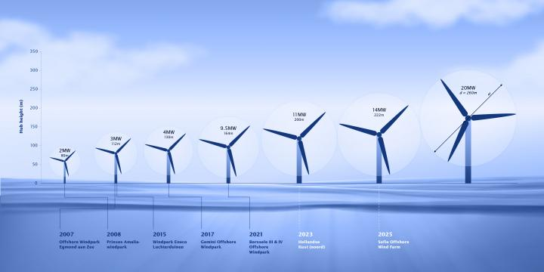
The size of the largest turbines has been increasing…
Source: https://www.vanoord.com/en/updates/van-oord-orders-mega-ship/

Slide 31
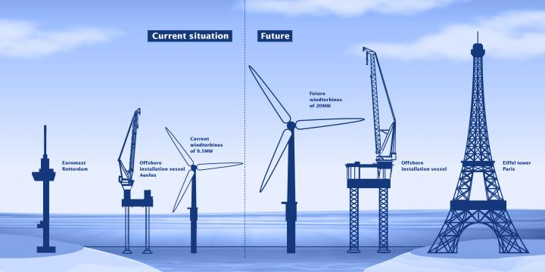
Source: https://www.vanoord.com/en/updates/van-oord-orders-mega-ship/

Slide 32
The Patentee

Slide 36
The Defendant

Slide 37
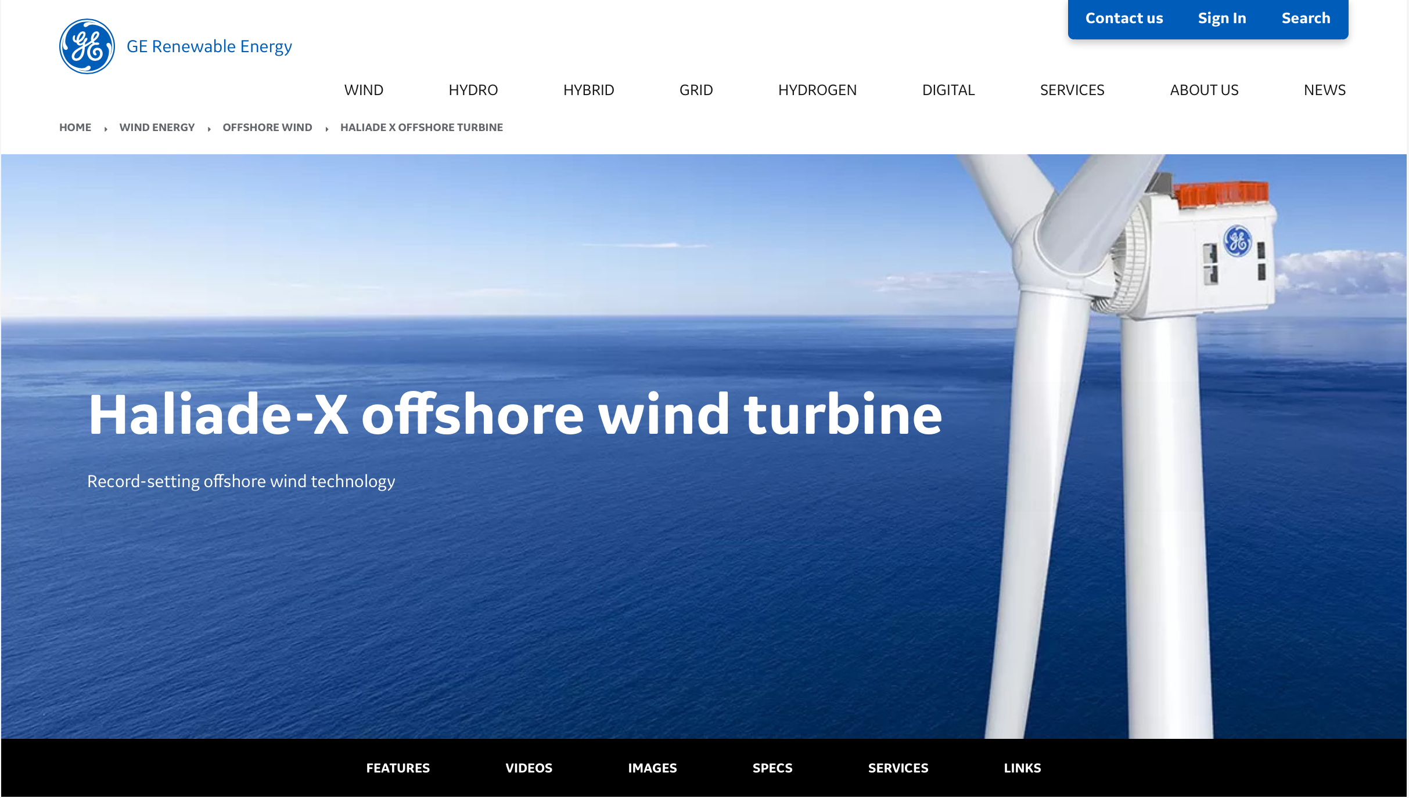

Slide 38
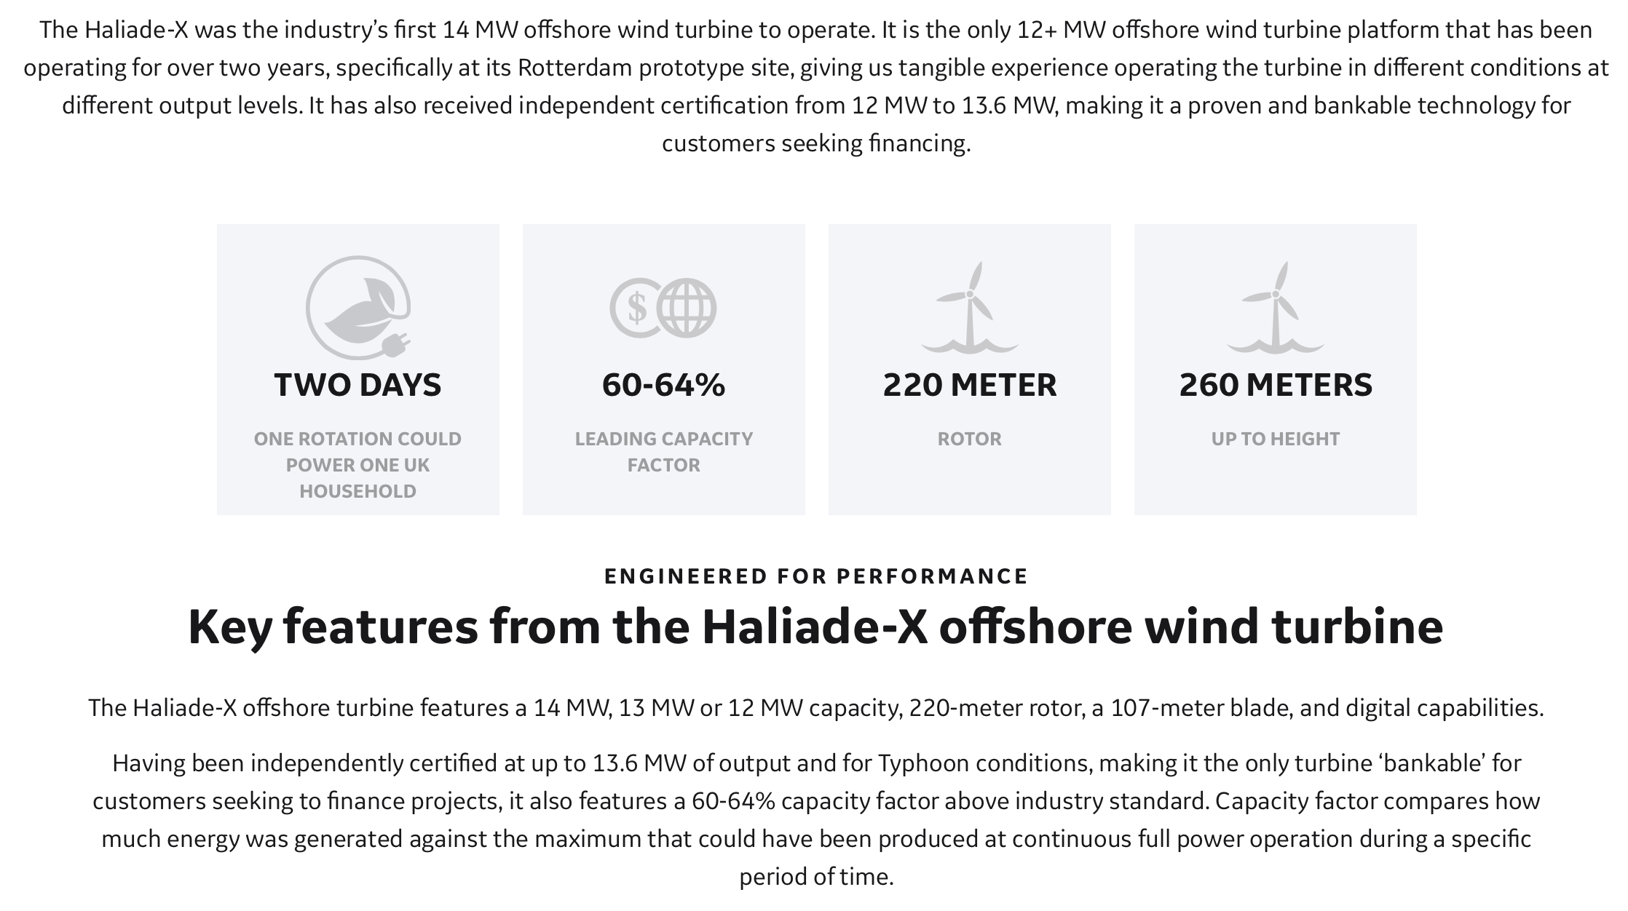

Slide 39
Source: https://www.vanoord.com/en/updates/van-oord-orders-mega-ship/

Slide 40
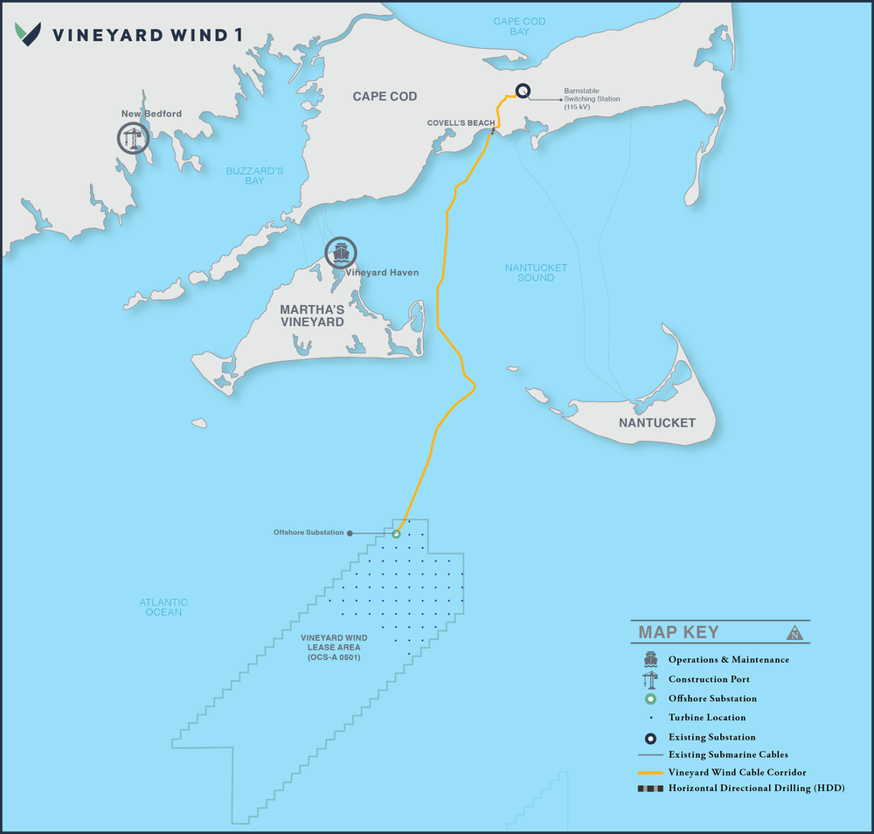

Slide 41
62 Haliade-X turbines
Planned for installation here

Slide 42
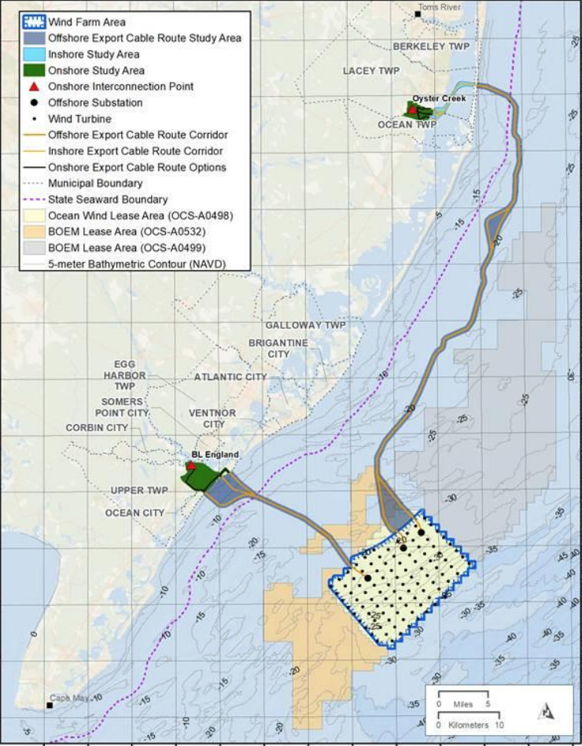
New Jersey
“Ocean Wind” Project

Slide 43
The Patent

Slide 44
US Patent 9279413

Slide 45
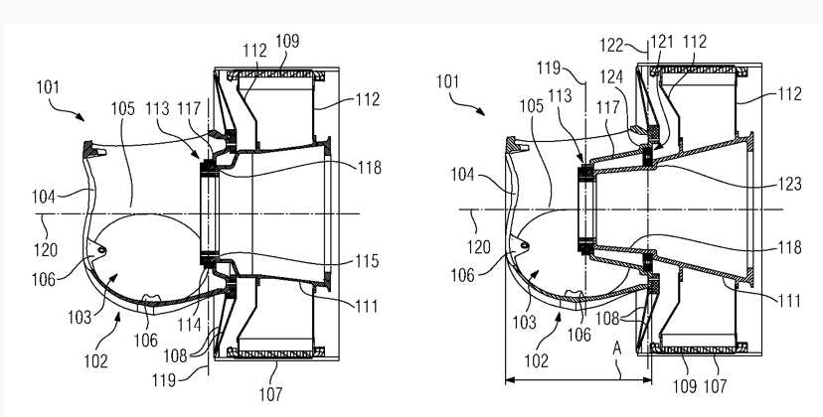
US Patent 9279413

Slide 46
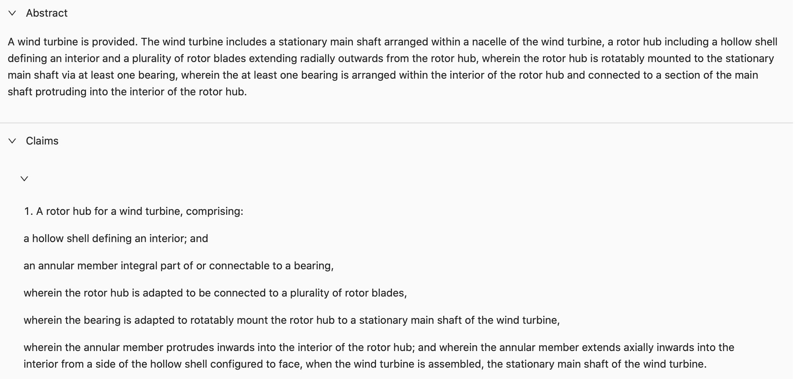
US Patent 9279413

Slide 47
US Patent 9279413

Slide 48
Outcome

Slide 49
Jury Verdict
“At the conclusion of the trial, on June 17, 2022, the jury issued its verdict, finding claims 1, 2, 3, 6, and 7 of the ‘776 Patent invalid and not infringed and claims 1, 2, 8, and 11 of the ‘413 Patent valid and infringed.
“The Jury also concluded SGRE was not entitled to lost profits, but that SGRE had proved its entitlement to a running reasonable royalty rate of $30,000 per Megawatt.”
i.e., even though no GE turbines have yet been installed, the jury found that a reasonably royalty for infringing turbines covered by existing sales agreements would be $30,000 per megawatt

Slide 50
Injunction?

Slide 51
Injunction: eBay Test
As laid out by the Supreme Court in eBay Inc. v. MercExchange, LLC, a four-factor test governs the appropriateness of permanent injunctive relief: [a patentee] must demonstrate:
(1) that it has suffered an irreparable injury;
(2) that remedies available at law, such as monetary damages, are inadequate to compensate for that injury;
(3) that, considering the balance of hardships between the plaintiff and defendant, a remedy in equity is warranted; and
(4) that the public interest would not be disserved by a permanent injunction.

Slide 52
Injunction: Siemens Argument
SGRE first argues it faces irreparable injury because GE’s sales of the infringing product are to the exclusion of SGRE’s sales “resulting in lost profits, lost market share and loss of good will.” It points both to the Vineyard Wind project, that SGRE competed for and lost, and to possible future projects. Furthermore, SGRE argues GE is solidifying its reputation in the United States offshore wind industry, to SGRE’s detriment, by using infringing technology. SGRE asserts a causal nexus exists between GE’s infringement and harm to SGRE because claim 8 of the ‘413 Patent “covers GE’s entire Haliade-X wind turbine.”
Second, SGRE asserts monetary damages are insufficient because SGRE and GE are direct competitors and because SGRE would never voluntarily license the ‘413 Patent. It furthermore argues that “it is impossible to estimate with reasonable certainty the damage to SGRE’s future business, goodwill, and reputation that will be caused by GE’s continuing infringement[,]” especially given that SGRE is losing out not only on revenue from turbine sales but also on revenue from “service costs, maintenance costs, and replacement parts.”
Third, it argues the balance of the equities weigh in its favor: (1) only a small portion of GE’s business is dedicated to offshore wind whereas it is SGRE’s primary product; (2) GE has yet to install even a single turbine in the United States; and (3) GE produces non-infringing turbines it could use instead.
Finally, SGRE argues the public interest would not be disserved by an injunction, given importance of a “robust patent system”; it also argues such an injunction would not harm environmental or public good since the turbines have yet to be installed.

Slide 53
Injunction: GE’s Argument
GE opposes SGRE’s motion arguing that SGRE fails to establish any of the four factors. First, GE argues SGRE cannot show irreparable harm or inadequacy of monetary damages for at least three reasons: (1) SGRE already proposed a royalty rate; (2) SGRE already experiences competition from Vestas, another wind turbine manufacturer; and (3) SGRE is precluded from seeking a permanent injunction given its failure to seek a preliminary injunction. Furthermore, GE argues that SGRE has not shown that the infringing feature drives consumer demand –- in fact, SGRE admits it does not practice the ‘413 Patent in its wind turbines.
GE argues the balance of the hardships weighs in its favor: while an injunction would cause GE to lose out on much of the work concomitant to the installation of the Haliade-X’s (cabling, foundation design, engineering of the on- and off-shore substations), SGRE would likely still lose out to another manufacturer –- Vestas -– even were GE out of the picture.
Finally, GE argues that an injunction would disrupt existing wind projects -– costing the community millions in benefits and tax revenue, hundreds of jobs, and enough renewable energy to power thousands of homes thus disserving the public interest. GE argues two of these projects, Vineyard Wind and Ocean Wind I, are already well underway –- in terms of designing and manufacturing. The public interest reaches beyond financial and electricity generation capacity, as disrupting these projects only serves further to compound the harm caused by the current climate crisis.

Slide 55
Injunction: Judge Young’s Order (Sept. 7, 2022)
Factors 1 & 2: “SGRE has shown irreparable harm and the inadequacy of monetary damages.”
The parties are direct competitors
Siemens has shown that it has lost market share through sales of GE’s infringing turbines
“SGRE has also shown that the ‘413 Patent provides a key element for the functionality of wind turbines -– creating a nexus between its use in the Haliade-X, and the harm in the market it is facing.”
Continued sales of infringing turbines will cause Siemens losses in “downstream sales,” which are difficult to quantify (maintenance, repairs, design and engineering contracts)
Presence in the market of a third competitors (Vesta) does not negate irreparable injury

Slide 56
Injunction: Judge Young’s Order (Sept. 7, 2022)
Factor 3: Balance of hardships tilts toward Siemens
Siemen’s primary product is offshore wind turbines, while “only a small portion of GE’s current business” consists of offshore wind turbines
Siemens has thus far deployed only 158 turbines, while Siemens has deployed over 5000

Slide 57
Injunction: Judge Young’s Order (Sept. 7, 2022)
Factor 4: “[T]he public interest would not be disserved by granting a carefully tailored injunction.”
“Allowing GE to continue its infringing conduct would surely chill advancement of wind turbine and renewable energy technology and thus would defy the public interest in closely protecting valued patent rights.”
The threat that an injunction would pose to the public interest in avoiding delay in addressing climate change can be addressed with “carve-outs”
“Indeed, were a carefully tailored permanent injunction not to issue here where, as between direct competitors in a lucrative emerging market, one has been determined to infringe the other’s valid patent, then the aggregate value of America’s intellectual property and the integrity of its beneficial patent system would be incalculably diminished”

Slide 58
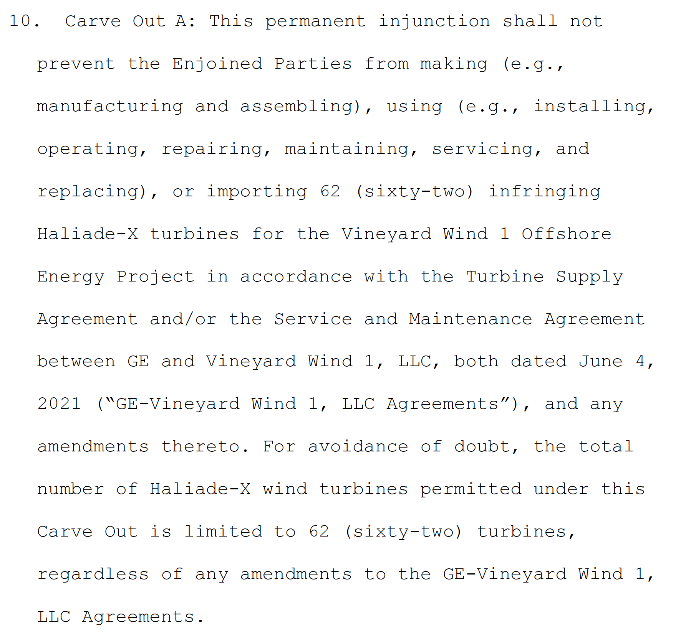
Remedy
Damages
Injunction
“Carve-outs”

Slide 59
Remedy
Damages
Injunction
“Carve-outs”

Slide 60
Remedy
Damages
Injunction
“Carve-outs”
Effect: Will increase cost of Vineyard Project by $3.2 billion

Slide 61
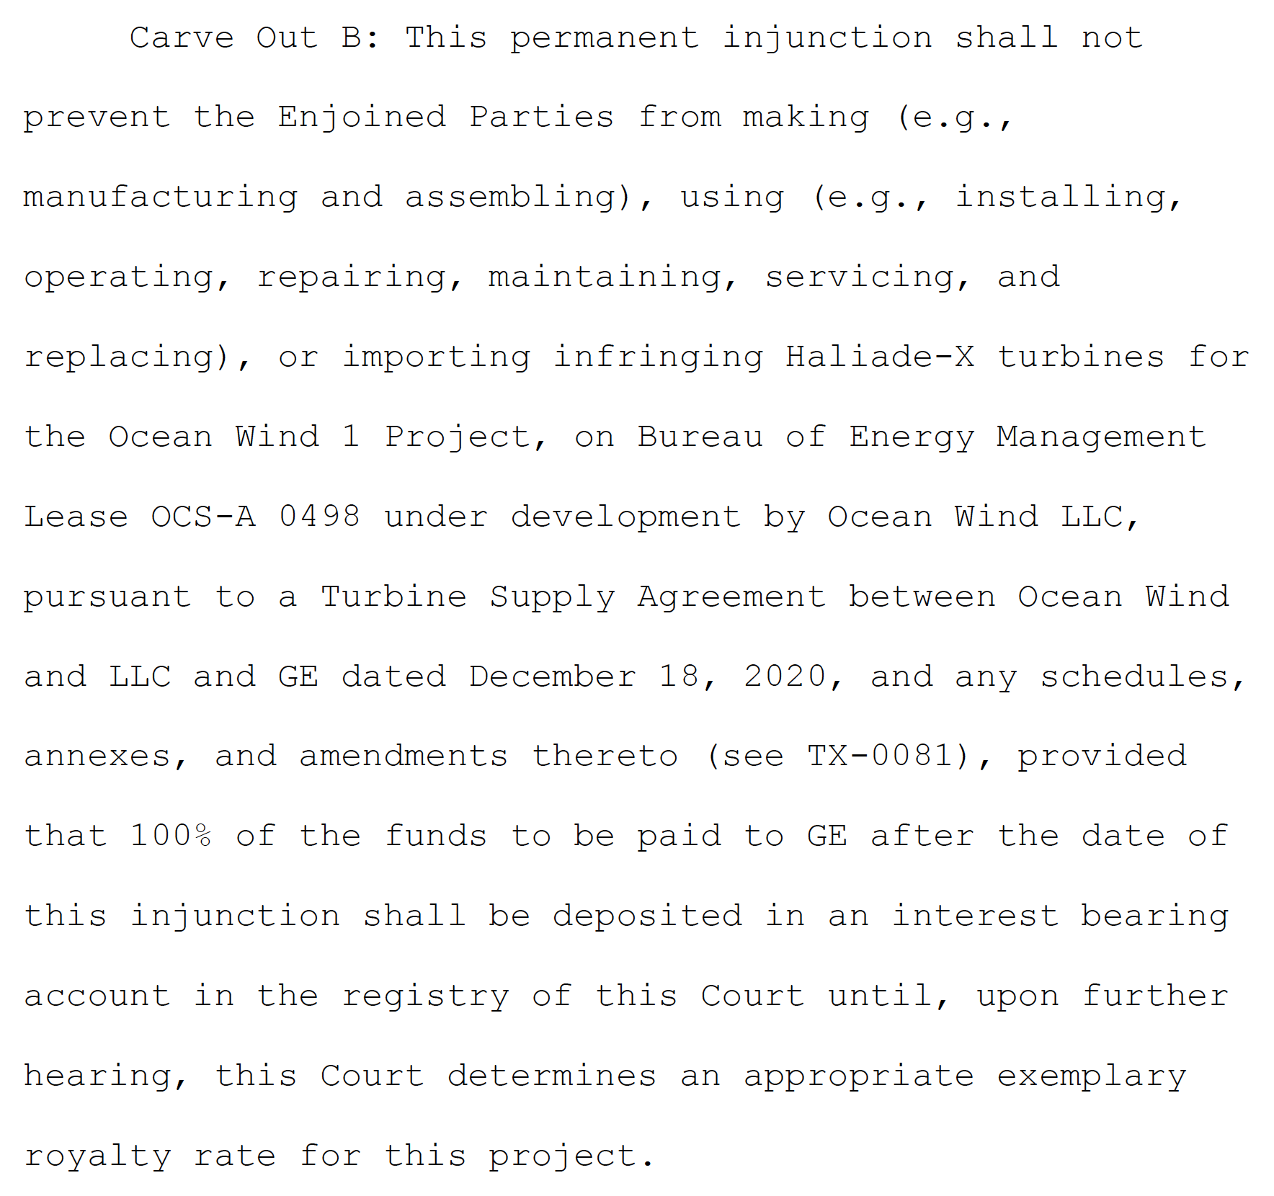
Remedy
Damages
Injunction
“Carve-outs”

Slide 62
Remedy
Net Effects
Carveouts will enable GE to complete contracts for projects providing a total of 2 gigawatts (Vineyard and New Jersey) – but will raise substantially the cost of those projects
Injunction will prevent performance of contracts for an additional 9 gigawatts
Damages
Injunction
“Carve-outs”

Slide 63
Aftermath

Slide 64
“GE unveils workaround for Haliade-X in patent dispute court filing,” Windpower Monthly, October 17, 2022
“GE has unveiled two new designs for the Haliade-X as part of its ongoing patent dispute with rival turbine manufacturer Siemens Gamesa in court filings made public today.
“The first design is a ‘work-around’ for the main shaft bearings of the flagship Haliade-X offshore wind turbine that GE said does not infringe the intellectual property of Siemens Gamesa….
“In its filing, GE’s work-around, the Haliade-X-ii, lacks a bearing within the interior of a rotor hub’s hollow shell, according to GE court documents filed with the US District Court in Boston on 17 October.
“Specifically, the bearing is outside of the interior of the rotor hub’s hollow shell - a design that GE said in its filing is “prior art”. Prior art cannot be patented, according to intellectual property law.
“The second design - the Haliade-X-iii – is for a next-generation of Haliade-X turbines and it also avoids the patented technology, said GE.
“The US conglomerate says that its new designs have “neither an annular member that protrudes into the interior defined by a hollow shell of a rotor hub nor a bearing in that interior”.
“GE said it will make both the Haliade-X-ii and the Haliade-X-iii available to customers developing offshore wind farms in the United States.”

Slide 65
December 2022
The High Court of England and Wales rules that the relevant claims in the parallel UK patent are invalid as obvious – and that GE did not infringe them in any event

Slide 66
February 2023
Judge Young orders GE to pay $60,000 per megawatt produced in the New Jersey project by infringing turbines
In issuing the order, Judge Young comments:
“This struggle does nothing to advance the public interest of the people of the United States or any other nation. Indeed, it inhibits efforts to combat climate change world-wide. It would be far, far better for these two corporate behemoths – consistent with antitrust requirements – to cross-license their particular technological contributions and forge ahead with production in the global public interest.”

Slide 67
March 31, 2023: Global Settlement
The parties have “reached an amicable settlement of all their wind turbine technology patent disputes in the United States and Europe on confidential terms and have granted each other and their respective subsidiaries worldwide cross licences under the asserted patent families, for the life of those patent families”
The financial terms remain confidential

Slide 68
“Offshore Wind Firm Cancels N.J. Projects, as Industry’s Prospects Dim,” New York Times, Nov. 1, 2023
“Orsted, the Danish company that is a leading offshore wind farm developer, said on Wednesday that it would scrap plans to build two wind farms off the coast of New Jersey, forcing the company to write off as much as $5.6 billion….
“’The world has in many ways, from a macroeconomic and industry point of view, turned upside down,’ Mads Nipper, Orsted’s chief executive, said on a call with reporters on Wednesday. The two projects, known as Ocean Wind 1 and 2, were destined to provide green energy to New Jersey.
“Offshore wind and other parts of the renewable industry have hit some snags in Europe, especially in Britain, but Mr. Nipper said the problems were more acute in the United States, because early contracts lacked protection from inflation and developers incurred high costs because of delays in approvals during the Trump administration.
“The company’s stock price fell about 20 percent on Wednesday morning as the company reported a loss of about $3.2 billion for the third quarter and warned that the write downs — essentially, a reduction in the value of the company’s investments — would impact Orsted’s finances.”

Slide 69
U.S. Dept. of the Interior, Bureau of Ocean Energy Management
“On Feb. 29, 2024, BOEM approved a two-year suspension of the operations term of Ocean Wind LLC's commercial lease (Renewable Energy Lease Number OCS-A 0498), and issued a suspension order pursuant to 30 C.F.R. § 585.418.”
Source: https://www.boem.gov/renewable-energy/state-activities/ocean-wind-1

Slide 70
“NJ Awards 3.74 GW of New Offshore Wind to Replace Pulled Projects,” January 26, 2024
“Looking to fill the gap in its offshore wind energy portfolio with the sudden cancellation last year of two projects totaling 2.25 GW, New Jersey has moved to replace the capacity with two new utility-scale awards.
“Selected on Jan. 24 to keep the state’s clean energy program on track is a U.S. based partnership between developers Invenergy and energyRe, with a second award to a joint venture of French utility TotalEnergies, London-based Corio Generation and U.S.-based Rise Power and Light. The two projects total 3.7 GW.”
Source: https://www.enr.com/articles/58057-nj-awards-374-gw-of-new-offshore-wind-to-replace-pulled-projects

Slide 71
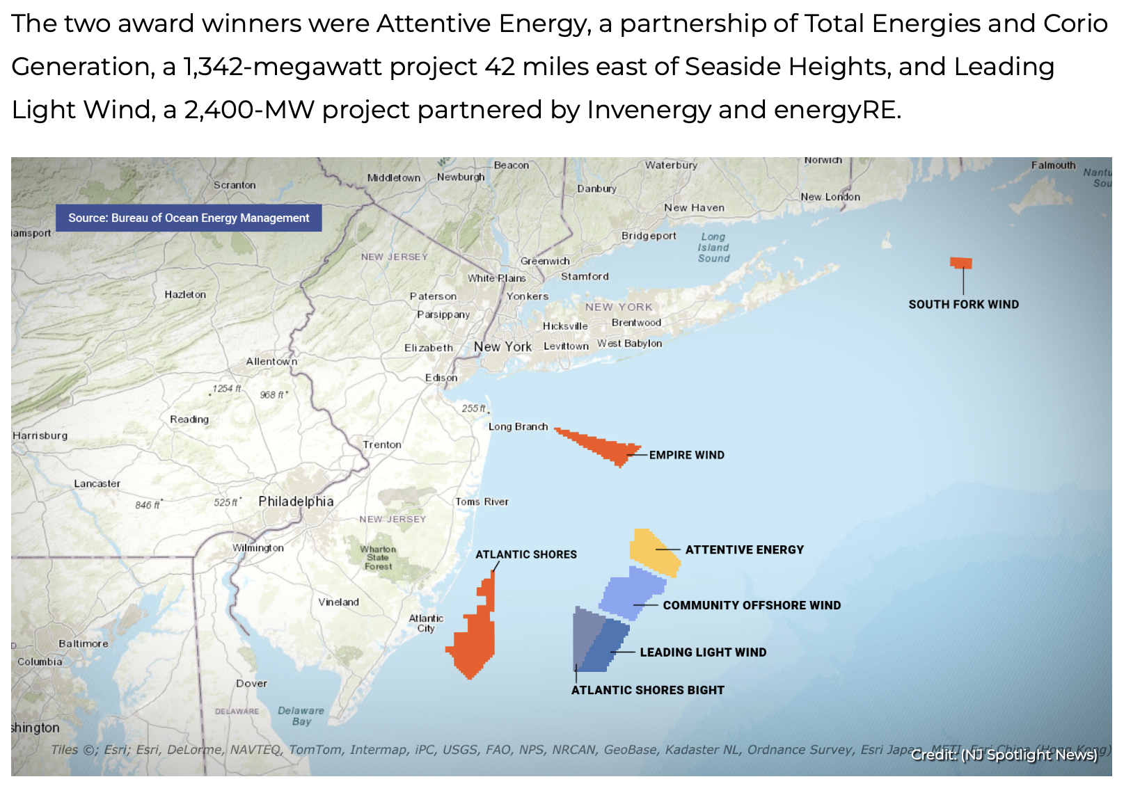
Source: https://www.njspotlightnews.org/2024/01/
nj-state-regulators-approve-2-new-wind-farms-boost-gov-phil-murphy-clean-energy-agenda/

Slide 73
Discussion Question #3: What Should be the Standard for Determining the Availability of an Injunction to Remedy Patent Infringement?

Slide 74
Lost profits
Alternative measures
of damages
Reasonable royalty
Patentee’s profits
Infringer’s profits
§286
2024
Patent
2008
2009
2010
2011
2012
2013
2014
2015
2016
2017
2018
2019
2020
2021
2022
2023
Lawsuit filed
Patentee prevails

Slide 75
Lost profits
Alternative measures
of damages
Reasonable royalty
Patentee’s profits
Infringer’s profits
§286
Injunction
2024
Patent
2008
2009
2010
2011
2012
2013
2014
2015
2016
2017
2018
2019
2020
2021
2022
2023
Lawsuit filed
Patentee prevails

Slide 76
Lost profits
Alternative measures
of damages
Reasonable royalty
Patentee’s profits
Infringer’s profits
§286
Injunction
2024
Patent
2008
2009
2010
2011
2012
2013
2014
2015
2016
2017
2018
2019
2020
2021
2022
2023
Lawsuit filed
Patentee prevails

Slide 77
Lost profits
Alternative measures
of damages
Voluntary license fee
Reasonable royalty
Patentee’s profits
Infringer’s profits
§286
Injunction
2024
Patent
2008
2009
2010
2011
2012
2013
2014
2015
2016
2017
2018
2019
2020
2021
2022
2023
Lawsuit filed
Patentee prevails

Slide 78
On average, the ongoing royalty is 1.6 x the “reasonable royalty”
Lost profits
Ongoing royalty
Reasonable royalty
Patentee’s profits
Infringer’s profits
§286
No Injunction
2024
Patent
2008
2009
2010
2011
2012
2013
2014
2015
2016
2017
2018
2019
2020
2021
2022
2023
Lawsuit filed
Patentee prevails

Slide 79
Lost profits
Semi-voluntary license fee
Voluntary license fee
Reasonable royalty
Patentee’s profits
Infringer’s profits
§286
2024
Patent
2008
2009
2010
2011
2012
2013
2014
2015
2016
2017
2018
2019
2020
2021
2022
2023
Lawsuit filed
Patentee prevails

Slide 80
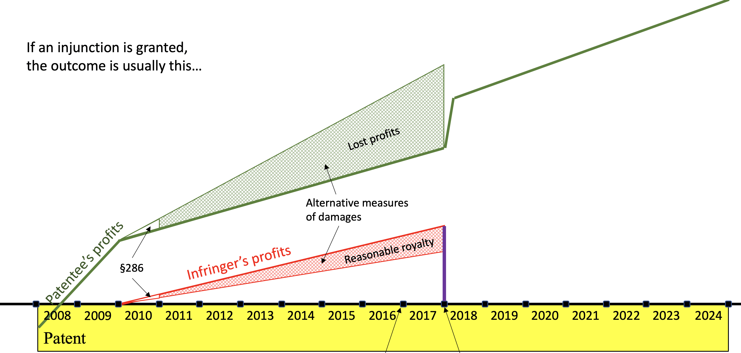
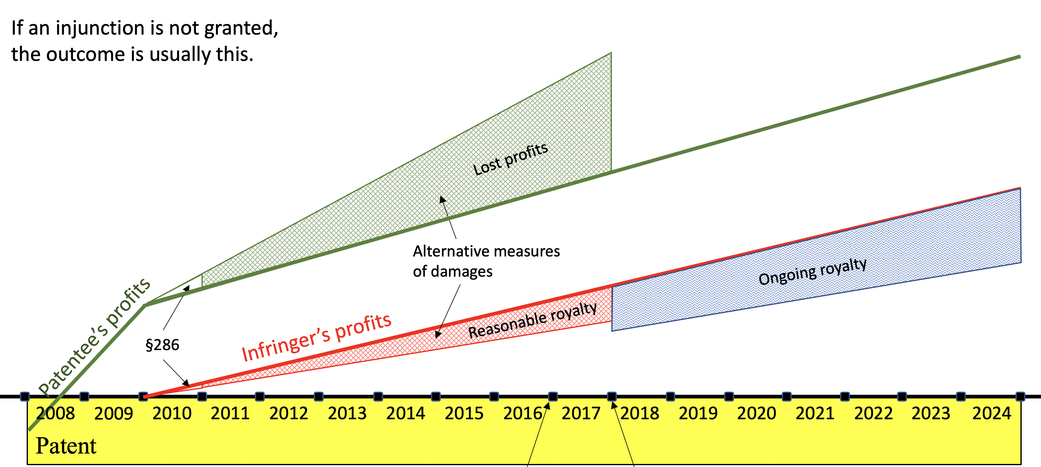
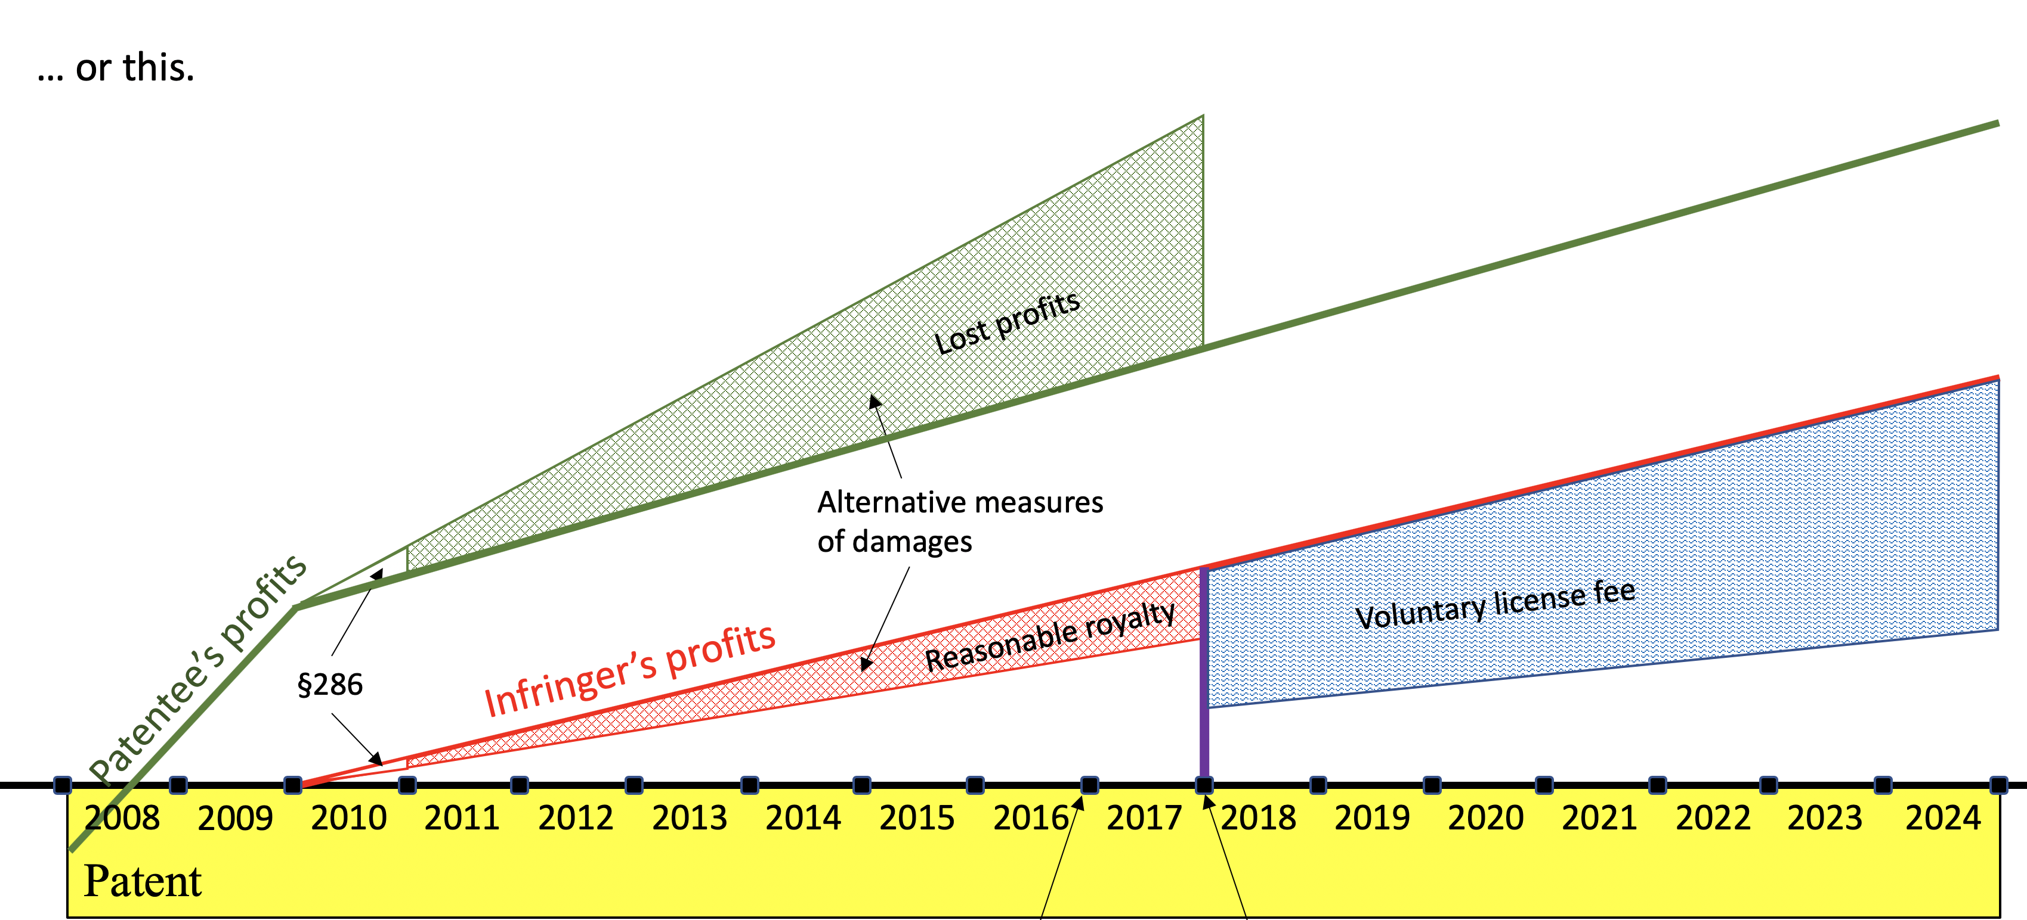
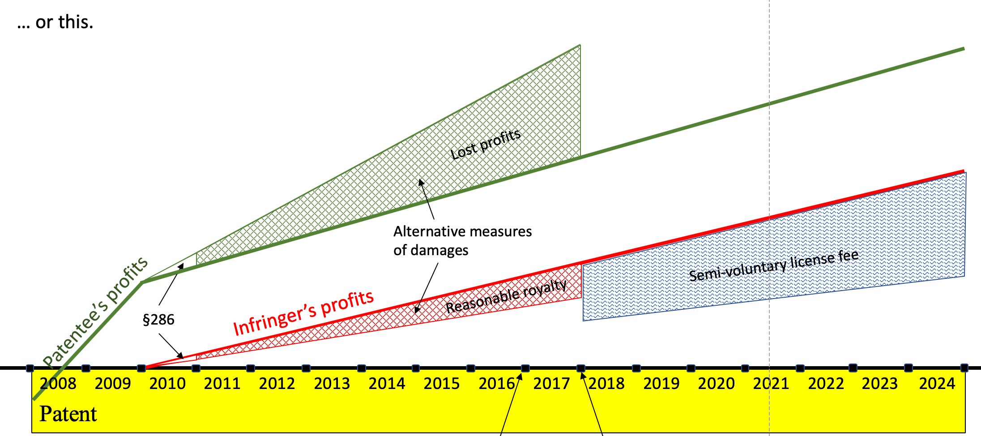
A
C
B
D

