Slide 1
Patentable Subject Matter
William Fisher
September 2021

Slide 2
The following images appear in the background of the lecture on “Patentable Subject Matter” in the PatentX lecture series. A recording of the lecture itself is available at https://ipxcourses.org/lectures-2/. Removed from their original context, the images will not make much sense. The function of this collection of images is to enable persons who have already watched the lecture to review the material it contains.
The terms on which these materials may be used or modified are available at http://ipxcourses.org.

Slide 3
Global Trends in Subject Matter Coverage
Harmonization
Contraction
Expansion
1750
1800
1850
1900
1950
2000
2025

Slide 4
Constitution of the United States: Article 1, Section 8, Clause 8
The Congress shall have Power … To promote the Progress of Science and useful Arts, by securing for limited Times to Authors and Inventors the exclusive Right to their respective Writings and Discoveries

Slide 5
Patent Act of 1790
Be it enacted by the Senate and House of Representatives of the United States of America in Congress assembled, That upon the petition of any person or persons to the Secretary of State, the Secretary for the department of war, and the Attorney General of the United States, setting forth, that he, she, or they, hath or have invented or discovered any useful art, manufacture, engine, machine, or device, or any improvement therein not before known or used, and praying that a patent may be granted therefor, it shall and may be lawful to and for the said Secretary of State, the Secretary for the department of war, and the Attorney General, or any two of them, if they shall deem the invention or discovery sufficiently useful and important, to cause letters patent to be made out in the name of the United States….

Slide 6
Patent Act of 1790
… any useful art, manufacture, engine, machine, or device, or any improvement therein …
Patent Act of 1793
… any new and useful art, machine, manufacture, composition of matter, or any new and useful improvement …
Patent Act of 1952
… any new and useful process, machine, manufacture, composition of matter, or any new and useful improvement …
a way of doing something

Slide 7
Patent Act of 1790
… any useful art, manufacture, engine, machine, or device, or any improvement therein …
Patent Act of 1793
… any new and useful art, machine, manufacture, composition of matter, or any new and useful improvement …
Patent Act of 1952
… any new and useful process, machine, manufacture, composition of matter, or any new and useful improvement …
artificial structure with moving parts

Slide 8
Patent Act of 1790
… any useful art, manufacture, engine, machine, or device, or any improvement therein …
Patent Act of 1793
… any new and useful art, machine, manufacture, composition of matter, or any new and useful improvement …
Patent Act of 1952
… any new and useful process, machine, manufacture, composition of matter, or any new and useful improvement …
static artificial structure

Slide 9
Patent Act of 1790
… any useful art, manufacture, engine, machine, or device, or any improvement therein …
Patent Act of 1793
… any new and useful art, machine, manufacture, composition of matter, or any new and useful improvement …
Patent Act of 1952
… any new and useful process, machine, manufacture, composition of matter, or any new and useful improvement …
chemical compound

Slide 10
Laws of Nature
Medical
Procedures
Tax
strategies
Sports
Business
Methods
Principles
Processes
Manufacture
Genes
Software
Purified
Compositions
of Matter
Machines
Animals
Design
Patents
PVPA
Products of Nature
PPA
Plants

Slide 11
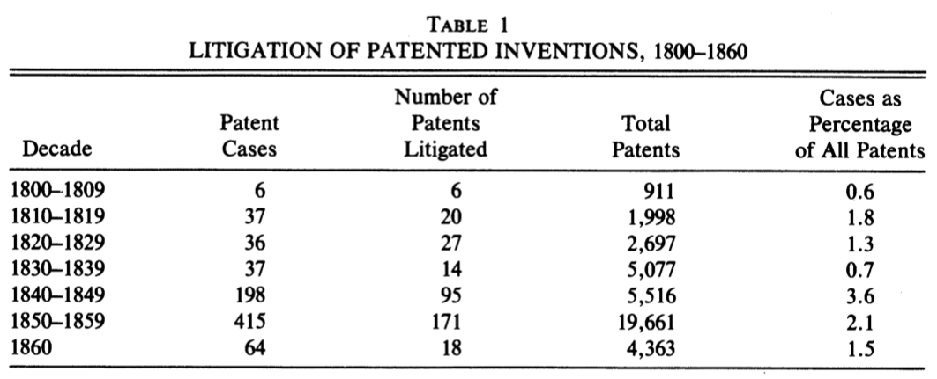
Source: Zorina Kahn, “Property Rights and Patent Litigation in Early Nineteenth Century America,” Journal of Economic History 55 (1995), 58-97

Slide 12
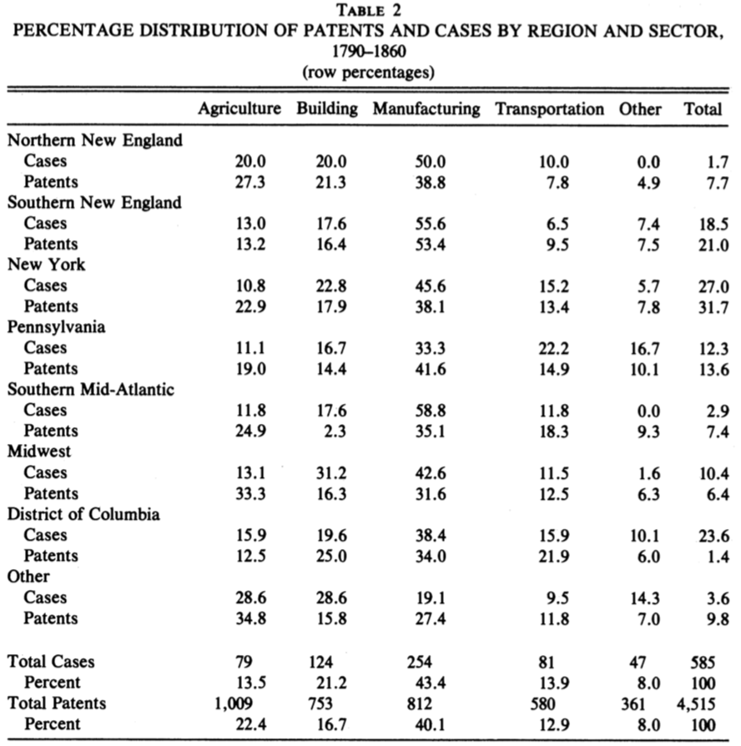
Source: Zorina Kahn, “Property Rights and Patent Litigation in Early Nineteenth Century America,” Journal of Economic History 55 (1995), 58-97

Slide 13
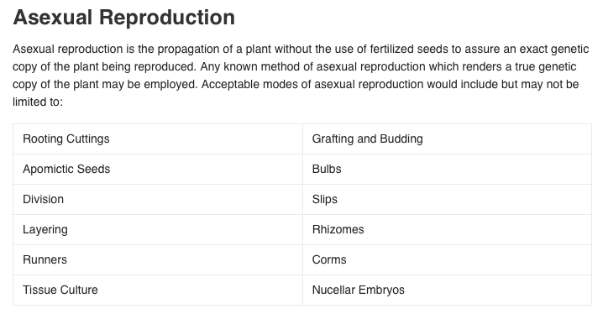
Source: https://www.uspto.gov/patents-getting-started/patent-basics/types-patent-applications/general-information-about-35-usc-161#heading-4

Slide 14
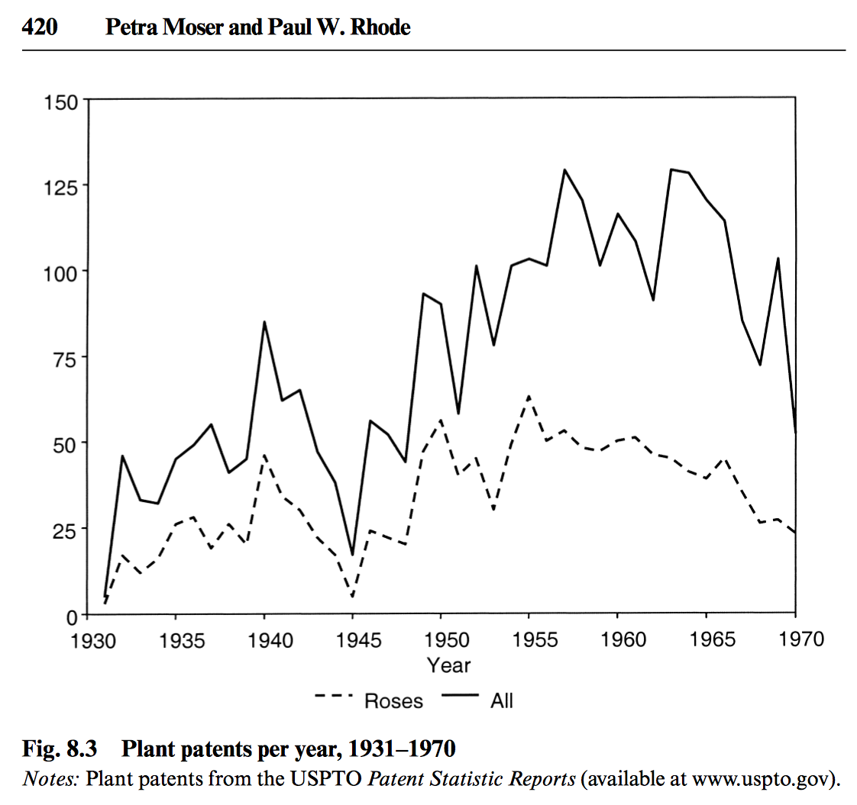
Source: http://www.nber.org/chapters/c12362.pdf
Source: https://www.newswire.com/news/weeks-roses-
introduces-seven-new-rose-varieties-for-spring-2017-18800198

Slide 15
Patent No. 5,080,111
Abstract:
A substantially self-sealing episcleral incision having an approximate central point 1.5 to 3.0 millimeters posterior to the limbus. Portions of the incision extending from the approximate central point extend laterally away from the curvature of the limbus. The configuration of the self-sealing incision allows the incision to seal as the eye is inflated following surgery and therefore requires no sutures for sealing. Accordingly, the probability of astigmatism is eliminated or greatly reduced and the reliance on sutures is eliminated.
BRIEF DESCRIPTION OF THE DRAWINGS
FIG. 1 is a schematic representation of a top view of a human eye;
FIG. 2 is a schematic representation of the interior of a human eye; and
FIGS. 3-4 are highly enlarged representations of the configurations of incisions in accordance with the present invention.

Slide 16
Patent No. 5,960,411 (Sept. 28, 1999)
Abstract:
A method and system for placing an order to purchase an item via the Internet. The order is placed by a purchaser at a client system and received by a server system. The server system receives purchaser information including identification of the purchaser, payment information, and shipment information from the client system. The server system then assigns a client identifier to the client system and associates the assigned client identifier with the received purchaser information. The server system sends to the client system the assigned client identifier and an HTML document identifying the item and including an order button. The client system receives and stores the assigned client identifier and receives and displays the HTML document. In response to the selection of the order button, the client system sends to the server system a request to purchase the identified item. The server system receives the request and combines the purchaser information associated with the client identifier of the client system to generate an order to purchase the item in accordance with the billing and shipment information whereby the purchaser effects the ordering of the product by selection of the order button.

Slide 17
Patent No. 5,800,268
(Sept. 1, 1998)
Abstract:
A method by which a player may participate in a live casino game from a location remote from the casino is disclosed. A player establishes an information link with a casino from an interface station including a video monitor and keypad. In response to the player's entry of financial account information, the casino establishes an information line with the player's financial institution. The casino assigns the player to a gaming table at which a "live" game is occurring, transmitting all images of game play and instructions to the player. The player transmits bet and game play information to the casino. Because of the open line between the casino and player's financial institution, bets are checked, winnings paid, and losses debited, instantaneously.

Slide 18
Patent No. 5,191,573 (March 2, 1993)
Abstract:
The present invention is a method for transmitting a desired digital video or audio signal stored on a first memory of a first party to a second memory of a second party. The method comprises the steps of transferring money via a telecommunications line to the first party from the second party. Additionally, the method comprises the step of then connecting electronically via a telecommunications line the first memory with the second memory such that the desired signal can pass therebetween. Next, there is the step of transmitting the desired digital signal from the first memory with a transmitter in control and in possession of the first party to a receiver having the second memory at a location determined by the second party. The receiver is in possession and in control of the second party. There is also the step of then storing the digital signal in the second memory.

Slide 19
Patent No. 5,848,396 (Dec. 8, 1998)
Abstract:
Computer network method and apparatus provides targeting of appropriate audience based on psychographic or behavioral profiles of end users. The psychographic profile is formed by recording computer activity and viewing habits of the end user. Content of categories of interest and display format in each category are revealed by the psychographic profile, based on user viewing of agate information. Using the profile (with or without additional user demographics), advertisements are displayed to appropriately selected users. Based on regression analysis of recorded responses of a first set of users viewing the advertisements, the target user profile is refined. Viewing by and regression analysis of recorded responses of subsequent sets of users continually auto-targets and customizes ads for the optimal end user audience.

Slide 20
The Increased Receptivity to Software Patents
Gottshalk
(SCOTUS 1972)
Flook
(SCOTUS 1978)
Diehr
(SCOTUS 1981)
Prater
(CCPA 1969)
Bernhart
(CCPA 1969)
Musgrave
(CCPA 1970)
Freeman
(CCPA 1977)
Walter
(CCPA 1980)
Abele
(CCPA 1982)
Iwahashi (CAFC 1989)
Arrhythmia (CAFC 1992)
Allappat (CAFC 1994)
PTO
Guidelines (1996)

Slide 21
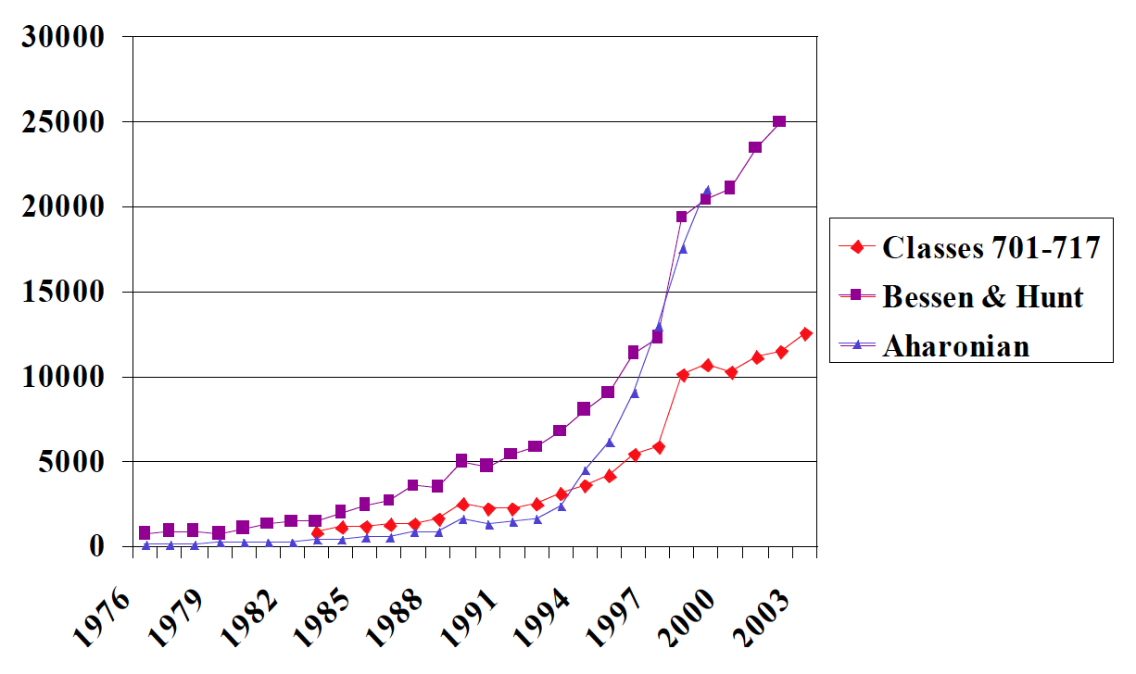
Estimates of Software Patents Issued in the United States

Slide 23
Music
Prints
Photos
Surgery
Sports
Paintings
Business
Methods
Sound
recordings
Books, maps,
charts
Processes
Software
Purified
Genes
Movies
Sculpture
Products
Dramatic
works
Animals
Ads
Useful objects
Arch.
Design
Patents
PVPA
Choreography
Lectures
PPA
Characters
Plants
Configuration
Packaging
Labels
Names of
manufacturers
Descriptive
Geographic
Arbitrary
Smells
Slogans
Symbols
Sounds
Service Marks
Colors

Slide 24
Potential Explanations for Historical Trends
Expansion (1800-2000)
Changing Basis of the Economy
  Agriculture to industry to information processing
Political Economy
Ideology
  Labor Theory
  Classical Liberalism
  Romantic conception of inventors
  Frontier Ethic
  Pastoral Ideal
  Celebration of Social Mobility
”Propertization”
Contraction (2000-2021)
Political Economy
Ideology
  Nationalism/Mercantilism
  Intensified concern with public health
  Reservations concerning hubris and Pandora’s box
  Environmentalism

Slide 25
Section B: Harmonization

Slide 26
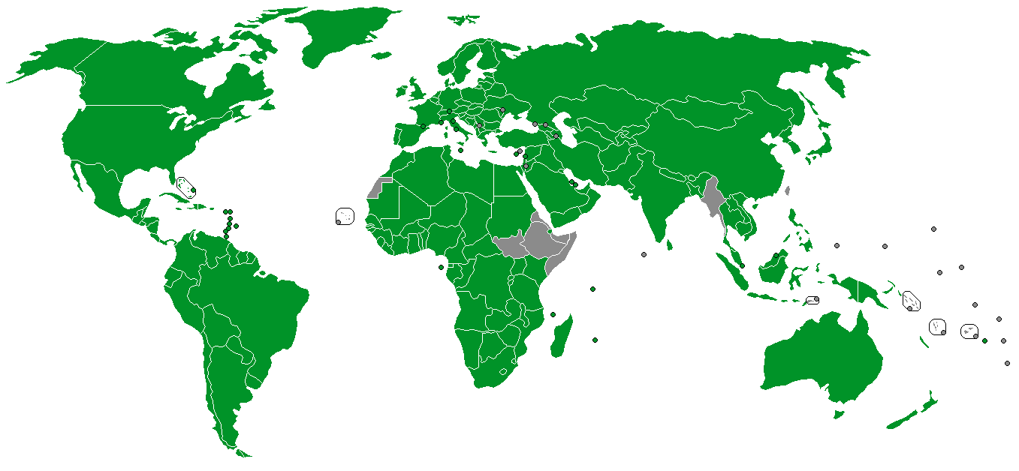
Paris Convention Member States (as of December 15, 2022)

Slide 27
“Gaps” in Patent Protection in the 92 Member Countries of the Paris Union (1988)
 | Countries
Pharmaceutical products | 49
Pharmaceutical processes | 10
Surgical and diagnostic methods | 44
Animals | 45
Plants | 44
Processes for production of plants & animals | 42
Microorganisms | 9
Food products | 35
Processes for production of food | 9
Software | 32
Chemical products | 22
Source: Joseph Straus, The Implications of the TRIPS Agreement in the Field of Patent Law, in From GATT to TRIPS (Friedrich-Karl Beier & Gerhard Shricker eds., 1996)

Slide 28
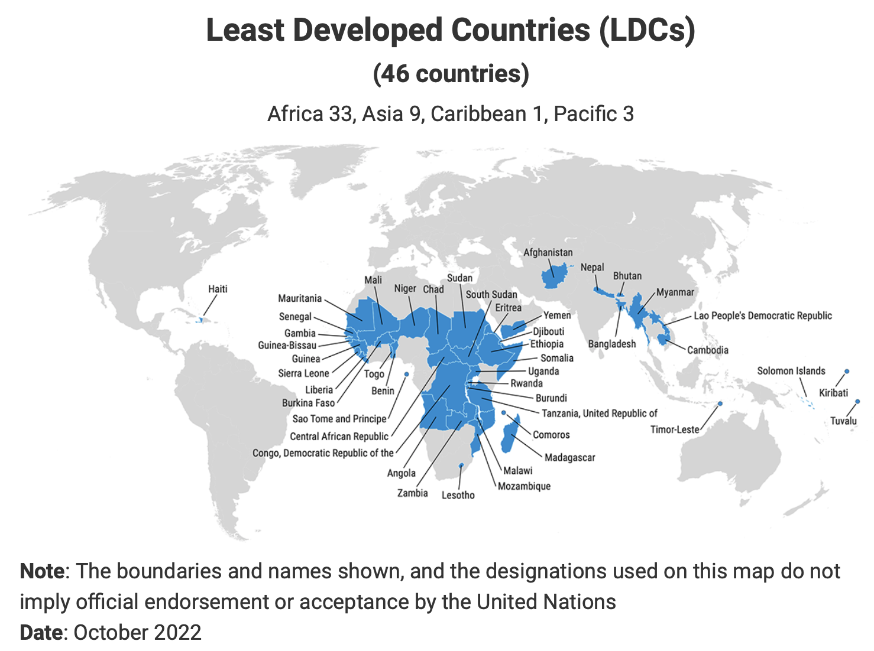
Source: https://unctad.org/topic/least-developed-countries/list

Slide 29
Section C: Contraction

Slide 30
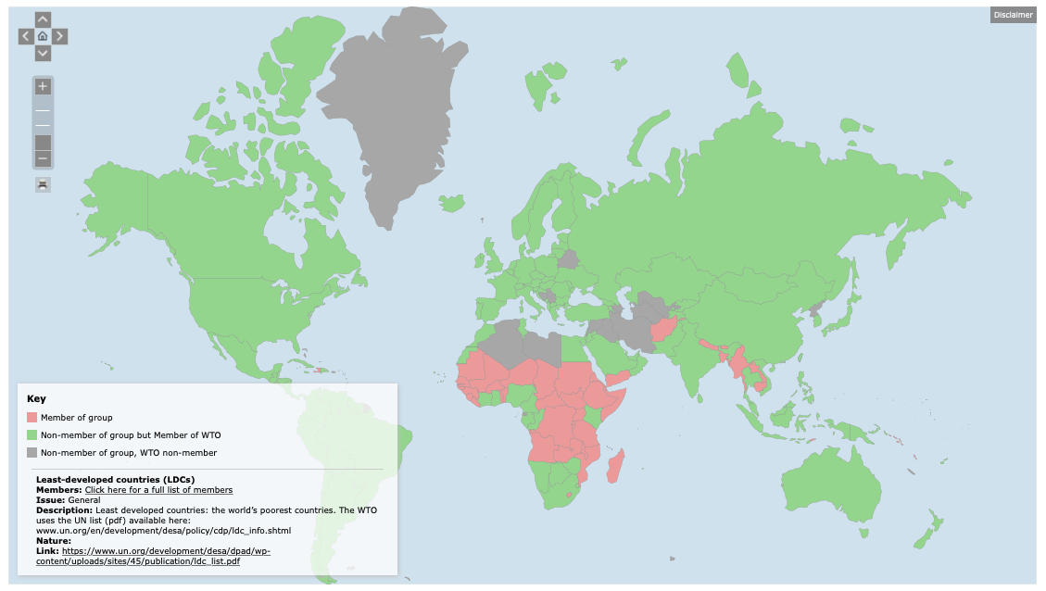

Slide 31
35 USC 287(c)
(1). With respect to a medical practitioner’s performance of a medical activity that constitutes an infringement under section 271(a) or (b), the provisions of sections 281, 283, 284, and 285 shall not apply against the medical practitioner or against a related health care entity with respect to such medical activity.
(2)(A) For the purpose of this subsection, the term “medical activity” means the performance of a medical or surgical procedure on a body, but shall not include (i) the use of a patented machine, manufacture, or composition of matter in violation of such patent, (ii) the practice of a patented use of a composition of matter in violation of such patent, or (iii) the practice of a process in violation of a biotechnology patent.

Slide 32
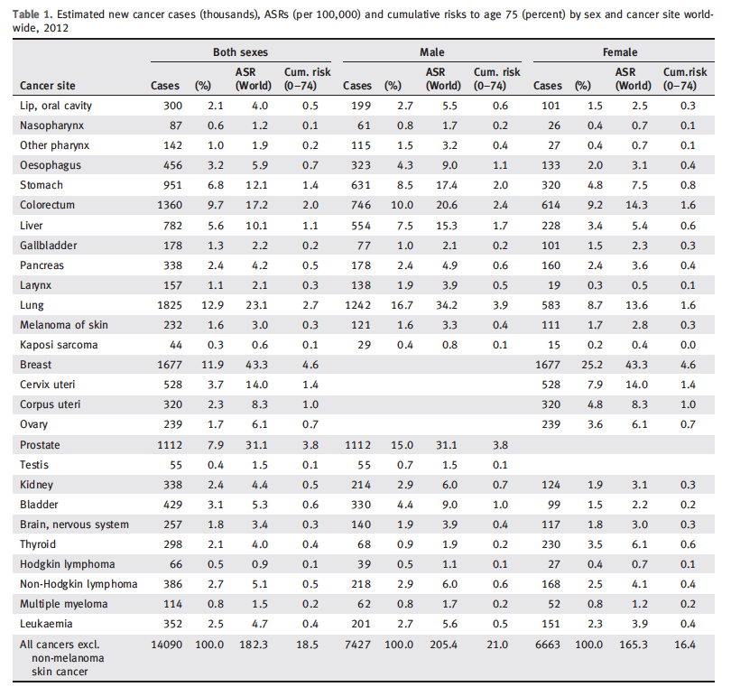
Source: Jacques Ferlay et al., “Cancer incidence and mortality worldwide: Sources, methods
and major patterns in GLOBOCAN 2012,” International Journal of Cancer 136 (2015): E359-E386

Slide 33
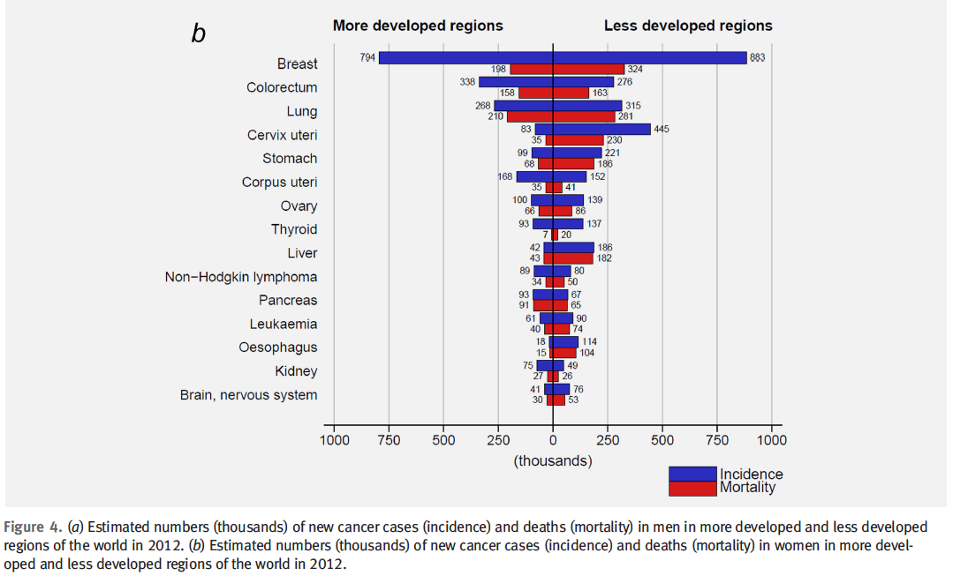
Source: Jacques Ferlay et al., “Cancer incidence and mortality worldwide: Sources, methods
and major patterns in GLOBOCAN 2012,” International Journal of Cancer 136 (2015): E359-E386

Slide 34
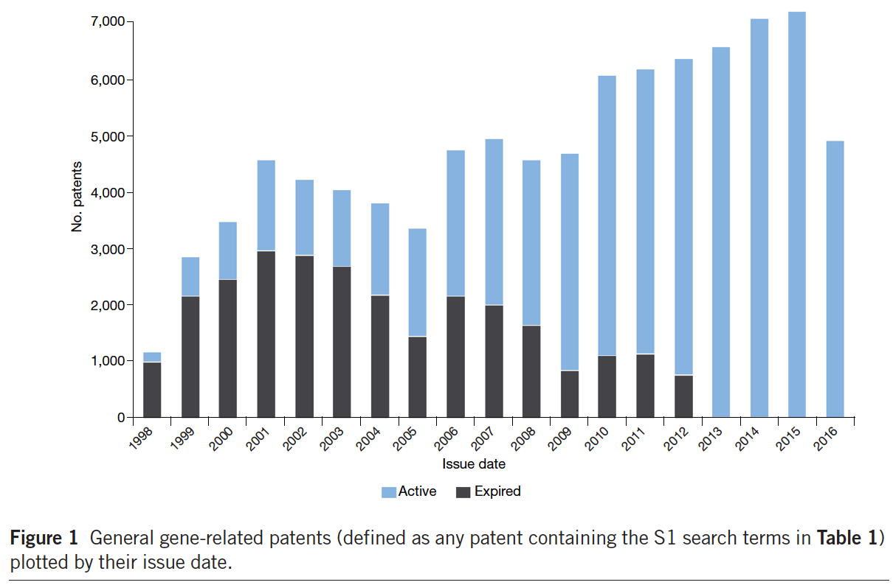
Source: Mateo Aboy, Kathleen Liddell, Johnathon Liddicoat & Cristina Crespo,
“Myriad’s impact on gene patents,”
Nature Biotechnology 34 (November 2016): 1119

Slide 35
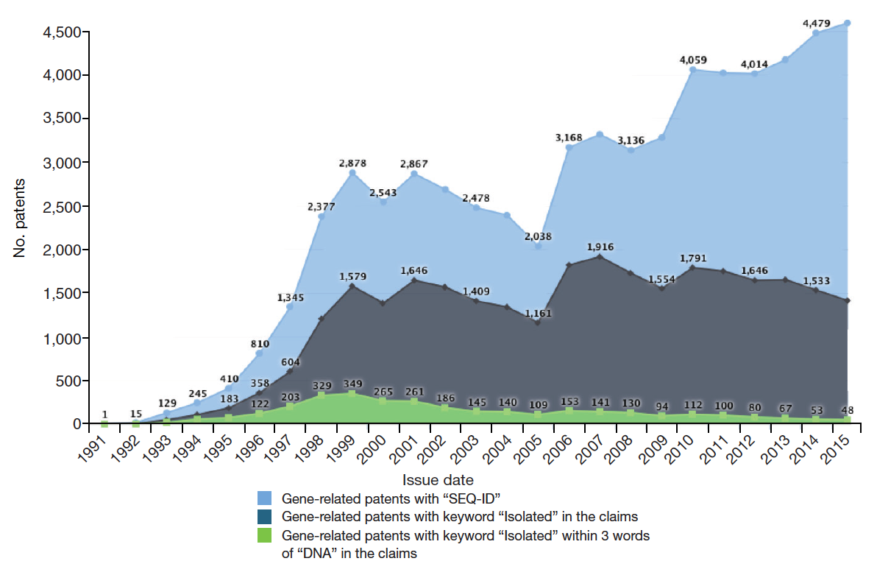
Source: Mateo Aboy, Kathleen Liddell, Johnathon Liddicoat & Cristina Crespo,
“Myriad’s impact on gene patents,”
Nature Biotechnology 34 (November 2016): 1119

Slide 36
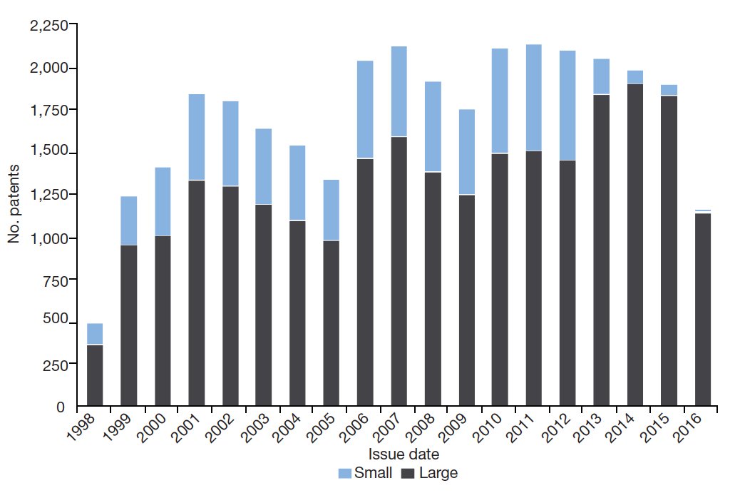
Source: Mateo Aboy, Kathleen Liddell, Johnathon Liddicoat & Cristina Crespo,
“Myriad’s impact on gene patents,”
Nature Biotechnology 34 (November 2016): 1119

Slide 37
Mayo (2012)
Laws of Nature
Medical
Procedures
Tax
strategies
Sports
Business
Methods
Myriad Genetics (2013)
Principles
Alice (2014)
Processes
Manufacture
Genes
Software
Purified
Compositions
of Matter
Machines
Animals
Design
Patents
PVPA
Products of Nature
PPA
Plants

Slide 38
USA circa 2021
Laws of Nature
Medical
Procedures
Tax
strategies
Sports
Business
Methods
Principles
Processes
Manufacture
Genes
Software
Purified
Compositions
of Matter
Machines
Animals
Design
Patents
PVPA
Products of Nature
PPA
Plants

