Slide 1
Patent Scope
William Fisher WilmerHale Professor of Intellectual Property Law
Harvard Law School
February 2023

Slide 2
The following images appear in the background of the lecture on “Patent Scope” in the PatentX lecture series. A recording of the lecture itself is available at https://ipxcourses.org/lectures-2/. Removed from their original context, the images will not make much sense. The function of this collection of images is to enable persons who have already watched the lecture to review the material it contains.
The terms on which these materials may be used or modified are available at http://ipxcourses.org.

Slide 3
Statutory Provisions
United States: 35 U.S.C 271(a)
“… Whoever, without authority makes, uses, offers to sell, or sells any patented invention, within the United States or imports into the United States any patented invention during the term of the patent therefor, infringes the patent.”
Patent Act of Korea, Art. 94
“A patentee shall have the exclusive right to commercially and industrially execute his/her patented invention.”
Patent Act of Japan, Art. 68
“A patentee shall have the exclusive right to work the patented invention as a business.”

Slide 4
Central Claiming
Products or processes made or used by others
Essence
of the Invention
Infringing
Not infringing
Patentee defines red zone; government official (typically a judge) defines blue zone

Slide 5
Peripheral Claiming
Products or processes made or used by others
Not infringing
Infringing
Examples
of the Invention
Patentee defines red zone; government official (typically a judge) defines blue zone

Slide 6
Statutory Provisions
Patent Act of Korea, Art. 97
“The scope of protection of a patented invention shall be determined by the descriptions of the claims.”
Patent Act of Japan, Art. 70
“The technical scope of a patented invention shall be determined based upon the statements in the scope of claims attached to the application.”
Patent Act of China, Art. 59
“For the patent right of an invention or a utility model, the scope of protection shall be confined to what is claimed, and the written description and the pictures attached may be used to explain what is claimed.”
United States, 35 USC 112(b)
“The specification shall conclude with one or more claims particularly pointing out and distinctly claiming the subject matter which the inventor or a joint inventor regards as the invention.”

Slide 7
Patent No. 5,415,398

Slide 8
Patent No. 5,415,398
I claim:
1. A bat, comprising: a hollow tubular bat frame having a circular cross-section; and an insert positioned within the frame, the insert having a circular cross-section, the insert having first and second ends adjoining the tubular frame, the insert being separated from the tubular frame by a gap forming at least part of an annular shape along a central portion between said first and second ends, the frame elastically deflectable across the gap to operably engage the insert along a portion of the insert between the insert first and second ends.

Slide 9
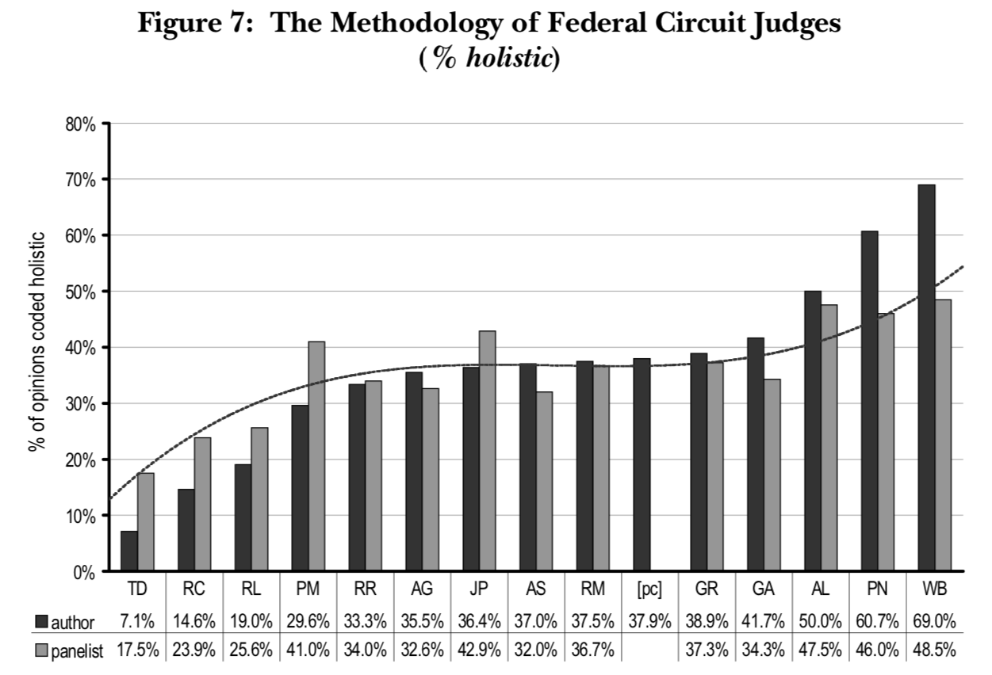
“Holistics”
Bryson
Newman
Prost
“Proceduralists”
“Swing”
Lourie
Plager
Per curiuam
Archer
Michel
Gajarsa
Rader
Schall
Mayer
Rich
Clevenger
Linn
Dyk
Source: Wagner & Petherbridge, “Is the Federal Circuit Succeeding?,” 152 U. Penn. L. Rev. 1105, 1158 (2004)

Slide 10
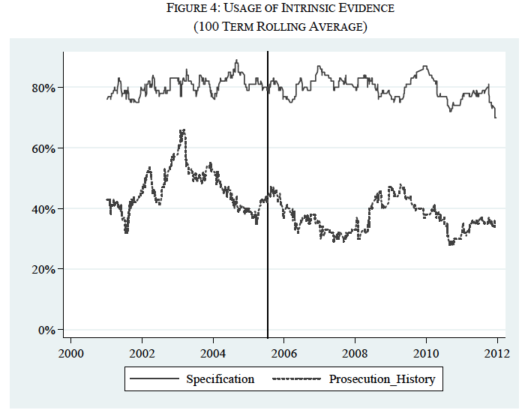

Slide 11
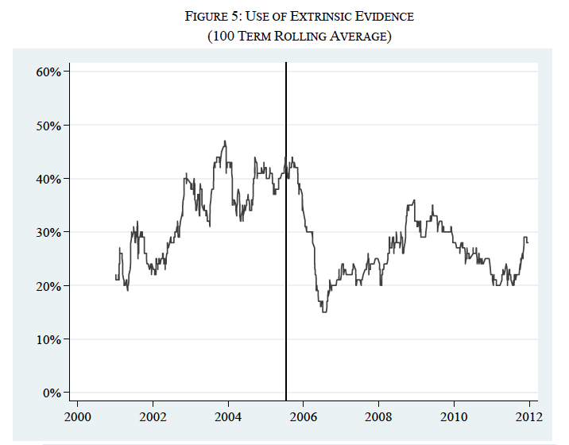

Slide 12
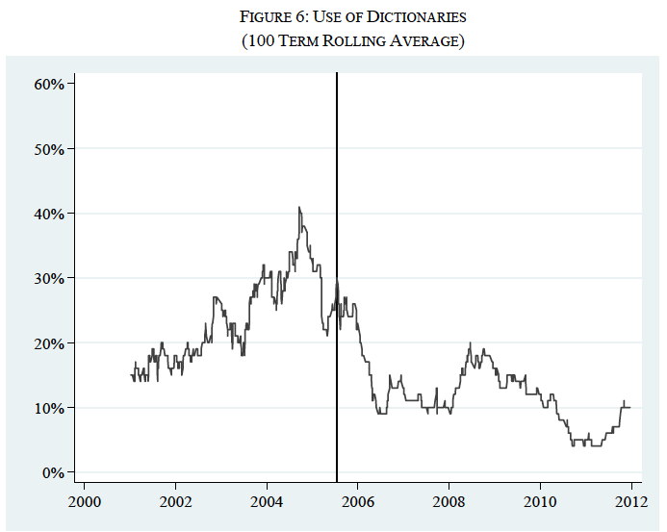

Slide 13
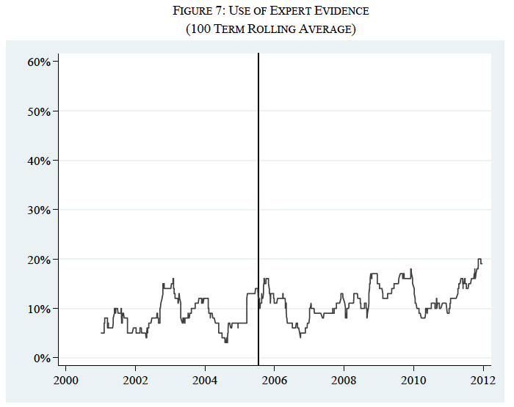

Slide 14
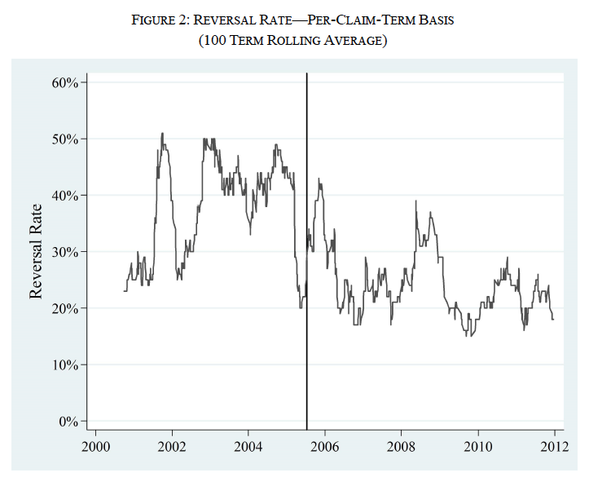

Slide 15
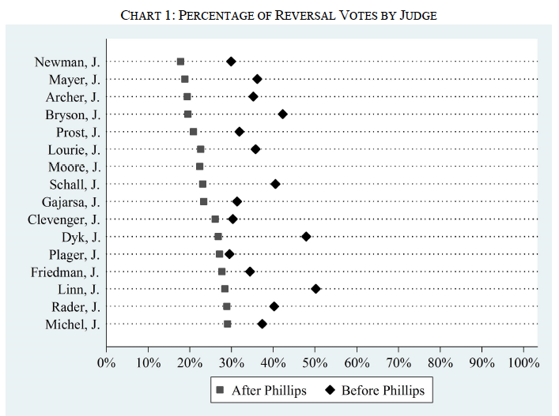

Slide 17
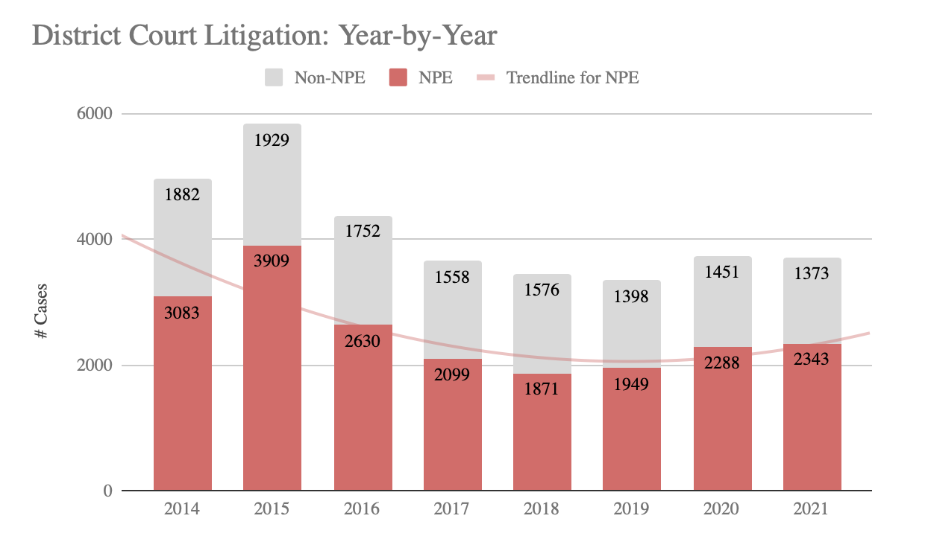
Source: https://www.unifiedpatents.com/insights/2022/1/3/2021-patent-dispute-report-year-in-review

Slide 18
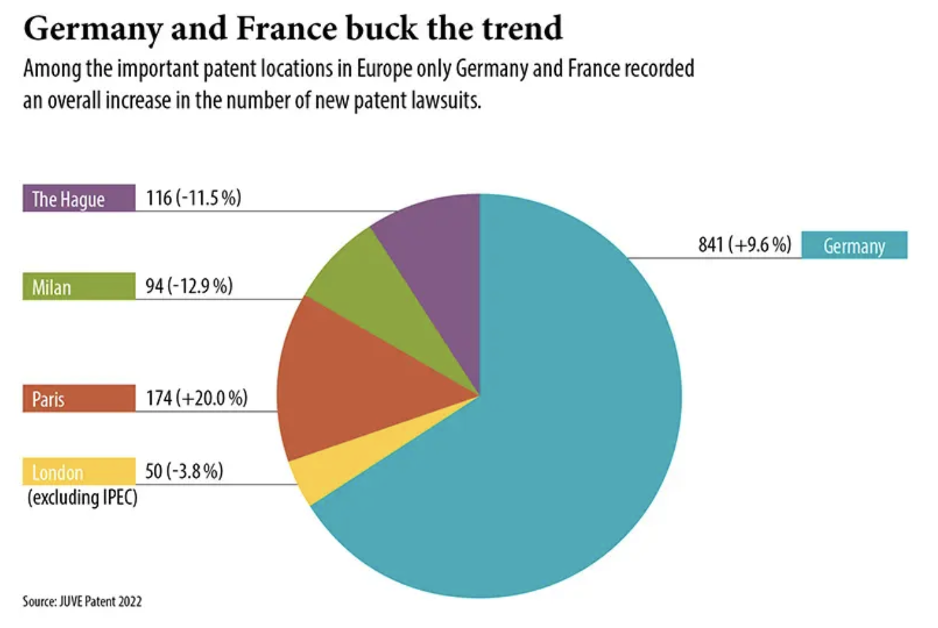
Source: https://www.juve-patent.com/people-and-business/case-numbers-soar-at-french-patent-courts-although-germany-remains-ahead/

Slide 19
European Patent Convention Art. 69 (original form)
“The extent of the protection conferred by a European patent or a European patent application shall be determined by the terms of the claims. Nevertheless, the description and drawings shall be used to interpret the claims.”

Slide 20
Duration of Utility Patents, 1791-1836
14 years
time
Patent Grant
Patent application

Slide 21
Duration of Utility Patents, 1836-1861
7-year
renewal
term
14 years
time
Patent Grant
Patent application

Slide 22
Duration of Utility Patents, 1861-1995
17 years
time
Patent Grant
Patent application

Slide 23
Duration of Utility Patents, 1995-present
20 years
time
Patent Grant
Patent application

Slide 24
Duration of Utility Patents, 1995-present
Referenced continuation application (§120)
20 years
time
Patent Grant
Patent application

Slide 25
Duration of Utility Patents, 1995-present
Referenced divisional application (§121)
20 years
time
Patent Grant
Patent application

Slide 26
Duration of Utility Patents, 1995-present
Referenced PCT application naming U.S. (§365(c))
20 years
time
Patent Grant
Patent application

Slide 27
Duration of Utility Patents, 1995-present
Referenced Paris-Convention application (§119)
20 years
time
Patent Grant
Patent application

Slide 28
Duration of Utility Patents, 1995-present
§154(b)(1)(A) Extension:
Slow PTO responses
to specific submissions
20 years
time
Patent Grant
Patent application

Slide 29
Duration of Utility Patents, 1995-present
§154(b)(1)(B) Extension:
More than 3 years elapse
between application and grant
(exclusions for continuations
or applicant’s neglect)
20 years
time
Patent Grant
Patent application

Slide 30
Duration of Utility Patents, 1995-present
§154(b)(1)(C) Extensions:
--Interferences;
--Secrecy Orders;
--Winning Appeals
20 years
time
Patent Grant
Patent application

Slide 31
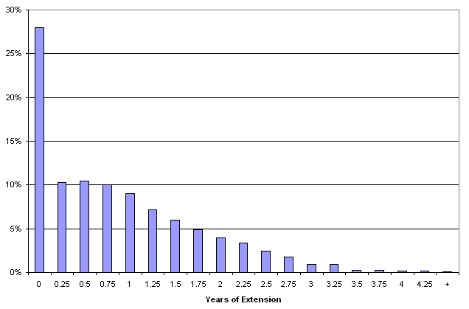
Source: Patently-O, 3/14/2008, http://patentlaw.typepad.com/

Slide 32
Duration of Utility Patents
Construct components
of combination patent; test them
Sell components
to customers
20 years
time
Patent Grant
Customers assemble and use
Patent application

Slide 33
Paper Converting Machine (CAFC 1984)
“It is undisputed that Magna-Graphics intended to finesse Paper Converting out of the sale of a machine on which Paper Converting held a valid patent during the life of that patent. Given the amount of testing performed here, coupled with the sale and delivery during the patent-term of a ‘completed’ machine (completed by being ready for assembly and with no useful noninfringing purpose), we are not persuaded that the district court committed clear error in finding that the Magna-Graphics' machine infringed the … patent.
“To reach a contrary result would emasculate the congressional intent to prevent the making of a patented item during the patent's full term of 17 years. If without fear of liability a competitor can assemble a patented item past the point of testing, the last year of the patent becomes worthless whenever it deals with a long lead-time article. Nothing would prohibit the unscrupulous competitor from aggressively marketing its own product and constructing it to all but the final screws and bolts, as Magna-Graphics did here.”

Slide 34
years
0
4
8
12
16
20
24
28
32
Discovery &
preclinical
Roche: this is infringement;
No experimental-use defense
Clinical
development
FDA
review
Patent protection
Generic Drug Distribution
Generic Drug Development
FDA review
4
8
12
16
20
Adapted from Choi et al,
“Medicines for the Mind,”
84 Neuron 554 (2014)
Commercial life
FDA
approval

Slide 35
years
0
4
8
12
16
20
24
28
32
Discovery &
preclinical
Clinical
development
FDA
review
Patent protection
§156
Generic Drug Distribution
Generic Drug Development
FDA review
4
8
12
16
20
Adapted from Choi et al,
“Medicines for the Mind,”
84 Neuron 554 (2014)
Commercial life
FDA
approval

Slide 36
Key provisions of Hatch-Waxman Act (1984)
Extension of patent term to offset FDA approval process – up to 5 years, but no further than 14 years from date of FDA approval (§156)
No liability for making, using, or selling “a patented invention” “solely for uses reasonably related to the development and submission of information” to FDA (§271(e)(1))
Abbreviated New Drug Application procedure (ANDA) for seeking FDA approval for generic equivalent of FDA-approved drug (§271(e)(2)). Applicant must show:
Bioequivalence of the generic and the pioneer drug
No patent impediment to commercial distribution of the generic version
The drug at issue has not been patented
The patent on the drug has expired
Identify the date on which the patent will expire
The patent on the drug is invalid or will not be infringed by the generic

Slide 37
years
0
4
8
12
16
20
24
28
32
Discovery &
preclinical
Clinical
development
FDA
review
Patent protection
§156
Generic Drug Distribution
Generic Drug Development
FDA review
4
8
12
16
Adapted from Choi et al,
“Medicines for the Mind,”
84 Neuron 554 (2014)
Commercial life
FDA
approval

Slide 38
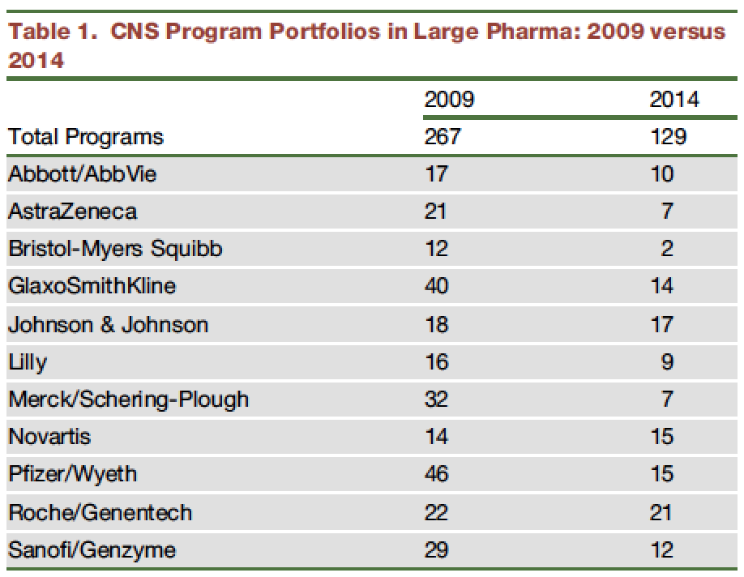

Slide 39
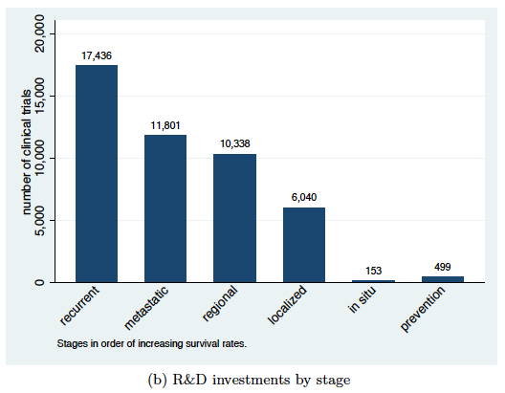
estimated impact of this distortion: 890,000 lost life years (in the United States alone) among patients diagnosed in a single year
Source: Budish, Roin & Williams, “Do Fixed Patent Terms Distortion Innovation?: Evidence from Cancer Clinical Trials (2013)

Slide 40
years
0
4
8
12
16
20
24
28
32
Discovery &
preclinical
Clinical
development
FDA
review
Patent protection
§156
Generic Drug Distribution
Generic Drug Development
FDA review
4
8
12
16
20
Adapted from Choi et al,
“Medicines for the Mind,”
84 Neuron 554 (2014)
Commercial life
FDA
approval

Slide 41
years
0
4
8
12
16
20
24
28
32
Typical duration of research and development of CNS drugs
Discovery &
preclinical
Clinical
development
FDA
review
Patent protection
§156
Generic Drug
Distribution
Generic Drug Development
FDA review
4
8
12
16
Adapted from Choi et al,
“Medicines for the Mind,”
84 Neuron 554 (2014)
Commercial life
FDA
approval

