Slide 1
Utility and Disclosure
William Fisher

Slide 2
The following images appear in the background of the lecture on “Utility and Disclosure” in the PatentX lecture series. A recording of the lecture itself is available at https://ipxcourses.org/lectures-2/. Removed from their original context, the images will not make much sense. The function of this collection of images is to enable persons who have already watched the lecture to review the material it contains.
The terms on which these materials may be used or modified are available at http://ipxcourses.org.

Slide 3
Policy Arguments Pertaining to Early-Stage Research
Favor patents on early-stage research
(Rich, Harlan, Kieff)
Stimulate R&D for new compounds
New-use (blocking) patents are possible and will create incentives
Patentee who has discovered a single use can claim just as much
Encourage inventors of new compounds to disclose, not hide them
Disclosure doctrine should be fixed
Utility reviews are costly and have no apparent benefit
Oppose patents on early-stage research
(Fortas, Eisenberg, Heller, Rai)
Patents on primary research tools impede cumulative innovation
No incentive for others to explore uses
Alternative motivations for early-stage research
Risk giving patentee too much ground
Art of patent drafting impedes disclosure
Efficient-boundary theory

Slide 4
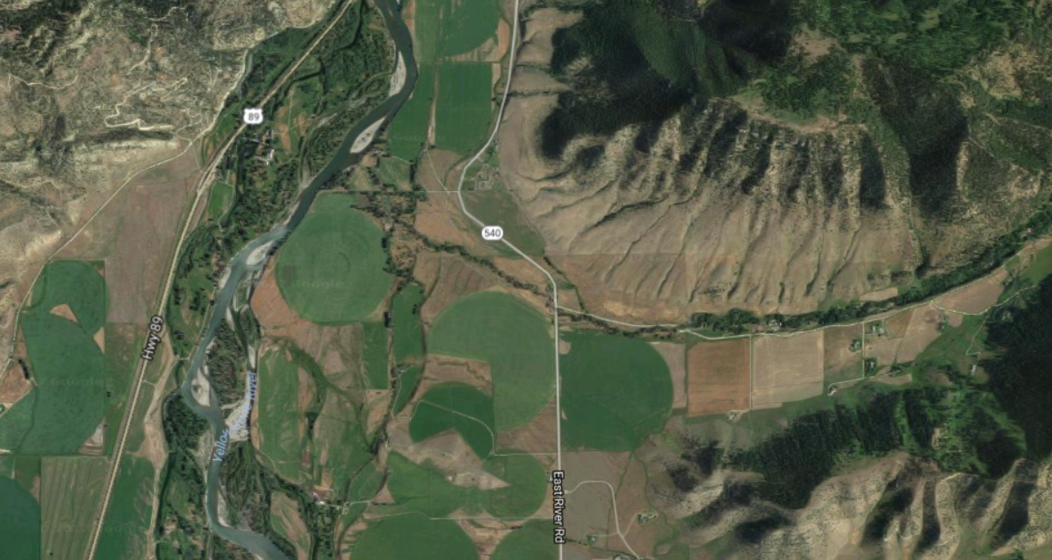
Assigning Property Rights to a Large Tract of Public Land
Conservation (state)
Wilderness (federal)
Private property (farmers)

Slide 5
Beneficial Utility Problems
Anti-photo radar license plate attachment
Large capacity ammunition magazine
Improved anti-personnel landmine
Terminator gene
Technique for increasing efficiency of Hydraulic Fracking
Sarco

Slide 6
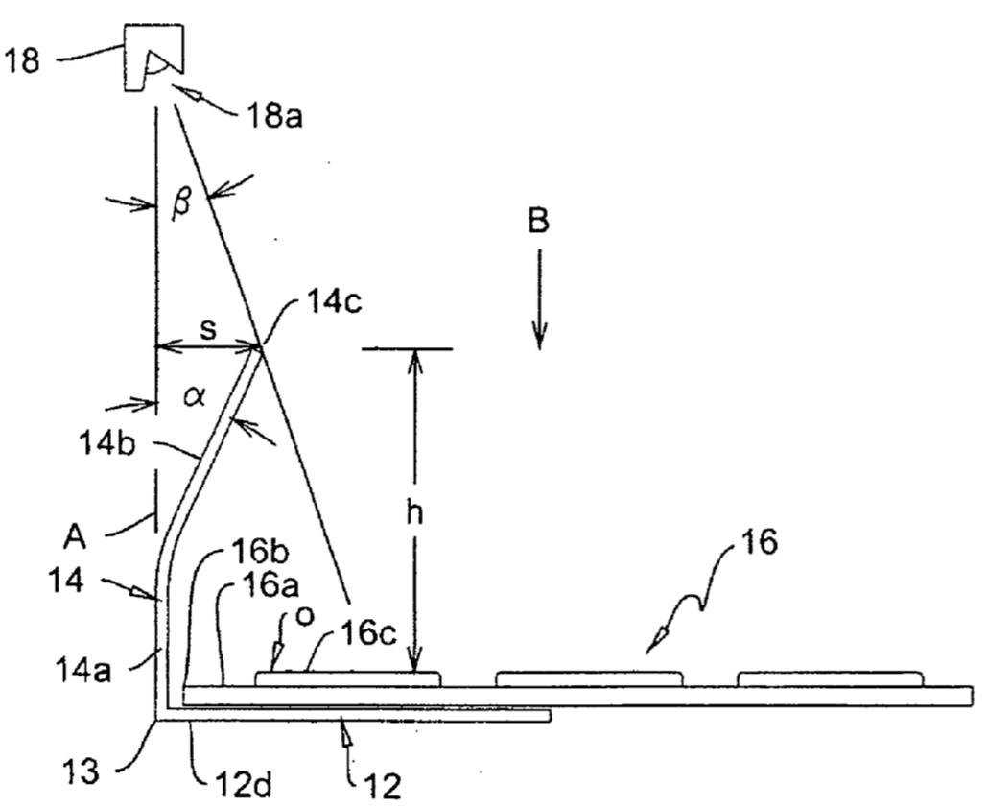
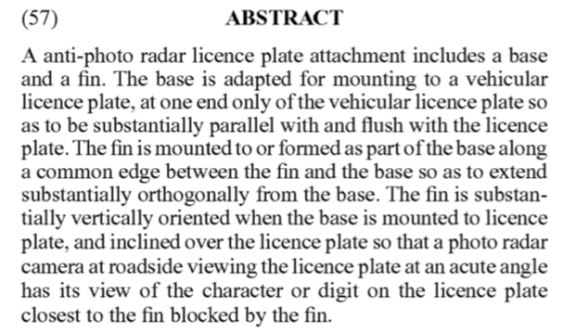

Slide 7
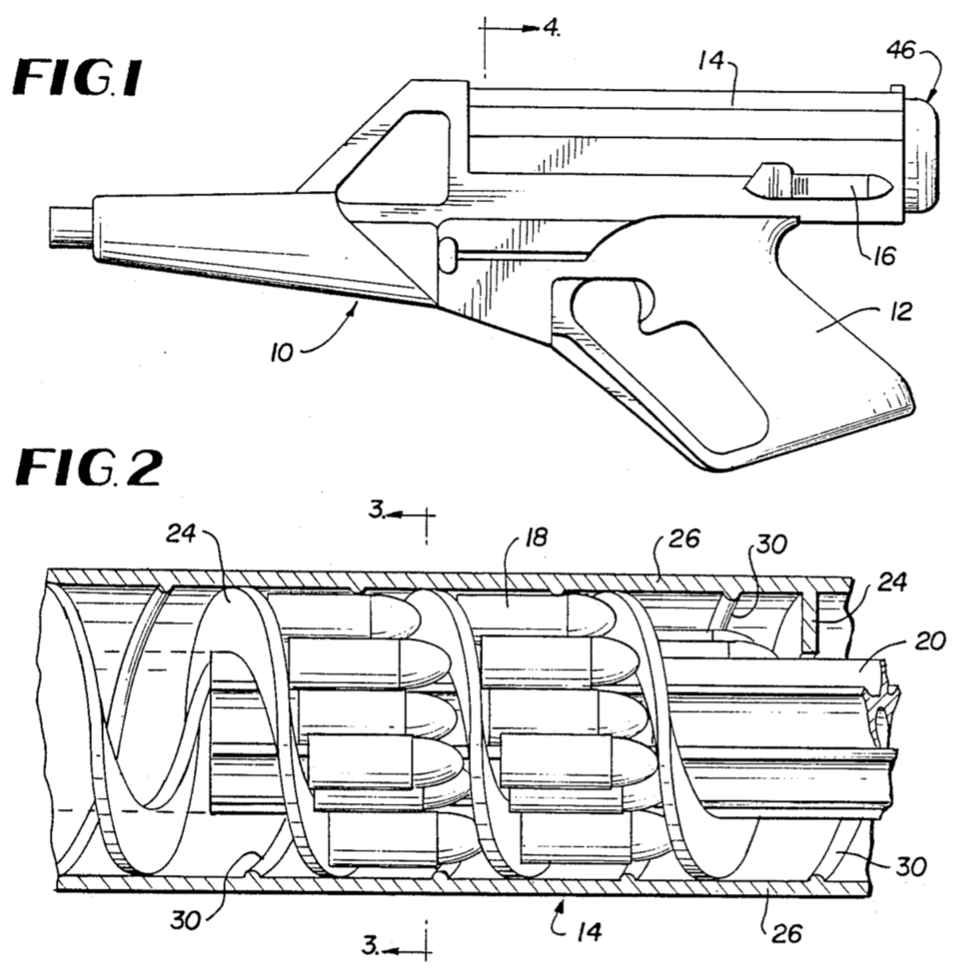
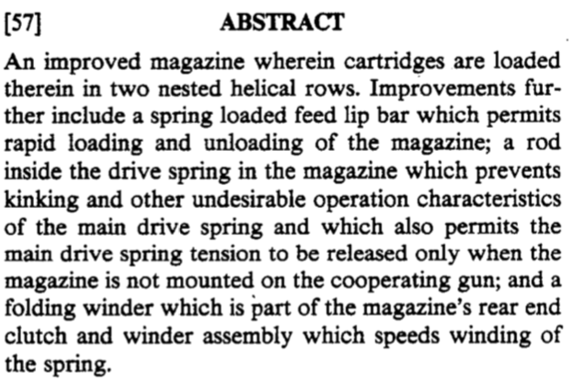

Slide 8
Anti-personnel mine in Cambodia
Source: https://en.wikipedia.org/wiki/Anti-personnel_mine#/media/File:Anti_personnel_mine.JPG

Slide 10
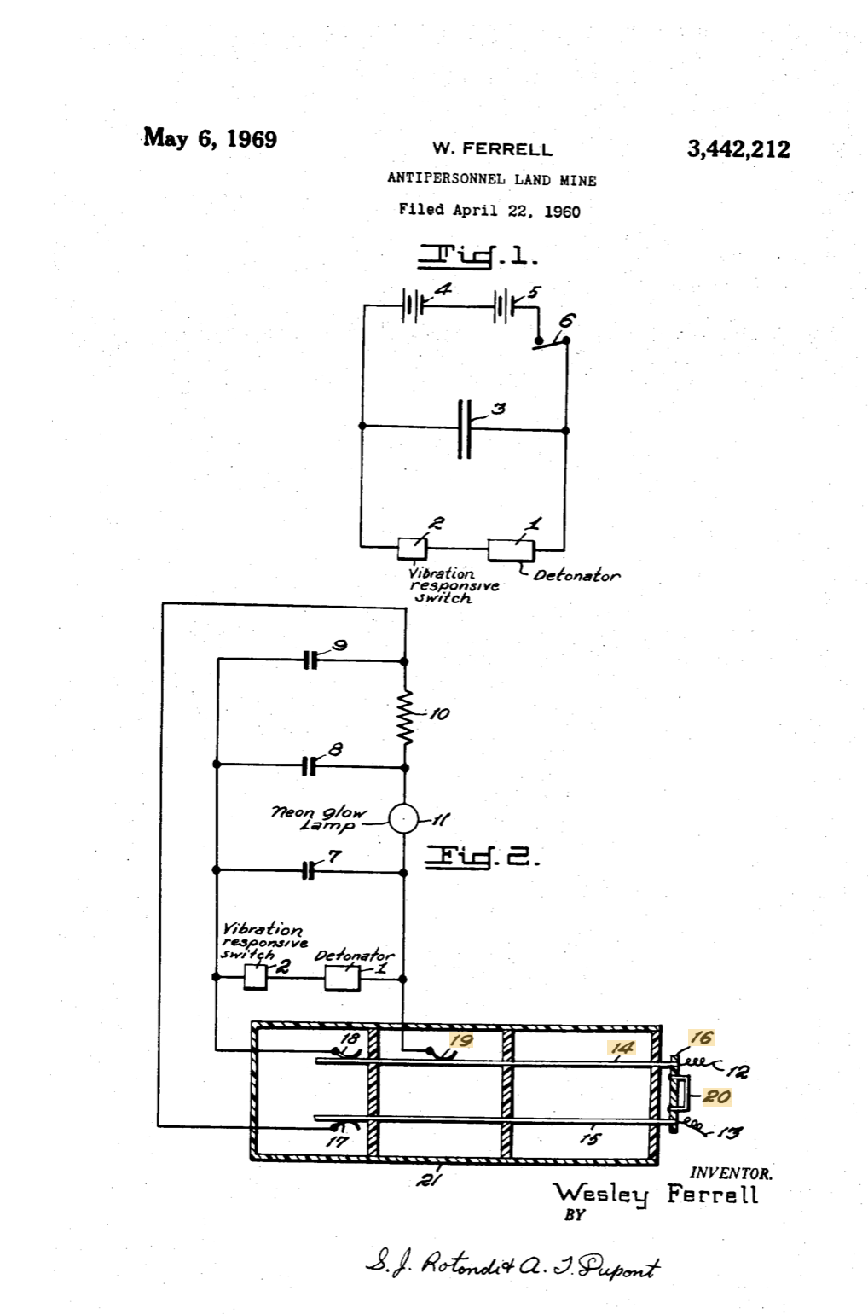
A problem in the laying of land mines is to provide a mine which is entirely safe to handle when it is being laid and will remain safe for a long enough period for the laying personnel to get clear of the area. In conventional type mines the person who lays the mine removes a safety device such as a pin, wire or the like and the mine is then armed and ready for detonation. It can thus be seen that if the mine is to be sensitive for the purpose intended it is also dangerous to the laying personnel after having been armed.
The mine of the present invention overcomes the above noted deficiencies of conventional land mines. The mine of this invention is provided with an electrical arming means which has a time delay in the circuit. When personnel lay the mines they initiate the arming process. A charge is then built up on a condenser and until this charge reaches the amount necessary to operate the detonator the mine is safe. By properly selecting the components of the arming circuit this delay can be made to be several minutes, thus giving the laying personnel ample time to retreat from the area. The detonator is operated by suitable means such as a vibration responsive switch and it can be seen that this means can be made as sensitive as desired Without endangering the laying personnel.
An object of this invention is to provide a land mine which is safe to lay and very sensitive after having been laid.

Slide 11
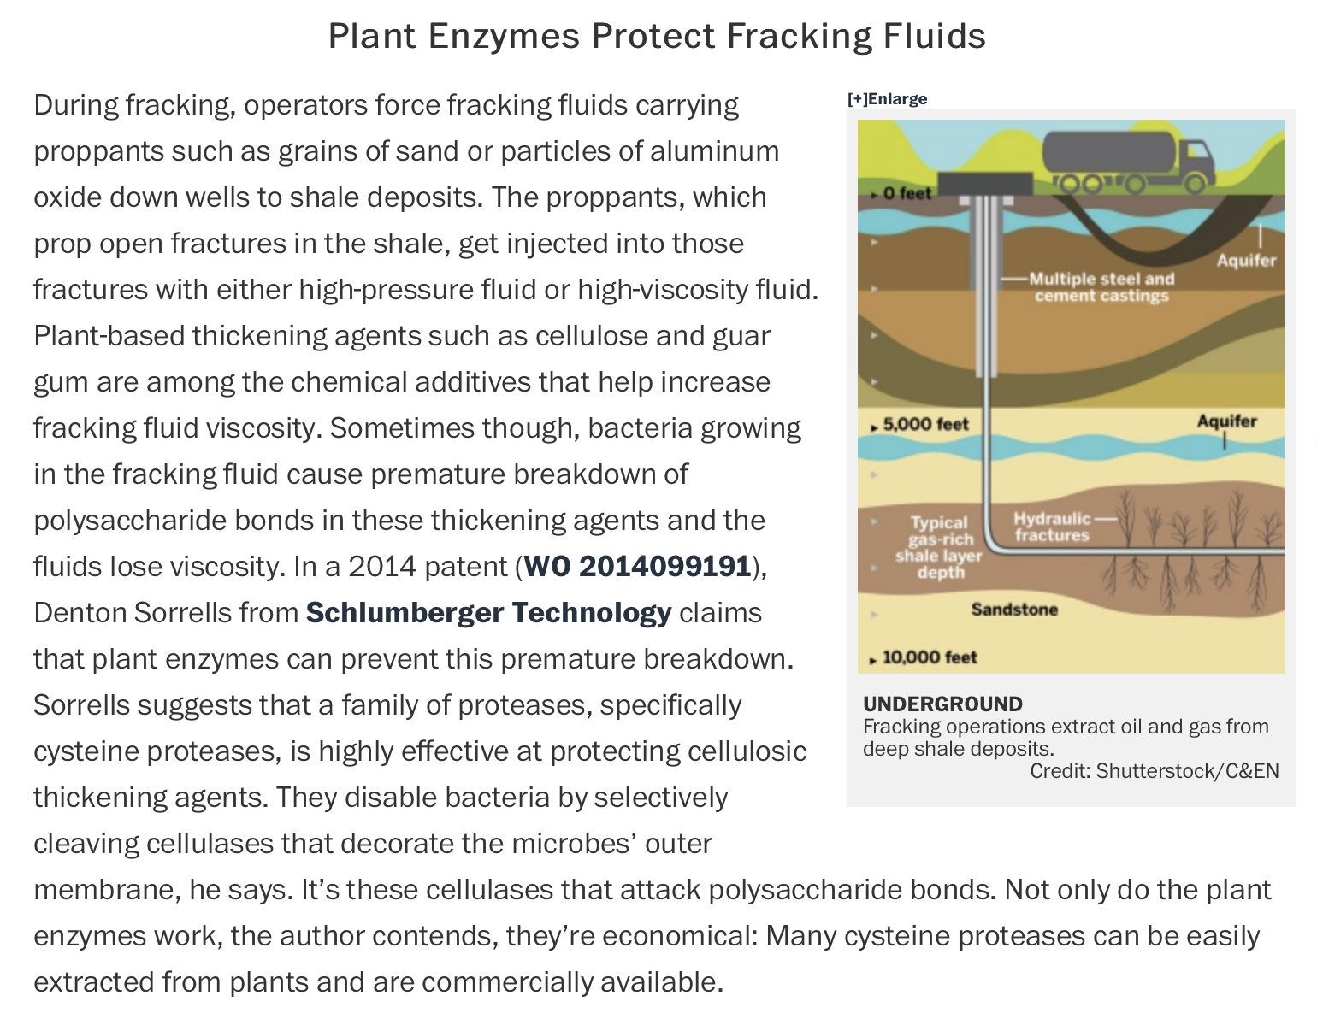
Source: https://cen.acs.org/articles/93/i4/Patent-Picks-Fracking-Technology.html

Slide 12
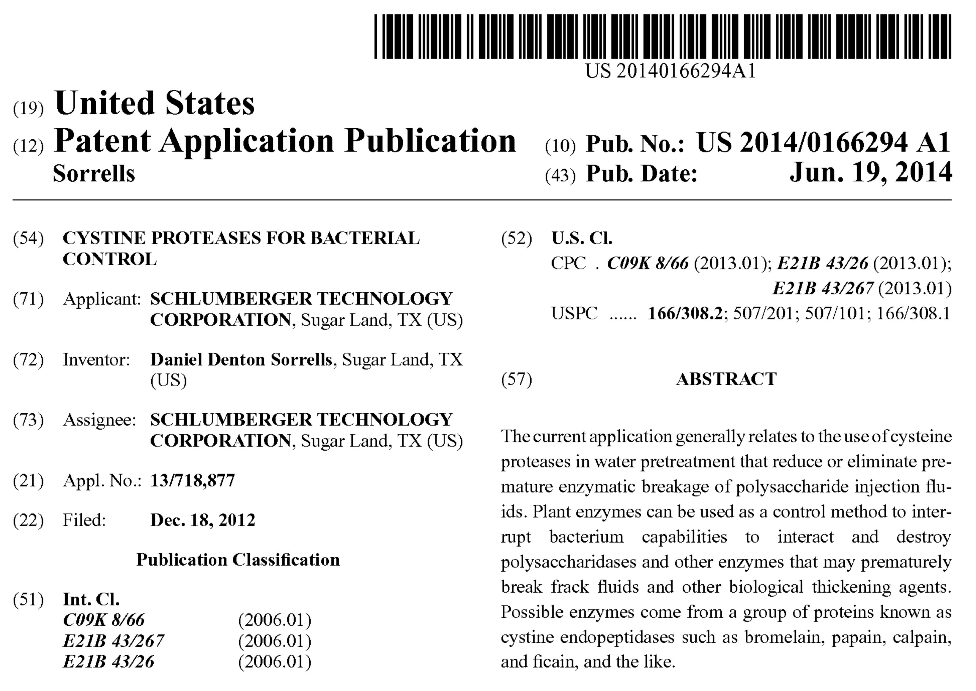

Slide 13
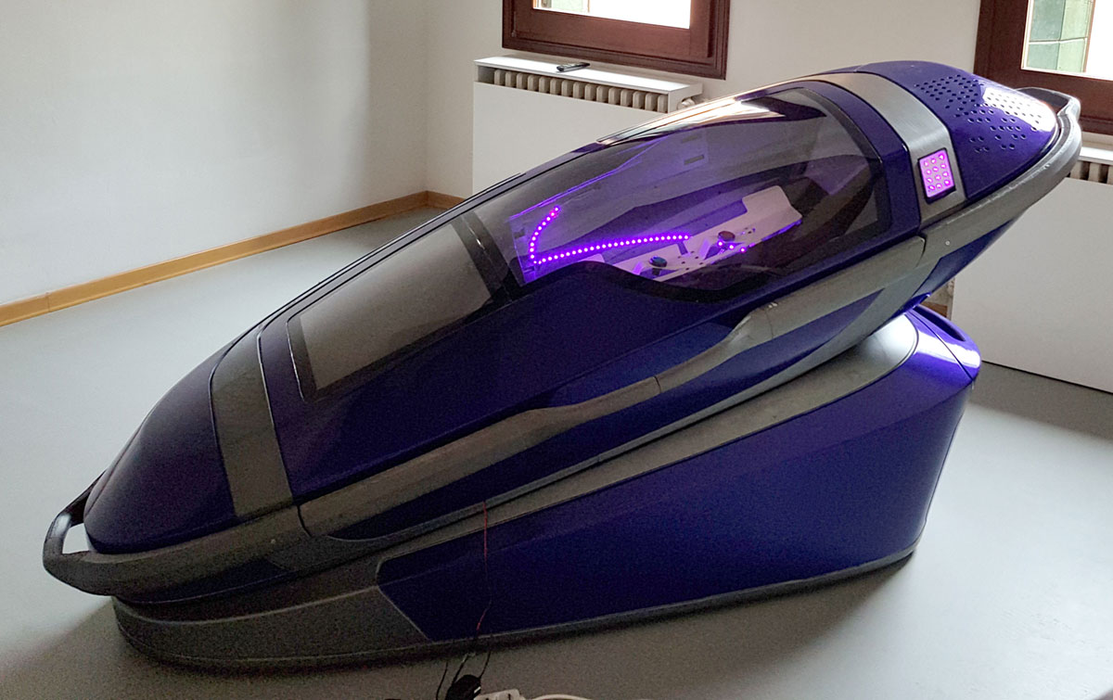
“A controversial suicide pod that enables its occupant to kill themselves at the press of a button went on display at an Amsterdam funeral show on Saturday.
Called the ‘Sarco,’ short for sarcophagus, the 3D-printed machine invented by Australian euthanasia activist Philip Nitschke and Dutch designer Alexander Bannink comes with a detachable coffin, mounted on a stand that contains a nitrogen canister.
‘The person who wants to die presses the button and the capsule is filled with nitrogen. He or she will feel a bit dizzy but will then rapidly lose consciousness and die,’ said Nitschke. The Sarco was a device ‘to provide people with a death when they wish to die,’ Nitschke said.”
Source: The Guardian, April 14, 2018

Slide 14
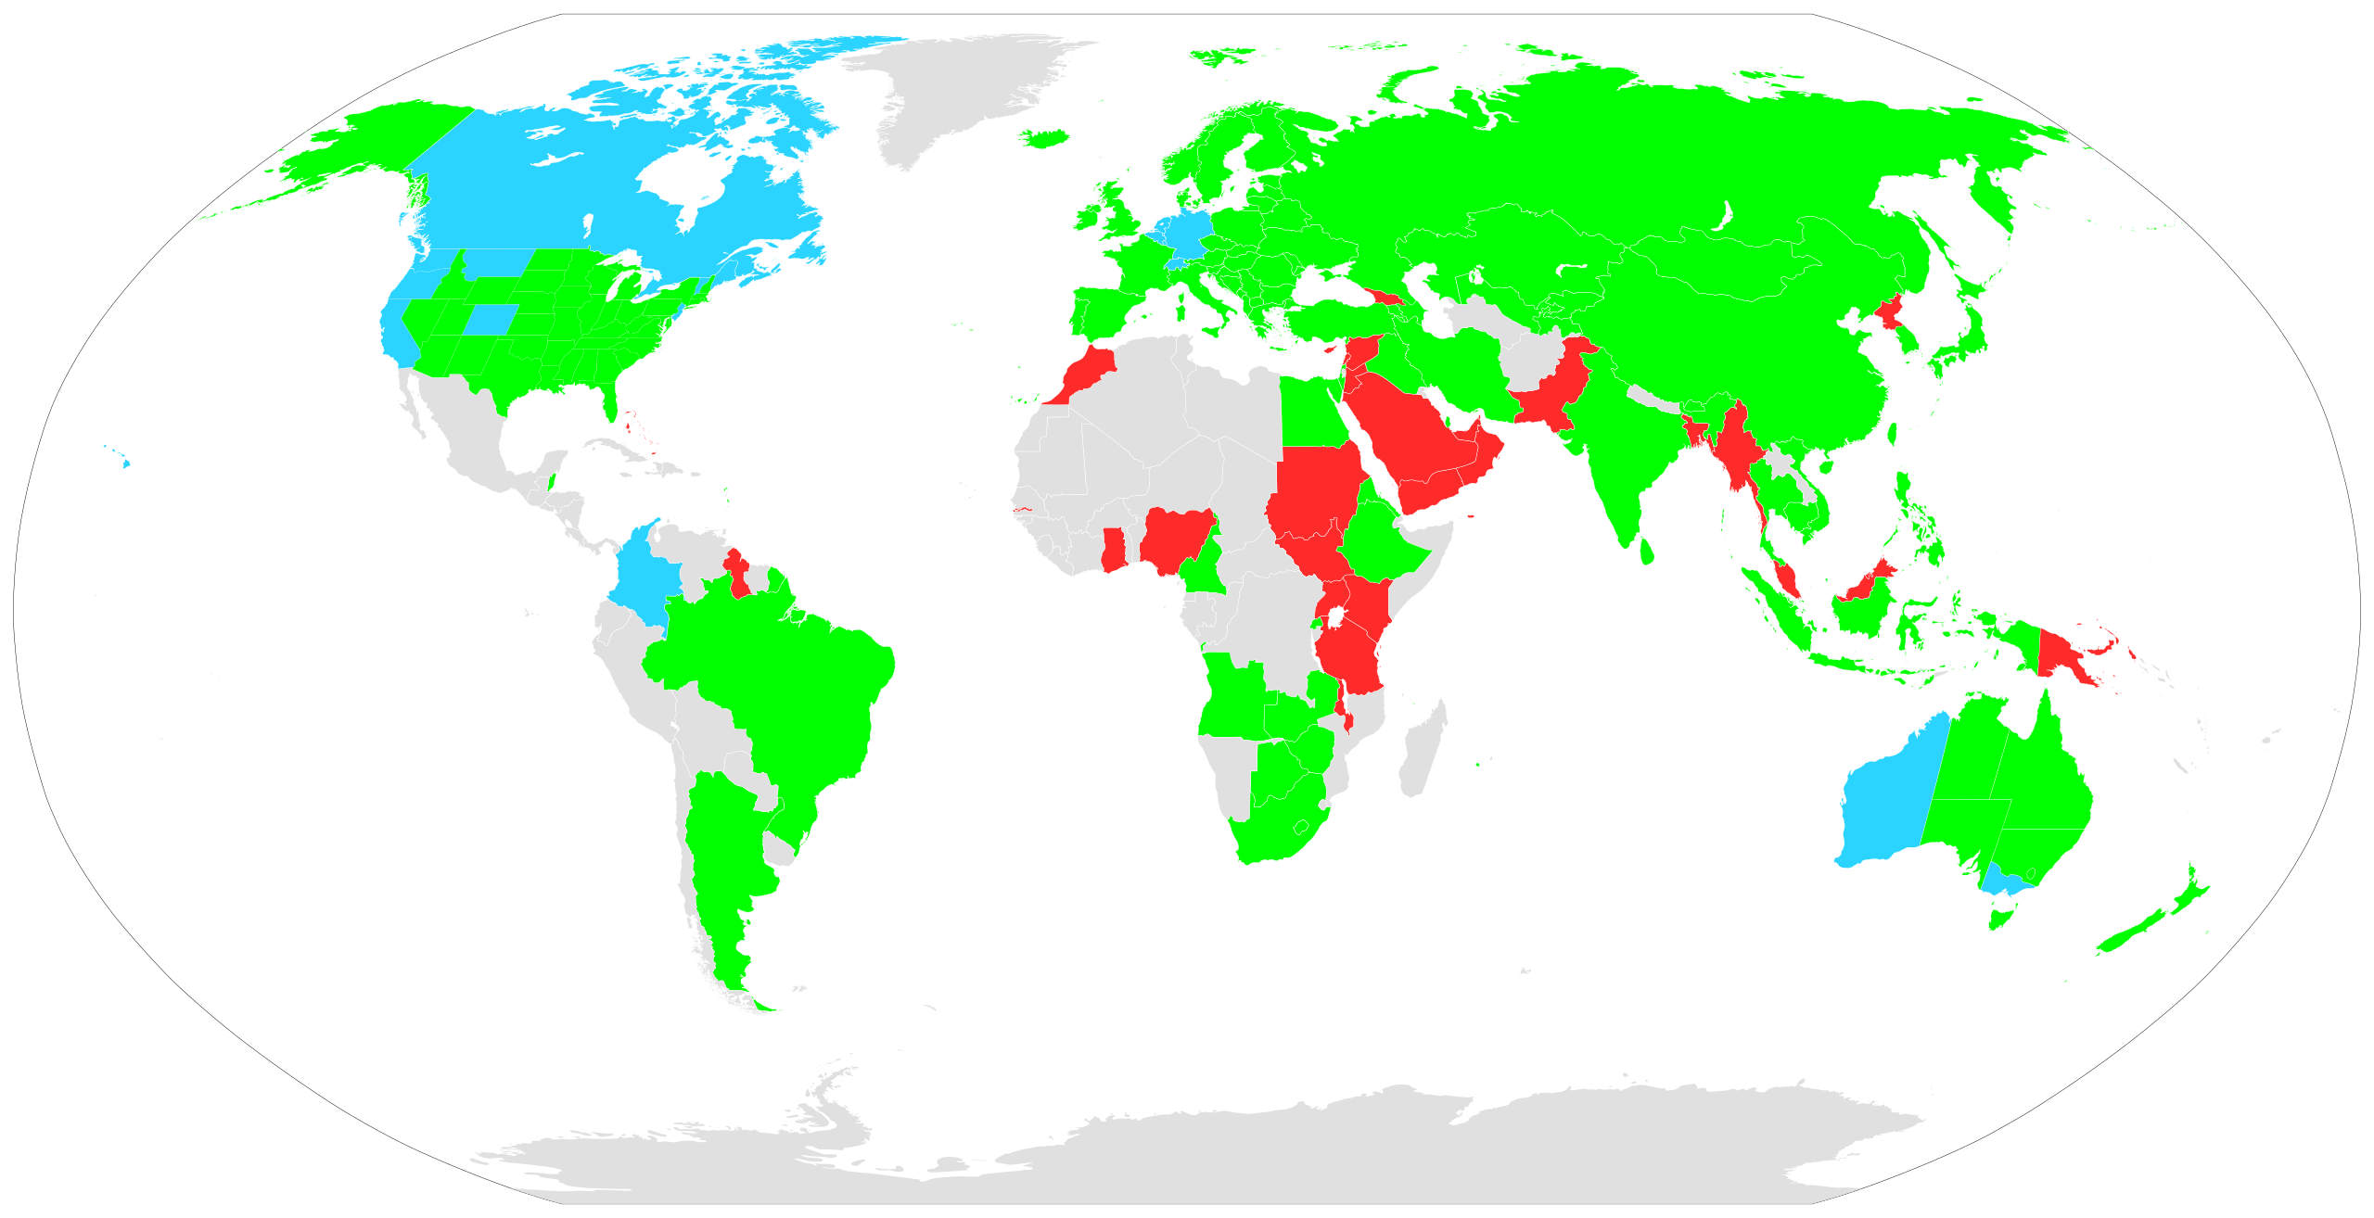
Source: Wikipedia

Slide 15
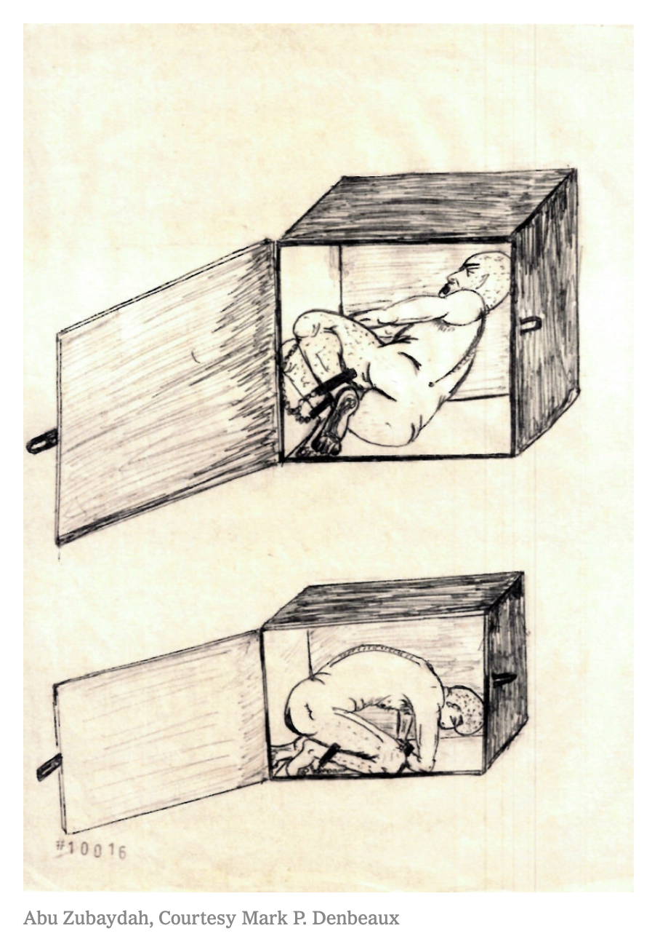
Method of Enhanced Interrogation
Confinement of a prisoner in a box with dimensions:
Width: 53cm
Depth: 76cm
Height: 76cm
Sources: Carol Rosenberg, “What the C.I.A.’s Torture Program Looked Like to the Tortured,” New York Times, December 4, 2019; “CIA Tactics: What is ‘Enhanced Interrogation,’” BBC, December 10, 2014

Slide 16
Beneficial Utility Debate
Minimal beneficial utility requirement:
The market is the best measure of social utility
Institutional Competence
Moral standards evolve more rapidly than 20-year cycles.
Significant beneficial utility requirement:
Patents should be available only for inventions that promote social welfare
Misalignment of social welfare and consumers’ ability and willingness to pay
PTO could develop this expertise
Congress could set guidelines
20-year lag is not prohibitive
Expropriation of extant patents could supplement adoption of new grounds for disqualification

Slide 17
Purposes of Disclosure Requirement
a. Compel patentee to reveal information that will facilitate further technical progress
b. Provide competitors guidance in what they may and may not do
c. Provide courts guidance in understanding the invention and construing the claims
d. Prevent patentee from locking up a disproportionate territory
e. Reinforce priority principles by denying priority dates to persons who have not yet fully achieved the invention

