Slide 1
Module 104 Slides
William Fisher WilmerHale Professor of Intellectual Property Law
Harvard Law School
February 2023

Slide 2
The following images appear in the background of the lecture on “Newness” in the PatentX lecture series. A recording of the lecture itself is available at https://ipxcourses.org/lectures-2/. Removed from their original context, the images will not make much sense. The function of this collection of images is to enable persons who have already watched the lecture to review the material it contains.
The terms on which these materials may be used or modified are available at http://ipxcourses.org.

Slide 3
Section A: Novelty

Slide 4
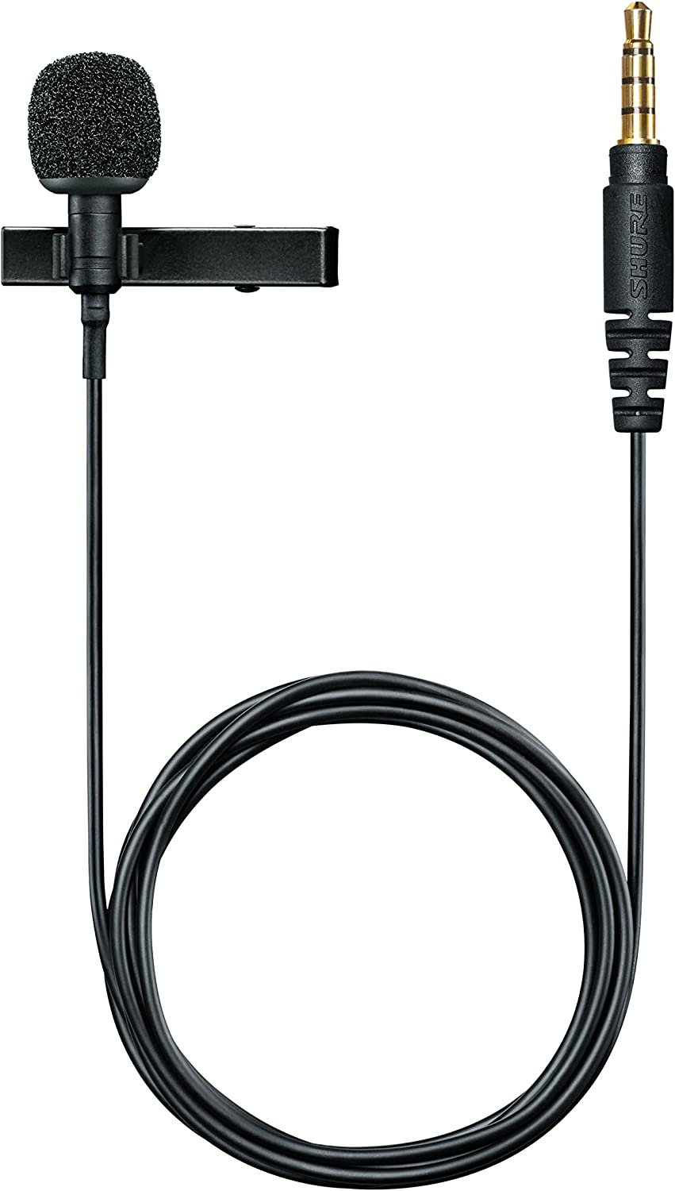
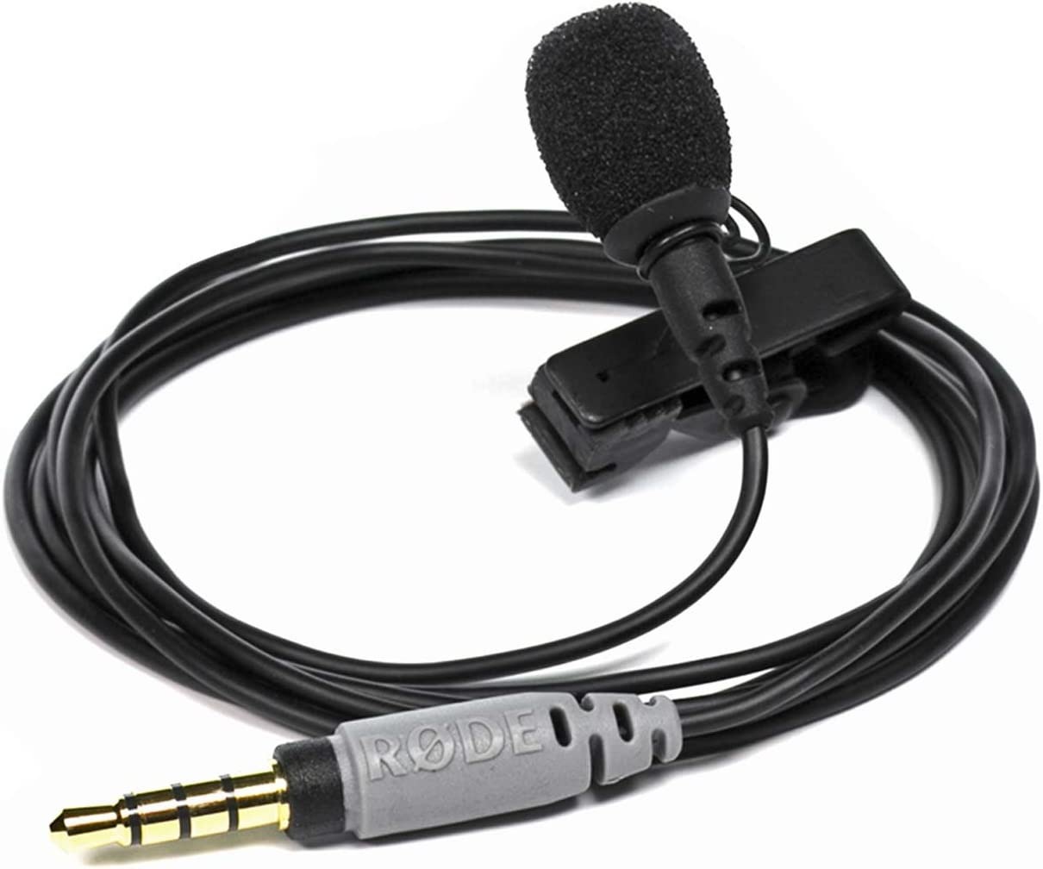
Doe Microphone 2021
Fisher Microphone 2023

Slide 5
Details, details…
Terminal date for prior art
Definition of “available to the public”?
Grace period?
Duration of grace period?
Kinds of disclosures that are excused?

Slide 6
Fisher Microphone
Doe Microphone
Reduction to Practice
Patent
Application
Conception
Publication
Grant

Slide 7
France
1. Disclosure not to be taken into account in determining novelty if it occurred within six months before the filing date due to:
an evident abuse in relation to the applicant or his predecessor in title;
display of the invention by the applicant or his predecessor in title at an official or officially recognized international exhibition.
2. The applicant shall declare at the time of filing that the invention has been so displayed, and furnish proof to that effect within a prescribed time limit.
Source: https://www.wipo.int/export/sites/www/scp/en/national_laws/grace_period.pdf

Slide 8
Germany
1. Disclosure not to be taken into account in determining novelty if it occurred within six months before the filing date due to:
(a) an evident abuse in relation to the applicant or his predecessor in title;
(b) display of the invention by the applicant or his predecessor in title at an official or officially recognized international exhibition notified in the Federal Law Gazette.
2. The applicant shall state when filing the application that the invention has been so displayed, and file a certificate within four months.
Source: https://www.wipo.int/export/sites/www/scp/en/national_laws/grace_period.pdf

Slide 9
Argentina
1. Disclosure not to be taken into account in determining novelty if it occurred within one year before the filing date (priority date) by the inventor or his successor in title by:
(a) any medium of communication;
(b) display at a national or international exhibition.
2. The application shall be accompanied by documentary supporting evidence.
Source: https://www.wipo.int/export/sites/www/scp/en/national_laws/grace_period.pdf

Slide 10
Chile
Disclosure not to be taken into account in determining novelty if it occurred within twelve months before the filing date in consequence of : ` 1. acts done, authorized or derived from the applicant, or; 2. abuse and unfair practices in relation to the applicant or his predecessor in title.
Source: https://www.wipo.int/export/sites/www/scp/en/national_laws/grace_period.pdf

Slide 11
Brazil
1. Disclosure not to be considered as part of the state of the art if it occurred within 12 months before the filing date (priority date):
(a) by the inventor;
(b) publication by the Office of a patent application based on information obtained from the inventor and filed without his consent;
(c) by another person based on information obtained from the inventor.
2. The Office may require a statement relating to the disclosure, possibly accompanied by proof.
Source: https://www.wipo.int/export/sites/www/scp/en/national_laws/grace_period.pdf

Slide 12
Philippines
The disclosure of information contained in the application during the twelve (12) months preceding the filing date or the priority date of the application shall not prejudice the applicant on the ground of lack of novelty if such disclosure was made by:
The inventor;
A patent office and the information was contained (a) in another application filed by the inventor and should not have been disclosed by the office, or (b) in an application filed without the knowledge or consent of the inventor by a third party which obtained the information directly or indirectly from the inventor; or
A third party which obtained the information directly or indirectly from the inventor.
"Inventor" also means any person who, at the filing date of application, had the right to the patent.
Source: https://www.wipo.int/export/sites/www/scp/en/national_laws/grace_period.pdf

Slide 13
Kenya
Disclosure not to be taken into account in determining novelty and inventive step if it occurred within 12 months before the filing date (priority date):
by the applicant or his predecessor in title;
due to an evident abuse committed by a third party in relation to the applicant or his predecessor in title.
Source: https://www.wipo.int/export/sites/www/scp/en/national_laws/grace_period.pdf

Slide 14
South Africa
Disclosure not to be taken into account in determining patentability if it occurred any time before the filing date (priority date) due to:
knowledge or matter obtained from the applicant or his predecessor in title and disclosed or used without his knowledge or consent (provided that, where the applicant learnt of that disclosure, use or knowledge before the filing date (priority date), he then applied for protection with reasonable diligence);
working the invention in South Africa, by the applicant or his predecessor in title, for reasonable technical trial or experiment.
Source: https://www.wipo.int/export/sites/www/scp/en/national_laws/grace_period.pdf

Slide 15
India
An invention shall not be deemed to have been anticipated by:
Disclosures at any time before the filing date (priority date) of matter obtained from, and published without the consent of, the inventor or his successor in title (provided that the invention was not commercially worked in India, otherwise than for the purpose of reasonable trial, and that a patent application for the invention was filed in India or a convention country as soon as reasonably practicable thereafter).
Other applications made in contravention of the rights of the inventors or his successor in title or public use or publication of the invention without the consent of the inventor or his successor in title by the applicants of such other applications or by any other person in consequence of the disclosure.
Disclosures due to the communication of the invention to the Government or to any person authorized by the Government to investigate the invention or its merits, or for the purpose of that investigation.
Disclosures within 12 months before the application is made (calculated from the opening of the exhibition or the reading or publication of the paper) by:
display or use of the invention with the consent of the inventor or his predecessor in title at an industrial or other exhibition notified in the Official Gazette;
publication of the invention in consequence of such display or use;
use of the invention during the period of the exhibition without the consent of the inventor or his predecessor in title;
description of the invention in a paper read by the inventor before a learned society, or published with his consent in the transactions of such a society.
Disclosures within one year before the filing date (priority date) by public working the invention for reasonable trial, by or with the consent of the applicant or his predecessor in title.
Publication of invention anywhere in the world or use of the invention in India at any time after the filing of the provisional specification or complete specification which is treated as provisional specification by virtue of a direction under sub-section (3) of section 9 of the Act.
Source: https://www.wipo.int/export/sites/www/scp/en/national_laws/grace_period.pdf

Slide 16
Japan
1. Disclosure not to be taken into consideration in determining novelty and inventive step if it occurred within one year before the filing date:
(a) against the will of the person having the right to obtain a patent; or
(b) as a result of an act of the person having the right to obtain a patent (excluding the case in which it has been disclosed through the publication in the bulletin pertaining to inventions, utility models, designs or trademarks).
2. The applicant shall submit (in the case of 1 (b) above):
(a) a written statement to that effect at the time of filing; and
(b) proof, within 30 days of the filing date, that the disclosure was in respect of the invention.
Source: https://www.wipo.int/export/sites/www/scp/en/national_laws/grace_period.pdf

Slide 17
Republic of Korea
Disclosure not to be taken into account in determining novelty and inventive step if it occurred within twelve months before the filing date:
by the person with the right to obtain a patent (excluding the disclosure made by a national or foreign Office according to legislations or international treaties);
contrary to the intention of the person with the right to obtain a patent.
In the case of 1(a) above, the applicant shall state the intention to have 1(a) above applied in the application and, within 30 days from the filing date, a document proving the relevant facts.
Regardless of 2 above, where the applicant pays complement fees, it is allowed to submit a document stating the intention to have 1(a) above applied or another document to prove relevant facts within one of the following periods.
Period of amendment.
From the receiving date of a copy of a decision of allowance or a trial decision to cancel a decision of refusal (limited to trial decision which decided registration) to the earlier date of 3 months after the receiving date or the date to obtain registration of establishment of the patent right.
Source: https://www.wipo.int/export/sites/www/scp/en/national_laws/grace_period.pdf

Slide 18
China
An invention-creation for which a patent is applied for does not lose its novelty where, within six months before the filing date, one of the following events occurred:
1. where it was made public for the first time for the purpose of public interest when a state of emergency or an extraordinary situation occurred in the country.
where it was first exhibited at an international exhibition sponsored or recognized by the Chinese Government;
where it was first made public at a prescribed academic or technological meeting;
where it was disclosed by any person without the consent of the applicant.
Source: https://www.wipo.int/export/sites/www/scp/en/national_laws/grace_period.pdf

Slide 19
United States
For applications filed on or after March 16, 2013 (after AIA): Disclosure made one year or less before the effective filing date of a claimed invention shall not be prior art to the claimed invention for the determination of novelty and inventive step if: 1. the disclosure was made by the inventor or joint inventor or by another who obtained the subject matter disclosed directly or indirectly from the inventor or a joint inventor; 2. the subject matter disclosed had, before such disclosure, been publicly disclosed by the inventor or a joint inventor or another who obtained the subject matter disclosed directly or indirectly from the inventor or a joint inventor.
For applications filed before March 16, 2013 (before Leahy-Smith America Invents Act (AIA)): Disclosure not to be taken into consideration in determining novelty and inventive step if it occurred within one year before the filing date in the form of: 1. inventions patented or described in a printed publication in the US or abroad; 2. public use or on sale in the US.
Source: https://www.wipo.int/export/sites/www/scp/en/national_laws/grace_period.pdf

Slide 20
When addressing these details, lawmakers tacitly assign different weights to secondary policies
Fairness – e.g., reward effort; do not penalize innocent parties
Maximize enrichment of the body of publicly available technical knowledge
Give inventors some time to refine their inventions and assess inventions before bearing the costs of patenting
Limit the commercial life of patents
Nationalism -- e.g., local production

Slide 21
Section B: The Inventive Step

Slide 22
Venetian Patent Statute, 1474
WE HAVE among us men of great genius, apt to invent and discover ingenious devices; and in view of the grandeur and virtue of our City, more such men come to us every day from divers parts. Now, if provision were made for the works and devices discovered by such persons, so that others who may see them could not build them and take the inventor’s honor away, more men would then apply their genius, would discover, and would build devices of great utility and benefit to our commonwealth. Therefore:
BE IT ENACTED that, by the authority of this Council, every person who shall build any new and ingenious device in this City, not previously made in our Commonwealth, shall give notice of it to the office of our General Welfare Board when it has been reduced to perfection so that it can be used and operated. It being forbidden to every other person in any of our territories and towns to make any further device conforming with and similar to said one, without the consent and license of the author, for the term of 10 years. And if anybody builds it in violation hereof, the aforesaid author and inventor shall be entitled to have him summoned before any magistrate of this City, by which magistrate the said infringer shall be constrained to pay him hundred ducats; and the device shall be destroyed at once. It being, however, with the power and discretion of the Government, in its activities, to take and use any such device and instrument, with this condition however that no one but the author shall operate it.
Source: Giulio Mandich, Venetian Patents (1450–1550), 30 J. PAT. OFF. SOC’Y 166, 176 (1948)

Slide 23
Evolution of the Inventive Step Requirement
(not to scale)
A patent may not be obtained though the invention is not identically disclosed or described as set forth in section 102 of this title, if the differences between the subject matter sought to be patented and the prior art are such that the subject matter as a whole would have been obvious at the time the invention was made to a person having ordinary skill in the art to which said subject matter pertains. Patentability shall not be negatived by the manner in which the invention was made. 66 Stat. 798
Stringency of the Standard
Cuno
(1941)
Hotchkiss
(1851)
§103
USA
England
“nontriviality”
1700
1800
1850
1900
1925
1950
1975
2000
2025

Slide 24
Evolution of the Inventive Step Requirement
(not to scale)
“Under §103, the scope and content of the prior art are to be determined; differences between the prior art and the claims at issue are to be ascertained; and the level of ordinary skill in the pertinent art resolved. Against this background the obviousness or nonobviousness of the subject matter is determined. Such secondary considerations as commercial success, long felt but unsolved needs, failure of others, etc., might be utilized to give light to the circumstances surrounding the origin of the subject matter sought to be patented.”
Stringency of the Standard
Cuno
(1941)
Hotchkiss
(1851)
§103
Graham
(1966)
USA
England
“nontriviality”
1700
1800
1850
1900
1925
1950
1975
2000
2025

Slide 25
Evolution of the Inventive Step Requirement
(not to scale)
E.g., Al-site (CAFC 1999): “In a challenge based on obviousness …, the person alleging invalidity must show prior art references which alone or combined with other references would have rendered the invention obvious to one of ordinary skill in the art at the time of invention. The ‘presumption of validity under 35 U.S.C. § 282 carries with it a presumption that the Examiner did his duty and knew what claims he was allowing.’ Therefore, the challenger's ‘burden is especially difficult when the prior art was before the PTO examiner during prosecution of the application.’ The party seeking patent invalidity based on obviousness must also show some motivation or suggestion to combine the prior art teachings. A suggestion or motivation to combine generally arises in the references themselves, but may also be inferred from the nature of the problem or occasionally from the knowledge of those of ordinary skill in the art.”
Stringency of the Standard
Cuno
(1941)
CAFC
Hotchkiss
(1851)
§103
Graham
(1966)
USA
England
“nontriviality”
1700
1800
1850
1900
1925
1950
1975
2000
2025

Slide 26
Evolution of the Inventive Step Requirement
(not to scale)
TSM demoted from a requirement to a factor.
Revive “obvious to try” issue as a factor.
Skepticism concerning nonobviousness of combination patents.
Increase the creativity attributed to PHOSITAs
Warn against exaggeration of hazards of hindsight bias
Stringency of the Standard
Cuno
(1941)
CAFC
Hotchkiss
(1851)
§103
Graham
(1966)
KSR
(2007)
USA
England
“nontriviality”
1700
1800
1850
1900
1925
1950
1975
2000
2025

Slide 27
Evolution of the Inventive Step Requirement
(not to scale)
Stringency of the Standard
Cuno
(1941)
CAFC
Hotchkiss
(1851)
§103
Graham
(1966)
AIA(2013)
KSR
(2007)
USA
England
“nontriviality”
1700
1800
1850
1900
1925
1950
1975
2000
2025

Slide 28
Pre-KSR (1990 to 2007)
SCOTUS
π
Patentee prevailed ~55%
π
Δ
Δ
CAFC
Patentee prevailed ~80%
π
Δ
π
Δ
District Court
infringement
litigation
ITC
exclusion
litigation
PTAB
allow
Patent
reject
allow
Examiner
PTO
amended
application
reject
application
Inventor

Slide 29
KSR to AIA (2007 to 2012)
SCOTUS
π
Patentee prevailed ~45%
π
Δ
Δ
CAFC
Patentee prevailed ~60%
π
Δ
π
Δ
District Court
infringement
litigation
ITC
exclusion
litigation
PTAB
allow
Patent
reject
allow
Examiner
PTO
amended
application
reject
application
Inventor

Slide 30
Post AIA (2012 to present)
SCOTUS
π
Patentee prevailed ~55%
π
Δ
Challenger
Δ
CAFC
Patentee prevailed ~60%
π
Δ
inter-
partes
review
π
Δ
District Court
infringement
litigation
ITC
exclusion
litigation
Patentee prevailed ~20%
allow
PTAB
Patent
reject
allow
Examiner
PTO
amended
application
reject
application
Inventor

Slide 31
Evolution of the Inventive Step Requirement
(not to scale)
Stringency of the Standard
Cuno
(1941)
CAFC
Hotchkiss
(1851)
§103
Graham
(1966)
AIA(2013)
KSR
(2007)
Thomson
(1889)
1932 statute
USA
England
“nontriviality”
1700
1800
1850
1900
1925
1950
1975
2000
2025

Slide 32
European Patent Convention, Article 56
An invention shall be considered as involving an inventive step if, having regard to the state of the art, it is not obvious to a person skilled in the art.

Slide 33
EPO Guidelines for Examination: ”The Problem-Solution Approach”
In order to assess inventive step in an objective and predictable manner, the so-called "problem-solution approach" is applied.
In the problem-solution approach, there are three main stages:
(i) determining the "closest prior art",
(ii) establishing the "objective technical problem" to be solved, and
(iii) considering whether or not the claimed invention, starting from the closest prior art and the objective technical problem, would have been obvious to the skilled person.
The closest prior art is that which in one single reference discloses the combination of features which constitutes the most promising starting point for a development leading to the invention. In selecting the closest prior art, the first consideration is that it must be directed to a similar purpose or effect as the invention or at least belong to the same or a closely related technical field as the claimed invention. In practice, the closest prior art is generally that which corresponds to a similar use and requires the minimum of structural and functional modifications to arrive at the claimed invention.

Slide 34
EPO Guidelines for Examination: ”The Problem-Solution Approach”
In order to assess inventive step in an objective and predictable manner, the so-called "problem-solution approach" is applied.
In the problem-solution approach, there are three main stages:
(i) determining the "closest prior art",
(ii) establishing the "objective technical problem" to be solved, and
(iii) considering whether or not the claimed invention, starting from the closest prior art and the objective technical problem, would have been obvious to the skilled person.
In the second stage, one establishes in an objective way the technical problem to be solved. To do this one studies the application (or the patent), the closest prior art and the difference (also called "the distinguishing feature(s)" of the claimed invention) in terms of features (either structural or functional) between the claimed invention and the closest prior art, identifies the technical effect resulting from the distinguishing features, and then formulates the technical problem….

Slide 35
EPO Guidelines for Examination: ”The Problem-Solution Approach”
In order to assess inventive step in an objective and predictable manner, the so-called "problem-solution approach" is applied.
In the problem-solution approach, there are three main stages:
(i) determining the "closest prior art",
(ii) establishing the "objective technical problem" to be solved, and
(iii) considering whether or not the claimed invention, starting from the closest prior art and the objective technical problem, would have been obvious to the skilled person.
In the third stage the question to be answered is whether there is any teaching in the prior art as a whole that would (not simply could, but would) have prompted the skilled person, faced with the objective technical problem, to modify or adapt the closest prior art while taking account of that teaching, thereby arriving at something falling within the terms of the claims, and thus achieving what the invention achieves.

Slide 36
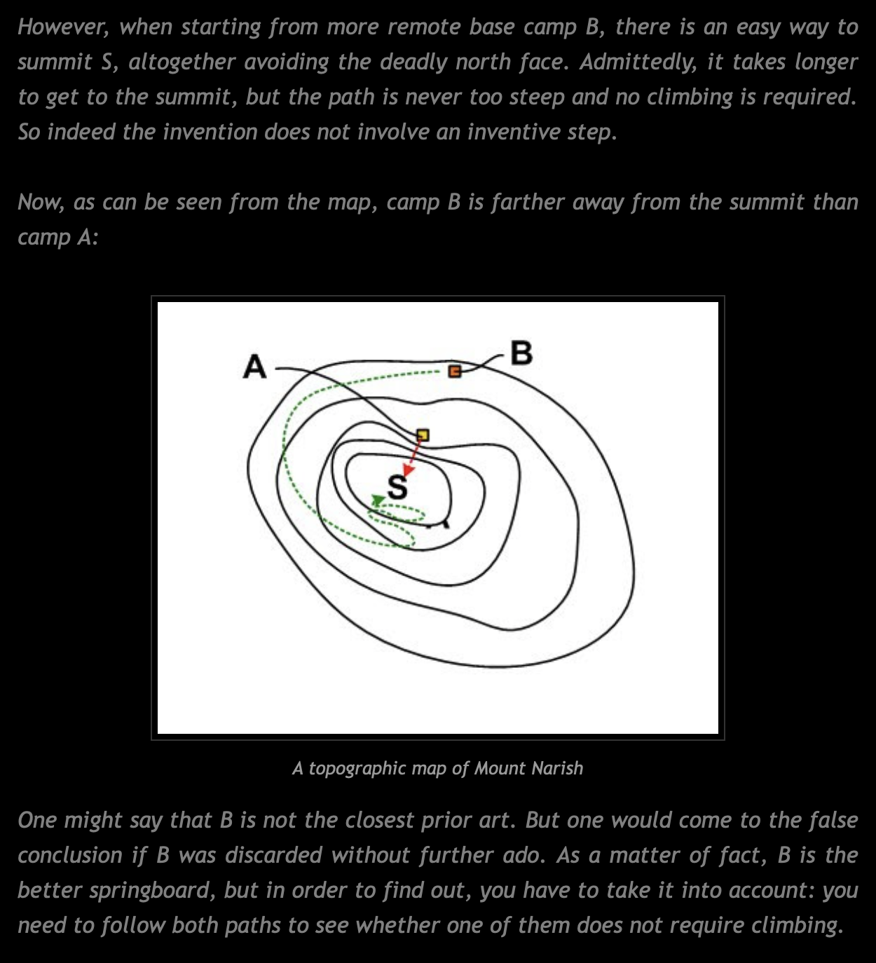
Source: https://k-slaw.blogspot.com/2012/09/t-5609-so-close.html

Slide 37
Patent Law of China, Article 22, Section 3
Inventiveness means that, as compared with the technology existing before the date of filing, the invention has prominent substantive features and represents notable progress.

Slide 38
Guidelines for Examination (1984)
To qualify, the invention must not be “derived from available technology by persons of ordinary skill in the art without analysis and deliberation, or derived from logical analysis, inference, and experimentation” but rather must reflect the unique intelligence of the inventor.
Source: Ada Yue Wang, ”The Test of Inventiveness in Chinese Patent Jurisprudence” (2019)

Slide 39
Guidelines for Examination (1993)
“That an invention has prominent substantive features, means that compared to prior arts, the invention is non-obvious to persons of skill in the art.”
Source: Ada Yue Wang, ”The Test of Inventiveness in Chinese Patent Jurisprudence” (2019)

Slide 40
Guidelines for Examination (2001)
Procedure:
First, “the closest prior art” needs to be identified
Second, the patent officer ought to determine the “distinguishing features of the invention and the technical problem actually solved by the invention;”
Third, the patent officer must decide “whether or not the claimed invention is obvious to a person skilled in the art.”
Reduction in the knowledge and creativity attributed to the person skilled in the art
More generous definition of “notable progress”
Source: Ada Yue Wang, ”The Test of Inventiveness in Chinese Patent Jurisprudence” (2019)

Slide 41
Guidelines for Examination (2001)
Procedure:
First, “the closest prior art” needs to be identified
Second, the patent officer ought to determine the “distinguishing features of the invention and the technical problem actually solved by the invention;”
Third, the patent officer must decide “whether or not the claimed invention is obvious to a person skilled in the art.”
Source: Ada Yue Wang, ”The Test of Inventiveness in Chinese Patent Jurisprudence” (2019)

Slide 42
Guidelines for Examination (2001)
Procedure:
First, “the closest prior art” needs to be identified
Second, the patent officer ought to determine the “distinguishing features of the invention and the technical problem actually solved by the invention;”
Third, the patent officer must decide “whether or not the claimed invention is obvious to a person skilled in the art.”
what is to be determined is whether or not there exists such a technical motivation in the prior art as to apply said distinguishing features to the closest prior art in solving the existing technical problem (that is, the technical problem actually solved by the invention), where a person skilled in the art, when confronted with the technical problem, could improve the closest prior art and thus reach the claimed invention. If there exists such a technical motivation in the prior art, the invention is obvious and thus fails to have a prominent substantive features.
Source: Ada Yue Wang, ”The Test of Inventiveness in Chinese Patent Jurisprudence” (2019)

Slide 43
Guidelines for Examination (2006)
Procedure:
First, “the closest prior art” needs to be identified
Second, the patent officer ought to determine the “distinguishing features of the invention and the technical problem actually solved by the invention;”
Third, the patent officer must decide “whether or not the claimed invention is obvious to a person skilled in the art.”
what is to be determined is whether or not there exists such a technical motivation in the prior art as to apply said distinguishing features to the closest prior art in solving the existing technical problem (that is, the technical problem actually solved by the invention), where such motivation would prompt a person skilled in the art, when confronted with the technical problem, to improve the closest prior art and thus reach the claimed invention. If there exists such a technical motivation in the prior art, the invention is obvious and thus fails to have a prominent substantive features.
Source: Ada Yue Wang, ”The Test of Inventiveness in Chinese Patent Jurisprudence” (2019)

Slide 44
Evolution of the Inventive Step Requirement
(not to scale)
1984
1993
China
2001
Stringency of the Standard
2006
Cuno
(1941)
CAFC
Hotchkiss
(1851)
§103
Graham
(1966)
AIA(2013)
KSR
(2007)
Thomson
(1889)
1932 statute
USA
England
“nontriviality”
1700
1800
1850
1900
1925
1950
1975
2000
2025

Slide 45
Nonobviousness Methodology in USA
Identify the relevant pieces of prior art
Includes everything in the field of the invention
Includes anything “reasonably pertinent to the particular problem with which the inventor was involved”
Includes anything “inherent” in those references
Determine height of the step between prior art and claimed invention
Define the PHOSITA (person having ordinary skill in the art)
Typical level of education
Level of skill in the field
Degree of predictability of the field
Ask whether a PHOSITA could have made the jump
Secondary (“objective”) factors
Commercial success (with a nexus to the inventive feature)
Long-felt unsolved need
Unexpected outcomes
Skepticism of experts
Applause
Fact that others copied or licensed it
Parallel independent invention
Ancillary factors
Did people or literature in the field teach toward or away? (Residue of TSM test)
Was the invention obvious to try?
Be wary of, but don’t exaggerate, hindsight bias.

Slide 46
EPO Guidelines for Examination: ”The Problem-Solution Approach”
The closest prior art is that which in one single reference discloses the combination of features which constitutes the most promising starting point for a development leading to the invention. In selecting the closest prior art, the first consideration is that it must be directed to a similar purpose or effect as the invention or at least belong to the same or a closely related technical field as the claimed invention. In practice, the closest prior art is generally that which corresponds to a similar use and requires the minimum of structural and functional modifications to arrive at the claimed invention.
In order to assess inventive step in an objective and predictable manner, the so-called "problem-solution approach" is applied.
In the problem-solution approach, there are three main stages:
(i) determining the "closest prior art",
(ii) establishing the "objective technical problem" to be solved, and
(iii) considering whether or not the claimed invention, starting from the closest prior art and the objective technical problem, would have been obvious to the skilled person.
In the second stage, one establishes in an objective way the technical problem to be solved. To do this one studies the application (or the patent), the closest prior art and the difference (also called "the distinguishing feature(s)" of the claimed invention) in terms of features (either structural or functional) between the claimed invention and the closest prior art, identifies the technical effect resulting from the distinguishing features, and then formulates the technical problem….
In the third stage the question to be answered is whether there is any teaching in the prior art as a whole that would (not simply could, but would) have prompted the skilled person, faced with the objective technical problem, to modify or adapt the closest prior art while taking account of that teaching, thereby arriving at something falling within the terms of the claims, and thus achieving what the invention achieves.

