Slide 1
Module 106 Slides
William Fisher WilmerHale Professor of Intellectual Property Law
Harvard Law School
2023

Slide 2
The following images appear in the background of the lecture on “Infringement” in the PatentX lecture series. A recording of the lecture itself is available at https://ipxcourses.org/lectures-2/. Removed from their original context, the images will not make much sense. The function of this collection of images is to enable persons who have already watched the lecture to review the material it contains.
The terms on which these materials may be used or modified are available at http://ipxcourses.org.

Slide 3
Part A: Forbidden Conduct

Slide 4
Statutory Provisions
United States: 35 U.S.C 271(a)
“… Whoever, without authority makes, uses, offers to sell, or sells any patented invention, within the United States or imports into the United States any patented invention during the term of the patent therefor, infringes the patent.”

Slide 5
All-Elements Rule
Accused
device
Claim
Elements
infringement

Slide 6
All-Elements Rule
Accused
device
Claim
Elements
No (literal) infringement

Slide 7
All-Elements Rule
Accused
device
Claim
Elements
No (literal) infringement

Slide 8
All-Elements Rule
Prior
Art
Accused
device
Claim
Elements
anticipation
infringement

Slide 9
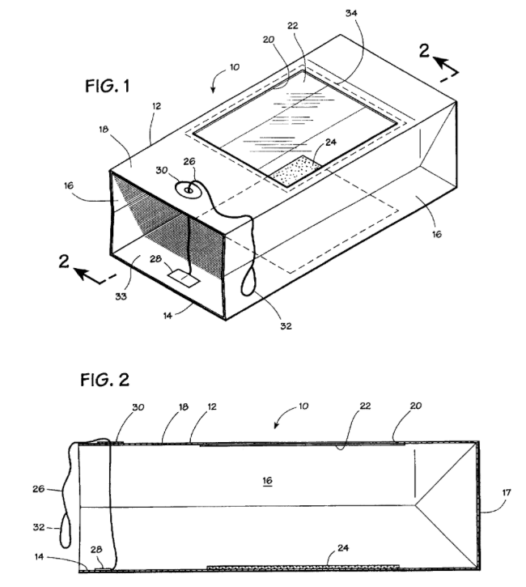
Suppose that D manufactures and sells an otherwise identical mousetrap that incorporates a screen instead of a window

Slide 10
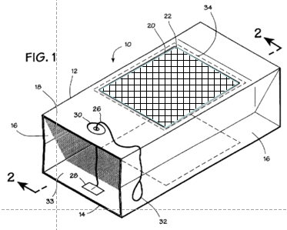
All-Elements Rule
I claim:1. A disposable rodent trapping device, comprising: [A] a substantially lightweight and flexible housing having a bottom face, a top face, an entrance opening in said housing for said rodent, and an aperture in said top face located near said entrance opening; [B] a trapping means situated on said bottom face; [C] a handle attached to said bottom face and passing through said aperture, wherein operation of said handle closes said entrance opening; [D] a viewing opening in said top face; and [E] a translucent window adhesively attached to the periphery of said viewing opening in said top face….
Claim
A
B
Elements
C
D
E
No (literal) infringement

Slide 11
Equivalents – Element by Element
Claim
Accused device
Tests:
Performs same function
in substantially same way
to obtain same result;
(b) Differences are
“insubstantial”
Elements
Equivalents

Slide 12
All-Elements Rule
I claim:1. A disposable rodent trapping device, comprising: [A] a substantially lightweight and flexible housing having a bottom face, a top face, an entrance opening in said housing for said rodent, and an aperture in said top face located near said entrance opening; [B] a trapping means situated on said bottom face; [C] a handle attached to said bottom face and passing through said aperture, wherein operation of said handle closes said entrance opening; [D] a viewing opening in said top face; and [E] a translucent window adhesively attached to the periphery of said viewing opening in said top face….
Accused
device
Claim
A
B
Performs same function
in substantially same way
to obtain same result?
Probably yes
Elements
C
D
E
Infringement through equivalents

Slide 13
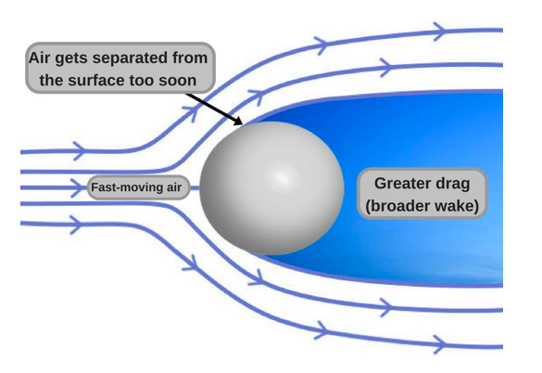
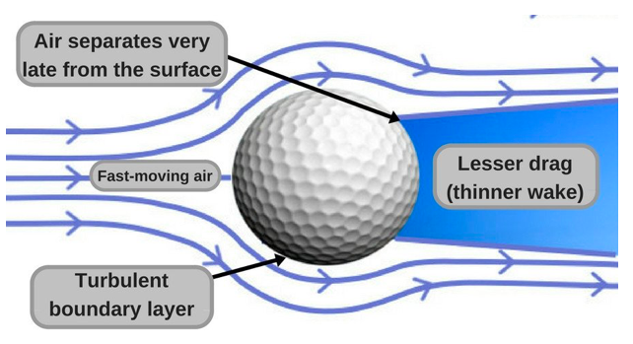
USGA Explanatory video: https://www.youtube.com/watch?v=fcjaxC-e8oY
Source: https://www.scienceabc.com/sports/golf-balls-dimpled-reason-speed-air-aerodynamic-drag.html

Slide 14
Wilson’s patent
1. A golf ball having a spherical surface with a plurality of dimples formed therein and six great circle paths which do not intersect any dimples, the dimples being arranged by dividing the spherical surface into twenty spherical triangles corresponding to the faces of a regular icosahedron, each of the twenty triangles being subdivided into four smaller triangles consisting of a central triangle and three apical triangles by connecting the midpoints of each of said twenty triangles along great circle paths, said dimples being arranged so that the dimples do not intersect the sides of any of the central triangles.

Slide 15
Wilson’s patent
1. A golf ball having a spherical surface with a plurality of dimples formed therein and six great circle paths which do not intersect any dimples, the dimples being arranged by dividing the spherical surface into twenty spherical triangles corresponding to the faces of a regular icosahedron, each of the twenty triangles being subdivided into four smaller triangles consisting of a central triangle and three apical triangles by connecting the midpoints of each of said twenty triangles along great circle paths, said dimples being arranged so that the dimples do not intersect the sides of any of the central triangles.
Polyhedron with 20 faces

Slide 16
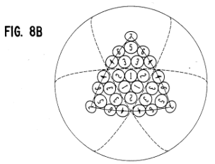
Wilson’s patent
1. A golf ball having a spherical surface with a plurality of dimples formed therein and six great circle paths which do not intersect any dimples, the dimples being arranged by dividing the spherical surface into twenty spherical triangles corresponding to the faces of a regular icosahedron, each of the twenty triangles being subdivided into four smaller triangles consisting of a central triangle and three apical triangles by connecting the midpoints of each of said twenty triangles along great circle paths, said dimples being arranged so that the dimples do not intersect the sides of any of the central triangles.

Slide 17
Wilson’s patent
1. A golf ball having a spherical surface with a plurality of dimples formed therein and six great circle paths which do not intersect any dimples, the dimples being arranged by dividing the spherical surface into twenty spherical triangles corresponding to the faces of a regular icosahedron, each of the twenty triangles being subdivided into four smaller triangles consisting of a central triangle and three apical triangles by connecting the midpoints of each of said twenty triangles along great circle paths, said dimples being arranged so that the dimples do not intersect the sides of any of the central triangles.
“Dunlop's balls are icosahedral balls with six great circles, five of which are intersected by dimples. The balls contain 432 to 480 dimples, 60 of which intersect great circles in amounts from 4 to 9 thousandths of an inch.”

Slide 18
Wilson’s patent
1. A golf ball having a spherical surface with a plurality of dimples formed therein and six great circle paths which do not intersect any dimples, the dimples being arranged by dividing the spherical surface into twenty spherical triangles corresponding to the faces of a regular icosahedron, each of the twenty triangles being subdivided into four smaller triangles consisting of a central triangle and three apical triangles by connecting the midpoints of each of said twenty triangles along great circle paths, said dimples being arranged so that the dimples do not intersect the sides of any of the central triangles.
“[A] hypothetical claim directed to an icosahedral ball having six great circles intersected by 60 dimples in amounts up to 9 thousandths of an inch…. Stated as a percentage of dimple radius, the intersection permitted in the hypothetical claim is 13% or less”

Slide 19
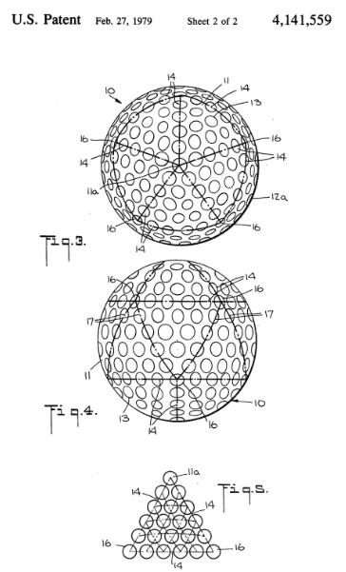
Uniroyal Ball
Wilson’s patent
“[A] hypothetical claim directed to an icosahedral ball having six great circles intersected by 60 dimples in amounts up to 9 thousandths of an inch…. Stated as a percentage of dimple radius, the intersection permitted in the hypothetical claim is 13% or less”

Slide 20
Uniroyal Ball
Wilson’s patent
Obvious
“[T]he dimples on the Uniroyal ball intersect by 17% to 21%”
“[A] hypothetical claim directed to an icosahedral ball having six great circles intersected by 60 dimples in amounts up to 9 thousandths of an inch…. Stated as a percentage of dimple radius, the intersection permitted in the hypothetical claim is 13% or less”
“We hold that these differences are so slight and relatively minor that the hypothetical claim--which permits twice as many intersecting dimples, but with slightly smaller intersections--viewed as a whole would have been obvious in view of the Uniroyal ball.”
Net result: No infringement

Slide 21
Obvious
Prior Art
Prior
Art
Equivalents
“Forseeable bar”
might allow patentee
to keep this area;
“complete bar”
approach doesn’t

Slide 22
Part B: Defenses

Slide 23
Westinghouse’s first air brake (1869)

Slide 24
Imperfections
Slow transfer of air pressure to the rearward cars in long trains substantially increased the time necessary to stop the trains and exerted pressure on the engine and forward cars
A break in the chain of couplings between the cars would make it impossible to set the brakes on any of the cars

Slide 25
Source: http://railroad.net/articles/railfanning/airbrakes/
Locomotive
Train car

Slide 26
Source: http://railroad.net/articles/railfanning/airbrakes/

Slide 27
Source: http://railroad.net/articles/railfanning/airbrakes/

Slide 28
Source: http://railroad.net/articles/railfanning/airbrakes/
Claim: “In a brake mechanism, the combination of a main air-pipe, an auxiliary reservoir, a brake-cylinder, and a triple valve having a piston whose preliminary traverse admits air from the auxiliary reservoir to the
brake-cylinder, and which by a further traverse admits air directly from the main air-pipe to the brake-cylinder, substantially as set forth”

Slide 29
Dissemination of the Technology
Problem: https://www.google.com/search?q=westinghouse+air+brake&source=lmns&tbm=vid&bih=712&biw=1071&client=safari&hl=en&sa=X&ved=2ahUKEwjftumCnbT9AhV6MlkFHcMLC6cQ0pQJKAR6BAgBEAo#fpstate=ive&vld=cid:9986559f,vid:k6nXOd7b7fw
Initial Solution: https://www.google.com/url?sa=t&rct=j&q=&esrc=s&source=video&cd=&ved=2ahUKEwjNooyGnbT9AhUPFlkFHafiC7AQtwJ6BAgBEAI&url=https%3A%2F%2Fwww.youtube.com%2Fwatch%3Fv%3D1a9-pc07KKc&usg=AOvVaw17RAPQEGXQNUMMP1FZmo-v
Adoption of the triple valve: https://www.youtube.com/watch?v=l3KqBZxzQTY&embeds_euri=https%3A%2F%2Fwww.google.com%2F&source_ve_path=MTM5MTE3LDM2ODQy&feature=emb_rel_end
Fruits: https://www.google.com/url?sa=t&rct=j&q=&esrc=s&source=video&cd=&ved=2ahUKEwjX-YnMobT9AhUUD1kFHQ_BCM8Qz40FegQIBhAl&url=https%3A%2F%2Fwww.youtube.com%2Fwatch%3Fv%3Dl3KqBZxzQTY&usg=AOvVaw2GsDTnyMaJtcsXBTOwUvT9

Slide 30
Source: http://railroad.net/articles/railfanning/airbrakes/
Boyden develops an improvement designed
to redirect some of the air from
the brake pipe to the auxiliary
reservoir in an emergency

Slide 31
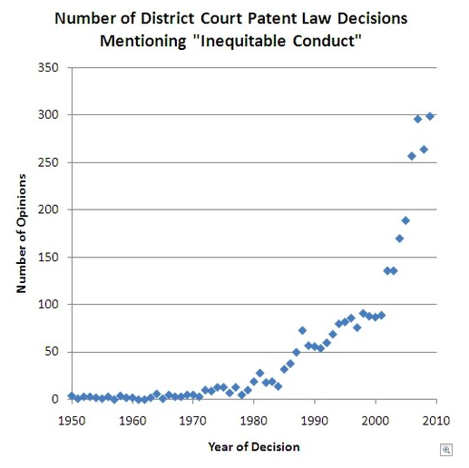
Source: https://patentlyo.com/patent/2010/06/measuring-the-plague-of-inequitable-conduct.html

Slide 32
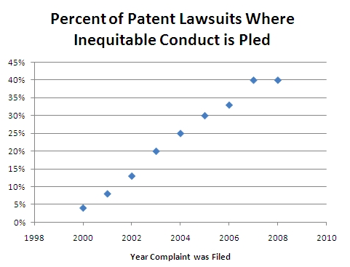
Source: https://patentlyo.com/patent/2010/06/measuring-the-plague-of-inequitable-conduct.html

Slide 33
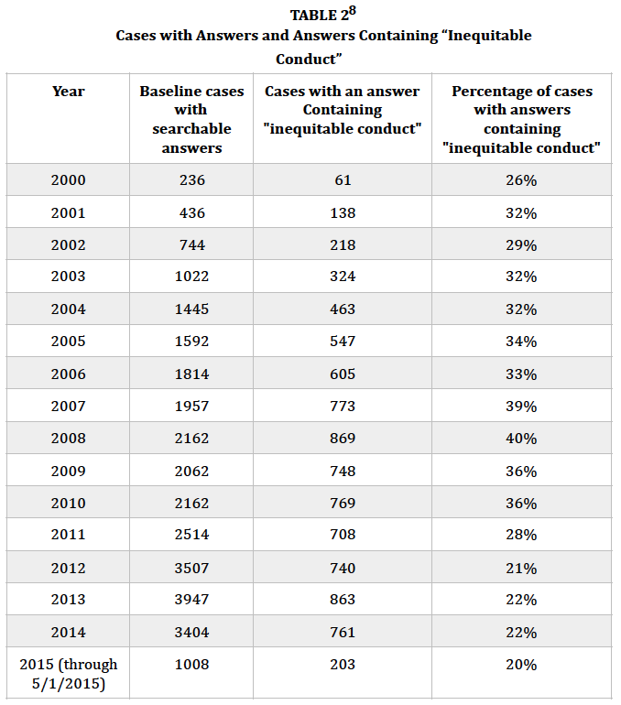
Source:
Rantanen & Petheridge
(2016)

Slide 34
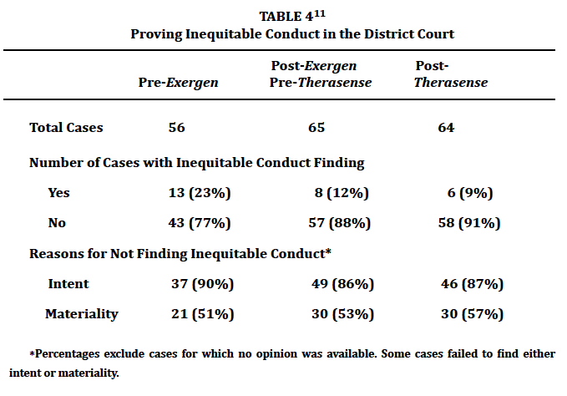
Swanson, “Therasense Effect” Stanford L. Rev. 2014

Slide 35
Swanson, “Therasense Effect” Stanford L. Rev. 2014

Slide 36
Swanson, “Therasense Effect” Stanford L. Rev. 2014

Slide 37
Evolution of the Scope of the Defenses
For each defense, the 3 columns represent
1980/2000/2019
Delay
Invalidity
Exhaustion
Prior User Right
Implied License
Patent Misuse
Abuse of SEPs
RP Settlements
Sovereign Immunity
Experimental Use
Equitable Estoppel
Reverse Equivalents
Inequitable Conduct

