Slide 1
Module 107 Slides
William Fisher
WilmerHale Professor of Intellectual Property Law
Harvard Law School
December 2020

Slide 2
The following images appear in the background of the lecture on “Remedies” in the PatentX lecture series. A recording of the lecture itself is available at https://ipxcourses.org/lectures-2/. Removed from their original context, the images will not make much sense. The function of this collection of images is to enable persons who have already watched the lecture to review the material it contains.
The terms on which these materials may be used or modified are available at http://ipxcourses.org.

Slide 3
Duration of Utility Patents
Provisional remedy possible
Publication
20 years
time
Patent Grant
Patent application

Slide 4
Finisar (ND Ca)
Source: Fish & Richardson, https://www.fr.com/wp-content/uploads/2016/12/Final_2016-12-15-Halo-Willfulness-Webinar-FINAL.pdf

Slide 5
CH2O v. Meras (CD Ca)
Source: Fish & Richardson, https://www.fr.com/wp-content/uploads/2016/12/Final_2016-12-15-Halo-Willfulness-Webinar-FINAL.pdf

Slide 6
Polara (CD Ca)
Source: Fish & Richardson, https://www.fr.com/wp-content/uploads/2016/12/Final_2016-12-15-Halo-Willfulness-Webinar-FINAL.pdf

Slide 7
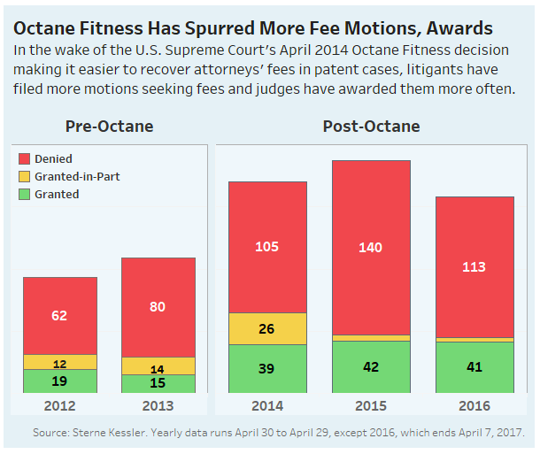
Source: https://www.law360.com/articles/915516/fee-awards-loom-large-in-patent-law-3-years-after-octane

Slide 8
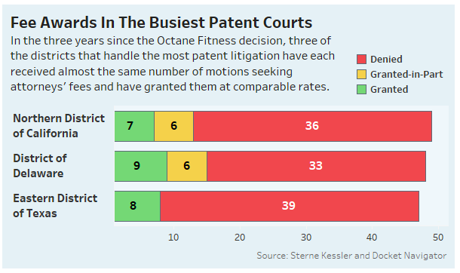
Source: https://www.law360.com/articles/915516/fee-awards-loom-large-in-patent-law-3-years-after-octane

Slide 9
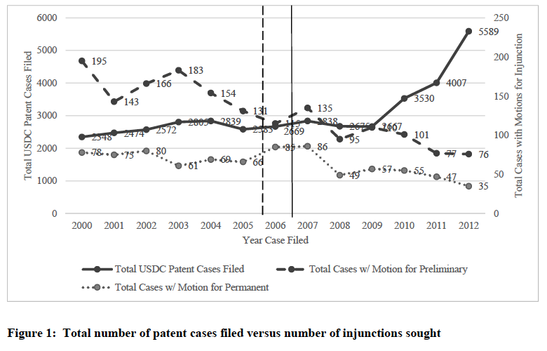
Grant of petition for certiorari in eBay
SCOTUS decision in eBay
Source: Kirti Gupta & Jay Kesan, “Studying the Impact of eBay on Injunctive Relief in Patent Cases” (2016)

Slide 10
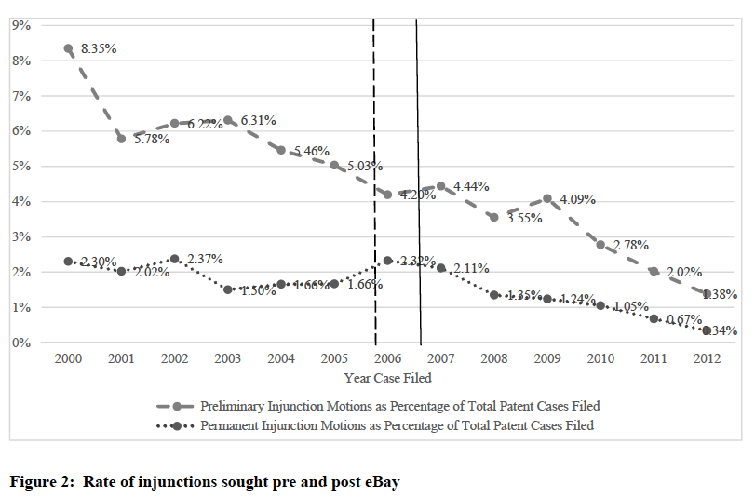
Source: Kirti Gupta & Jay Kesan, “Studying the Impact of eBay on Injunctive Relief in Patent Cases” (2016)

Slide 11
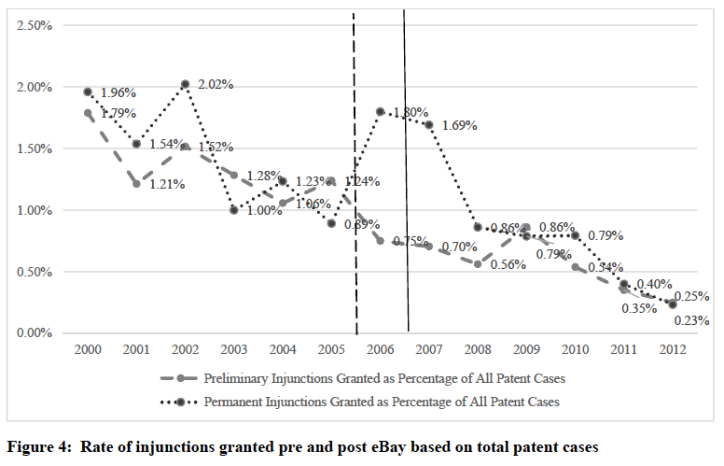
Source: Kirti Gupta & Jay Kesan, “Studying the Impact of eBay on Injunctive Relief in Patent Cases” (2016)

Slide 12
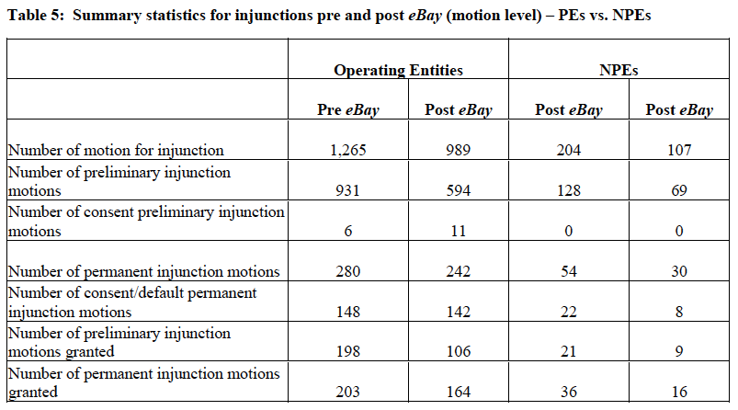
Source: Kirti Gupta & Jay Kesan, “Studying the Impact of eBay on Injunctive Relief in Patent Cases” (2016)

Slide 13
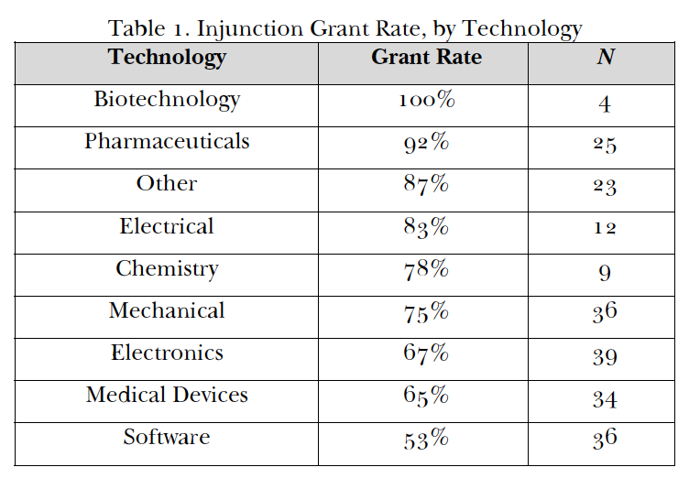
Source: Christopher Seaman, “Permanent Injunctions in Patent Litigation After eBay” (2016)

Slide 14
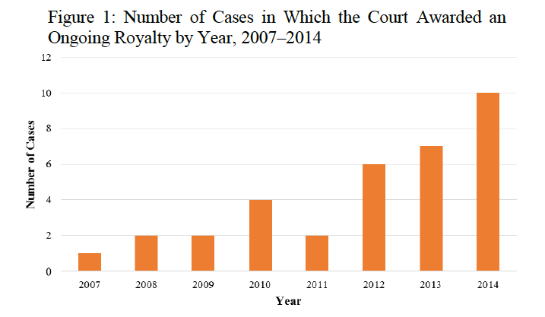
Source: J. Gregory Sidak, “ Ongoing Royalties for Patent Infringement” (2016)

Slide 15
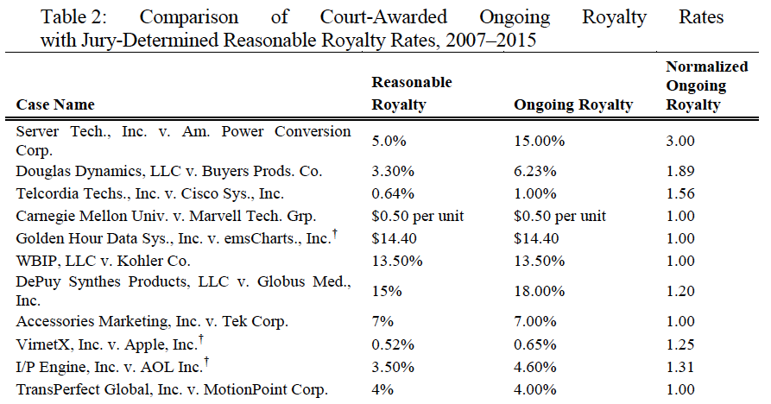
Source: J. Gregory Sidak, “ Ongoing Royalties for Patent Infringement” (2016)

Slide 16
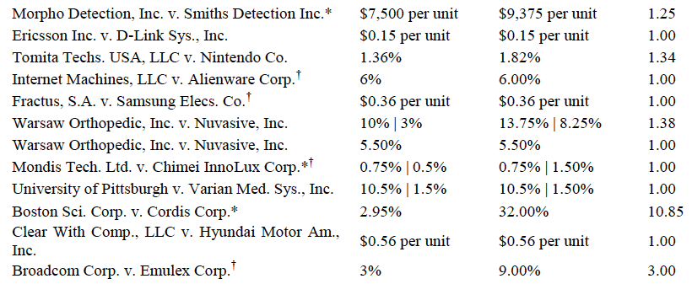
Source: J. Gregory Sidak, “ Ongoing Royalties for Patent Infringement” (2016)

Slide 17
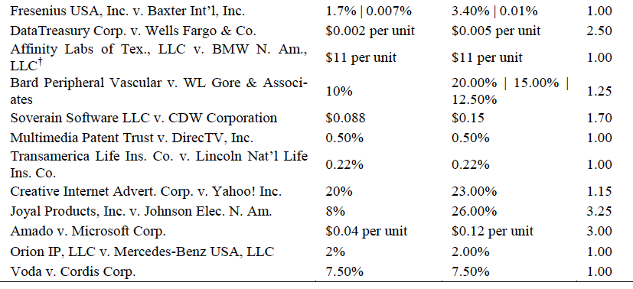
Source: J. Gregory Sidak, “ Ongoing Royalties for Patent Infringement” (2016)
Average: 1.66

Slide 18
Hypothetical, simplified patent dispute
2005: Paula applies for a US patent
2008:
  Patent is granted
  Paula immediately launches a business, selling products embodying the patented technology
2010:
  Ian enters into competition with Paula, selling products embodying a similar technology
2016, Paula files an infringement suit

Slide 19
Enhanced damages for
“egregious” conduct
Lost profits
Reasonable royalty
Patentee’s profits
Infringer’s profits
§286
2024
Patent
2008
2009
2010
2011
2012
2013
2014
2015
2016
2017
2018
2019
2020
2021
2022
2023
Lawsuit filed
Patentee prevails

Slide 20
Lost profits
Enhanced damages for
“egregious” conduct
Reasonable royalty
Patentee’s profits
Infringer’s profits
§286
2024
Patent
2008
2009
2010
2011
2012
2013
2014
2015
2016
2017
2018
2019
2020
2021
2022
2023
Lawsuit filed
Patentee prevails

Slide 21
Lost profits
Alternative measures
of damages
Reasonable royalty
Patentee’s profits
Infringer’s profits
§286
Injunction
2024
Patent
2008
2009
2010
2011
2012
2013
2014
2015
2016
2017
2018
2019
2020
2021
2022
2023
Lawsuit filed
Patentee prevails

Slide 22
Lost profits
Alternative measures
of damages
Voluntary license fee
Reasonable royalty
Patentee’s profits
Infringer’s profits
§286
Injunction
2024
Patent
2008
2009
2010
2011
2012
2013
2014
2015
2016
2017
2018
2019
2020
2021
2022
2023
Lawsuit filed
Patentee prevails

Slide 23
Defendant could continue to
infringe, but would risk another
lawsuit, and thus liability
for one of these zones
Lost profits
Alternative measures
of damages
Reasonable royalty
Patentee’s profits
Infringer’s profits
§286
No Injunction
2024
Patent
2008
2009
2010
2011
2012
2013
2014
2015
2016
2017
2018
2019
2020
2021
2022
2023
Lawsuit filed
Patentee prevails

Slide 24
Step 1: Encourage parties to negotiate a voluntary license
Lost profits
Alternative measures
of damages
Reasonable royalty
Patentee’s profits
Infringer’s profits
§286
No Injunction
2024
Patent
2008
2009
2010
2011
2012
2013
2014
2015
2016
2017
2018
2019
2020
2021
2022
2023
Lawsuit filed
Patentee prevails

Slide 25
Step 2: Order an ongoing royalty (a form of equitable relief)
Lost profits
Alternative measures
of damages
Ongoing royalty
Reasonable royalty
Patentee’s profits
Infringer’s profits
§286
No Injunction
2024
Patent
2008
2009
2010
2011
2012
2013
2014
2015
2016
2017
2018
2019
2020
2021
2022
2023
Lawsuit filed
Patentee prevails

Slide 26
On average, the ongoing royalty is 1.6 x the “reasonable royalty”
Lost profits
Ongoing royalty
Reasonable royalty
Patentee’s profits
Infringer’s profits
§286
No Injunction
2024
Patent
2008
2009
2010
2011
2012
2013
2014
2015
2016
2017
2018
2019
2020
2021
2022
2023
Lawsuit filed
Patentee prevails

Slide 27
Lost profits
Semi-voluntary license fee
Voluntary license fee
Reasonable royalty
Patentee’s profits
Infringer’s profits
§286
2024
Patent
2008
2009
2010
2011
2012
2013
2014
2015
2016
2017
2018
2019
2020
2021
2022
2023
Lawsuit filed
Patentee prevails

Slide 28
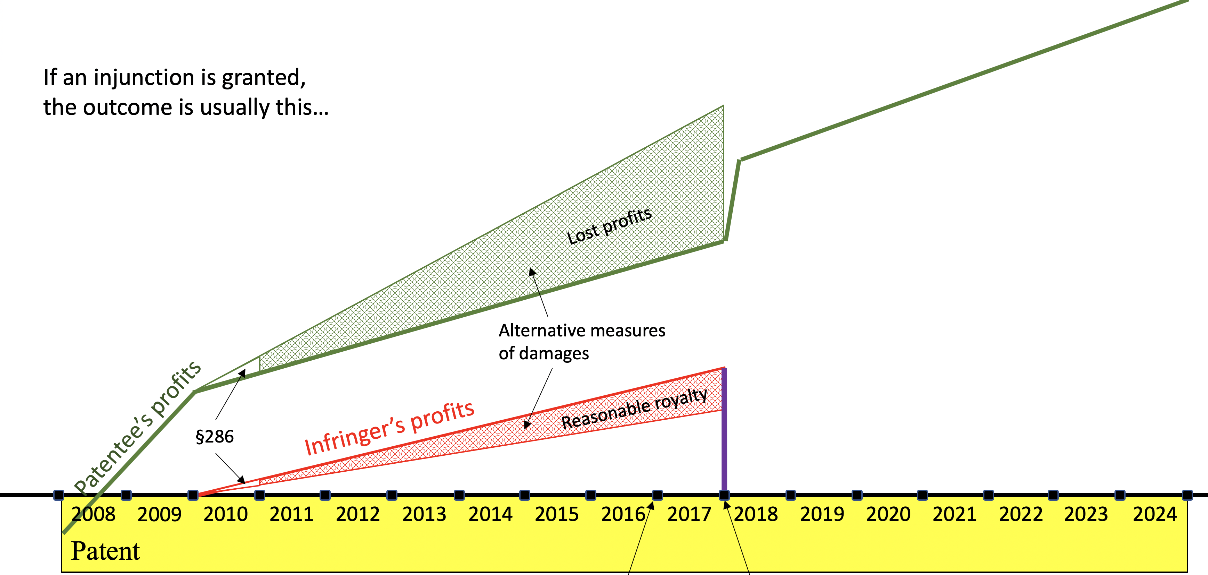
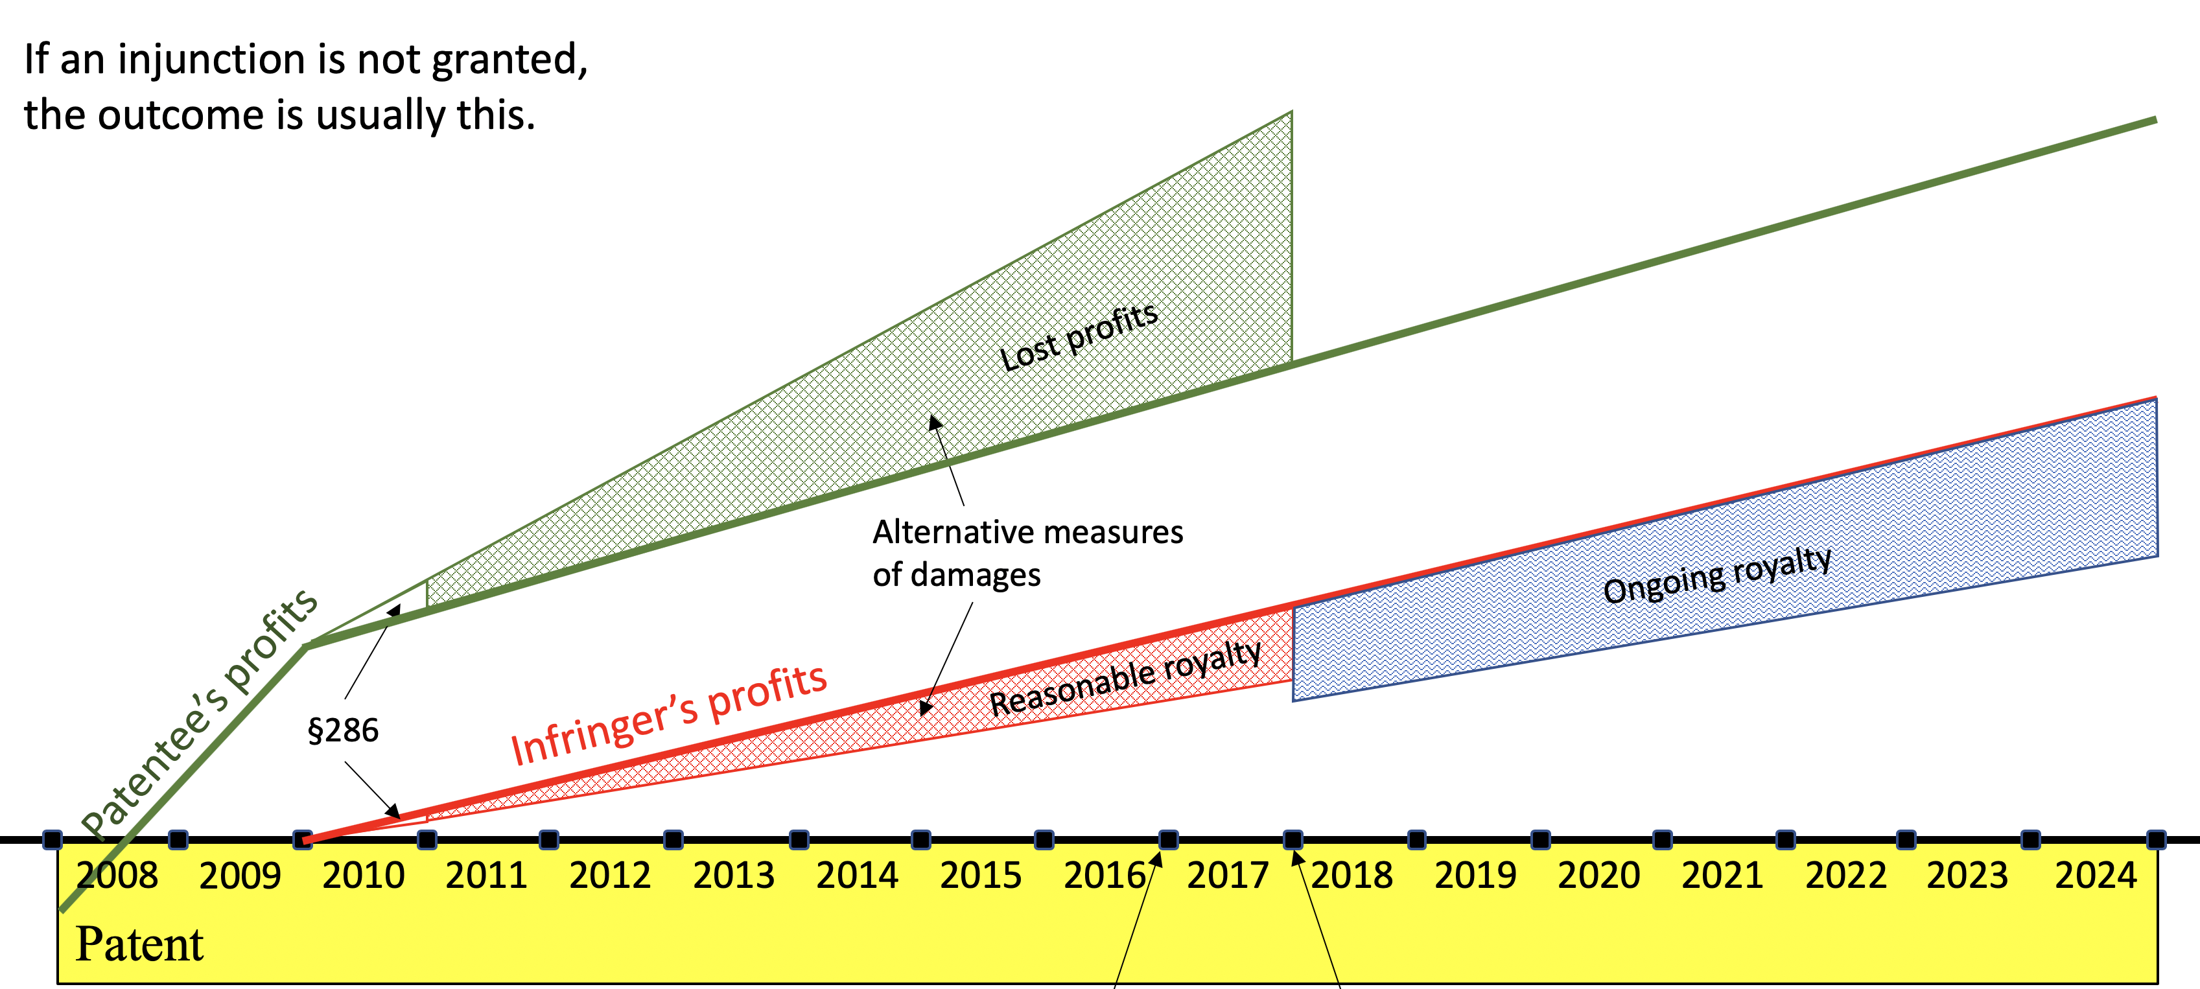
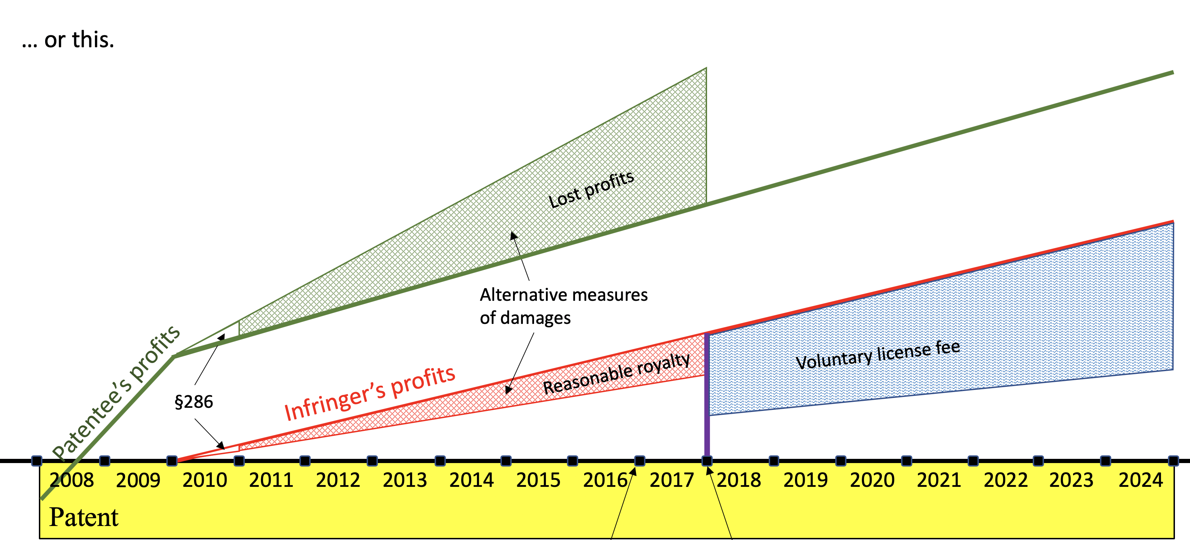
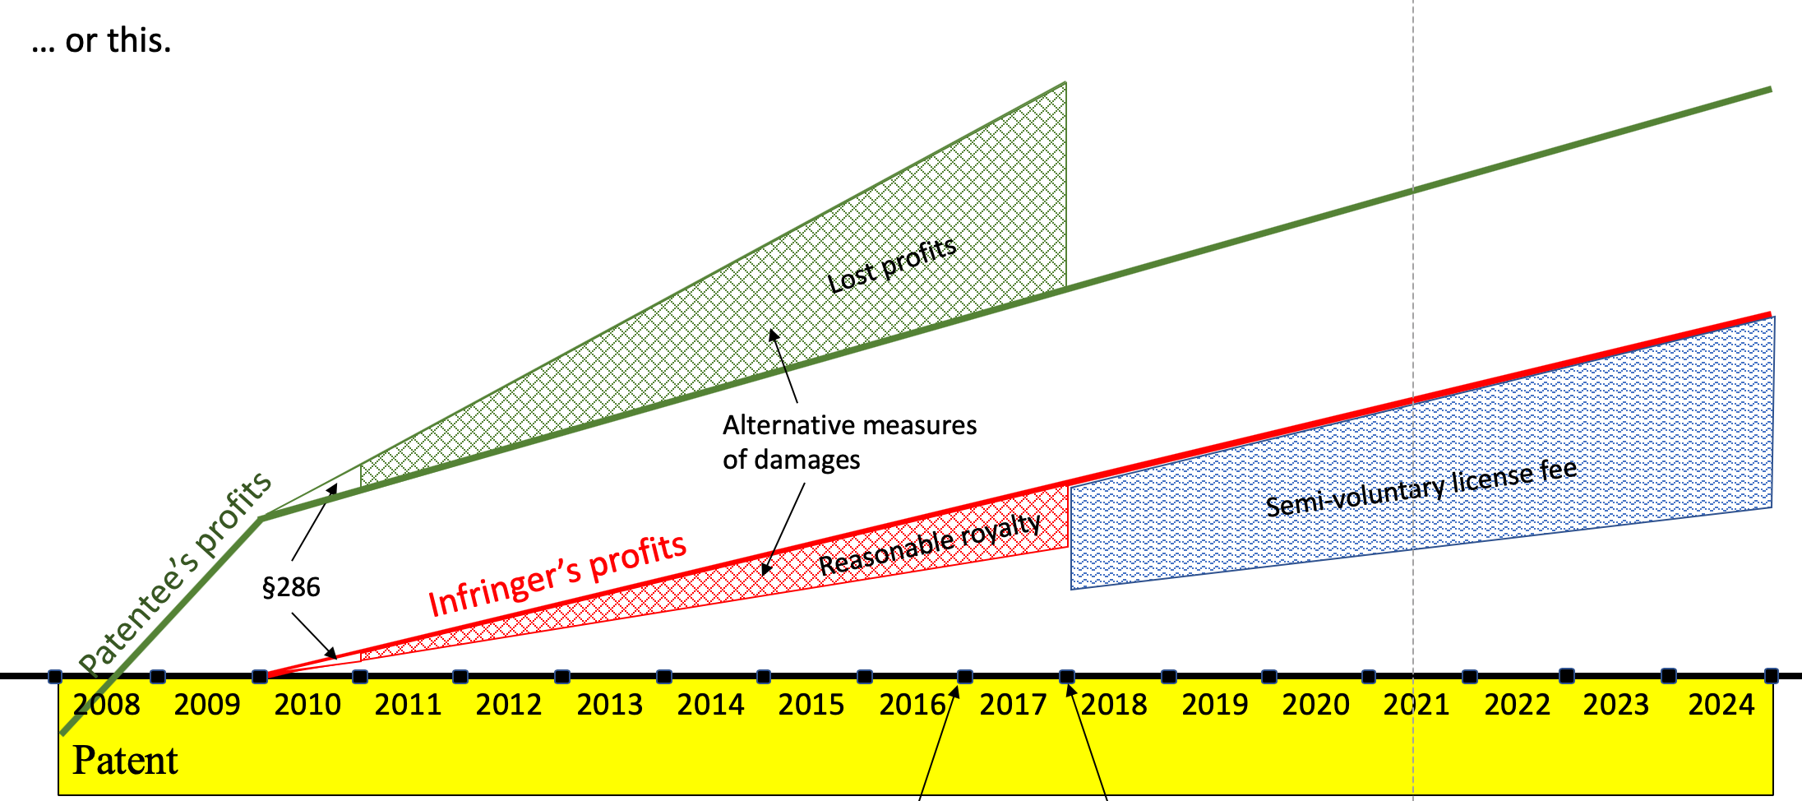
A
C
B
D

Slide 29
A
C
B
Primary policy argument for denying injunctive relief is that voluntary licenses will be “too high,” because:
Holdup power of the patentee;
The patent at issue is socially pernicious (e.g., business method patent);
The patentee is socially pernicious (e.g., NPE); or
“Royalty stacking”

Slide 30
Theoretical critique
Failure to identify the socially optimal level of incentive for innovation;
Patentees can and likely will use devices to avoid royalty stacking
  “repeated games”
  Informational asymmetry
  Norm-based limits on bargaining
Empirical critique
Strategies to avoid royalty stacking are indeed commonly used;
Little evidence that innovation has been curtailed in industries characterized by patent thickets
B
Primary policy argument for denying injunctive relief is that voluntary licenses will be “too high,” because:
Holdup power of the patentee;
The patent at issue is socially pernicious (e.g., business method patent);
The patentee is socially pernicious (e.g., NPE); or
“Royalty stacking”

