Slide 1
Module 203 Slides
William Fisher WilmerHale Professor of Intellectual Property Law
Harvard Law School
March 2023

Slide 2
The following images appear in the background of the lecture on “Improving IP” in the PatentX lecture series. A recording of the lecture itself is available at https://ipxcourses.org/lectures-2/. Removed from their original context, the images will not make much sense. The function of this collection of images is to enable persons who have already watched the lecture to review the material it contains.
The terms on which these materials may be used or modified are available at http://ipxcourses.org.

Slide 3
Part A: Developing Countries

Slide 4
TRIPS, Article 27.1
Subject to the provisions of paragraphs 2 and 3, patents shall be available for any inventions, whether products or processes, in all fields of technology, provided that they are new, involve an inventive step and are capable of industrial application. Subject to paragraph 4 of Article 65, paragraph 8 of Article 70 and paragraph 3 of this Article, patents shall be available and patent rights enjoyable without discrimination as to the place of invention, the field of technology and whether products are imported or locally produced.

Slide 5
TRIPS, Articles 42-49
42. Members shall make available to right holders civil judicial procedures concerning the enforcement of any intellectual property right covered by this Agreement….
44.1 The judicial authorities shall have the authority to order a party to desist from an infringement, inter alia to prevent the entry into the channels of commerce in their jurisdiction of imported goods that involve the infringement of an intellectual property right, immediately after customs clearance of such goods. Members are not obliged to accord such authority in respect of protected subject matter acquired or ordered by a person prior to knowing or having reasonable grounds to know that dealing in such subject matter would entail the infringement of an intellectual property right.
44. 2. Notwithstanding the other provisions of this Part and provided that the provisions of Part II specifically addressing use by governments, or by third parties authorized by a government, without the authorization of the right holder are complied with, Members may limit the remedies available against such use to payment of remuneration in accordance with subparagraph (h) of Article 31.
In other cases, the remedies under this Part shall apply or, where these remedies are inconsistent with a Member’s law, declaratory judgments and adequate compensation shall be available.
45. 1. The judicial authorities shall have the authority to order the infringer to pay the right holder damages adequate to compensate for the injury the right holder has suffered because of an infringement of that person’s intellectual property right by an infringer who knowingly, or with reasonable grounds to know, engaged in infringing activity.
45.2. The judicial authorities shall also have the authority to order the infringer to pay the right holder expenses, which may include appropriate attorney’s fees. In appropriate cases, Members may authorize the judicial authorities to order recovery of profits and/or payment of pre-established damages even where the infringer did not knowingly, or with reasonable grounds to know, engage in infringing activity.

Slide 6
TRIPS, Article 39.3
Members, when requiring, as a condition of approving the marketing of pharmaceutical or of agricultural chemical products which utilize new chemical entities, the submission of undisclosed test or other data, the origination of which involves a considerable effort, shall protect such data against unfair commercial use. In addition, Members shall protect such data against disclosure, except where necessary to protect the public, or unless steps are taken to ensure that the data are protected against unfair commercial use.

Slide 7
Constraints Imposed by Free Trade Agreements
Limits on compulsory licenses
Rejection of international exhaustion
Mandatory duration of patents
Mandatory data-exclusivity protections

Slide 8
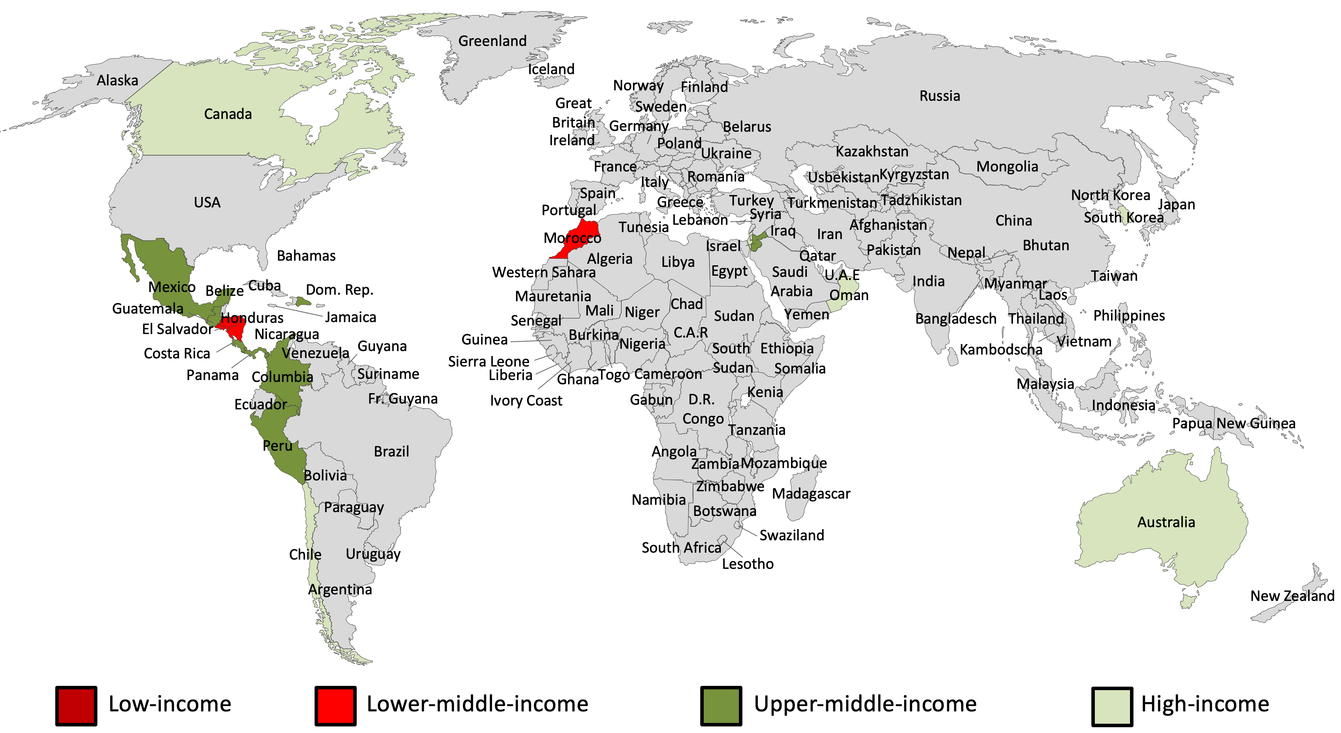
Countries subject to free trade agreements with the United States

Slide 9
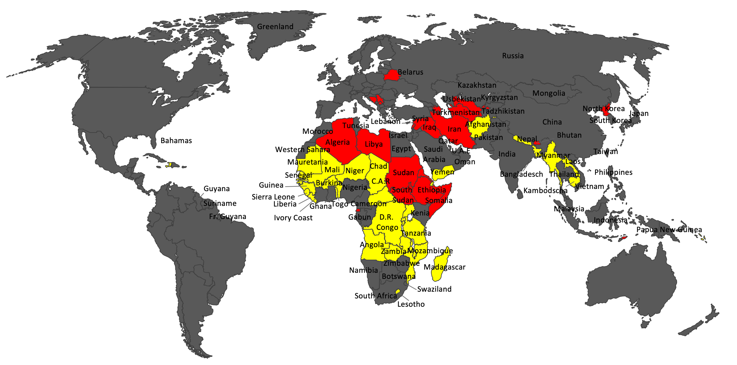
Countries not (yet) subject to TRIPS obligations
Red = not (yet) members of WTO; Yellow = Least Developed Countries (2033)

Slide 10
TRIPS Flexibilities
Limiting the Rights of Patentees
Parallel importation
Compulsory licenses
Tightening Patentability Requirements
Limiting the Duration of Patents
Limiting the Remedies for Infringement

Slide 11
TRIPS, Article 6
For the purposes of dispute settlement under this Agreement, subject to the provisions of Articles 3 and 4, nothing in this Agreement shall be used to address the issue of the exhaustion of intellectual property rights.

Slide 12
Constraints Imposed by Free Trade Agreements
Limits on compulsory licenses
Rejection of international exhaustion
Mandatory duration of patents
Mandatory data-exclusivity protections
European Union -- Georgia FTA, Article 152:
Each Party shall provide for a regime of domestic or regional exhaustion of intellectual property rights.

Slide 13
TRIPS, Article 30
Members may provide limited exceptions to the exclusive rights conferred by a patent, provided that such exceptions do not unreasonably conflict with a normal exploitation of the patent and do not unreasonably prejudice the legitimate interests of the patent owner, taking account of the legitimate interests of third parties.

Slide 14
TRIPS, Article 31
Where the law of a Member allows for other use of the subject matter of a patent without the authorization of the right holder, including use by the government or third parties authorized by the government, the following provisions shall be respected:
(a) authorization of such use shall be considered on its individual merits;
(b) such use may only be permitted if, prior to such use, the proposed user has made efforts to obtain authorization from the right holder on reasonable commercial terms and conditions and that such efforts have not been successful within a reasonable period of time. This requirement may be waived by a Member in the case of a national emergency or other circumstances of extreme urgency or in cases of public non-commercial use. In situations of national emergency or other circumstances of extreme urgency, the right holder shall, nevertheless, be notified as soon as reasonably practicable. In the case of public non-commercial use, where the government or contractor, without making a patent search, knows or has demonstrable grounds to know that a valid patent is or will be used by or for the government, the right holder shall be informed promptly;
(c) the scope and duration of such use shall be limited to the purpose for which it was authorized, and in the case of semi-conductor technology shall only be for public non-commercial use or to remedy a practice determined after judicial or administrative process to be anti-competitive;
(d) such use shall be non-exclusive;
(e) such use shall be non-assignable, except with that part of the enterprise or goodwill which enjoys such use;
(f) any such use shall be authorized predominantly for the supply of the domestic market of the Member authorizing such use;
(g) authorization for such use shall be liable, subject to adequate protection of the legitimate interests of the persons so authorized, to be terminated if and when the circumstances which led to it cease to exist and are unlikely to recur. The competent authority shall have the authority to review, upon motivated request, the continued existence of these circumstances;
[continued….]

Slide 15
TRIPS, Article 31
(h) the right holder shall be paid adequate remuneration in the circumstances of each case, taking into account the economic value of the authorization;
(i) the legal validity of any decision relating to the authorization of such use shall be subject to judicial review or other independent review by a distinct higher authority in that Member;
(j) any decision relating to the remuneration provided in respect of such use shall be subject to judicial review or other independent review by a distinct higher authority in that Member;
(k) Members are not obliged to apply the conditions set forth in subparagraphs (b) and (f) where such use is permitted to remedy a practice determined after judicial or administrative process to be anti-competitive. The need to correct anti-competitive practices may be taken into account in determining the amount of remuneration in such cases. Competent authorities shall have the authority to refuse termination of authorization if and when the conditions which led to such authorization are likely to recur;
(l) where such use is authorized to permit the exploitation of a patent (“the second patent”) which cannot be exploited without infringing another patent (“the first patent”), the following additional conditions shall apply:
(i) the invention claimed in the second patent shall involve an important technical advance of considerable economic significance in relation to the invention claimed in the first patent;
(ii) the owner of the first patent shall be entitled to a cross-licence on reasonable terms to use the invention claimed in the second patent; and
(iii) the use authorized in respect of the first patent shall be non-assignable except with the assignment of the second patent.

Slide 16
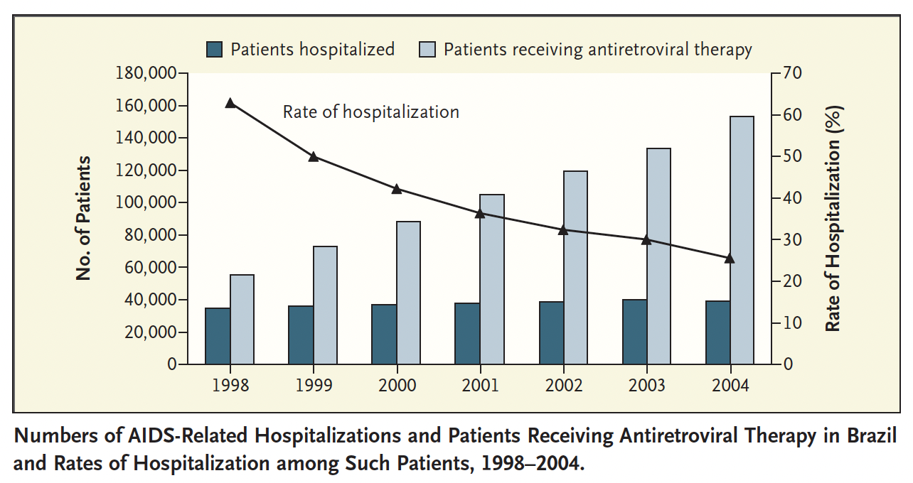
Source: Okie, “Fighting HIV – Lessons from Brazil,” NE Journal of Medicine (2006)

Slide 17
TRIPS, Article 31bis
1. The obligations of an exporting Member under Article 31(f) shall not apply with respect to the grant by it of a compulsory licence to the extent necessary for the purposes of production of a pharmaceutical product(s) and its export to an eligible importing Member(s) in accordance with the terms set out in paragraph 2 of the Annex to this Agreement.
2. Where a compulsory licence is granted by an exporting Member under the system set out in this Article and the Annex to this Agreement, adequate remuneration pursuant to Article 31(h) shall be paid in that Member taking into account the economic value to the importing Member of the use that has been authorized in the exporting Member. Where a compulsory licence is granted for the same products in the eligible importing Member, the obligation of that Member under Article 31(h) shall not apply in respect of those products for which remuneration in accordance with the first sentence of this paragraph is paid in the exporting Member.
3. With a view to harnessing economies of scale for the purposes of enhancing purchasing power for, and facilitating the local production of, pharmaceutical products: where a developing or least developed country WTO Member is a party to a regional trade agreement within the meaning of Article XXIV of the GATT 1994 and the Decision of 28 November 1979 on Differential and More Favourable Treatment Reciprocity
and Fuller Participation of Developing Countries (L/4903), at least half of the current membership of which is made up of countries presently on the United Nations list of least developed countries, the obligation of that Member under Article 31(f) shall not apply to the extent necessary to enable a pharmaceutical product produced or imported under a compulsory licence in that Member to be exported to the markets of those other developing or least developed country parties to the regional trade agreement that share the health problem in question. It is understood that this will not prejudice the territorial nature of the patent rights in question.
4. Members shall not challenge any measures taken in conformity with the provisions of this Article and the Annex to this Agreement under subparagraphs 1(b) and 1(c) of Article XXIII of GATT 1994.
5. This Article and the Annex to this Agreement are without prejudice to the rights, obligations and flexibilities that Members have under the provisions of this Agreement other than paragraphs (f) and (h) of Article 31, including those reaffirmed by the Declaration on the TRIPS Agreement and Public Health (WT/MIN(01)/DEC/2), and to their interpretation. They are also without prejudice to the extent to which pharmaceutical products produced under a compulsory licence can be exported under the provisions of Article 31(f).

Slide 18
TRIPS, Article 31bis
1. The obligations of an exporting Member under Article 31(f) shall not apply with respect to the grant by it of a compulsory licence to the extent necessary for the purposes of production of a pharmaceutical product(s) and its export to an eligible importing Member(s) in accordance with the terms set out in paragraph 2 of the Annex to this Agreement.
2. Where a compulsory licence is granted by an exporting Member under the system set out in this Article and the Annex to this Agreement, adequate remuneration pursuant to Article 31(h) shall be paid in that Member taking into account the economic value to the importing Member of the use that has been authorized in the exporting Member. Where a compulsory licence is granted for the same products in the eligible importing Member, the obligation of that Member under Article 31(h) shall not apply in respect of those products for which remuneration in accordance with the first sentence of this paragraph is paid in the exporting Member.
3. With a view to harnessing economies of scale for the purposes of enhancing purchasing power for, and facilitating the local production of, pharmaceutical products: where a developing or least developed country WTO Member is a party to a regional trade agreement within the meaning of Article XXIV of the GATT 1994 and the Decision of 28 November 1979 on Differential and More Favourable Treatment Reciprocity
and Fuller Participation of Developing Countries (L/4903), at least half of the current membership of which is made up of countries presently on the United Nations list of least developed countries, the obligation of that Member under Article 31(f) shall not apply to the extent necessary to enable a pharmaceutical product produced or imported under a compulsory licence in that Member to be exported to the markets of those other developing or least developed country parties to the regional trade agreement that share the health problem in question. It is understood that this will not prejudice the territorial nature of the patent rights in question.
4. Members shall not challenge any measures taken in conformity with the provisions of this Article and the Annex to this Agreement under subparagraphs 1(b) and 1(c) of Article XXIII of GATT 1994.
5. This Article and the Annex to this Agreement are without prejudice to the rights, obligations and flexibilities that Members have under the provisions of this Agreement other than paragraphs (f) and (h) of Article 31, including those reaffirmed by the Declaration on the TRIPS Agreement and Public Health (WT/MIN(01)/DEC/2), and to their interpretation. They are also without prejudice to the extent to which pharmaceutical products produced under a compulsory licence can be exported under the provisions of Article 31(f).

Slide 19
TRIPS, Article 31bis, Annex
2. The terms referred to in paragraph 1 of Article 31bis are that:
(a) the eligible importing Member(s)4 has made a notification2 to the Council for TRIPS, that:
(i) specifies the names and expected quantities of the product(s) needed5;
(ii) confirms that the eligible importing Member in question, other than a least developed country Member, has established that it has insufficient or no manufacturing capacities in the pharmaceutical sector for the product(s) in question in one of the ways set out in the Appendix to this Annex; and
(iii) confirms that, where a pharmaceutical product is patented in its territory, it has granted or intends to grant a compulsory licence in accordance with Articles 31 and 31bis of this Agreement and the provisions of this Annex6;
(b) the compulsory licence issued by the exporting Member under the system shall contain the following conditions:
(i) only the amount necessary to meet the needs of the eligible importing Member(s) may be manufactured under the licence and the entirety of this production shall be exported to the Member(s) which has notified its needs to the Council for TRIPS;
(ii) products produced under the licence shall be clearly identified as being produced under the system through specific labelling or marking. Suppliers should distinguish such products through special packaging and/or special colouring/shaping of the products themselves, provided that such distinction is feasible and does not have a significant impact on price; and
(iii) before shipment begins, the licensee shall post on a website7 the following information:
— the quantities being supplied to each destination as referred to in indent (i) above; and
— the distinguishing features of the product(s) referred to in indent (ii) above;
(c) the exporting Member shall notify8 the Council for TRIPS of the grant of the licence, including the conditions attached to it.9 The information provided shall include the name and address of the licensee, the product(s) for which the licence has been granted, the quantity(ies) for which it has been granted, the country(ies) to which the product(s) is (are) to be supplied and the duration of the licence. The notification shall also indicate the address of the website referred to in subparagraph (b)(iii) above.

Slide 20
TRIPS, Article 31bis, Annex
2. The terms referred to in paragraph 1 of Article 31bis are that:
(a) the eligible importing Member(s)4 has made a notification2 to the Council for TRIPS, that:
(i) specifies the names and expected quantities of the product(s) needed5;
(ii) confirms that the eligible importing Member in question, other than a least developed country Member, has established that it has insufficient or no manufacturing capacities in the pharmaceutical sector for the product(s) in question in one of the ways set out in the Appendix to this Annex; and
(iii) confirms that, where a pharmaceutical product is patented in its territory, it has granted or intends to grant a compulsory licence in accordance with Articles 31 and 31bis of this Agreement and the provisions of this Annex6;
(b) the compulsory licence issued by the exporting Member under the system shall contain the following conditions:
(i) only the amount necessary to meet the needs of the eligible importing Member(s) may be manufactured under the licence and the entirety of this production shall be exported to the Member(s) which has notified its needs to the Council for TRIPS;
(ii) products produced under the licence shall be clearly identified as being produced under the system through specific labelling or marking. Suppliers should distinguish such products through special packaging and/or special colouring/shaping of the products themselves, provided that such distinction is feasible and does not have a significant impact on price; and
(iii) before shipment begins, the licensee shall post on a website7 the following information:
— the quantities being supplied to each destination as referred to in indent (i) above; and
— the distinguishing features of the product(s) referred to in indent (ii) above;
(c) the exporting Member shall notify8 the Council for TRIPS of the grant of the licence, including the conditions attached to it.9 The information provided shall include the name and address of the licensee, the product(s) for which the licence has been granted, the quantity(ies) for which it has been granted, the country(ies) to which the product(s) is (are) to be supplied and the duration of the licence. The notification shall also indicate the address of the website referred to in subparagraph (b)(iii) above.

Slide 21
TRIPS, Article 31bis, Annex, footnotes
(footnote original) 4 Joint notifications providing the information required under this subparagraph may be made by the regional organizations referred to in paragraph 3 of Article 31bis on behalf of eligible importing Members using the system that are parties to them, with the agreement of those parties.
(footnote original) 2 It is understood that this notification does not need to be approved by a WTO body in order to use the system.
(footnote original) 5 The notification will be made available publicly by the WTO Secretariat through a page on the WTO website dedicated to the system.
(footnote original) 6 This subparagraph is without prejudice to Article 66.1 of this Agreement.
(footnote original) 7 The licensee may use for this purpose its own website or, with the assistance of the WTO Secretariat, the page on the WTO website dedicated to the system.
(footnote original) 8 It is understood that this notification does not need to be approved by a WTO body in order to use the system.
(footnote original) 9 The notification will be made available publicly by the WTO Secretariat through a page on the WTO website dedicated to the system.

Slide 22
Constraints Imposed by Free Trade Agreements
US-Singapore FTA, Article 16.7(6):
Neither Party shall permit the use of the subject matter of a patent without the authorization of the right holder except in the following circumstances:
(a) to remedy a practice determined after judicial or administrative process to be anti-competitive under the competition laws of the Party;
(b) in the case of public non-commercial use or in the case of a national emergency or other circumstances of extreme urgency, provided that:
(i) such use is limited to use by the government or third parties authorized by the government;
(ii) the patent owner is provided with reasonable and entire compensation for such use and manufacture; and
(iii) the Party shall not require the patent owner to transfer undisclosed information or technical "know how" related to a patented invention that has been authorized for use without the consent of the patent owner pursuant to this paragraph.
Limits on compulsory licenses
Rejection of international exhaustion
Mandatory duration of patents
Mandatory data-exclusivity protections

Slide 23
TRIPS Flexibilities
Limiting the Rights of Patentees
Tightening Patentability Requirements
Inventive step requirement
Enablement requirement
Limiting the Duration of Patents
Limiting the Remedies for Infringement

Slide 24
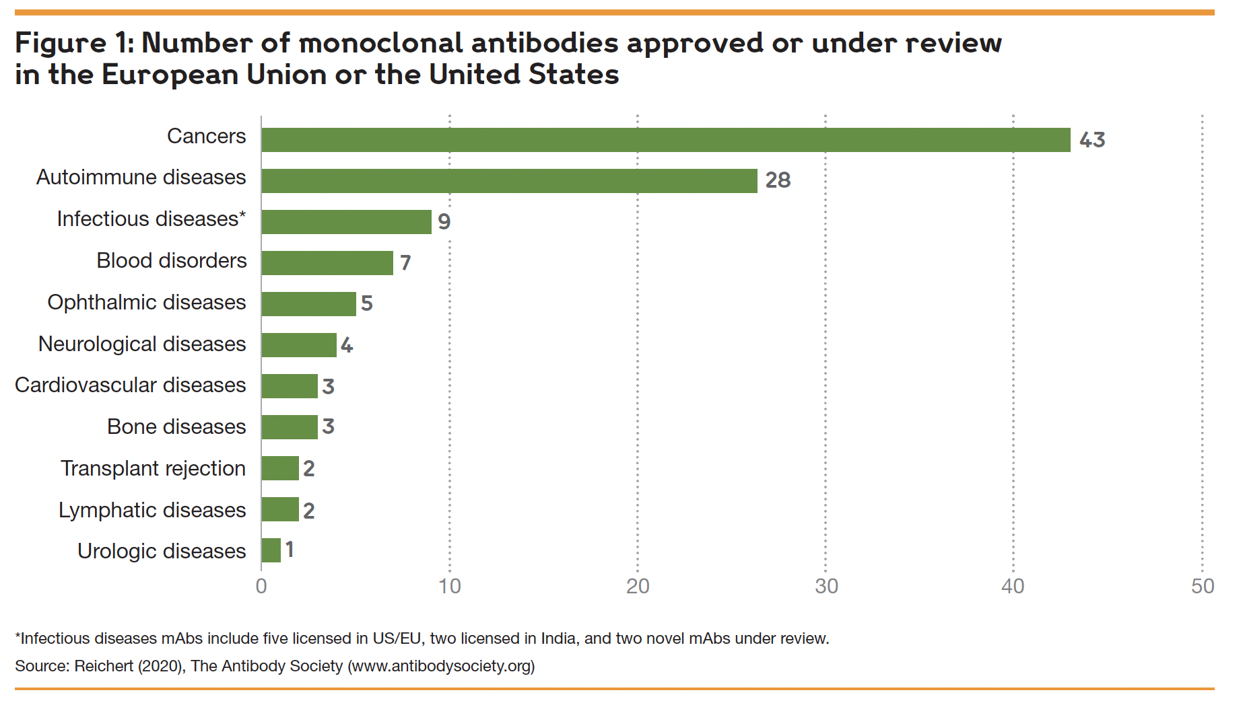
Source: Wellcome/IAVI, “Expanding Access to Monoclonal Antibody-based Products”

Slide 25
TRIPS Flexibilities
Limiting the Rights of Patentees
Tightening Patentability Requirements
Limiting the Duration of Patents
Slowing down the review process?
Renouncing patent-term extensions
Limiting the Remedies for Infringement

Slide 26
Constraints Imposed by Free Trade Agreements
US-Colombia FTA, Article 16.9(6):
Each Party shall make best efforts to process patent applications and marketing approval applications expeditiously with a view to avoiding unreasonable delays. The Parties shall cooperate and provide assistance to one another to achieve these objectives.
Each Party shall provide the means to and shall, at the request of the patent owner, compensate for unreasonable delays in the issuance of a patent, other than a patent for a pharmaceutical product, by restoring patent term or patent rights. Each Party may provide the means to and may, at the request of the patent owner, compensate for unreasonable delays in the issuance of a patent for a pharmaceutical product by restoring patent term or patent rights. Any restoration under this subparagraph shall confer all of the exclusive rights of a patent subject to the same limitations and exceptions applicable to the original patent. For purposes of this subparagraph, an unreasonable delay shall at least include a delay in the issuance of the patent of more than five years from the date of filing of the application in the territory of the Party, or three years after a request for examination of the application has been made, whichever is later, provided that periods attributable to actions of the patent applicant need not be included in the determination of such delays
Limits on compulsory licenses
Rejection of international exhaustion
Mandatory duration of patents
Mandatory data-exclusivity protections

Slide 27
Constraints Imposed by Free Trade Agreements
CAFTA, Article 15.9(6):
(a) Each Party, at the request of the patent owner, shall adjust the term of a patent to compensate for unreasonable delays that occur in granting the patent. For purposes of this paragraph, an unreasonable delay shall at least include a delay in the issuance of the patent of more than five years from the date of filing of the application in the territory of the Party, or three years after a request for examination of the application has been made, whichever is later, provided that periods attributable to actions of the patent applicant need not be included in the determination of such delays.
(b) With respect to any pharmaceutical product that is covered by a patent, each Party shall make available a restoration of the patent term to compensate the patent owner for unreasonable curtailment of the effective patent term resulting from the marketing approval process related to the first commercial marketing of the product in that Party.
Limits on compulsory licenses
Rejection of international exhaustion
Mandatory duration of patents
Mandatory data-exclusivity protections

Slide 28
TRIPS Flexibilities
Limiting the Rights of Patentees
Tightening Patentability Requirements
Limiting the Duration of Patents
Limiting the Remedies for Infringement
Denying injunctions when they would adversely affect public health; granting “ongoing royalties” instead

Slide 29
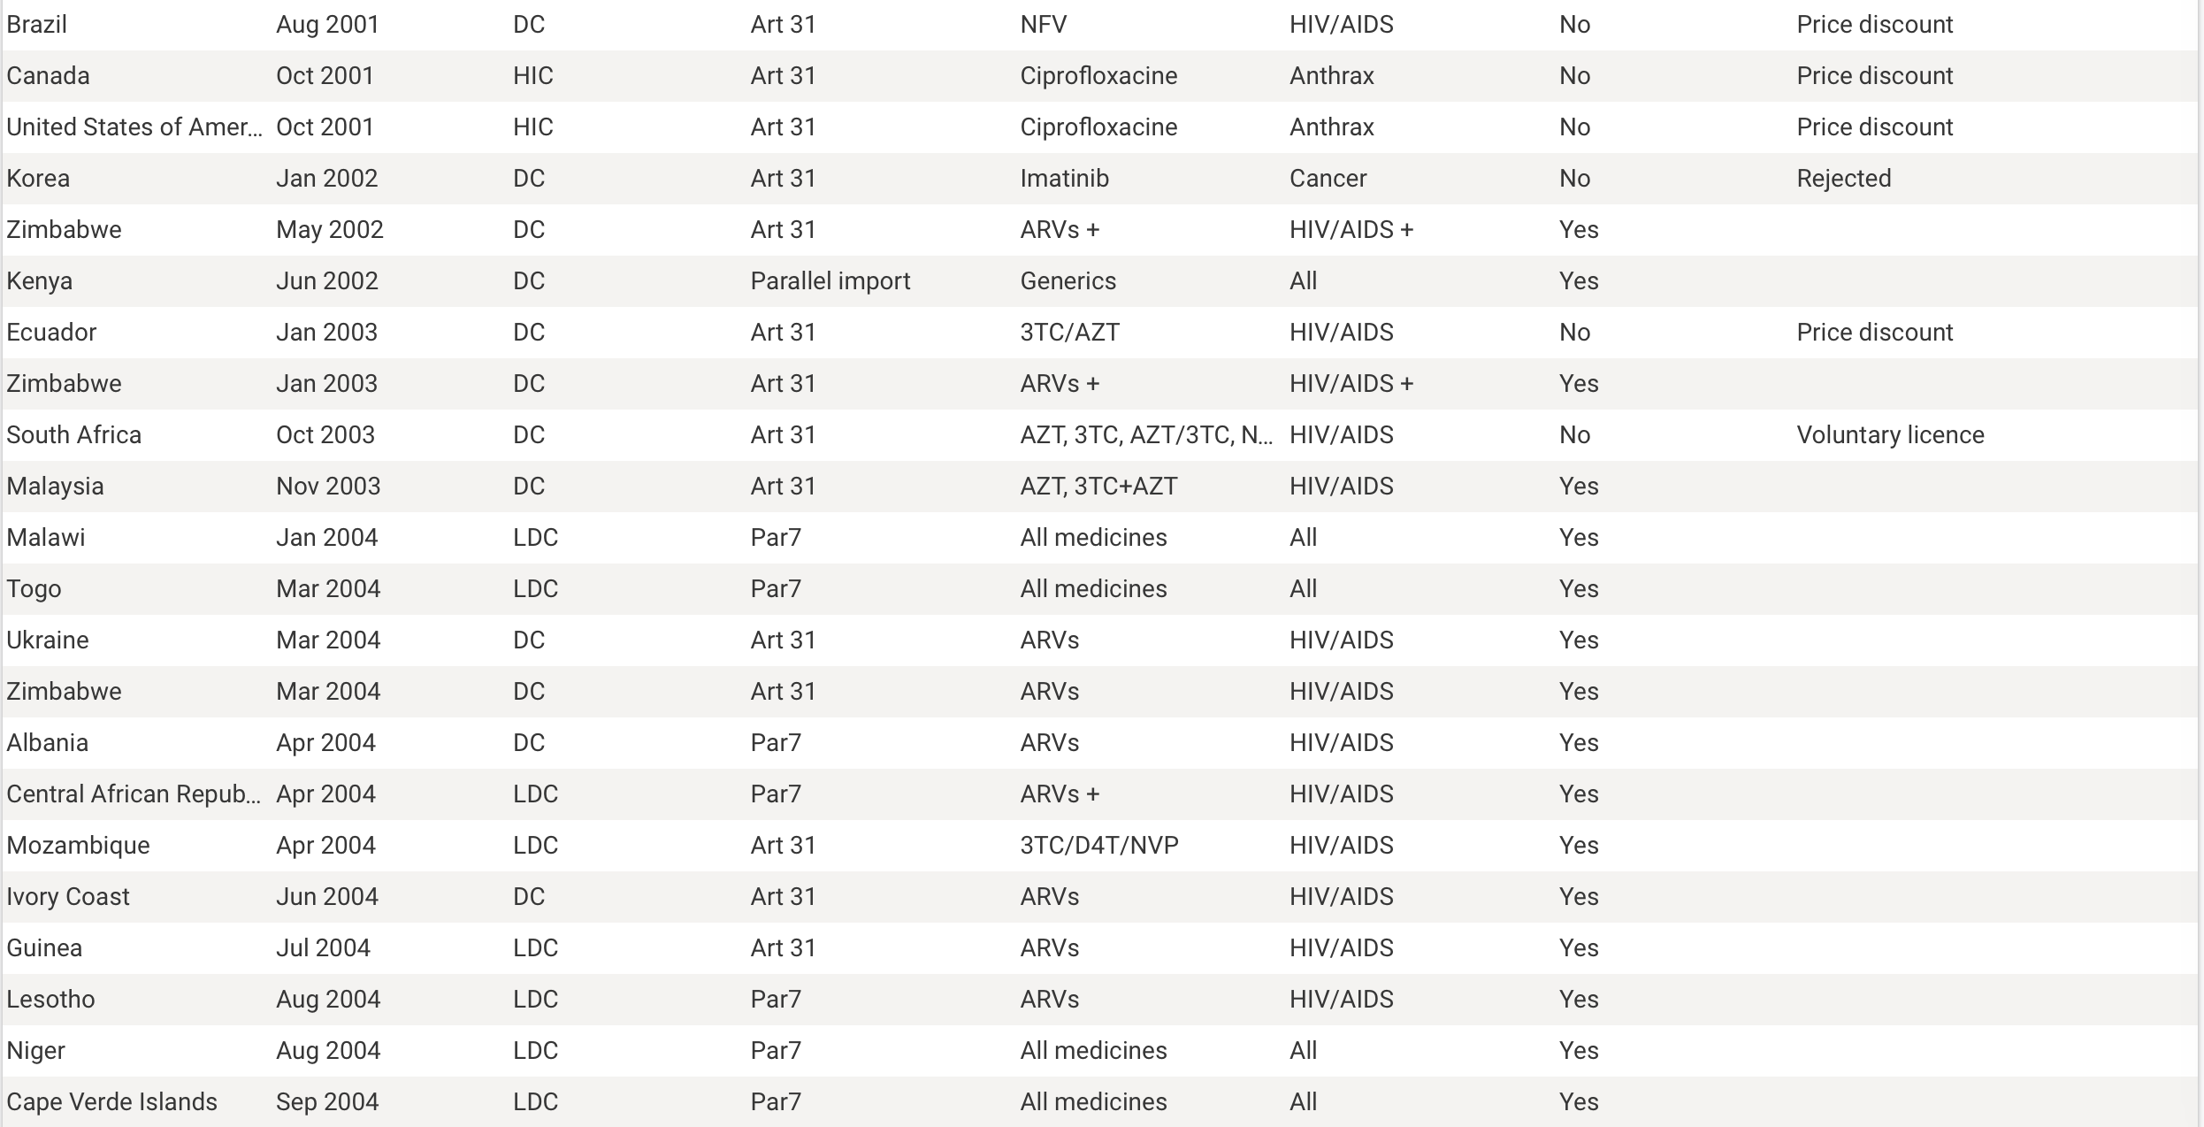

Slide 30
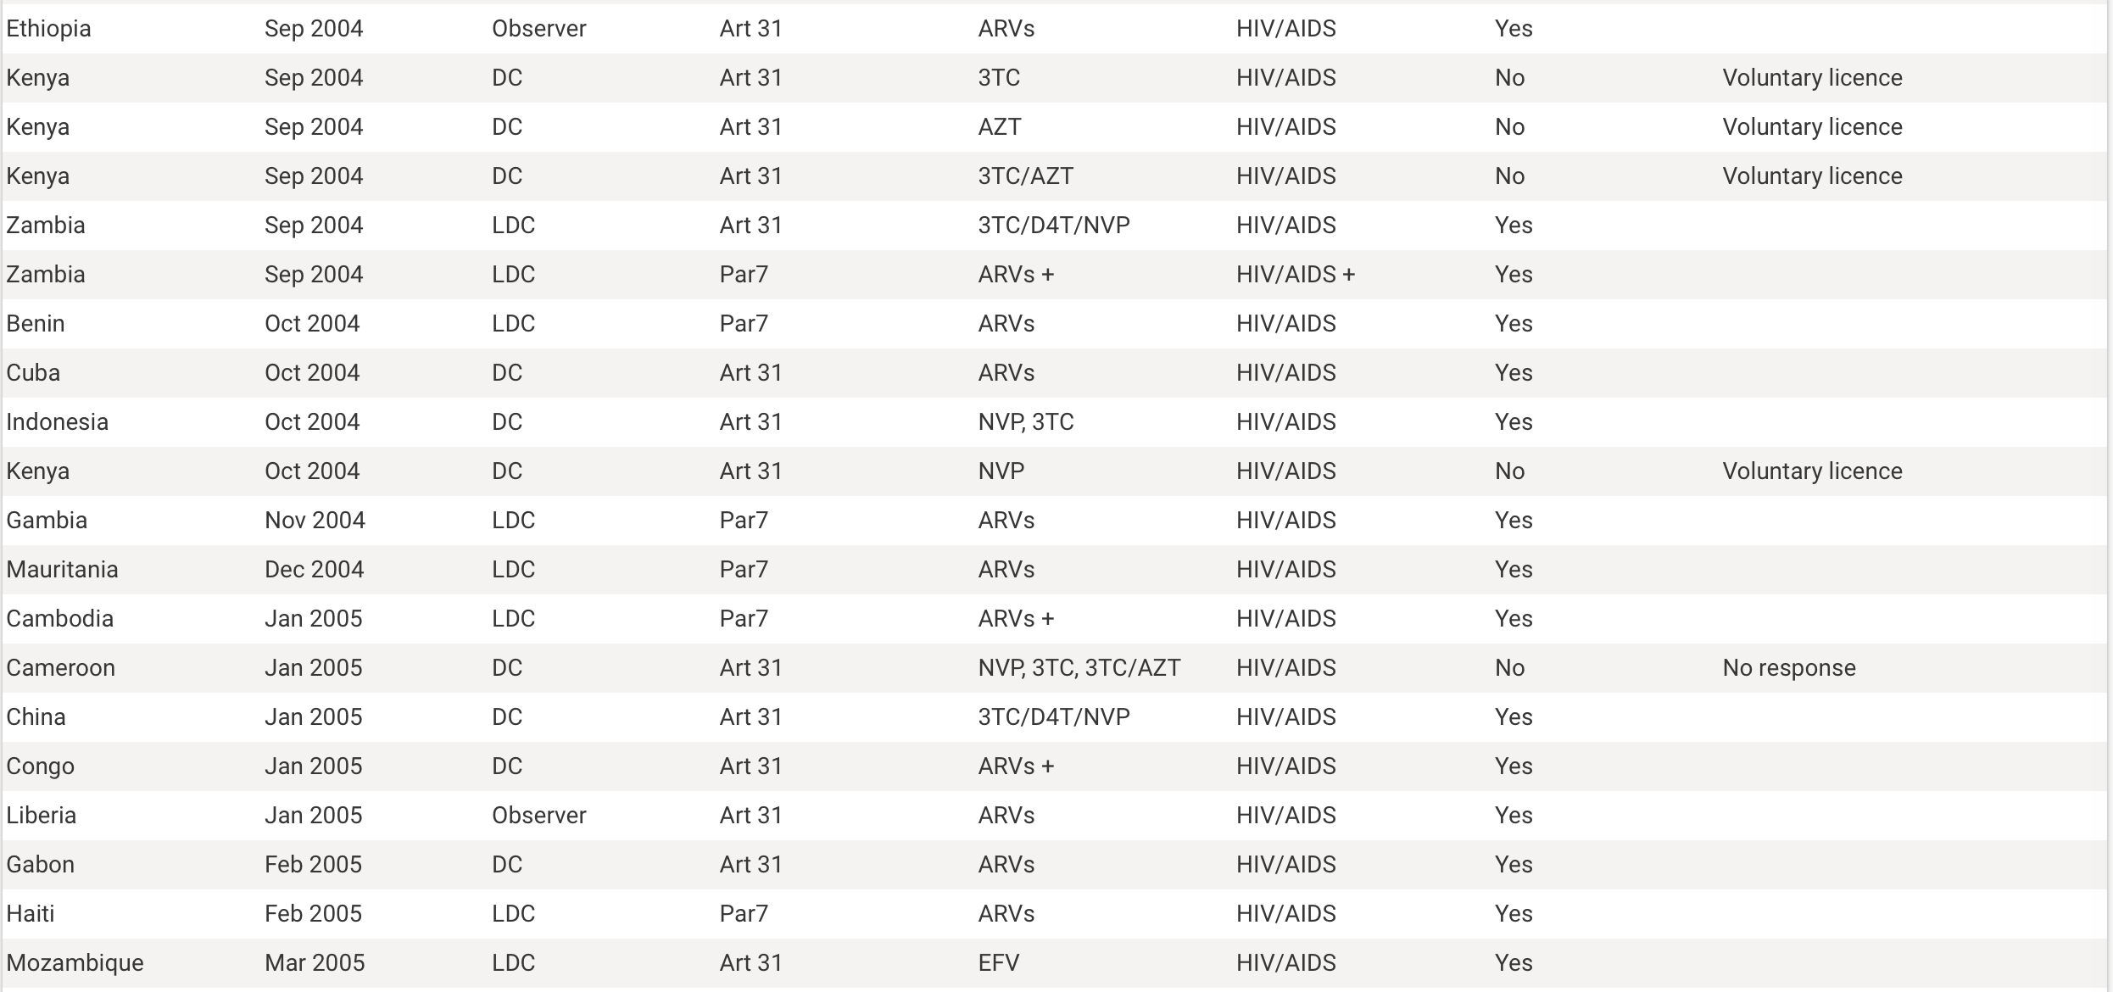

Slide 31
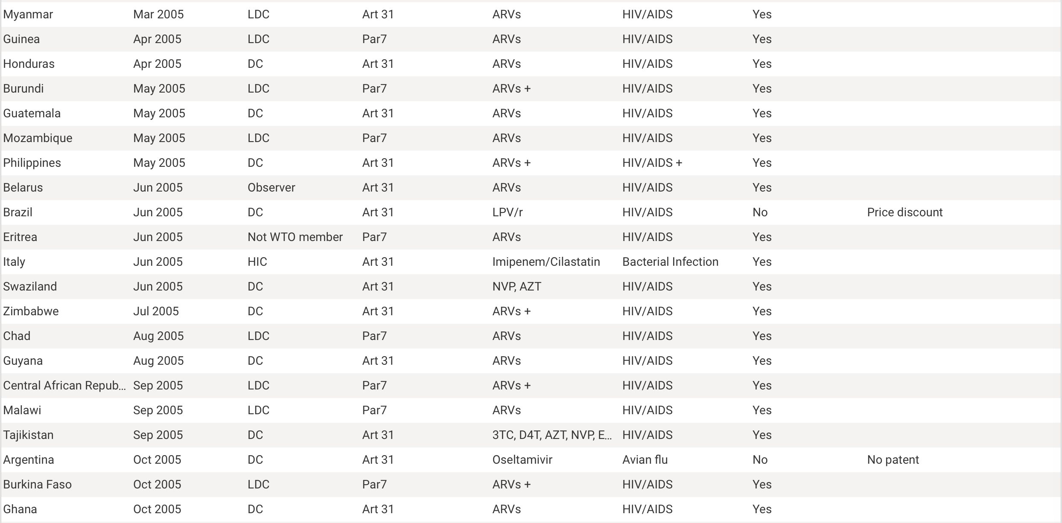

Slide 32
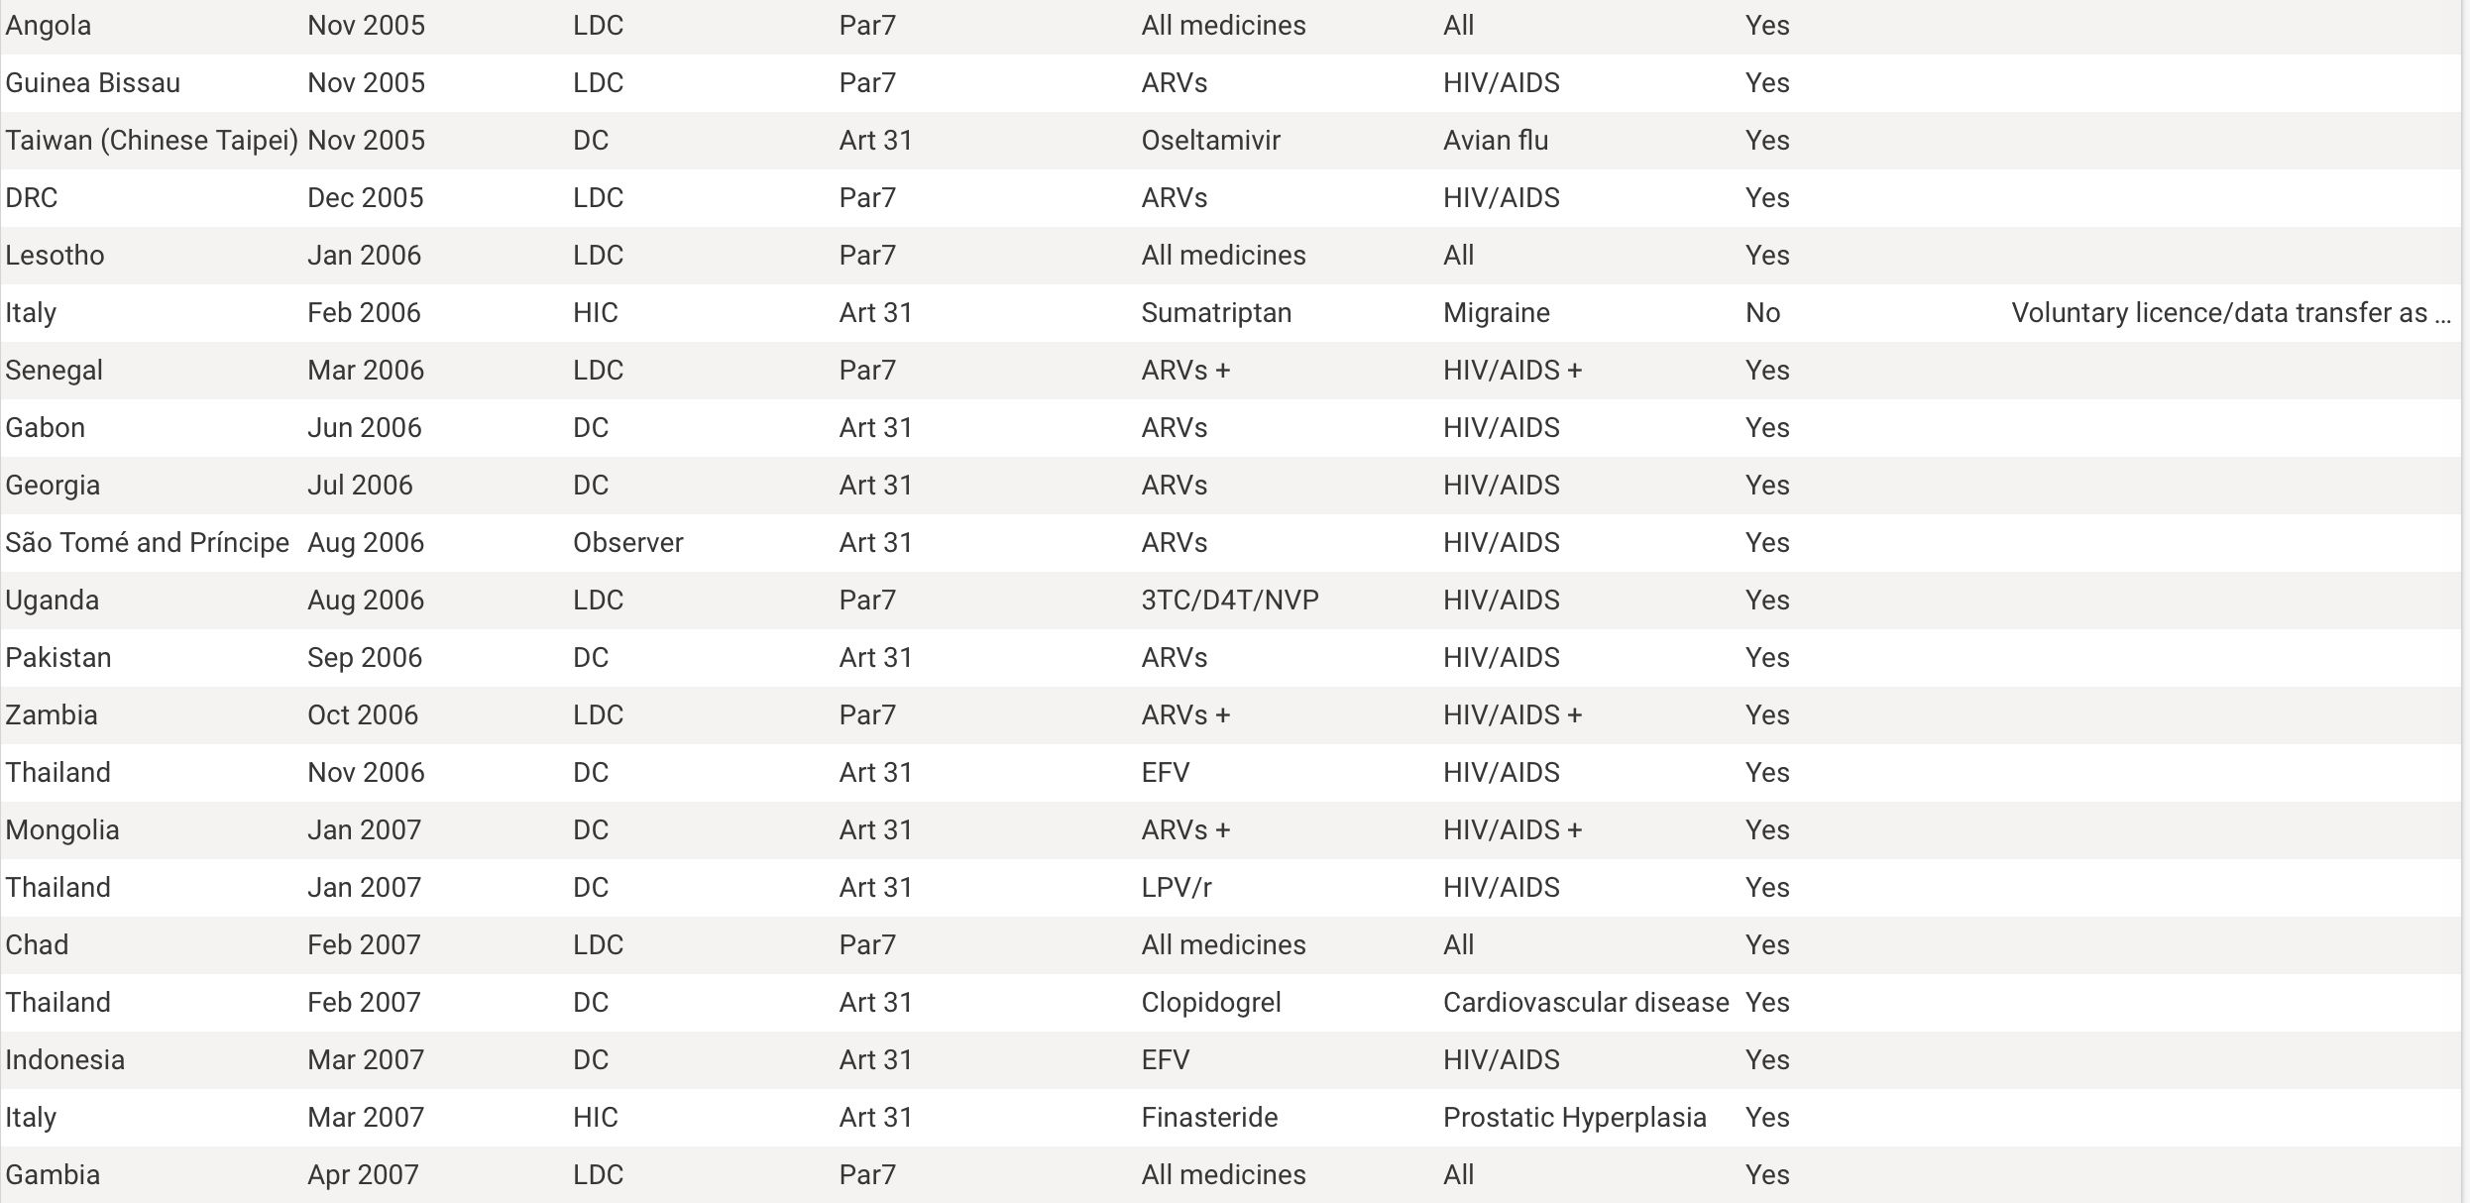

Slide 33
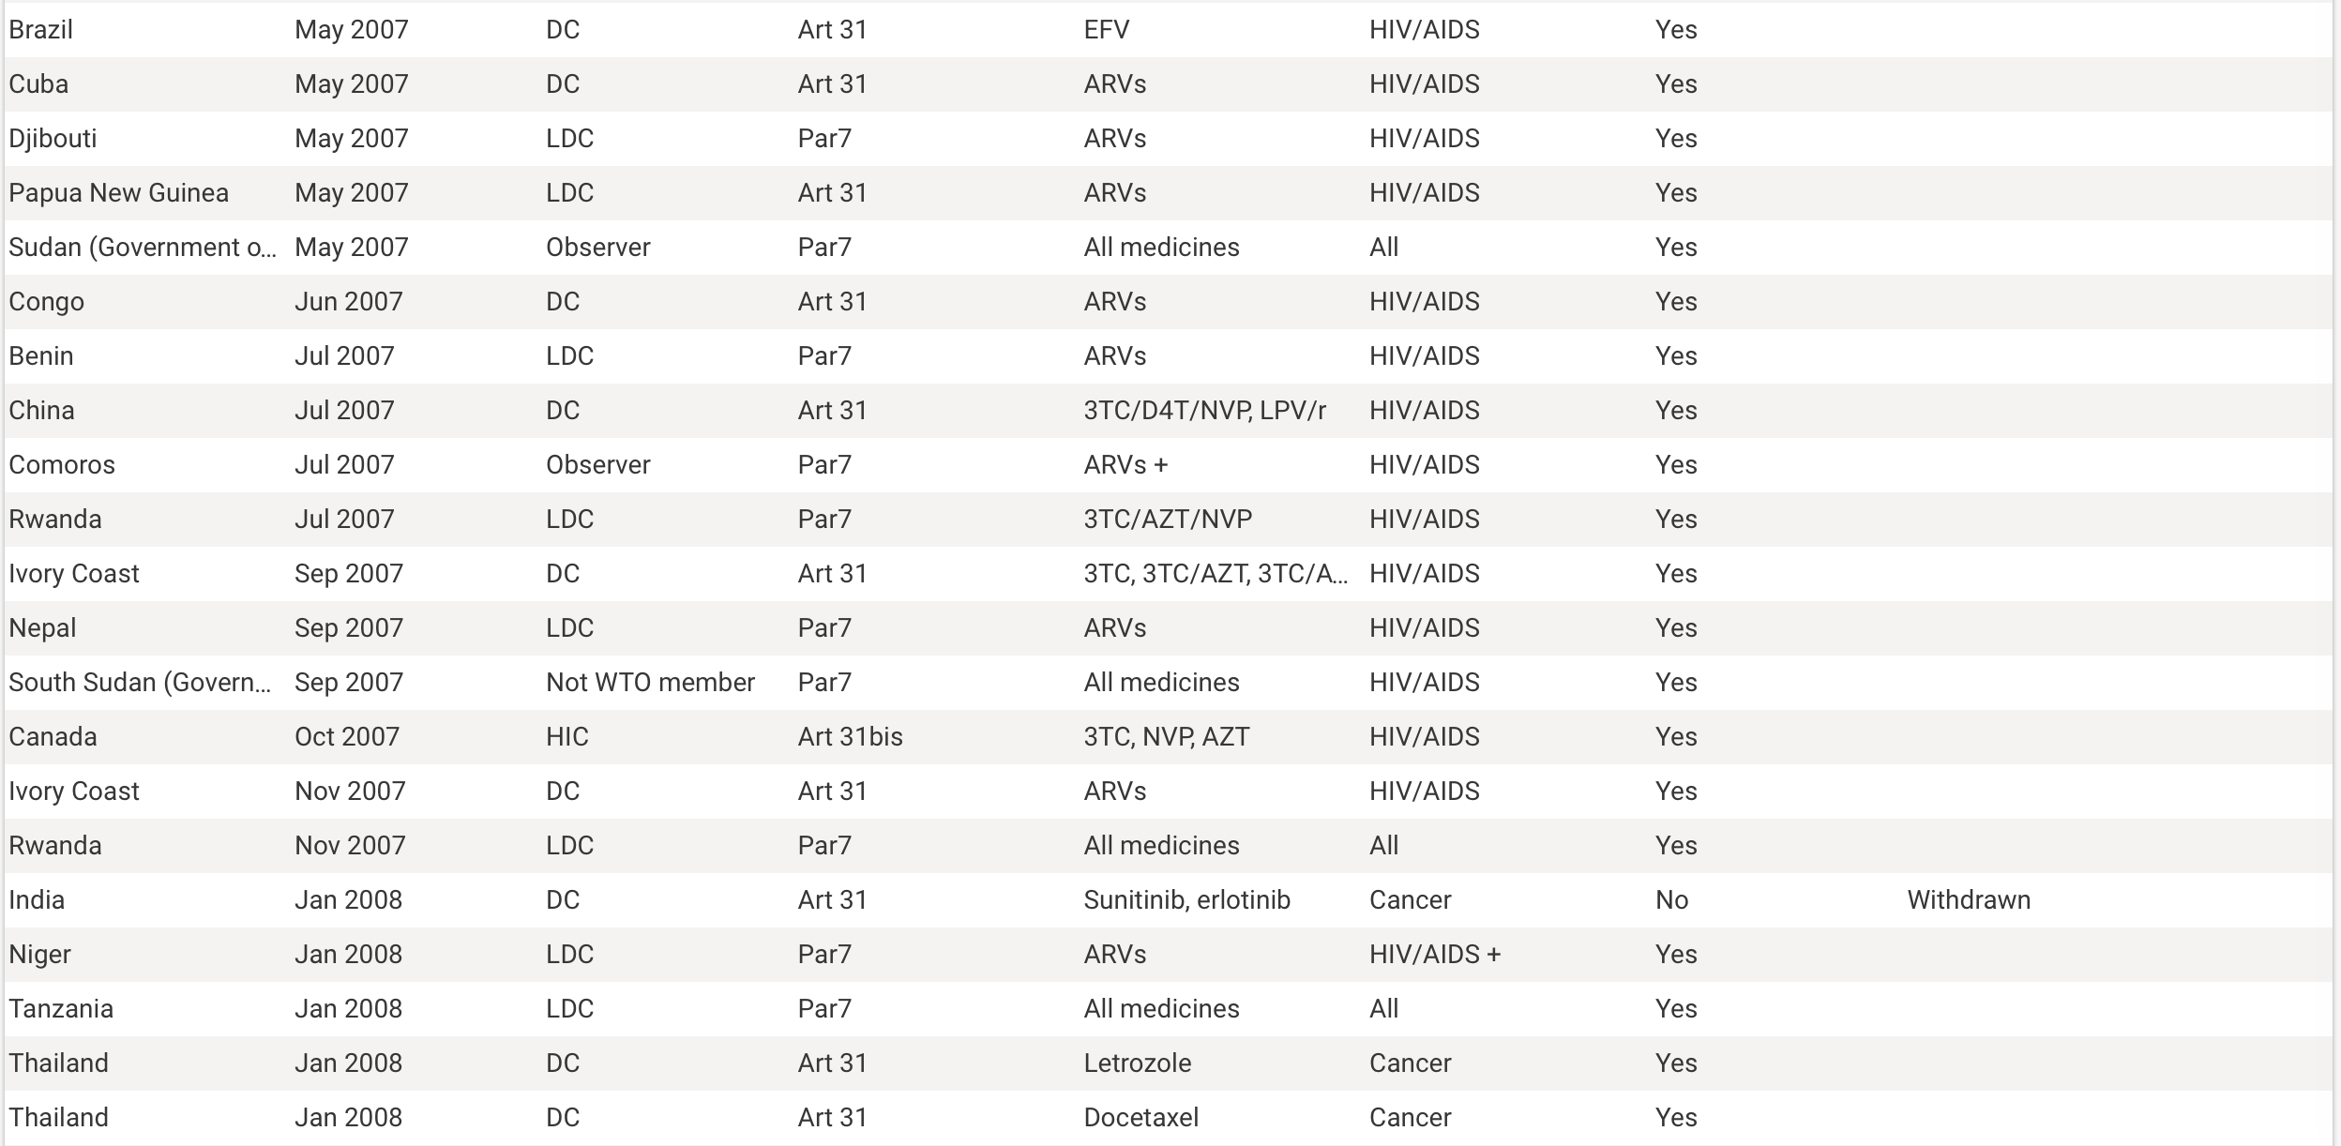

Slide 34
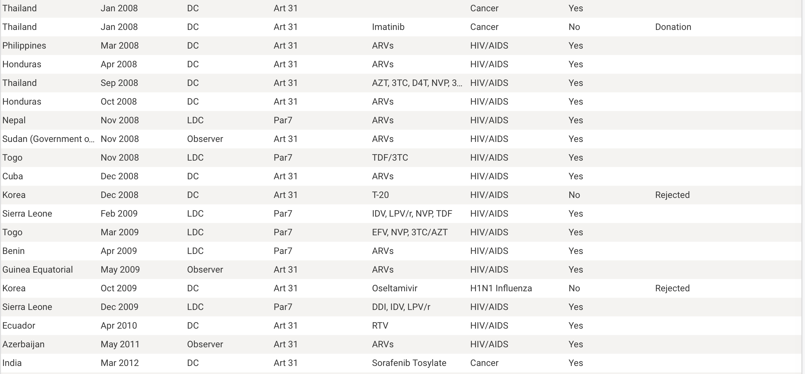

Slide 35
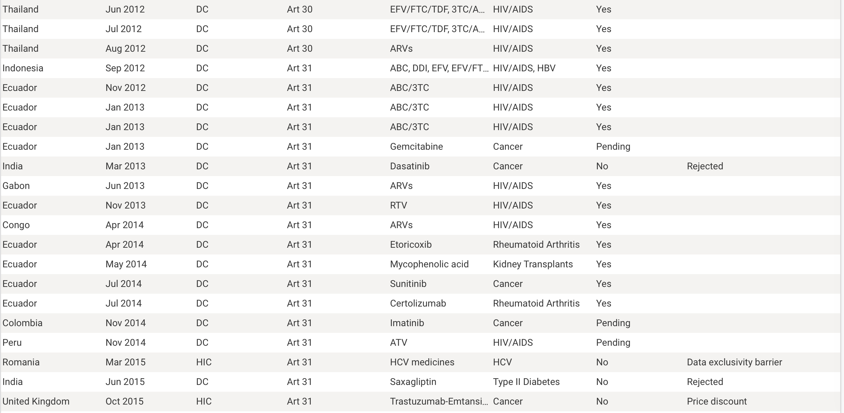

Slide 36
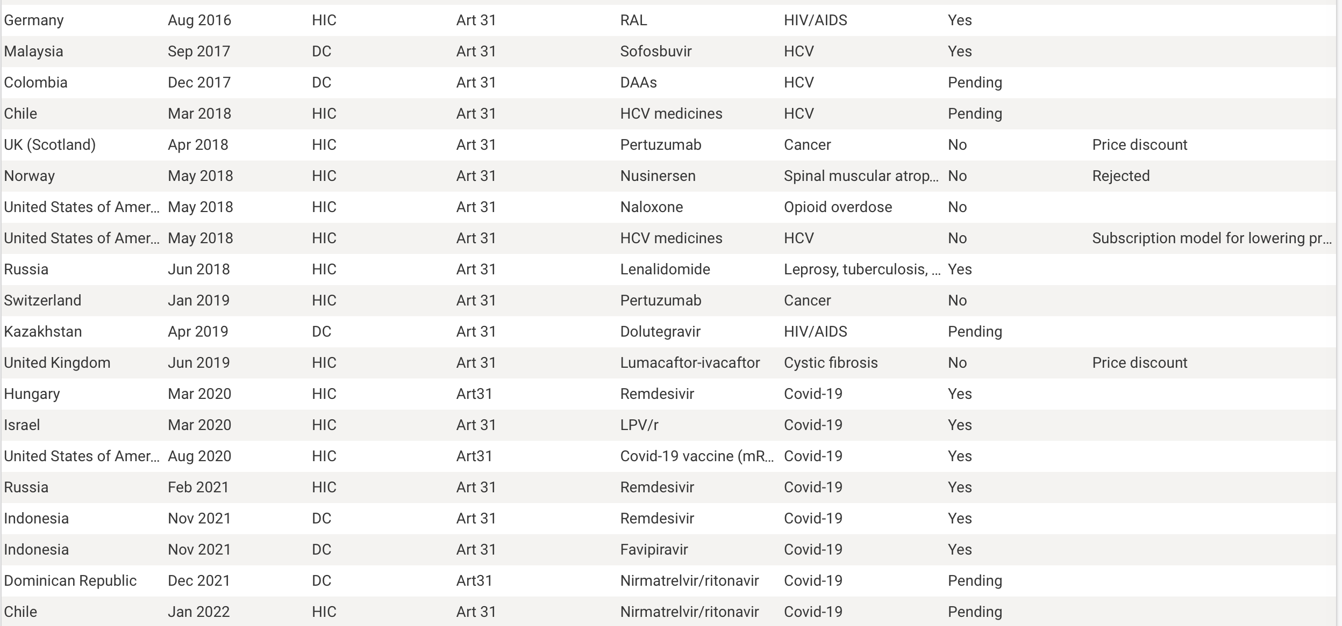

Slide 37
Source: The TRIPS Flexibilities Database, http://tripsflexibilities.medicineslawandpolicy.org (last visited March 24, 2023)

Slide 38
Usage of TRIPS Flexibilities, 2001-2022
Until 2014, the large majority of the invocations involved drugs aimed at HIV/AIDS. Since 2020, all have involved drugs aimed at COVID-19.
82% [130/158] were finally executed; 18% [28/158] were not; the remainder are still pending.
27% [46/168] were by least developed countries, invoking their exemption (confirmed by paragraph 7 of the Doha Declaration) from the relevant provisions of TRIPS.
13% [22/168] of the invocation were by high-income countries.
71% [120/168] involved compulsory licenses.
One involved Article 31bis.
The frequency of actual or threatened issuance of compulsory licenses by developing countries has been declining.

Slide 39
Compulsory Licenses (executed or threatened) 2001 to present
Source: The TRIPS Flexibilities Database, http://tripsflexibilities.medicineslawandpolicy.org (last visited March 24, 2023)

Slide 40
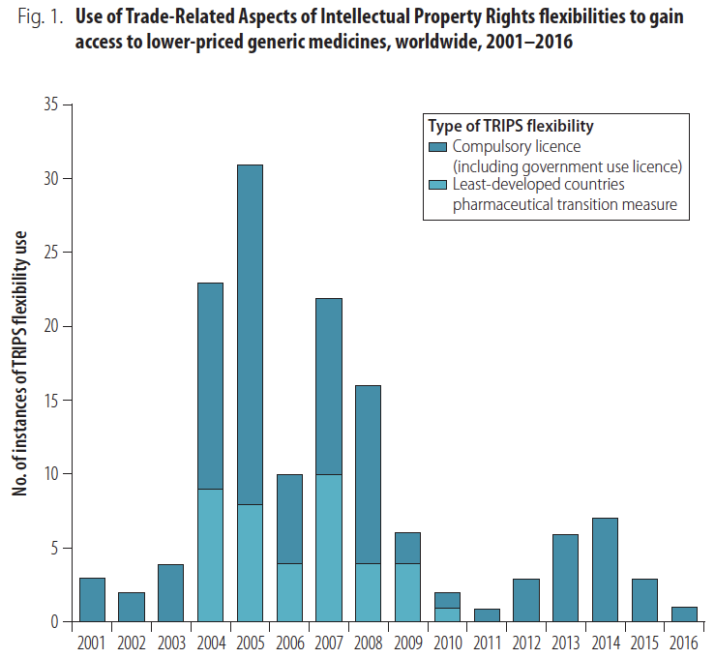
Source: Ellen ’t Hoen et al., "Medicine Procurement and the Use of Flexibilities in the Agreement on Trade-Related Aspects of Intellectual Property Rights, 2001–2016," Bulletin of the World Health Organization 96 (2018): 188

Slide 41
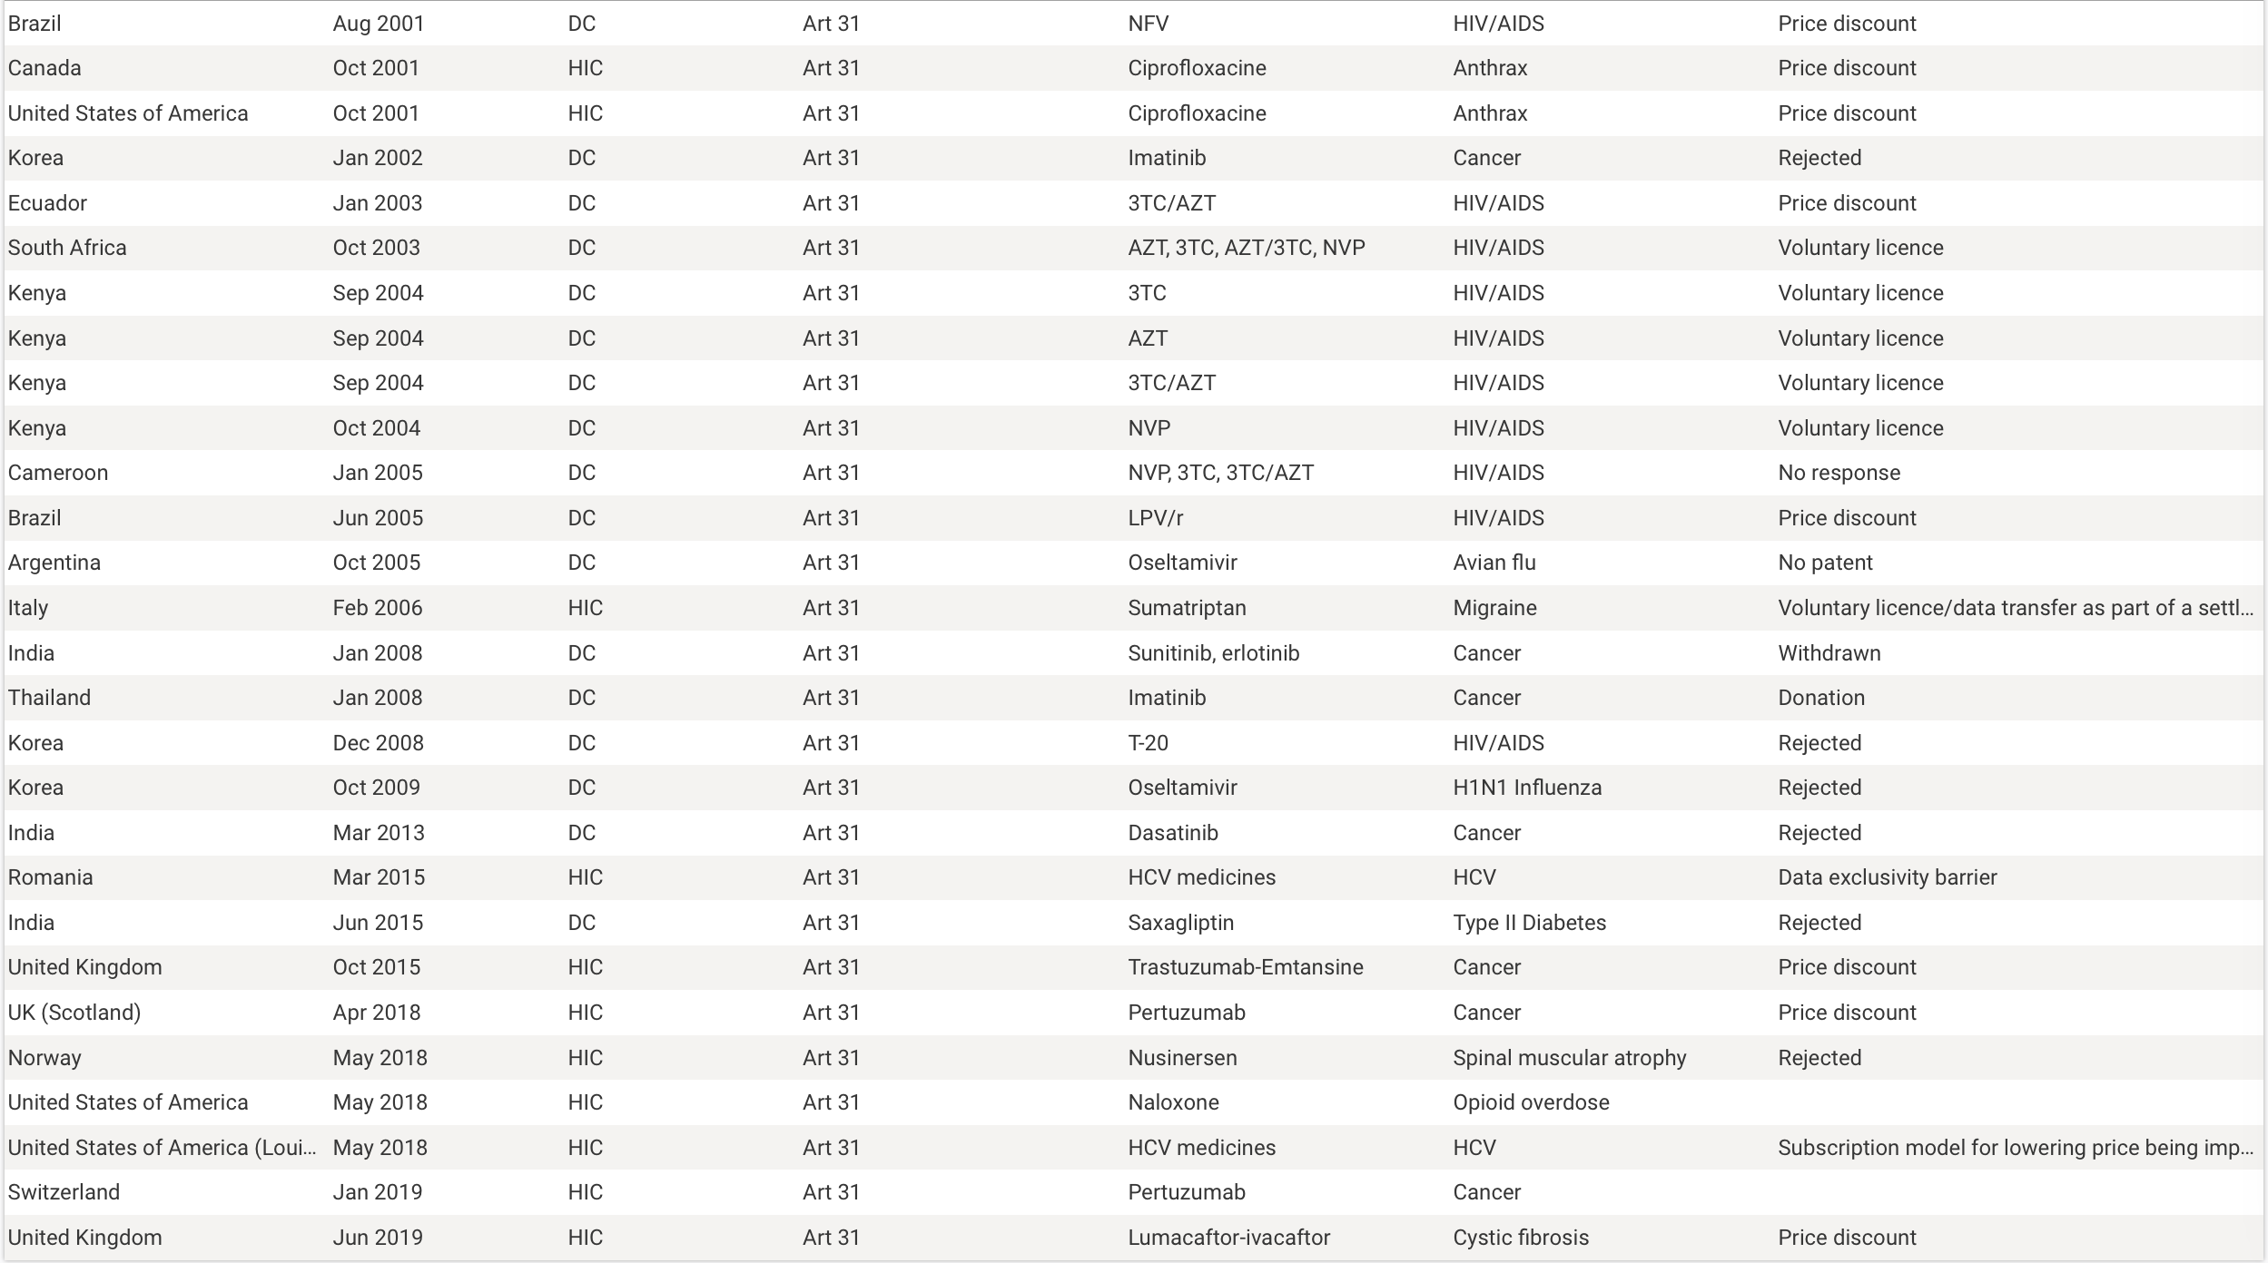

Slide 43
Constraints Imposed by Free Trade Agreements
Limits on compulsory licenses
Rejection of international exhaustion
Mandatory duration of patents
Mandatory data-exclusivity protections
Peru – European Free Trade Association, Article 6.11(2)
Where a Party requires, as a condition for marketing approval of pharmaceutical products or agricultural chemical products which utilise new chemical entities3, the submission of undisclosed test data related to safety and efficacy the origination of which involves a considerable effort, the Party shall not allow the marketing of a product which contains the same new chemical entity, based on the information provided by the first applicant without his consent, for a reasonable period, which, in the case of pharmaceutical products, means normally five years and, in the case of agricultural chemical products, ten years from the date of the marketing approval in the territory of the Party. Subject to this provision, there shall be no limitation on any Party to implement abbreviated approval procedures for such products on the basis of bioequivalence or bioavailability studies.

Slide 44
Empirical studies of the impact of compulsory licenses
Eduardo Urias and Shyama V. Ramani, "Access to Medicines after Trips: Is Compulsory Licensing an Effective Mechanism to Lower Drug Prices? A Review of the Existing Evidence," Journal of International Business Policy 3 (2020);
Frederick Abbott et al., "Using Competition Law to Promote Access to Health Technologies: A Guidebook for Low- and Middle-Income Countries," (UNDP, 2014), 153-54;
Francisco Viegas Neves da Silva, Ronaldo Hallal, and Andre Guimaraes, "Compulsory License and Access to Medicines: Economics Savings of Efavirenz in Brazil," in International AIDS Conference (Washington, D.C.2012);
Martin Khor, Compulsory License and “Government Use” to Promote Access to Medicines: Some Examples (Third World Network, 2014)

Slide 45
Apparatus for Administration of Compulsory Licenses
(a) a statement of the circumstances under which a compulsory license may be ordered that makes clear the legitimacy of using this device to ensure residents’ access to crucial medicines;
(b) identification of the governmental entity (ideally, an administrative agency rather than a court) that has the authority to impose such a license;
(c) a clear set of procedures for requesting, considering, and issuing such licenses;
(d) guidelines for the calculation of the associated (modest) license fees; and
(e) an appellate procedure that enables a patentee to challenge or amend a compulsory license, invocation of which does not suspend the operation of the license.

Slide 46
Evolution of the Inventive Step Requirement
(not to scale)
1984
1993
China
2001
Stringency of the Standard
2006
Cuno
(1941)
CAFC
Hotchkiss
(1851)
§103
Graham
(1966)
AIA(2013)
KSR
(2007)
Thomson
(1889)
1932 statute
USA
England
“nontriviality”
1700
1800
1850
1900
1925
1950
1975
2000
2025

Slide 47
Part B: Developed Countries

Slide 48
years
0
4
8
12
16
20
24
28
32
Discovery &
preclinical
Clinical
development
FDA
review
Patent protection
§156
Generic Drug Distribution
Generic Drug Development
FDA review
4
8
12
16
20
Adapted from Choi et al,
“Medicines for the Mind,”
84 Neuron 554 (2014)
Commercial life
FDA
approval

Slide 49
years
0
4
8
12
16
20
24
28
32
Discovery &
preclinical
Clinical
development
FDA
review
Patent protection
Generic Drug Distribution
Generic Drug Development
FDA review
4
8
12
16
20
Adapted from Choi et al,
“Medicines for the Mind,”
84 Neuron 554 (2014)
Commercial life
FDA
approval

Slide 50
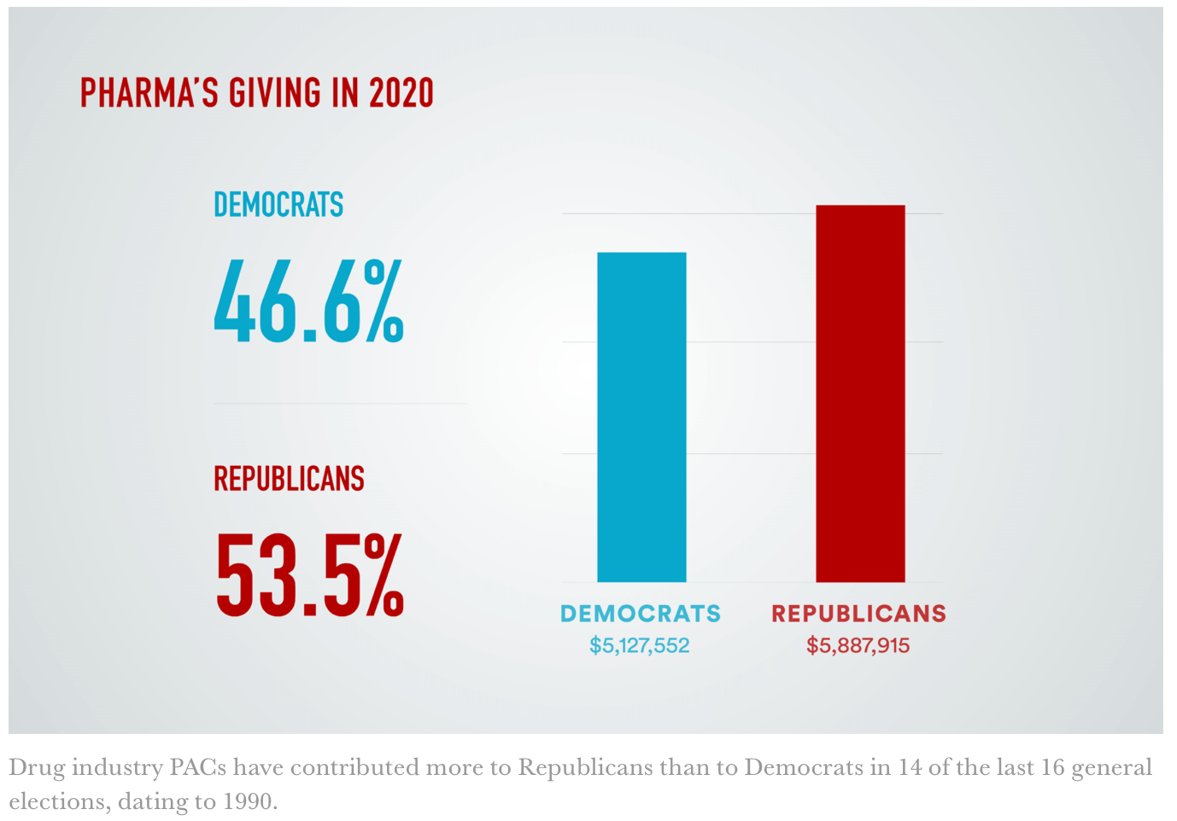
Source: Bartley & Facher, “Pharma is Showering Congress with Cash,” STAT, August 10, 2020

Slide 51
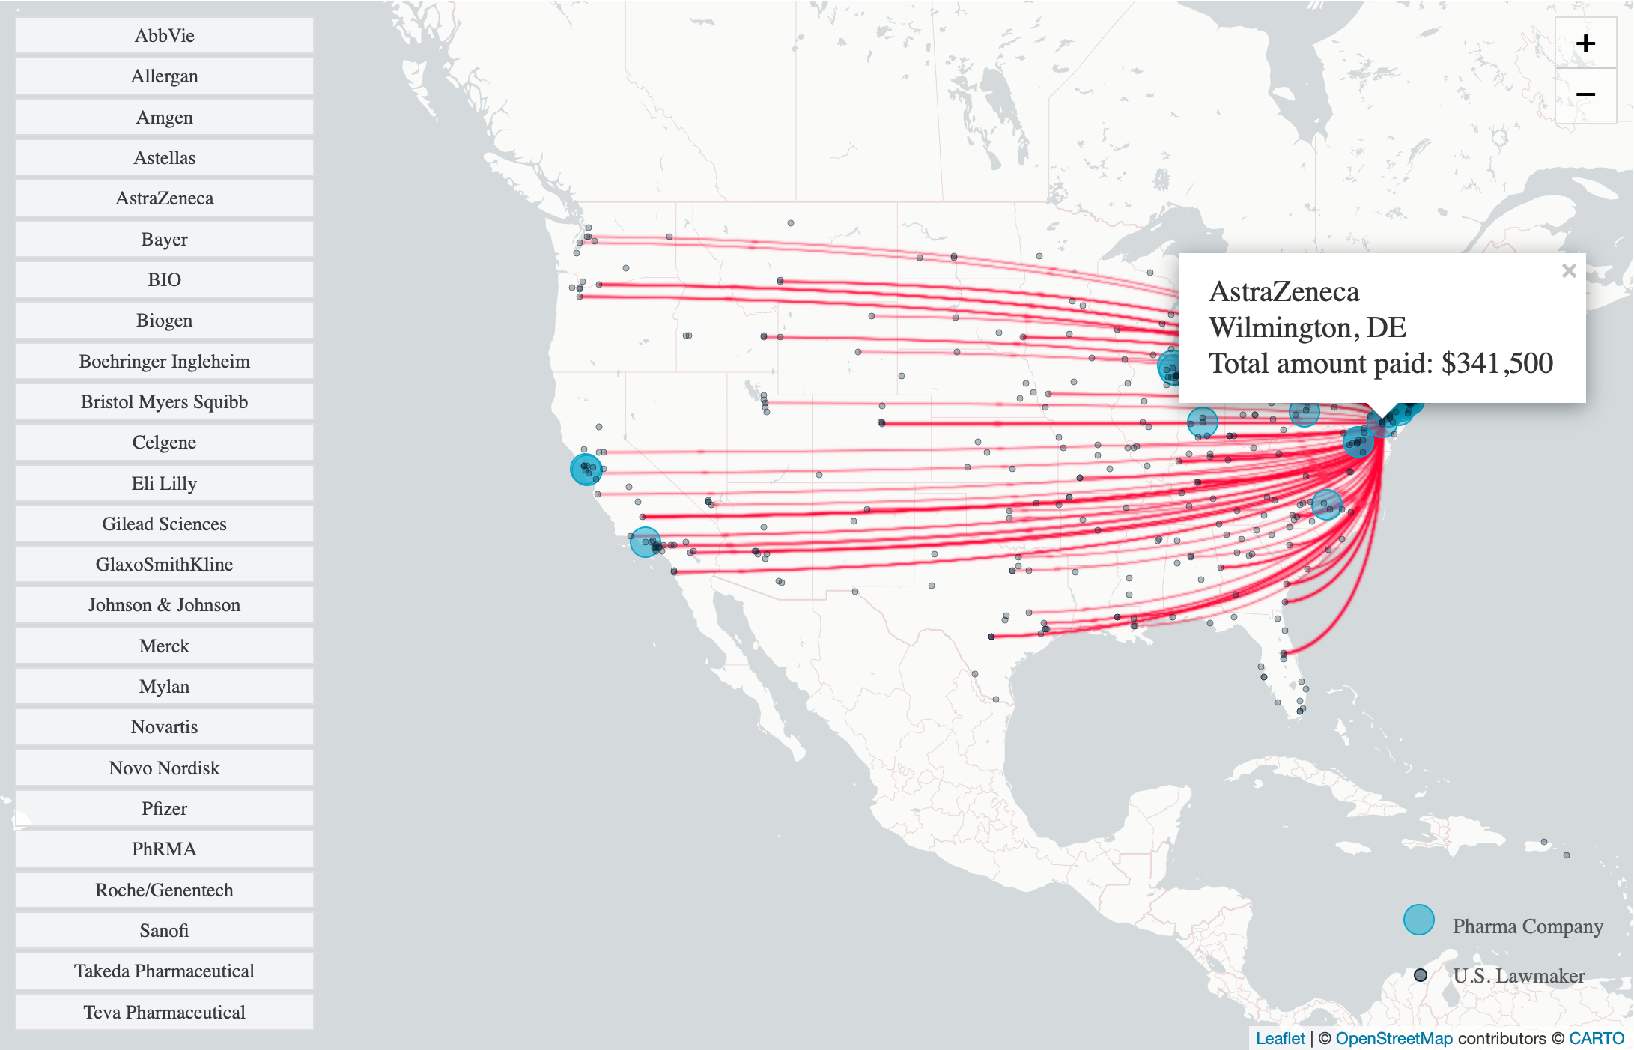
Source: Bartley & Facher, “Pharma is Showering Congress with Cash,” STAT, August 10, 2020

Slide 52
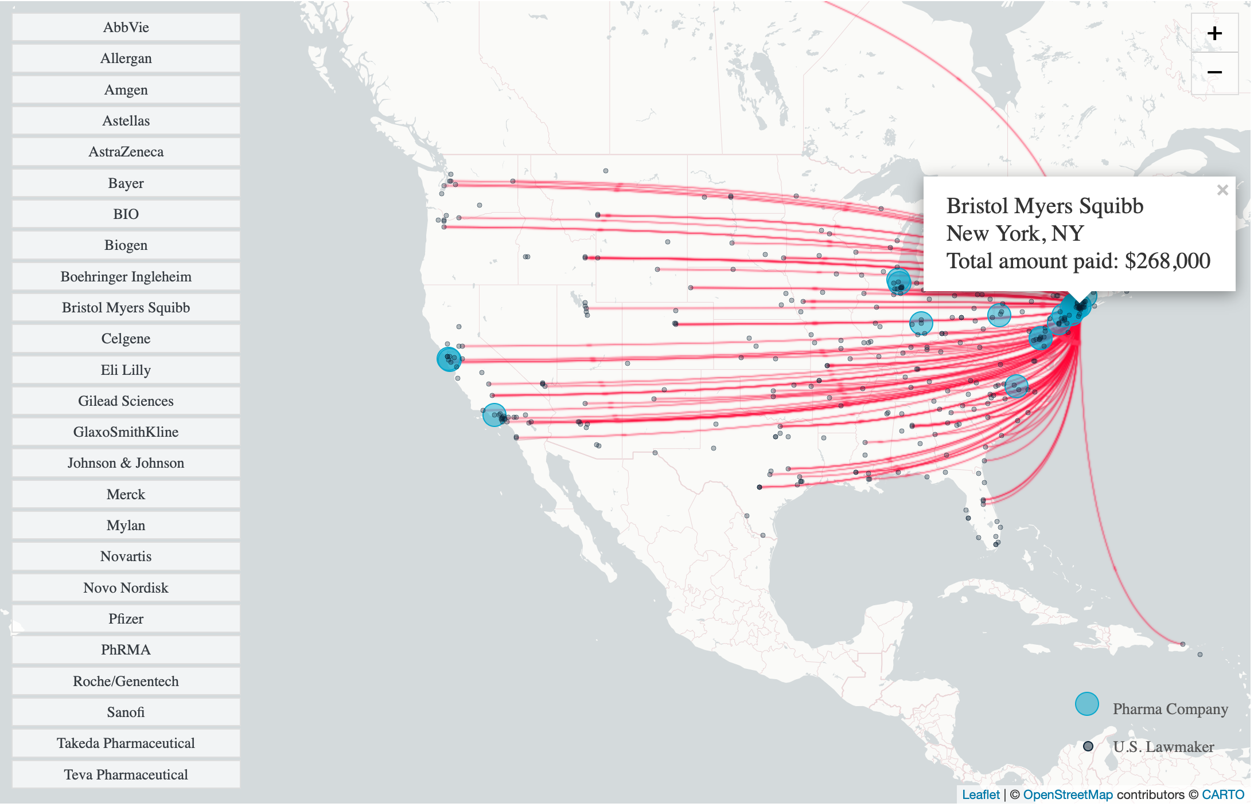
Source: Bartley & Facher, “Pharma is Showering Congress with Cash,” STAT, August 10, 2020

Slide 53
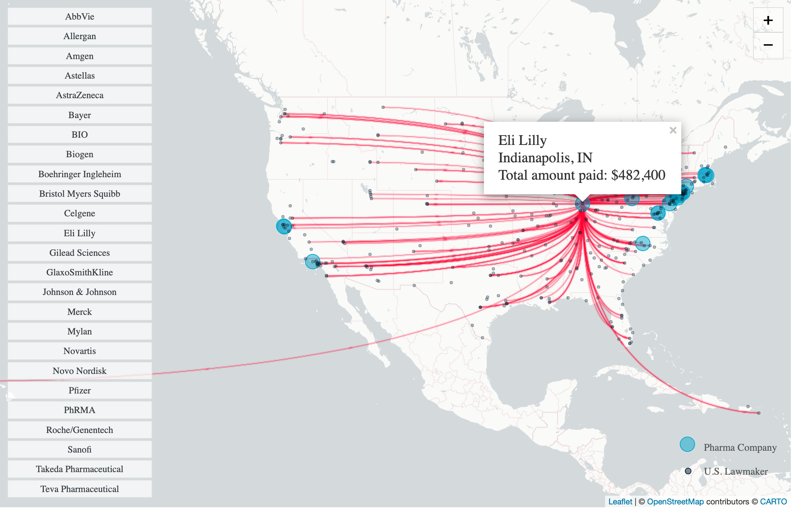
Source: Bartley & Facher, “Pharma is Showering Congress with Cash,” STAT, August 10, 2020

Slide 54
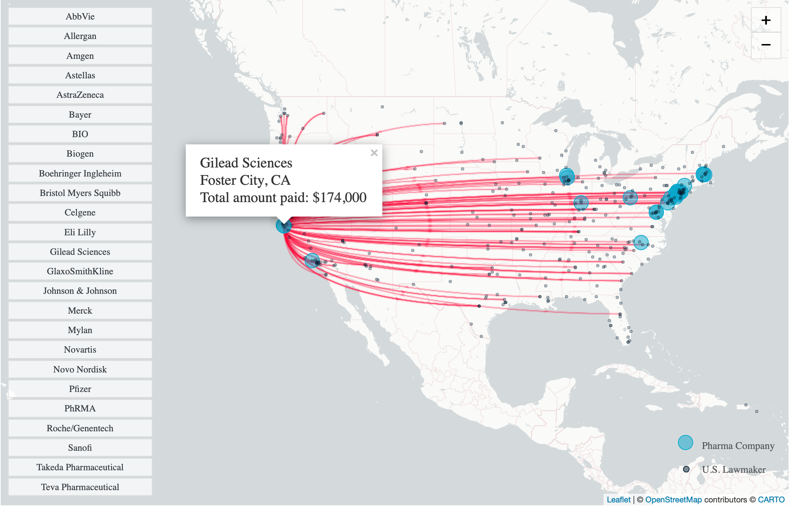
Source: Bartley & Facher, “Pharma is Showering Congress with Cash,” STAT, August 10, 2020

Slide 55
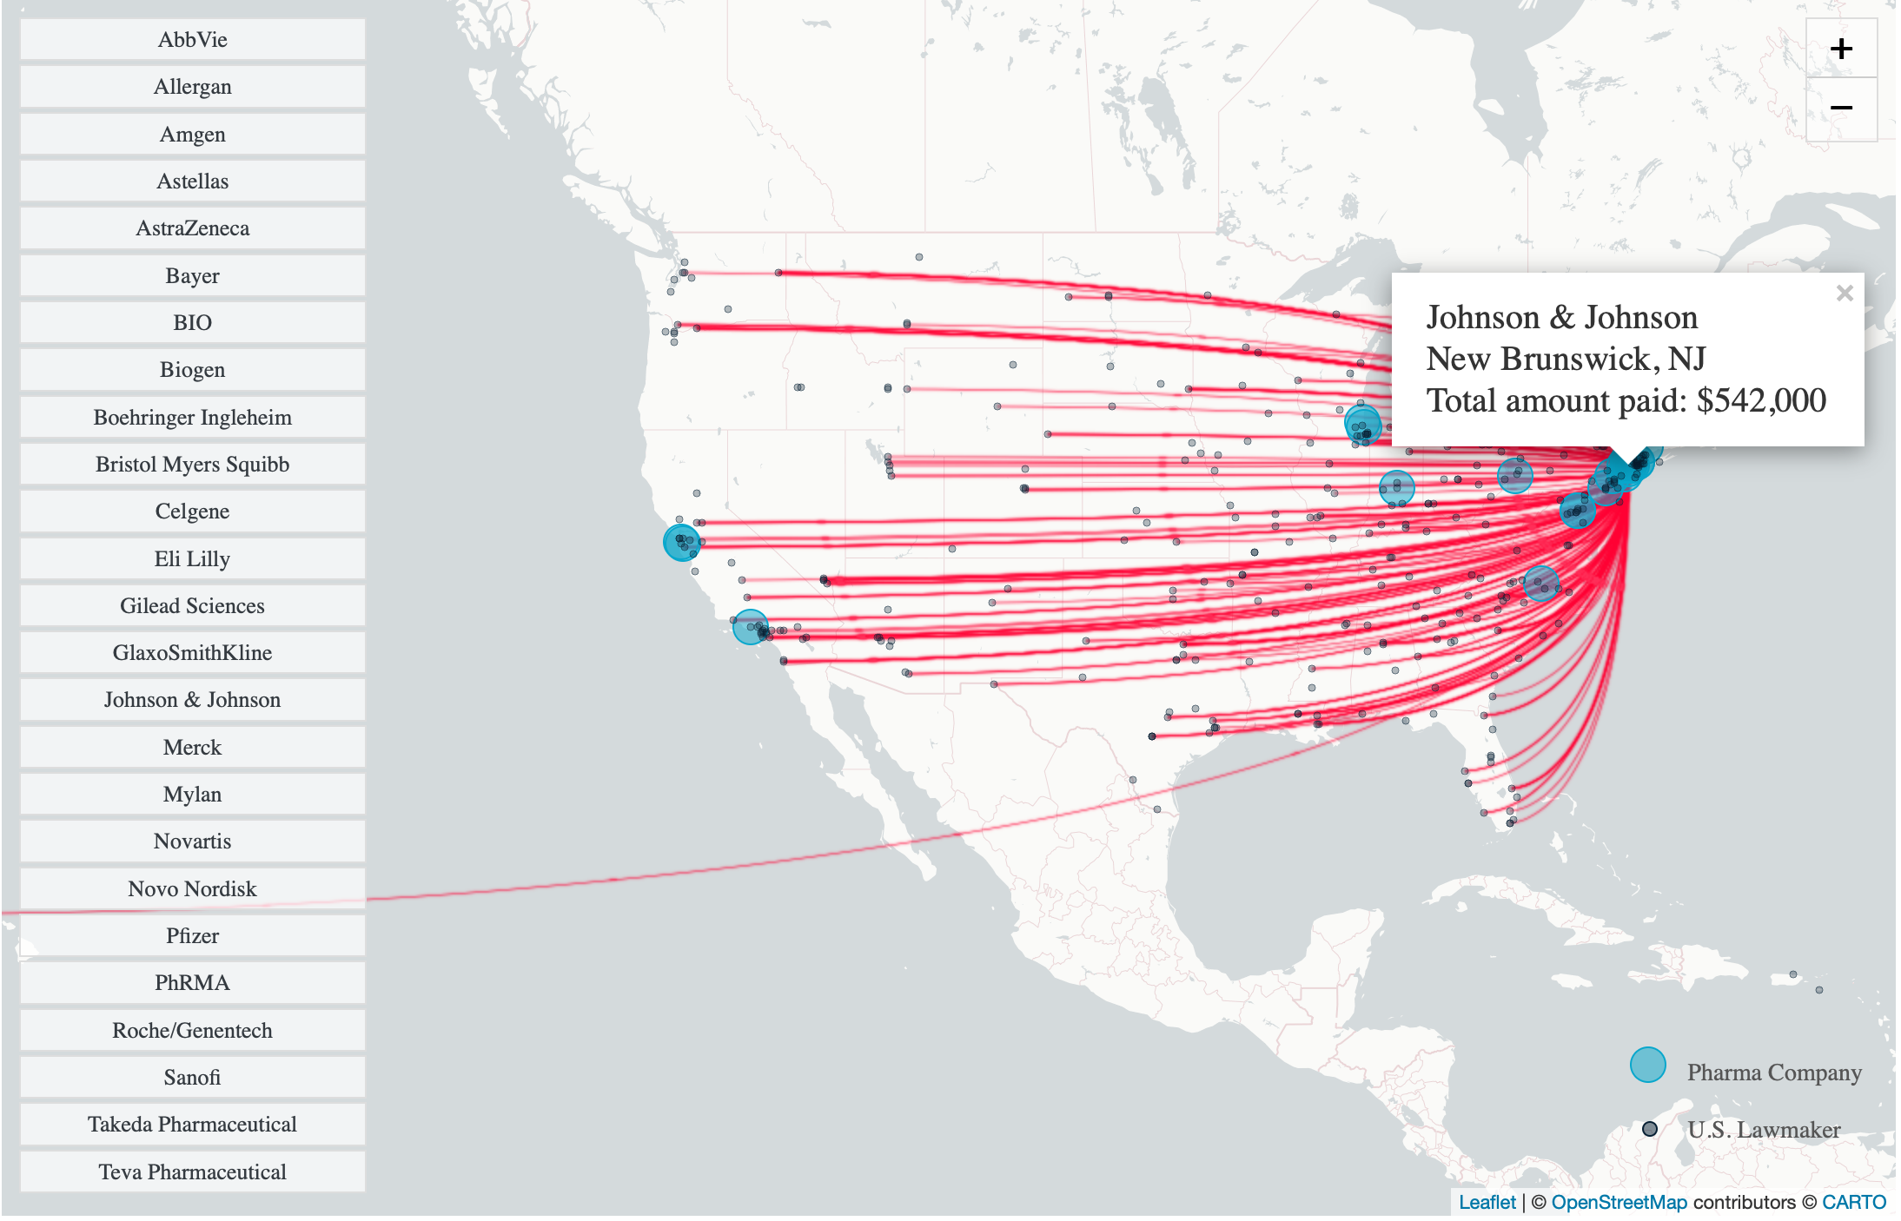
Source: Bartley & Facher, “Pharma is Showering Congress with Cash,” STAT, August 10, 2020

Slide 56
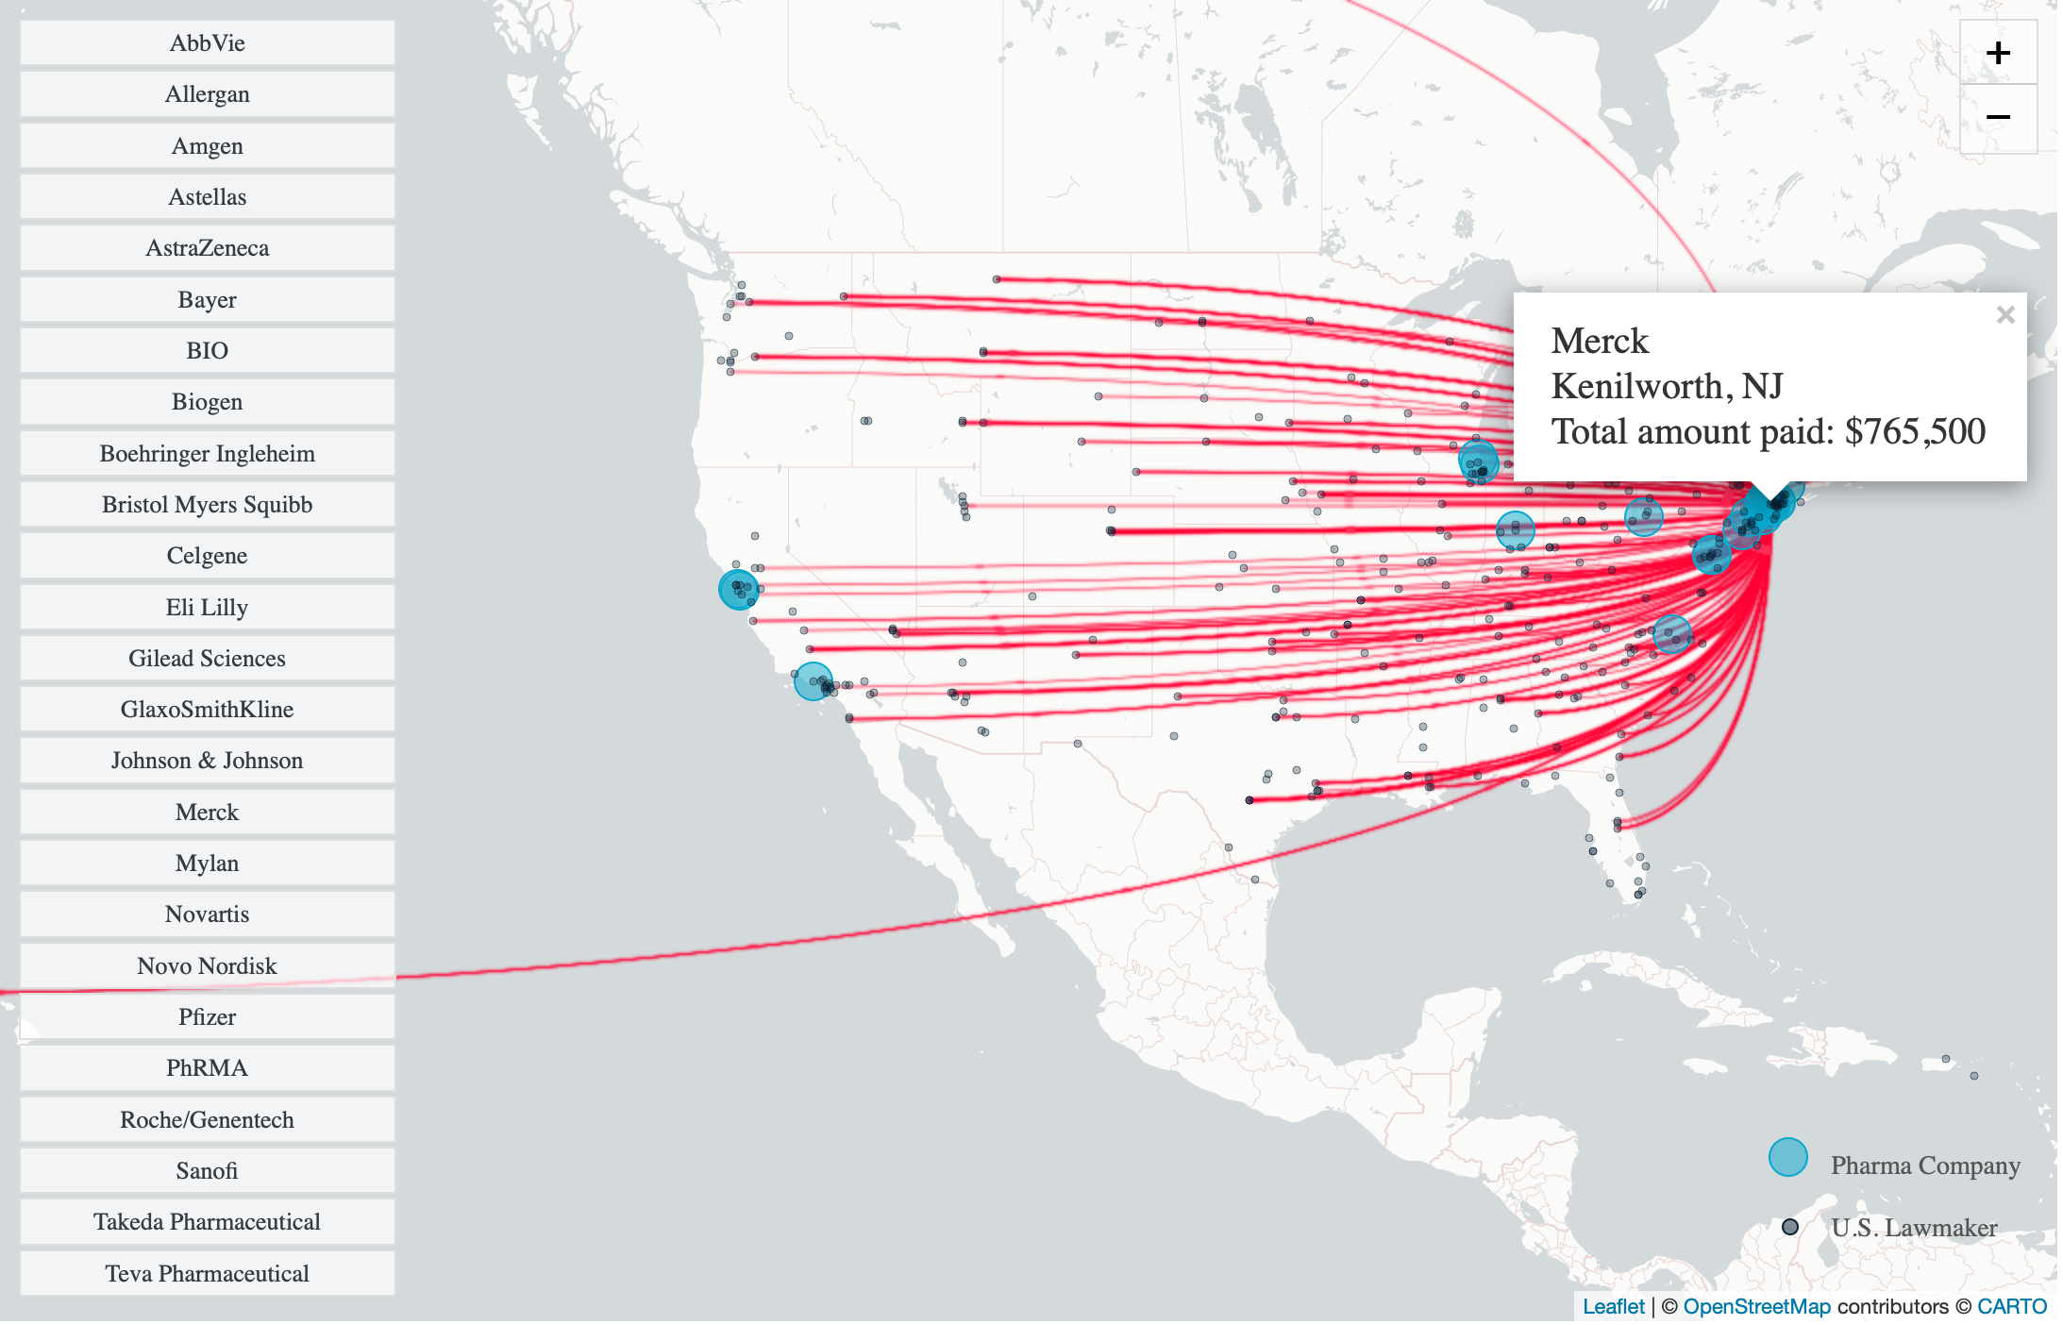
Source: Bartley & Facher, “Pharma is Showering Congress with Cash,” STAT, August 10, 2020

Slide 57
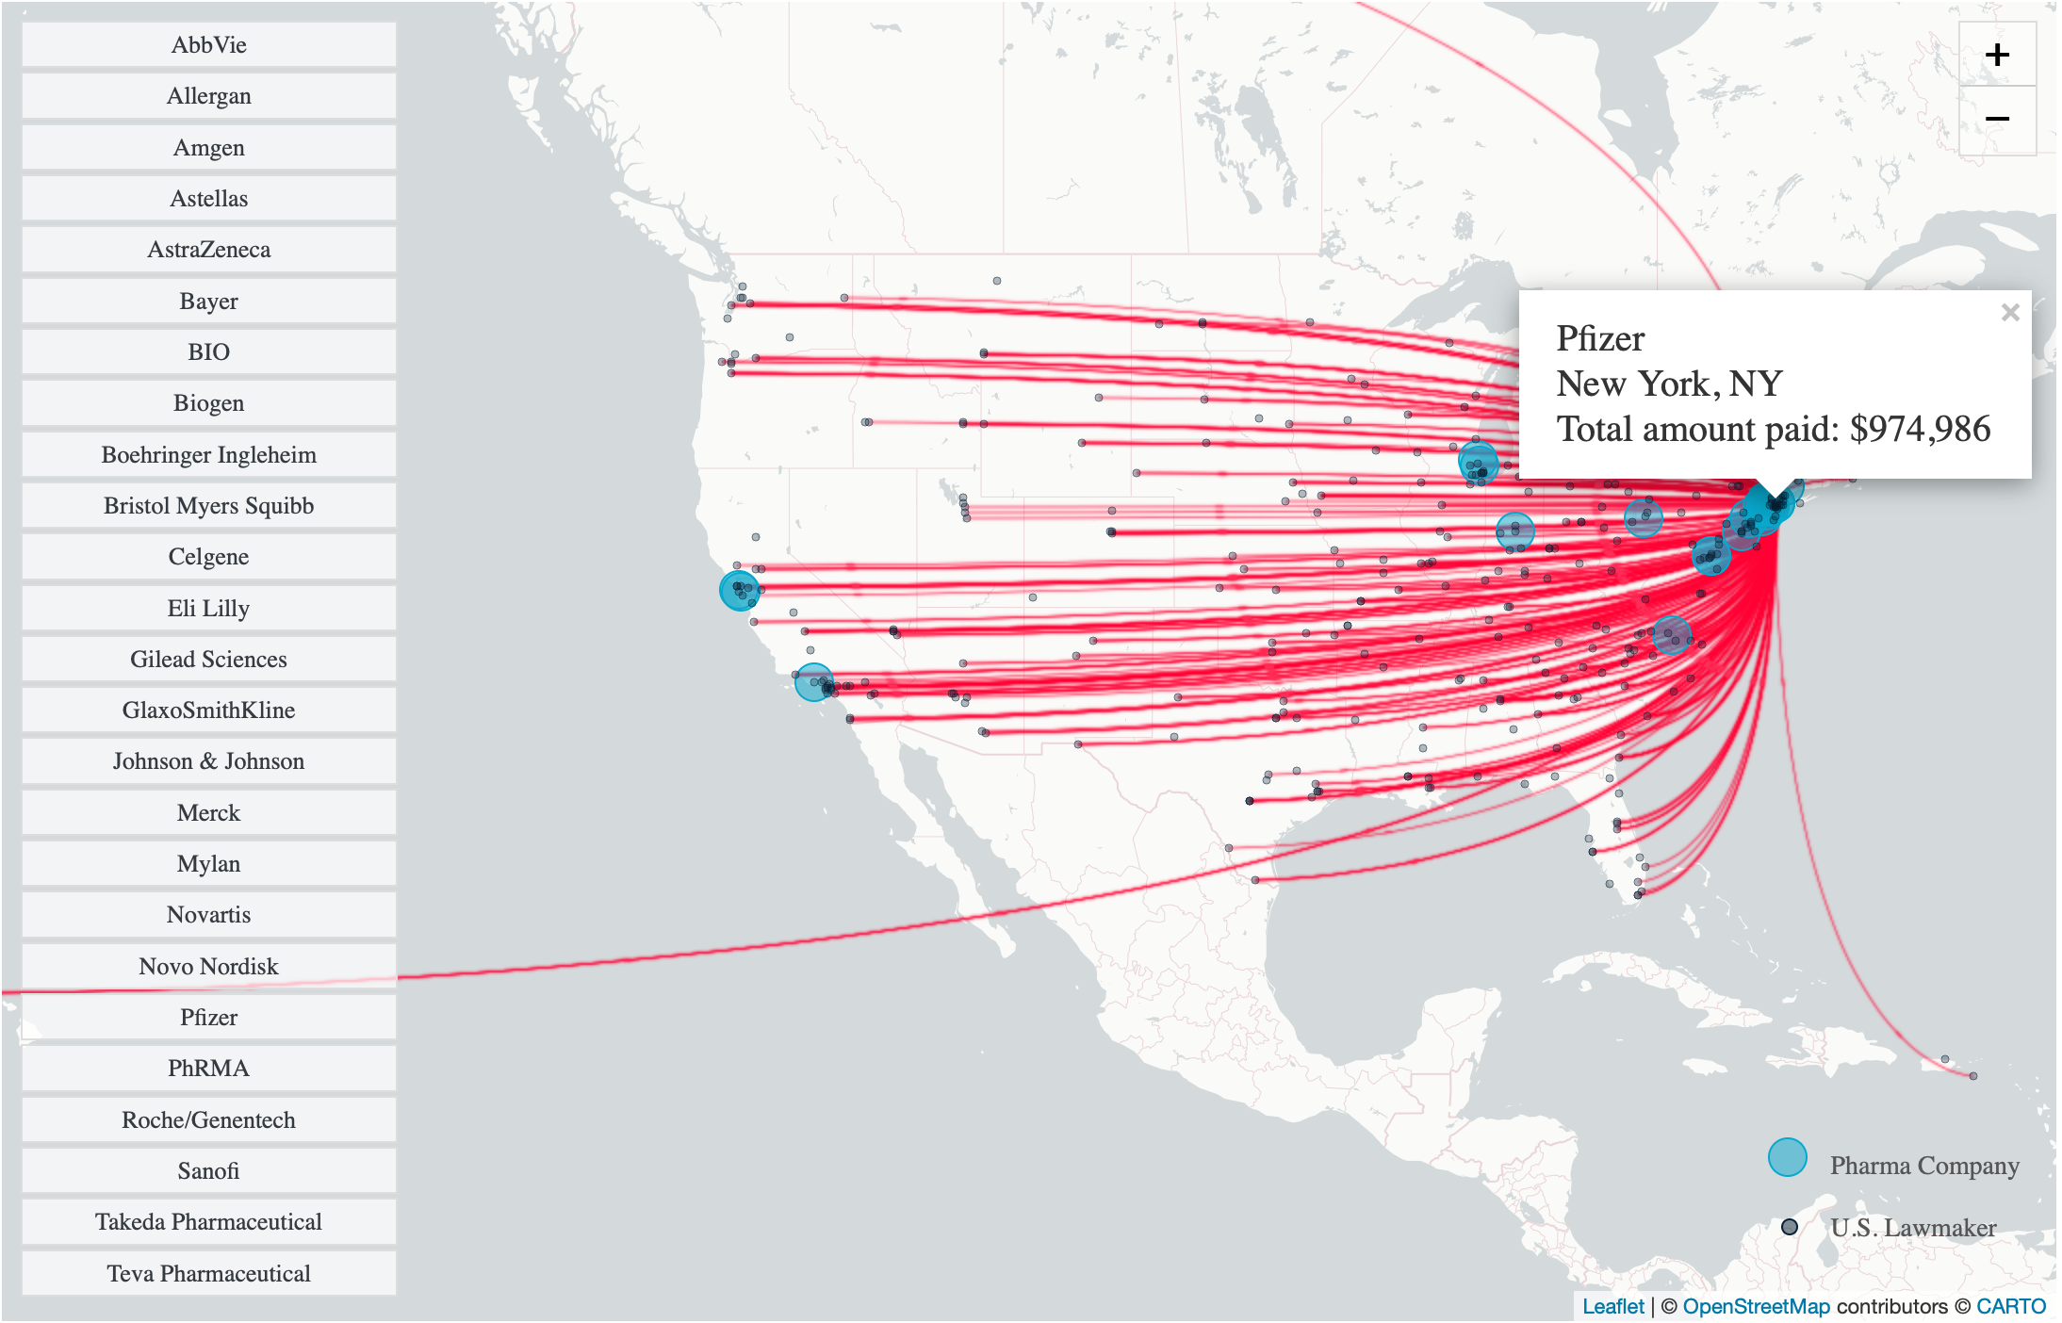
Source: Bartley & Facher, “Pharma is Showering Congress with Cash,” STAT, August 10, 2020

Slide 58
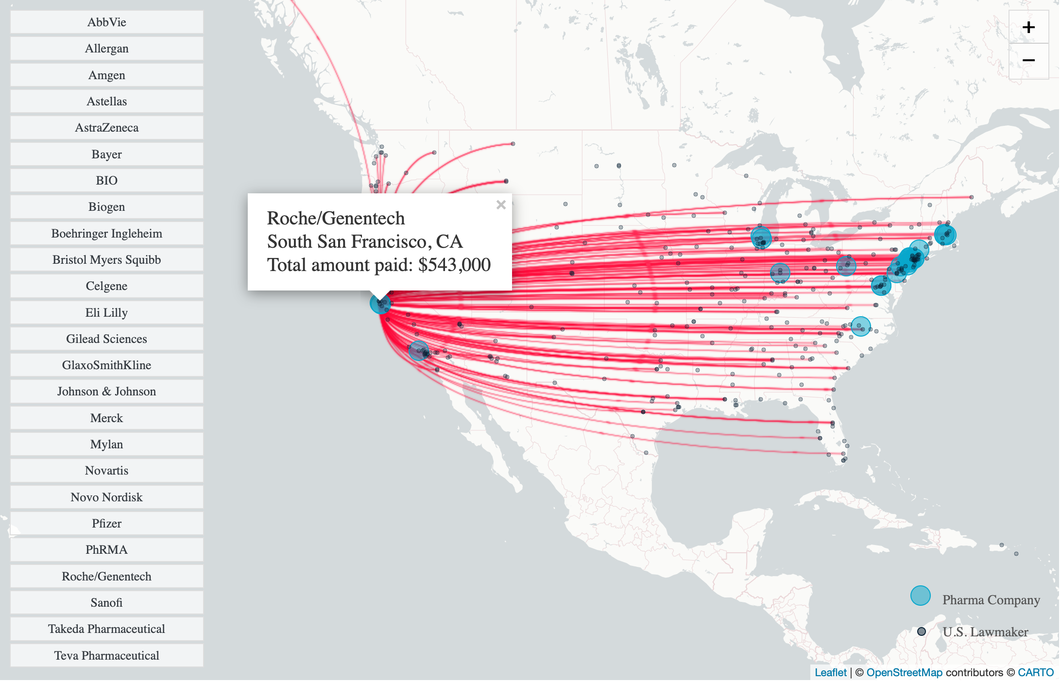
Source: Bartley & Facher, “Pharma is Showering Congress with Cash,” STAT, August 10, 2020

Slide 59
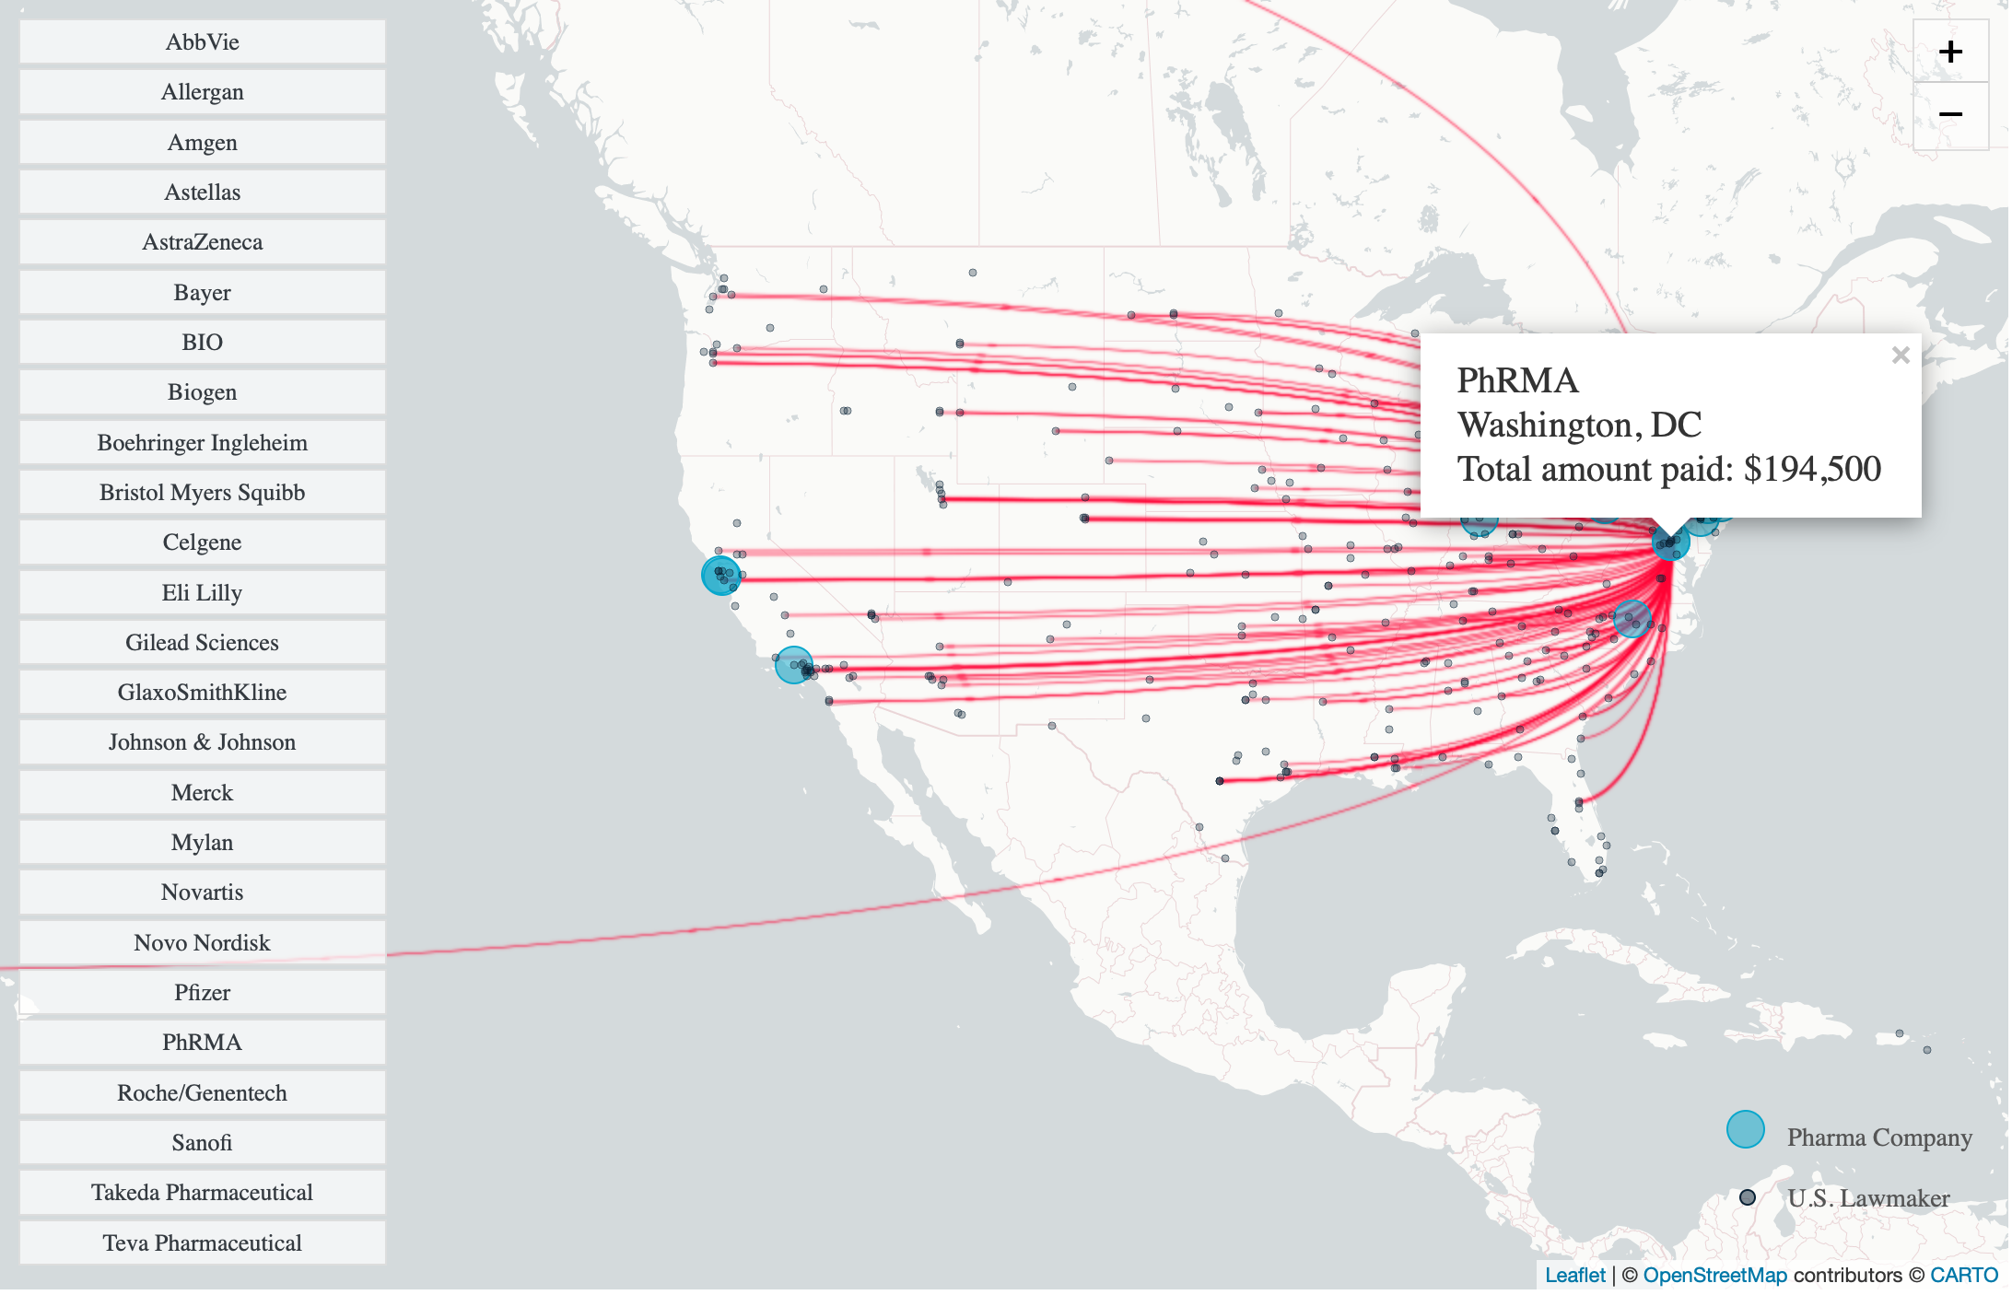
Source: Bartley & Facher, “Pharma is Showering Congress with Cash,” STAT, August 10, 2020

Slide 60
Tools:
Duration (of patents or data exclusivity)
Claim construction
Equivalents
Increased availability of injunctive relief
Breakthrough Drugs
Drugs aimed at Neglected Infectious Diseases
Vaccines

Slide 61
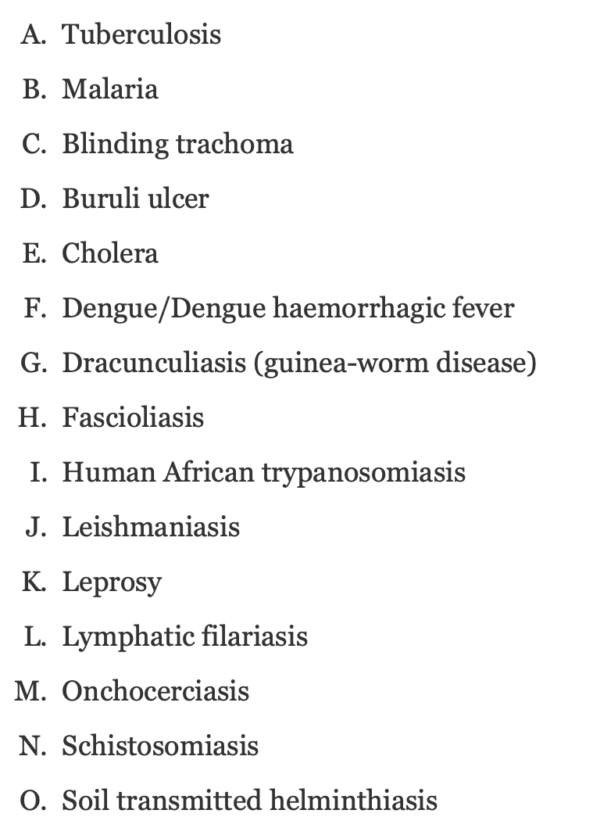
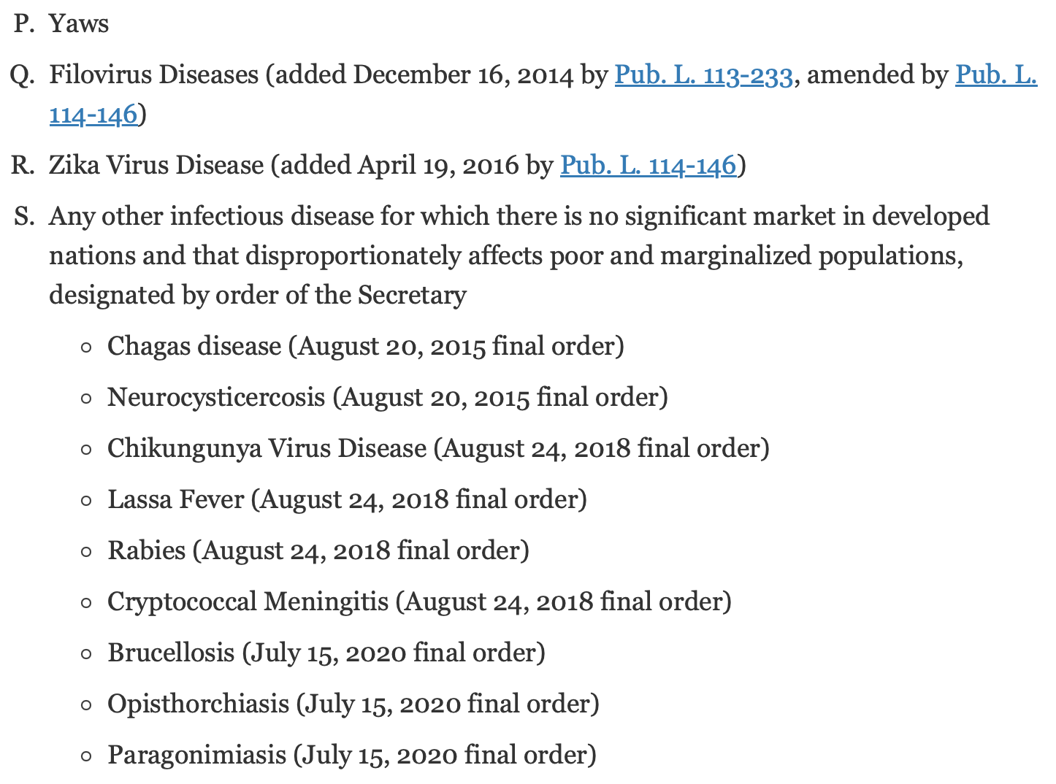
The current list of “Tropical Diseases”
Source: https://www.fda.gov/about-fda/center-drug-evaluation-and-research-cder/tropical-disease-priority-review-voucher-program

Slide 62
Definitions of “Pioneering” Inventions
“This word, although used somewhat loosely, is commonly understood to denote a patent covering a function never before performed, a wholly novel device, or one of such novelty and importance as to mark a distinct step in the progress of the art, as distinguished from a mere improvement or perfection of what had gone before. Most conspicuous examples of such patents are the one to Howe, of the sewing machine; to Morse, of the electrical telegraph; and to Bell, of the telephone.” Westinghouse v. Boyden Power Brake Co., 170 U.S. 537, 561-62 (1898)
Courts have considered an invention to be a pioneer when it presents a “broad breakthrough,” “major advance,” or “basic operational concept”; or is “broadly new” or “devoid of significant prior art.” Pioneer inventions have alternatively been called primary, basic, generic, “original,” or “key” inventions. John R. Thomas, "The Question Concerning Patent Law and Pioneer Inventions," High Technology Law Journal 10 (1995): 48

Slide 63
Tools to reduce incentives for R&D falling outside the zones:
Reduction of the duration of patents on “me-too” drugs (retroactive or prospective)
Denial of injunctions when patents on “me-too” drugs are infringed [cf. Kennedy’s concurrence in eBay)
Heightened nonobviousness requirement for “me-toos”
Breakthrough Drugs
Drugs aimed at Neglected Infectious Diseases
Vaccines

Slide 64
Evolution of the Inventive Step Requirement
(not to scale)
Stringency of the Standard
Cuno
(1941)
CAFC
Hotchkiss
(1851)
§103
Graham
(1966)
AIA(2013)
KSR
(2007)
USA
1700
1800
1850
1900
1925
1950
1975
2000
2025

